Slide 1

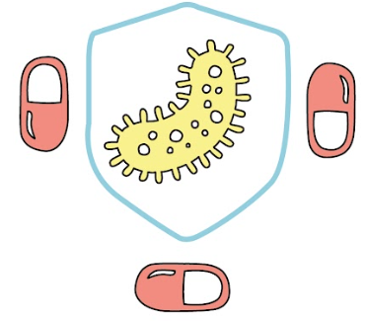
BioBits®: Antibiotic Resistance:
Explore the mechanisms of antibiotic resistance

Slide 2
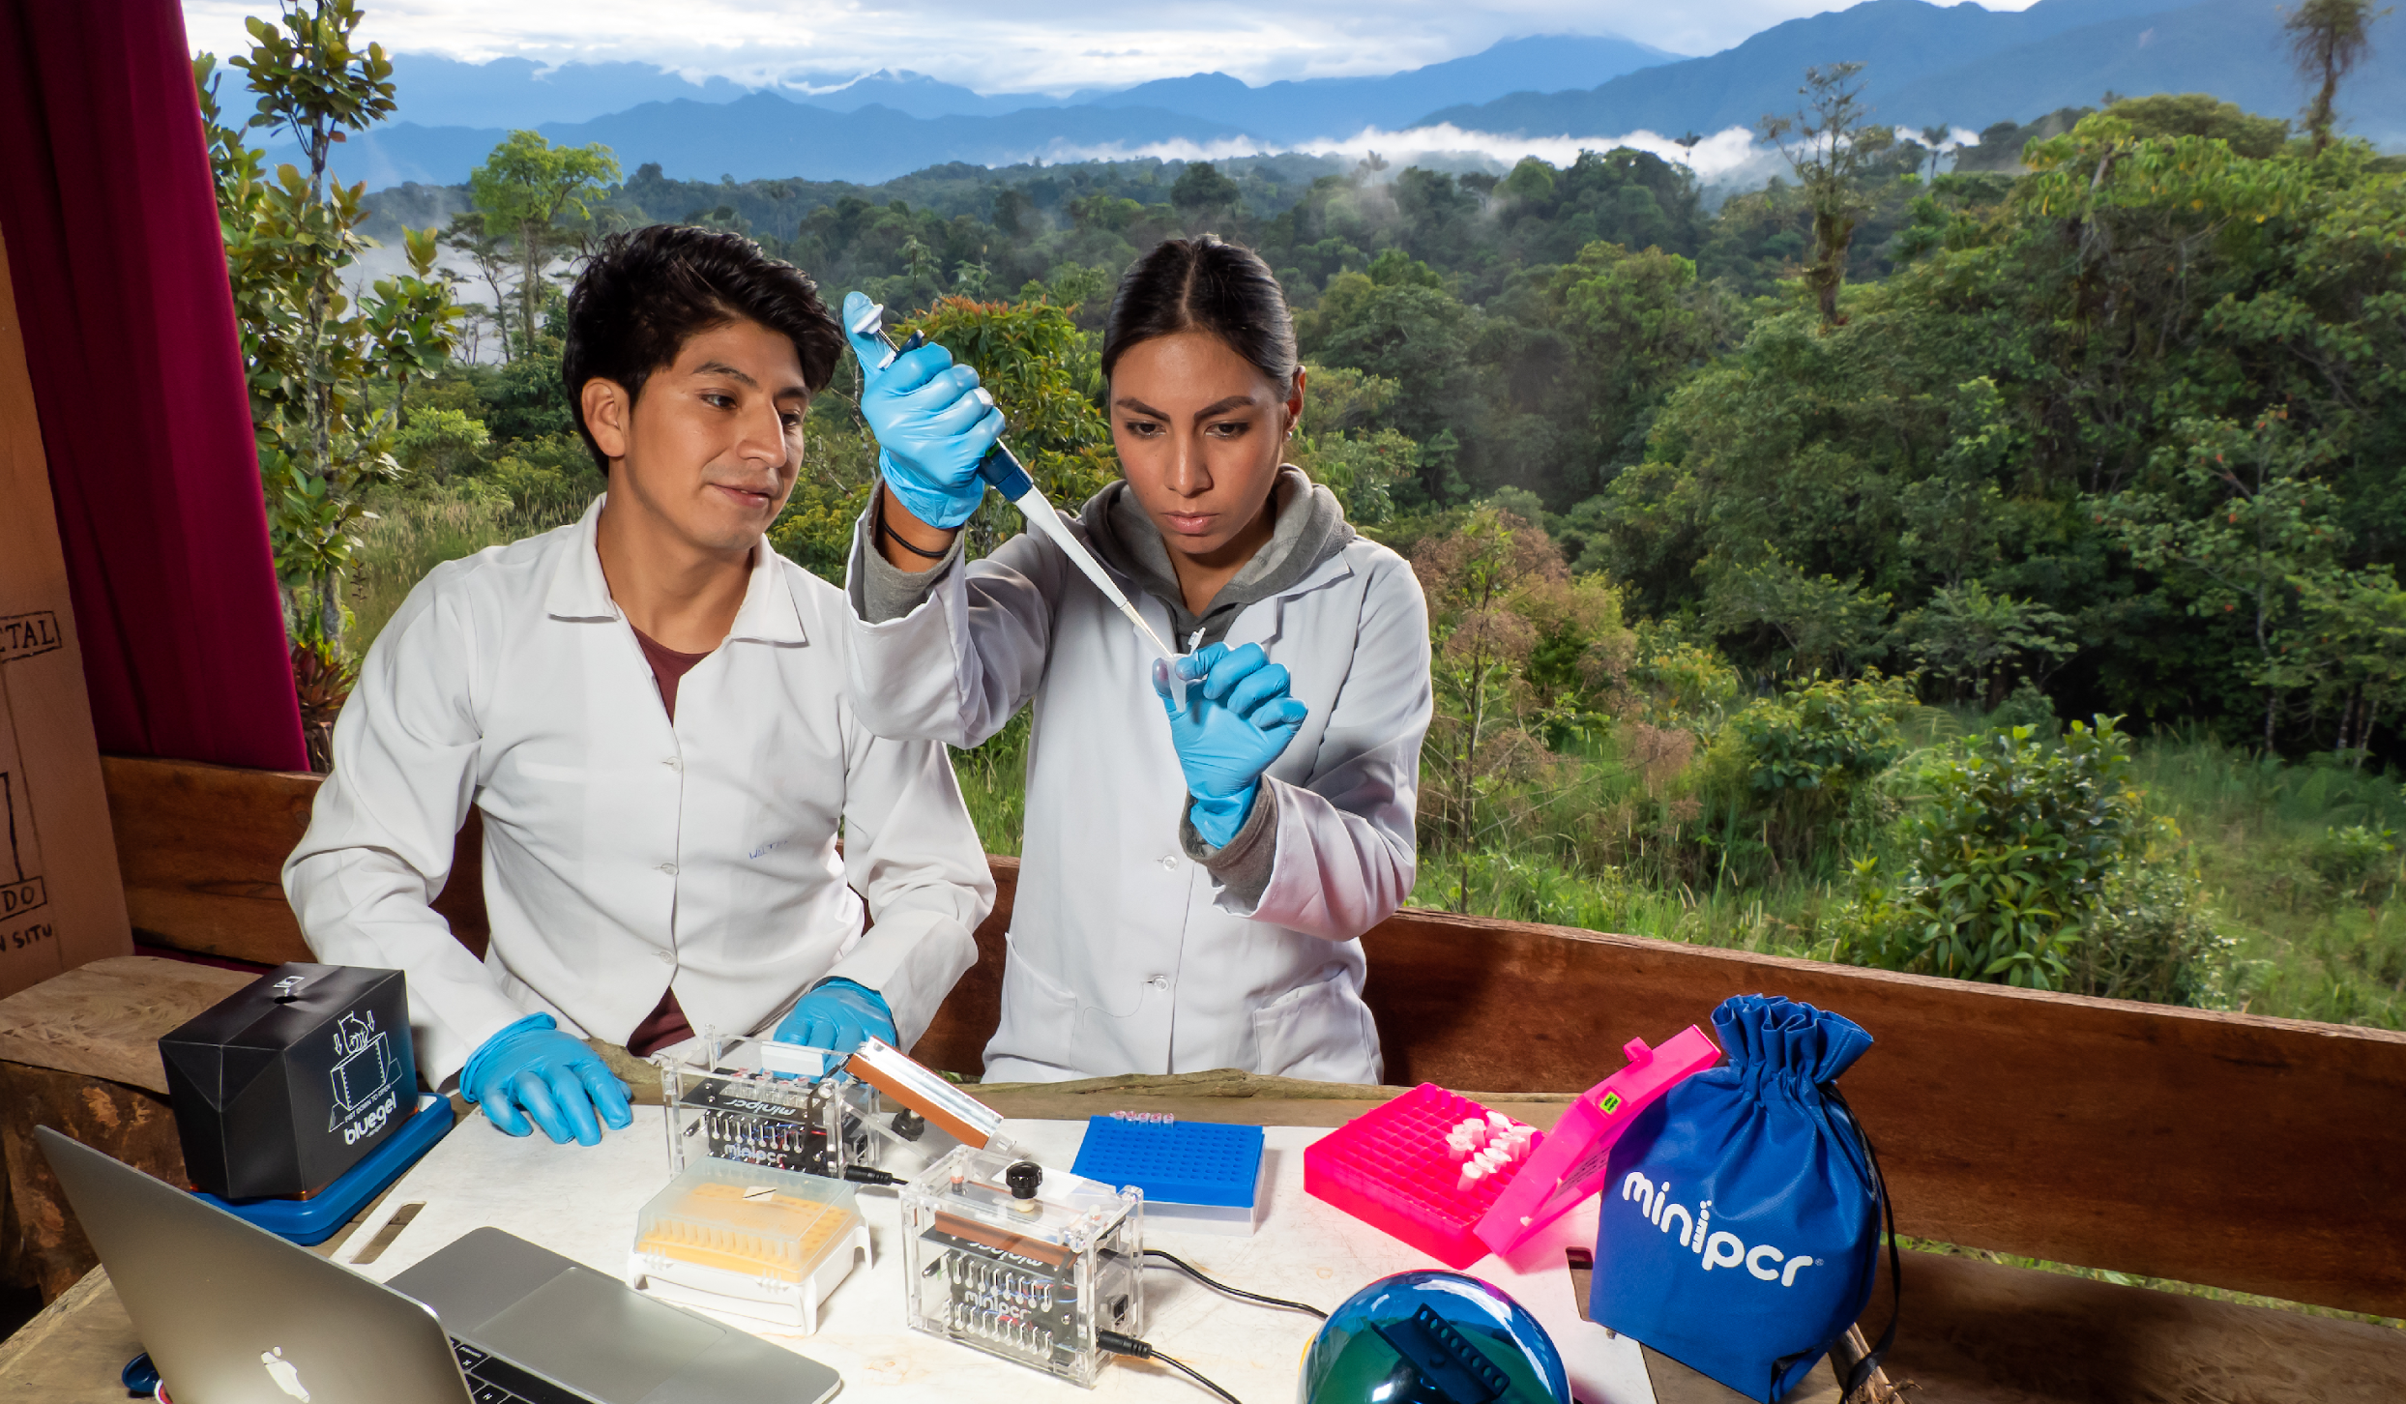
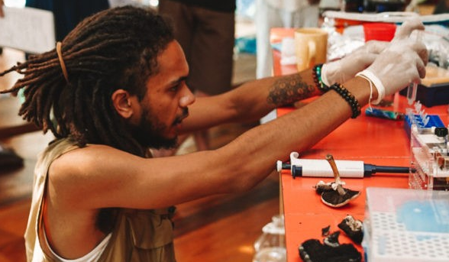
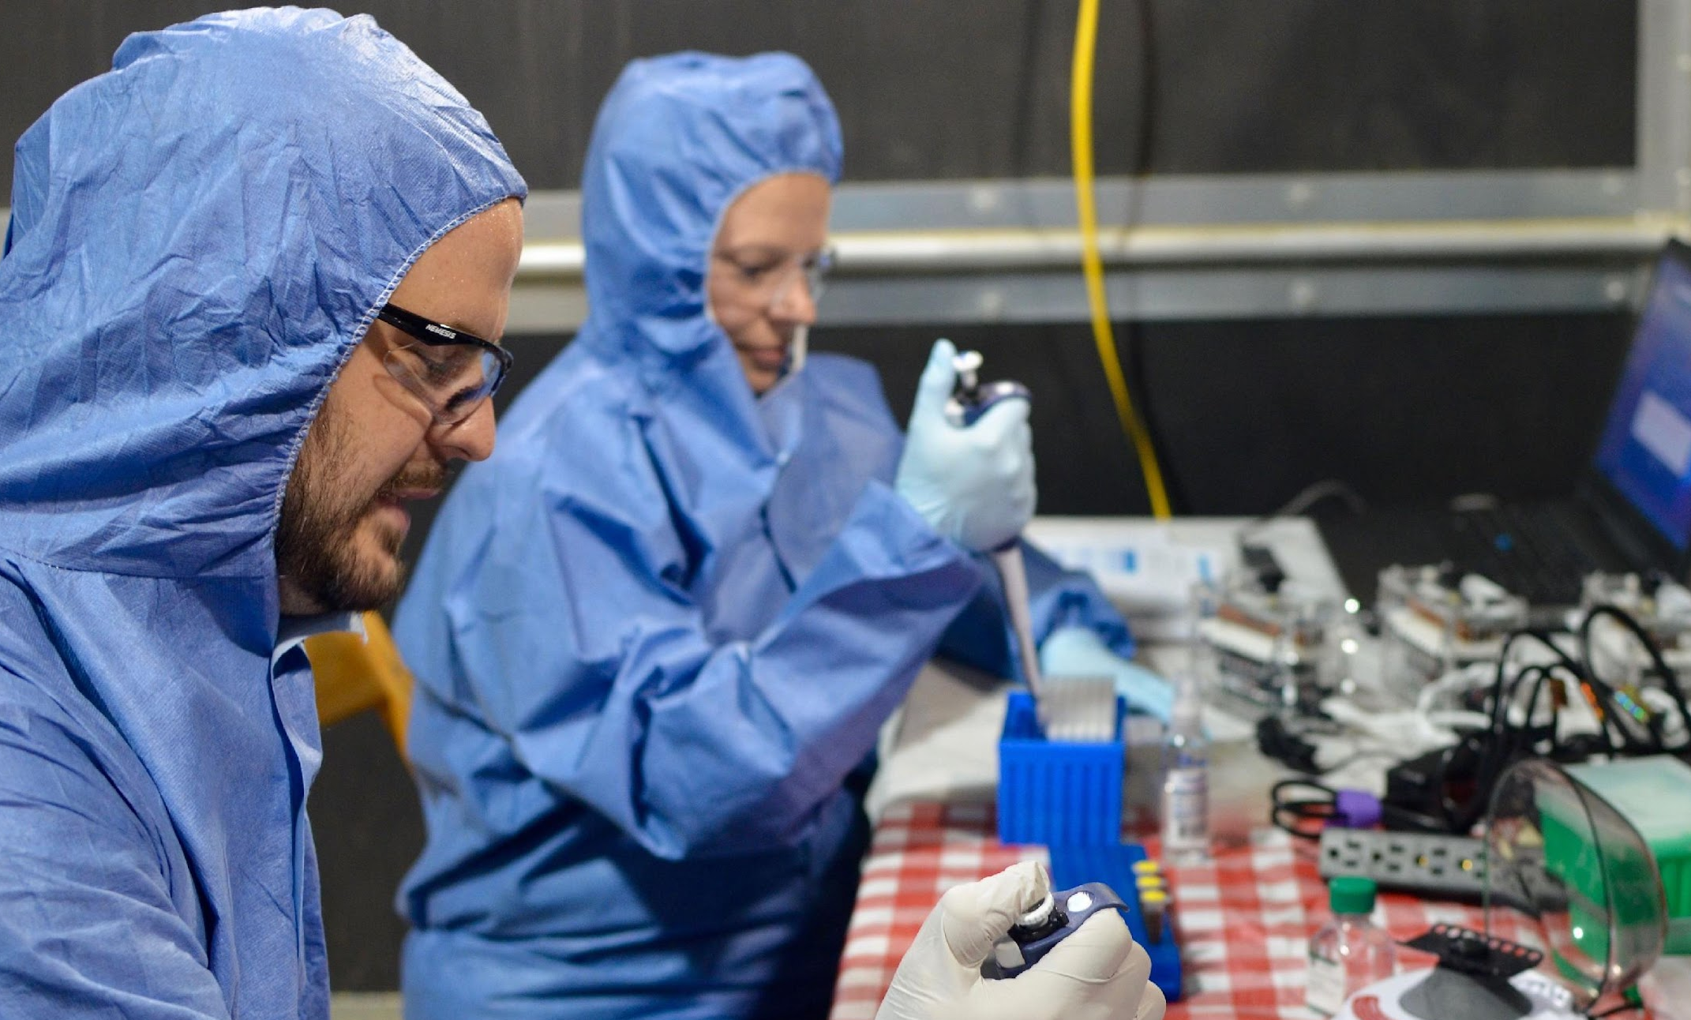
We are miniPCR bio
Researchers discovering new species in the Amazon
Amateur mycologists DNA barcoding foraged mushrooms
CDC monitoring
zoonotic viral outbreaks
Enable science for everyone, everywhere
© 2023 by miniPCR bio™
Notes:
Mycology: https://www.minipcr.com/will-padilla-brown-interview/
CDC: https://pubmed.ncbi.nlm.nih.gov/32024713/

Slide 3
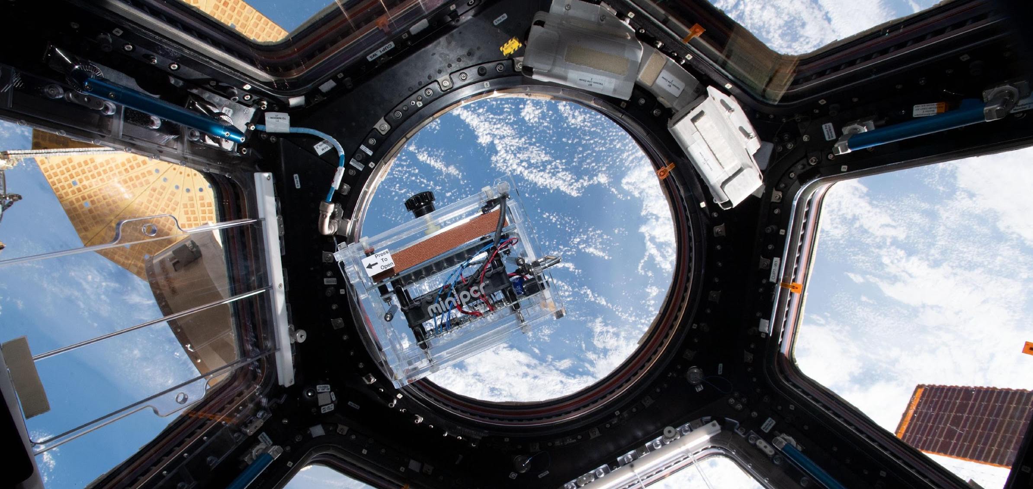
We make biotech accessible
In partnership with Boeing, miniPCR bio founded Genes in Space, engaging middle through high school students in designing DNA experiments to be performed on International Space Station.

Slide 4
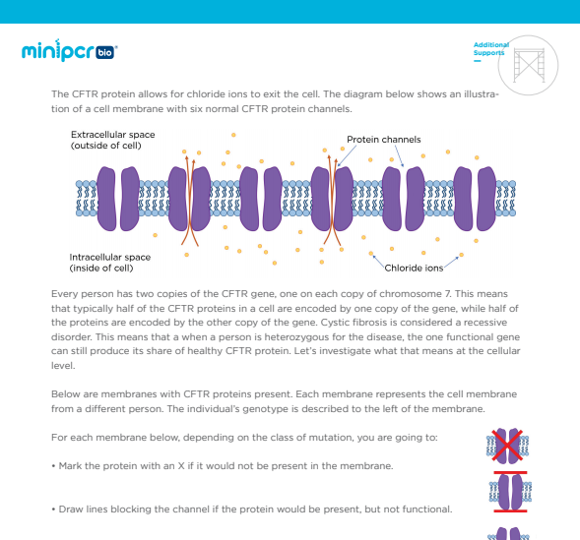
Activities that span the biology curriculum
Biotechnology is integral to the process of biology. It isn’t a one week unit.
Use biotechnology to explore fundamental concepts.
© 2023 by miniPCR bio™

Slide 5
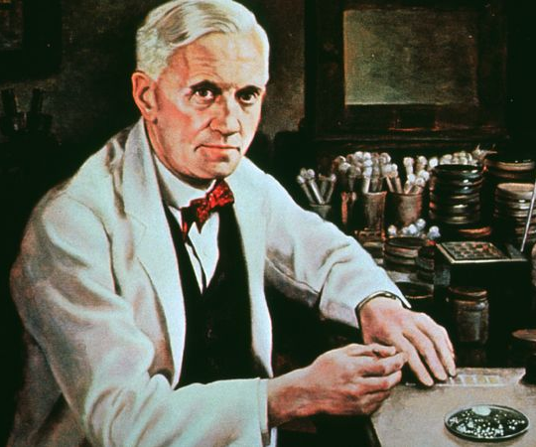
Antibiotics: one of the greatest medical advances
Used to treat or prevent bacterial infections
First antibiotic discovered in 1928 (penicillin)
Estimated to save millions of lives each year
One of the greatest medical advances of the 20th century
Alexander Fleming
Encyclopedia Britannica

Slide 6
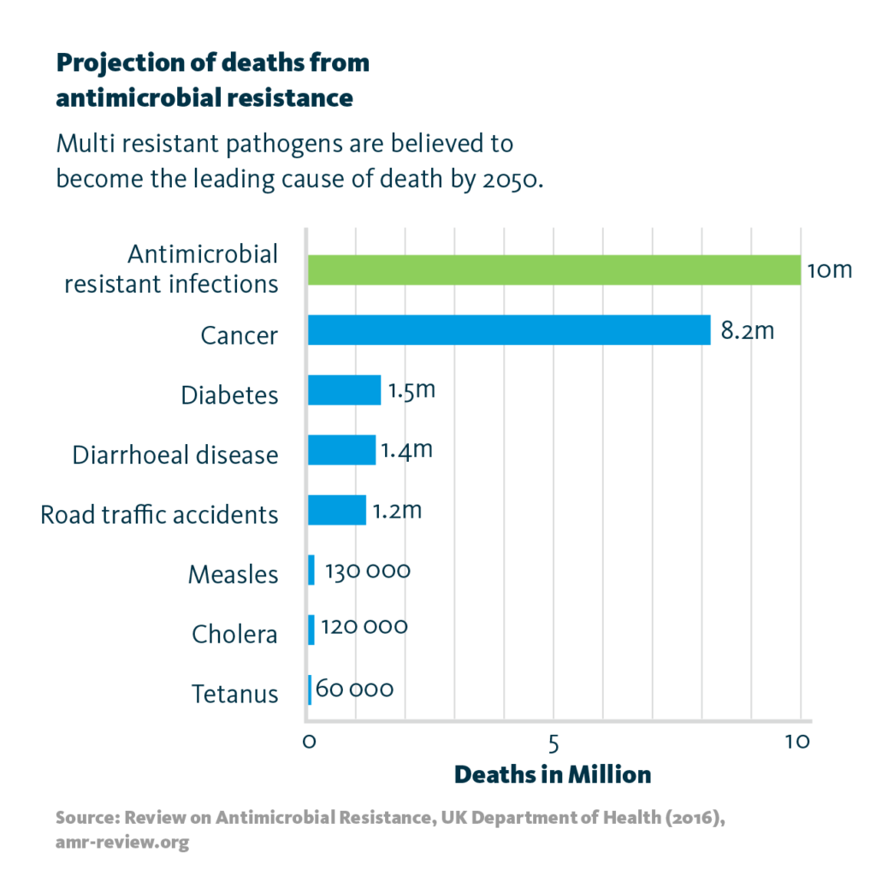
Growing problem of antibiotic resistance
More bacteria are becoming resistant to antibiotics
~1 million people/year die worldwide from antibiotic resistant bacterial infections – projected to increase to 10M/year
Health organizations consider this to be one of the biggest threats to global health

Slide 7
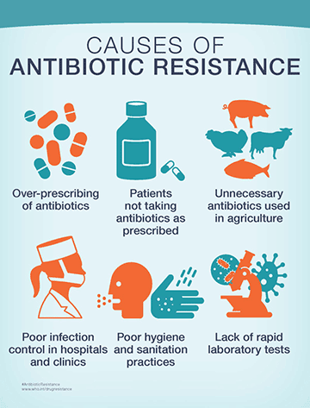
What do we do about antibiotic resistance?
Use antibiotics more appropriately
  Spread of resistance due to misuse
Discover new antibiotics
  Antibiotics are mostly discovered
    Ex: penicillin from mold
  Screening large collections of potential antibiotic chemicals
We need to understand how antibiotics and antibiotic resistance work.
  Scientists refer to this as "mechanism of action"
CDC

Slide 8

How antibiotics work
Antibiotics
Antibiotic = small chemical molecule that kills bacteria
Each antibiotic has a different target and mechanism
  Ex: inhibiting protein synthesis by targeting ribosomes
  Antibiotics are specific to only bacteria (not our cells)
Each antibiotic targets bacteria in a very specific way
Bacterial ribosome

Slide 9
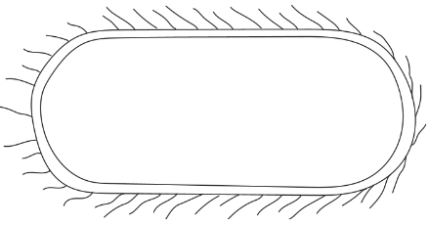
How antibiotic resistance works
Bacteria are resistant when they can survive in the presence of an antibiotic
Antibiotics
© 2023 by miniPCR bio™

Slide 10
How antibiotic resistance works
Bacteria are resistant when they can survive in the presence of an antibiotic
That means it is more likely to survive and reproduce
Over time, natural selection leads to more and more antibiotic resistant bacteria.
© 2023 by miniPCR bio™

Slide 11
How antibiotic resistance works
This makes it harder and harder to treat infections as bacteria become resistant to more and more antibiotics
Antibiotics
© 2023 by miniPCR bio™

Slide 12
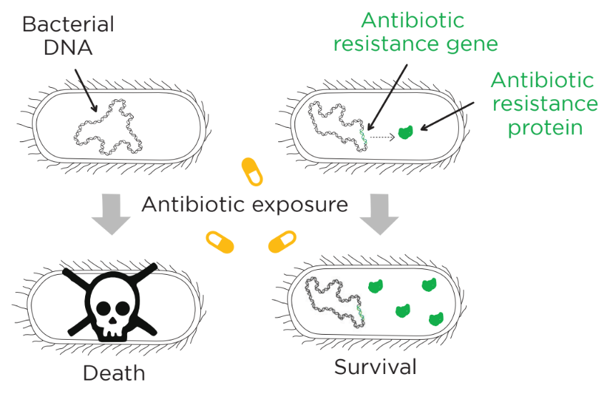
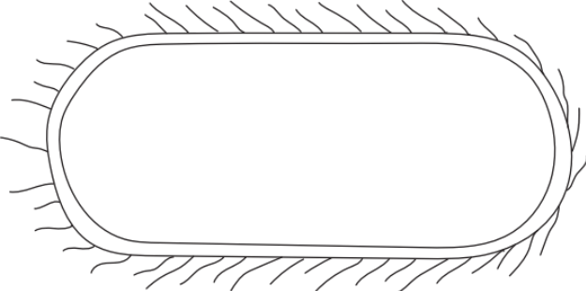
What makes bacteria resistant?
Resistant bacteria are able to produce proteins to protect against antibiotics
Instructions for making proteins are encoded in DNA, so it’s genetic info that makes bacteria resistant to antibiotic
A part of DNA that can make bacteria resistant is called antibiotic resistance gene

Slide 13
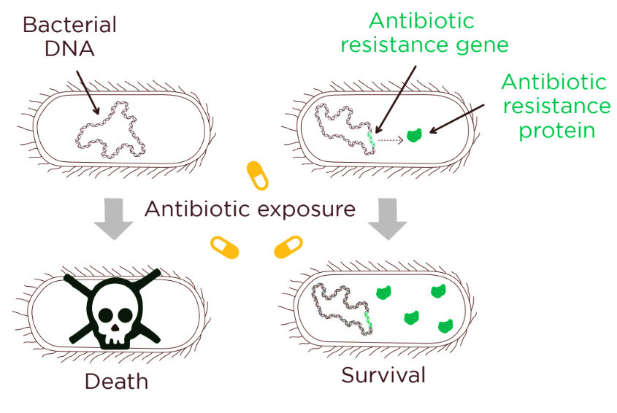
What makes bacteria resistant?
Antibiotic resistance genes confer protection against specific antibiotics

Slide 14
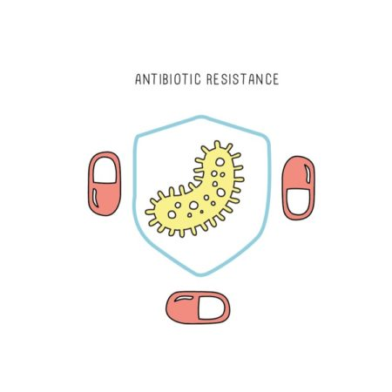
Introducing BioBits®: Antibiotic Resistance
Explore antibiotic resistance mechanisms – without culturing bacteria!
Use a cell-free system to test two different antibiotics and a resistance gene with minimal equipment
Understand antibiotic mechanisms and bacterial resistance

Slide 15
Today’s lab setup
Your class will characterize an antibiotic resistance gene and two antibiotics
Your goal is to answer these questions:
  Do both of these antibiotics inhibit protein synthesis?
    To demonstrate each antibiotic targets bacteria in a very specific way
  Which of these two antibiotics is vulnerable to the resistance gene?
    To demonstrate antibiotic resistance genes confer protection against specific antibiotics

Slide 16
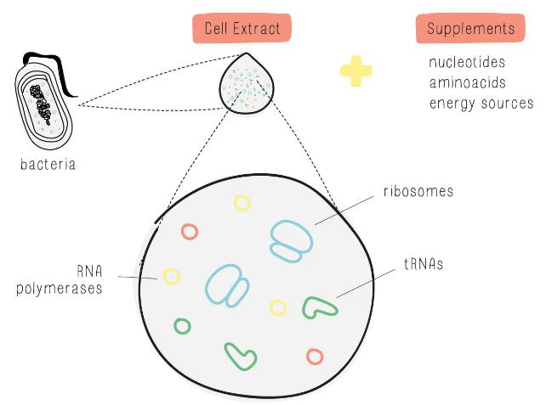
Studying antibiotics, the cell-free way
Usually study antibiotics in live bacteria
Bacteria cultures are time-consuming, require specialized lab setups, and may have safety concerns using resistant bacteria
Today, we will use the BioBits® cell-free system as a simpler and safer way of observing antibiotic function

Slide 17


Studying antibiotics, the cell-free way
BioBits® is a model that can be used to test antibiotics that block protein synthesis
DNA:
Instructions to make protein
Freeze-dried pellet:
Machinery & materials to build proteins
gene
protein

Slide 18
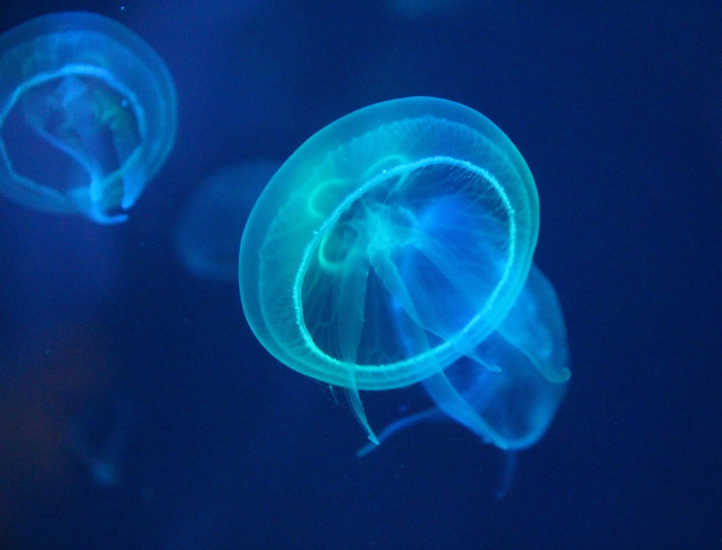
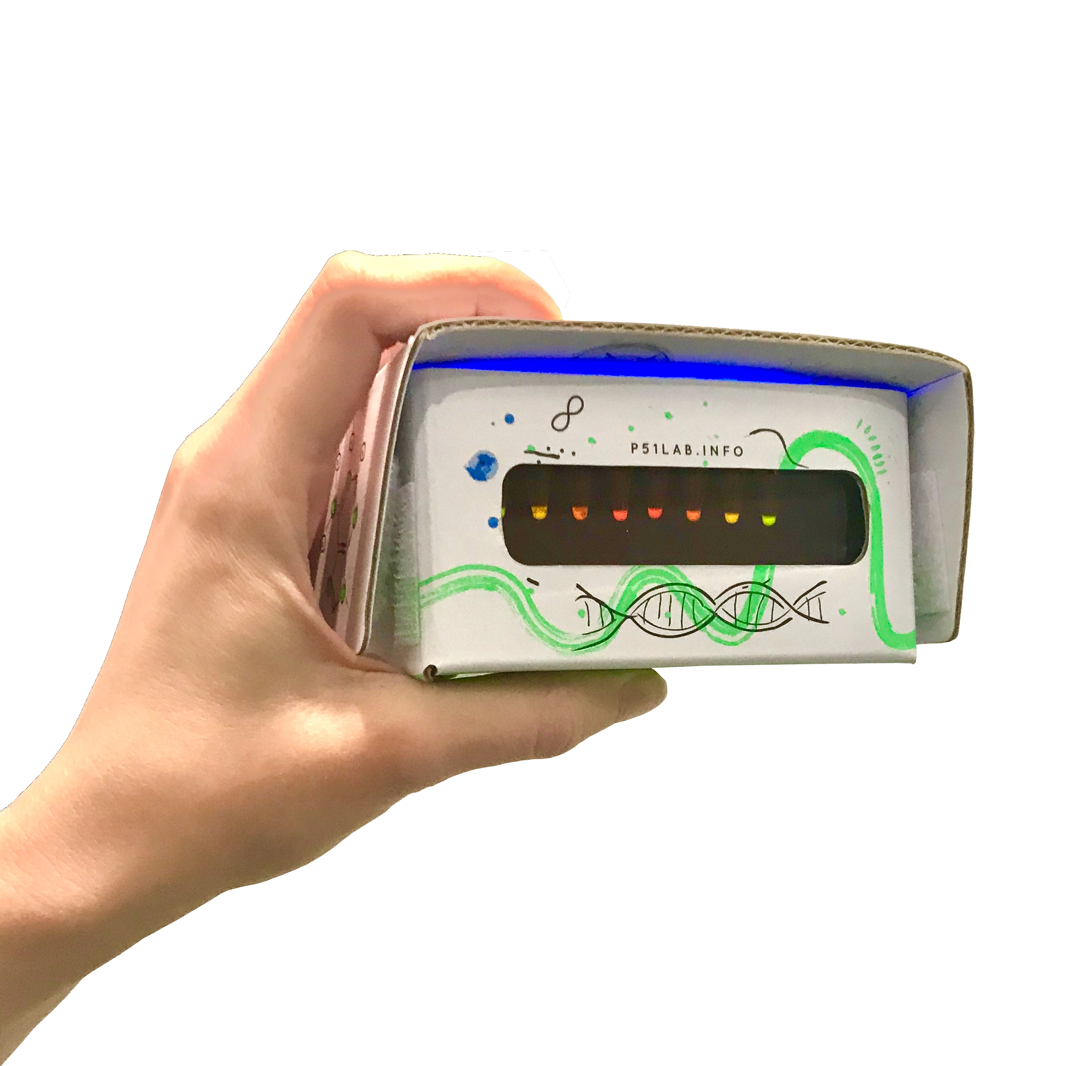
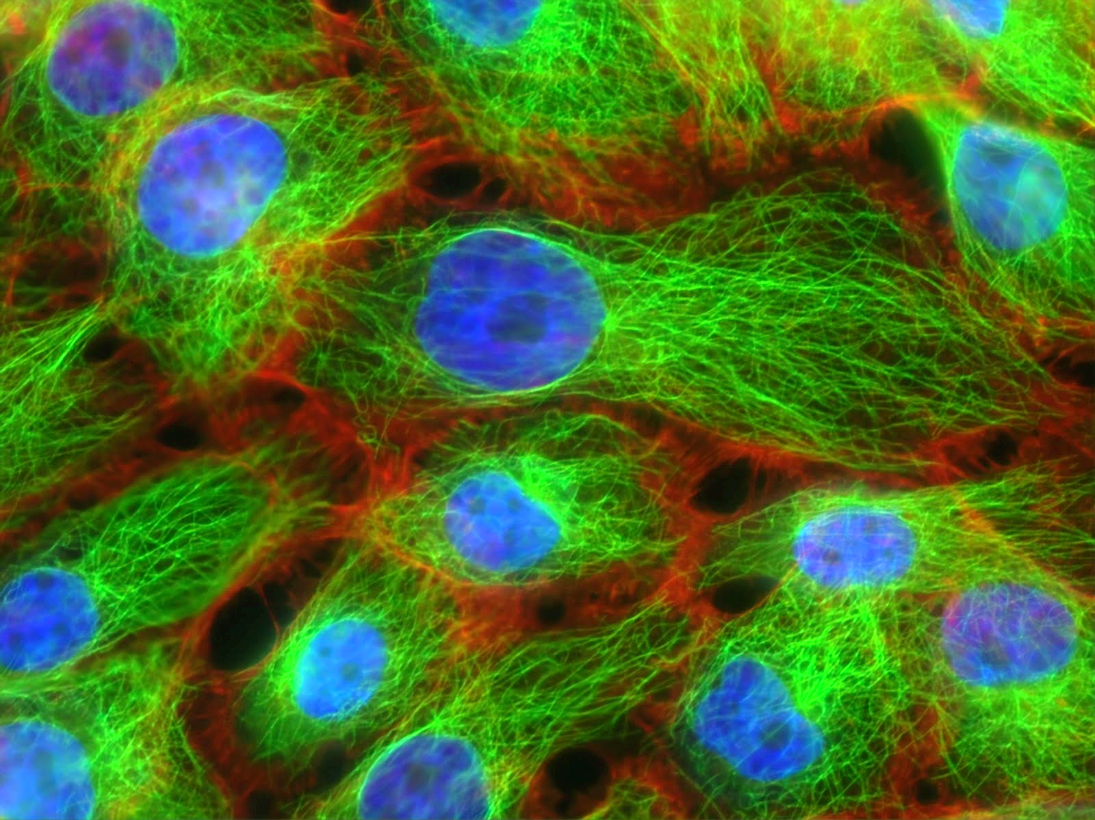
Using fluorescent proteins as our case study
Fluorescent proteins to indicate if protein synthesis is working
© 2023 by miniPCR bio™

Slide 19

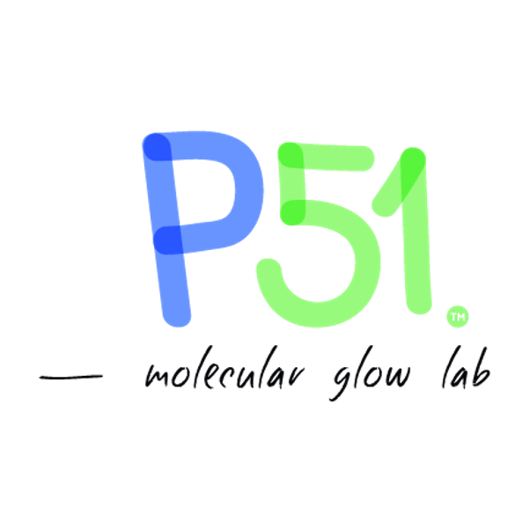
© 2023 by miniPCR bio™

Slide 20
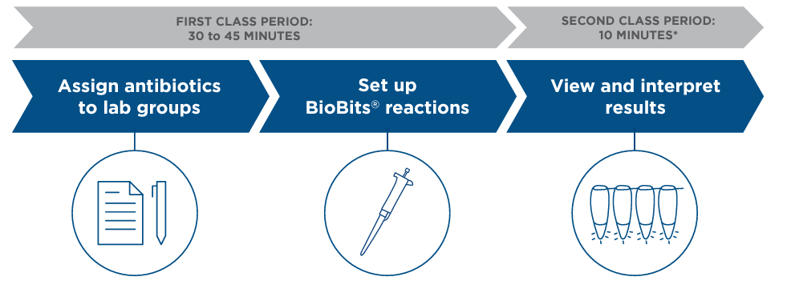
Lab workflow

Slide 21
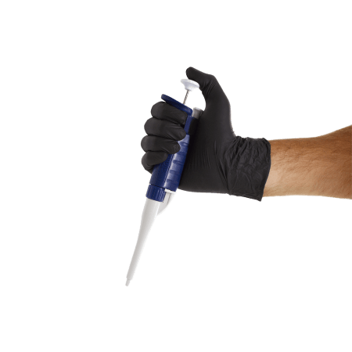
Equipment needed
Blue light transilluminator
2 – 20 uL micropipette + tips

Slide 22
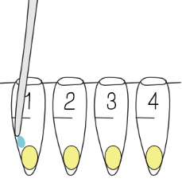
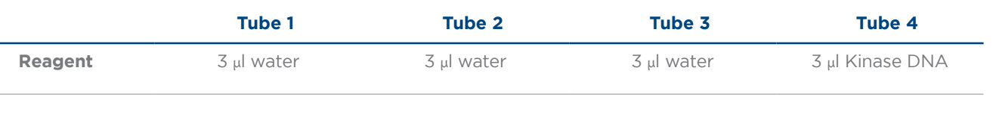

Setting up your experiment
Add reagents according to the chart below, using a new tip for each sample.
Cap the tubes and wait 10 minutes

Slide 23
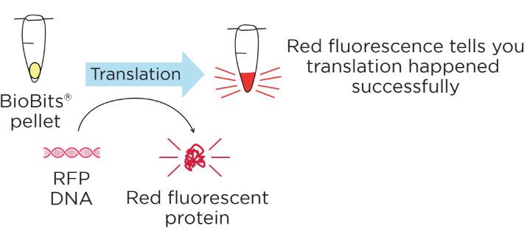
Red fluorescence = indicator of protein synthesis
Use BioBits® to make a red fluorescent protein (RFP)
RFP DNA → RFP (glowing red protein)
Red glow = protein synthesis works (models bacteria that are alive)

Slide 24
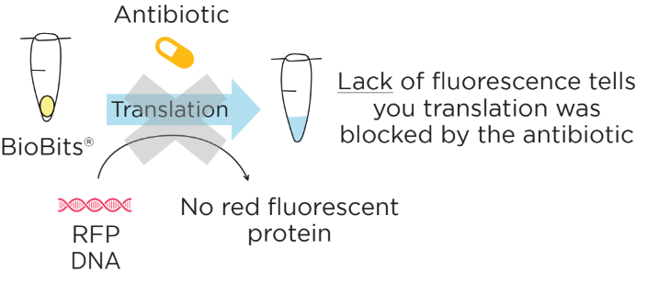
Antibiotics that block protein synthesis
Kanamycin and streptomycin block translation in bacteria
BioBits® is made with bacterial ribosomes, so those antibiotics will function in our model
No red glow = protein synthesis doesn’t work (models bacteria that are dead)

Slide 25
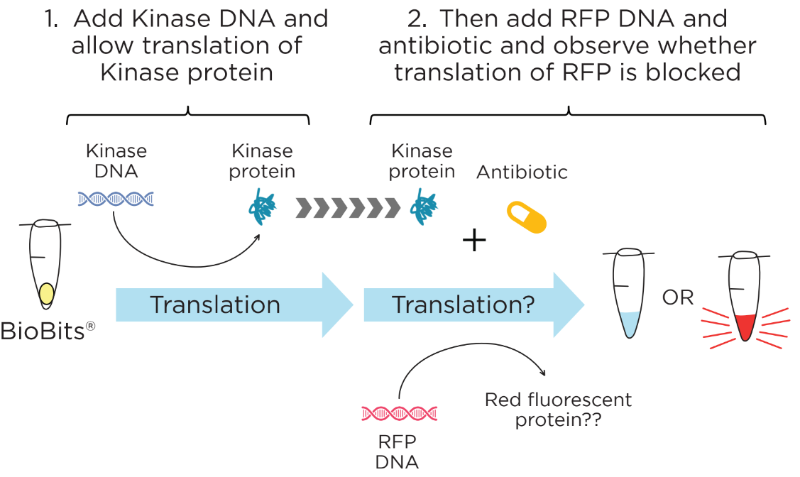
Restore translation with resistance gene
Kinase DNA encodes a protein known as aminoglycoside kinase that confers resistance to some antibiotics
Test if this antibiotic resistance gene confers resistance to kanamycin or streptomycin
Resistance gene protects against a specific antibiotic if tube is red (models bacteria that can survive in the presence of a specific antibiotic)

Slide 26
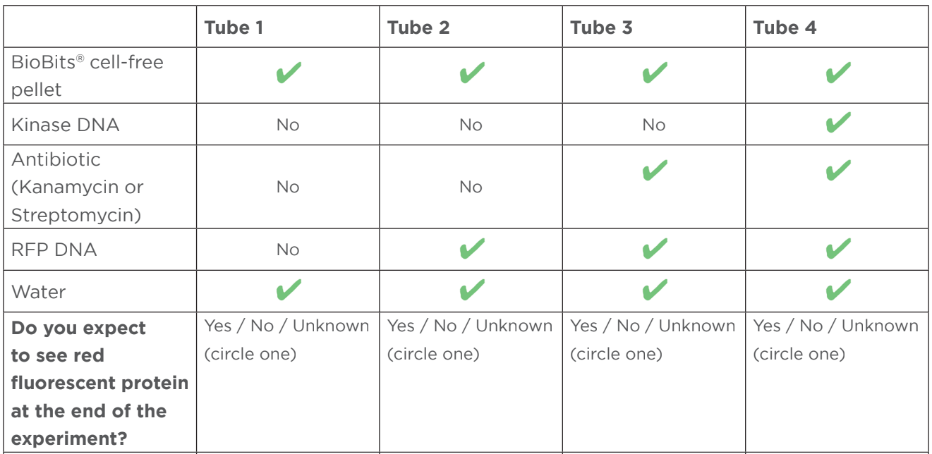
Pre-lab predictions

Slide 27
Setting up your experiment
Add reagents according to the chart below, using a new tip for each sample.
Cap the tubes and wait 10 minutes
Why add kinase DNA first?
Antibiotics inhibit ALL translation—including that of the kinase!

Slide 28
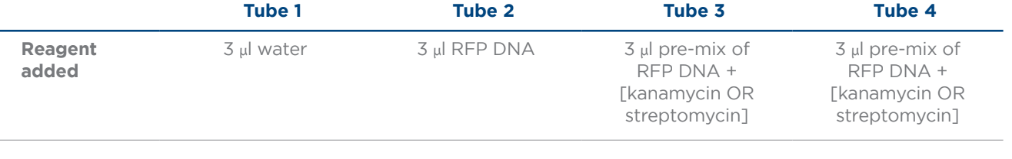
Setting up your experiment
After 10 minutes, add reagents according to the chart below, using a new tip for each sample.
Initial observations and then leave at room temperature overnight

Slide 29
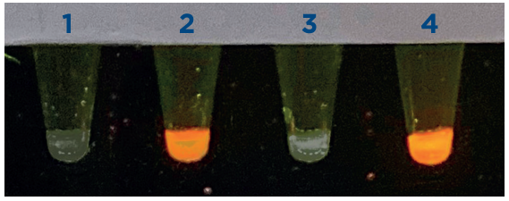
Reviewing our results
Kanamycin
Streptomycin
© 2023 by miniPCR bio™

Slide 30

Results: Tube 1 (water + water)
Water
Water
No translation because no DNA was added
Used as negative control and baseline
© 2023 by miniPCR bio™

Slide 31
Results: Tube 2 (water + RFP DNA)
Water
Yes! We have translation and RFP
Used as positive control and indicator of what successful protein synthesis looks like
© 2023 by miniPCR bio™

Slide 32
Results: Tube 3 (water + RFP DNA + antibiotic)
Water
X
X
No! We don’t have translation or RFP
Both kanamycin and streptomycin inhibit protein synthesis, so no RFP is made/seen
© 2023 by miniPCR bio™

Slide 33
Results: Tube 4 (kinase DNA + RFP DNA + streptomycin)
Streptomycin
X
X
No! We don’t have translation or RFP
Streptomycin is still inhibiting protein synthesis (no RFP is made/seen), so the kinase protein does not confer resistance
© 2023 by miniPCR bio™

Slide 34
Results: Tube 4 (kinase DNA + RFP DNA + kanamycin)
X
Kanamycin
✔
✔
Yes! We have translation and RFP
Kanamycin is NOT inhibiting protein synthesis (RFP is made/seen), so the kinase protein DOES confer resistance
© 2023 by miniPCR bio™

Slide 35
Discussion
  Do both of these antibiotics inhibit protein synthesis?
    Yes!
  Which of these two antibiotics is vulnerable to the resistance gene?
    Kanamycin!
© 2023 by miniPCR bio™

Slide 36
Lab takeaways
Each antibiotic targets bacteria in a very specific way
  Today, we looked at antibiotics that specifically targeted bacterial ribosomes to inhibit protein synthesis
  Even within a given cellular process, there are different ways it can be inhibited
© 2023 by miniPCR bio™

Slide 37
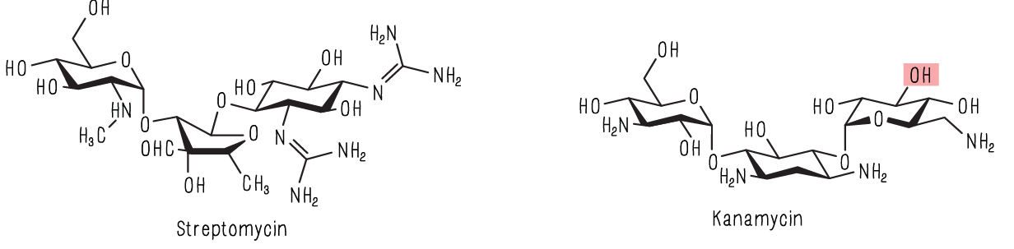
Lab takeaways
Each antibiotic targets bacteria in a very specific way
Antibiotic resistance genes confer protection against specific antibiotics
  Today, we looked at an AR gene that made a protein that specifically modified kanamycin so it couldn’t bind to ribosomes anymore
© 2023 by miniPCR bio™

Slide 38
Lab takeaways
Each antibiotic targets bacteria in a very specific way
Antibiotic resistance genes confer protection against specific antibiotics
The BioBits® cell-free system is an easy and safe way of testing certain mechanisms of antibiotics and antibiotics resistance
  Because the BioBits® system contains ribosomes, we are able to specifically test antibiotics and antibiotic resistance mechanism related to protein synthesis
© 2023 by miniPCR bio™

Slide 39
Lab takeaways
Each antibiotic targets bacteria in a very specific way
Antibiotic resistance genes confer protection against specific antibiotics
The BioBits® cell-free system is an easy and safe way of testing certain mechanisms of antibiotics and antibiotics resistance
© 2023 by miniPCR bio™

Slide 40
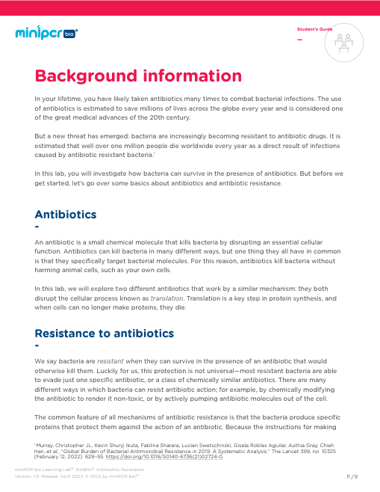
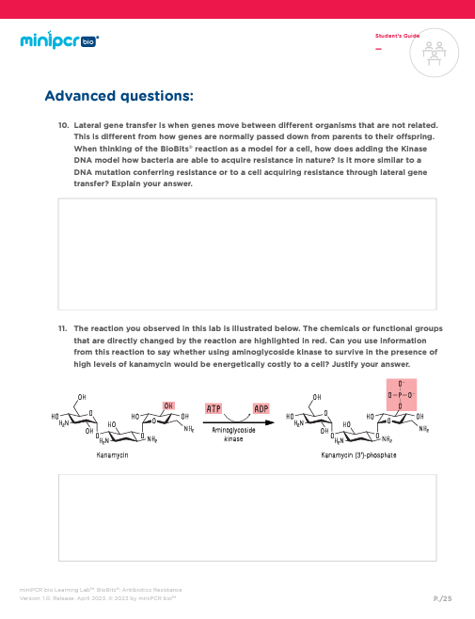
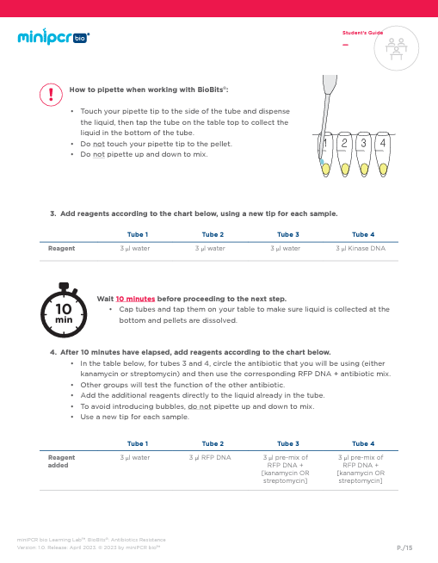
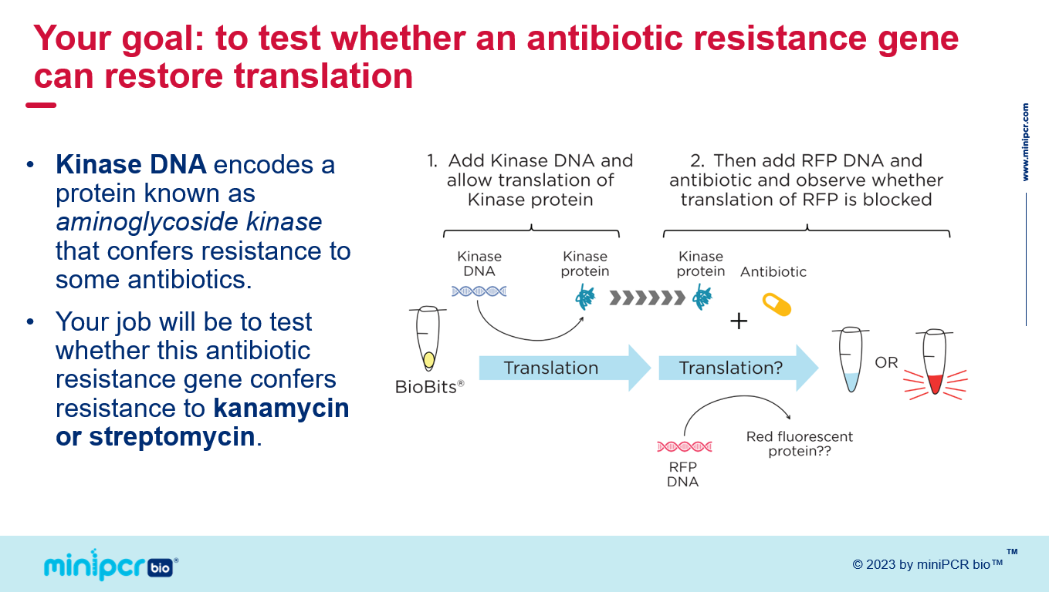
Access the full curriculum online!
All of our curriculum is free to download!
Under “Downloads” tab on the product page
Instructor guide with full lab protocol
Student guide with background, lab protocol, data tables, and study questions (including CER tables)
Classroom slides that are editable
© 2023 by miniPCR bio™

Slide 41
Q+A
How many students can use one kit?
Can students test both antibiotics?
Shelf life of the reagents?
Will there be more BioBits cell-free labs offered in the future?
How does antibiotic resistance spread?
© 2023 by miniPCR bio™

Slide 42
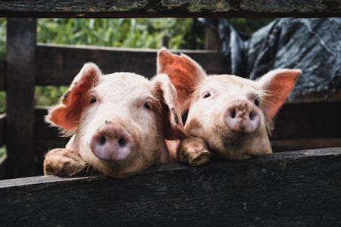
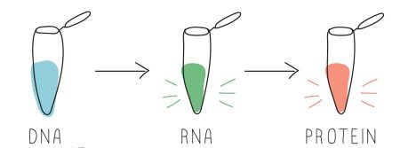
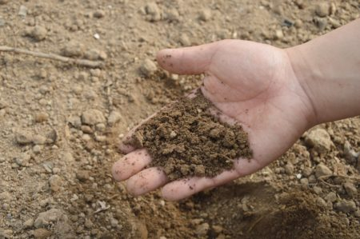
Other related miniPCR bio Learning Labs™
Scaffold this lab with the BioBits® Central Dogma Lab
Pair with other antibiotic resistance labs
Agricultural Monitoring Lab: A Case Study in Antibiotic Resistance
eDNA Project: Sampling Soil for Antibiotic Resistance
© 2023 by miniPCR bio™

Slide 43
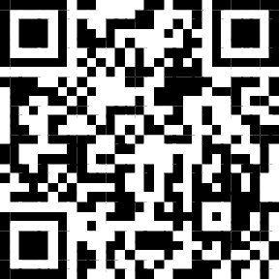
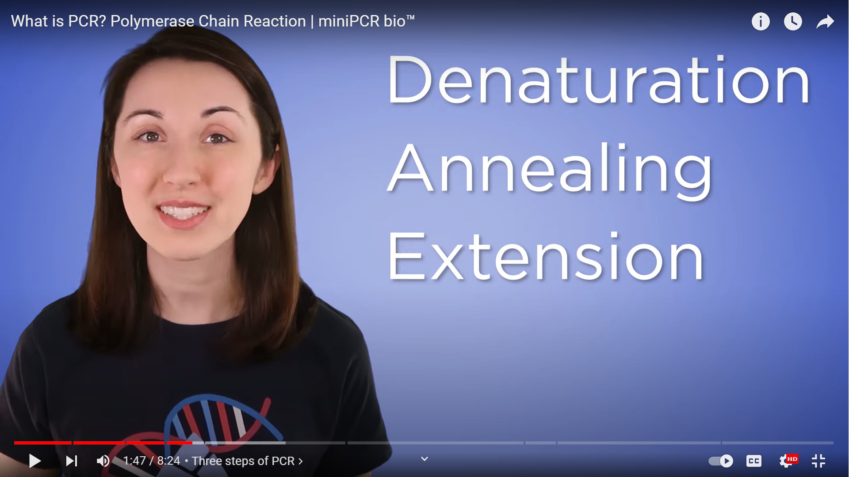
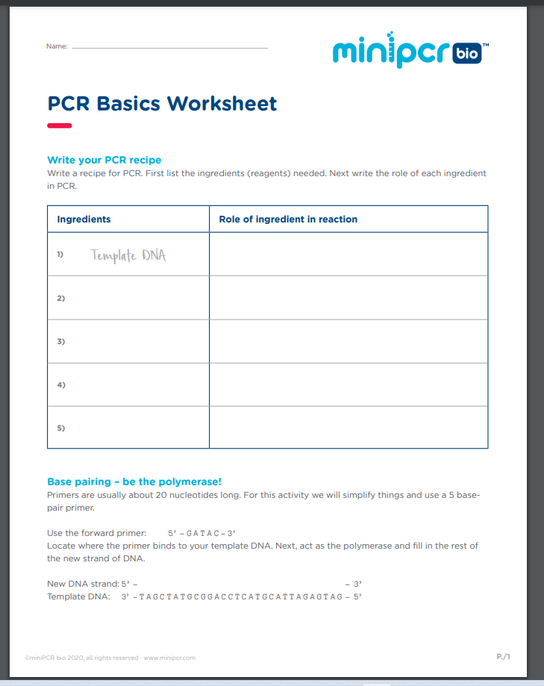
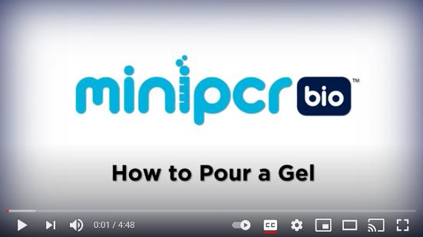

Visit our resources page!
Webinars and lab demos
Free worksheets
DNAdots
Genes in Space
And much more!
© 2023 by miniPCR bio™

Slide 44

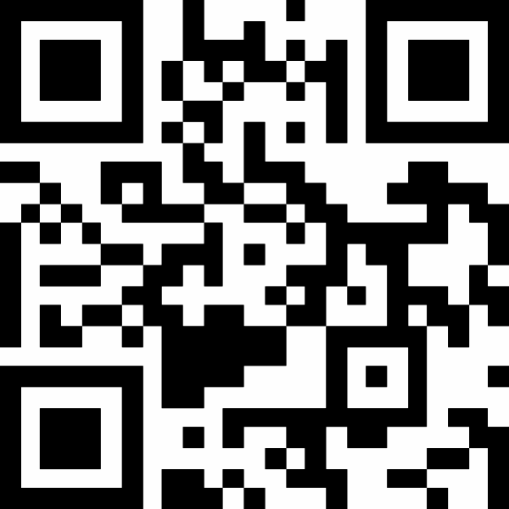



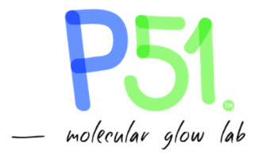


© 2023 by miniPCR bio™

Slide 45
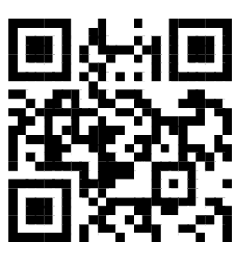
Want free personalized suggestions?
https://www.minipcr.com/demo/
@miniPCR
facebook.com/minipcr
@miniPCR
© 2023 by miniPCR bio™

