Slide 1
What is CRISPR?
Online webinar
April 27, 2020
@miniPCR
fb.minipcr.com
@miniPCR
© 2020 by Amplyus LLC

Slide 2


A revolutionary tool for gene editing
https://www.the-scientist.com/

Slide 3



Applications of CRISPR genome editing
?

Slide 4
Overview
Where did this technology come from?
How does it work?
How is it used?

Slide 5
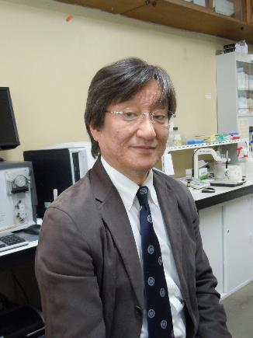
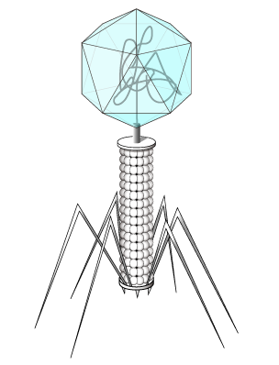
Clustered Regularly Interspaced Short Palindromic Repeats
Repeat
Spacer
Spacer
Spacer
Bacteriophage
Yoshizumi Ishino

Slide 6
Clustered Regularly Interspaced Short Palindromic Repeats
1
2
Phage
Phage
Phage genes
CRISPR RNAs
Phage genes
Transcription
Repeat
Repeat
Repeat
Repeat
Repeat
Repeat
Repeat
Repeat
Repeat
Repeat
Repeat
Repeat
CRISPR region
CRISPR region

Slide 7

Clustered Regularly Interspaced Short Palindromic Repeats
1
2
Phage
Phage
Phage genes
CRISPR RNAs
Phage genes
Transcription
Repeat
Repeat
Repeat
Repeat
Repeat
Repeat
Repeat
Repeat
Repeat
Repeat
Repeat
Repeat
CRISPR region
CRISPR region

Slide 8

Cas nucleases
Cas9
CRISPR RNA
Nuclease – a protein that cuts nucleic acids
Cas9 makes a double strand break
Directed to a sequence by an RNA – in bacteria the RNA produced from the CRISPR loci
Nearly ANY sequence
Double Strand Break

Slide 9
CRISPR/Cas9 as a gene editing tool
Cas9
Guide RNA
Guide RNA
Double Strand Break
Repair

Slide 10
CRISPR/Cas9 – two kinds of editing
Error prone DNA repair (NHEJ)
X
X
knock out = disrupt gene
Random bases added or deleted
Knock out = disrupt gene

Slide 11
CRISPR/Cas9 – two kinds of editing
DNA repair using a template (HR)
Repair instructions
Alter sequence to change function
Cell uses template to repair DNA
Alter the sequence to change function

Slide 12
Overview
Where did this technology come from?
How does it work?
How is it used?
  Treatment of Sickle Cell Anemia
  Understanding DNA repair in space

Slide 13
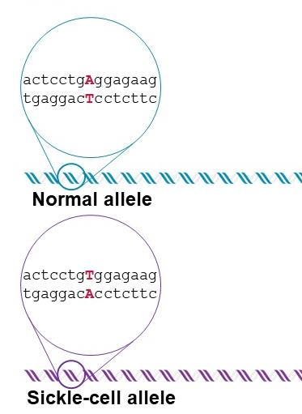
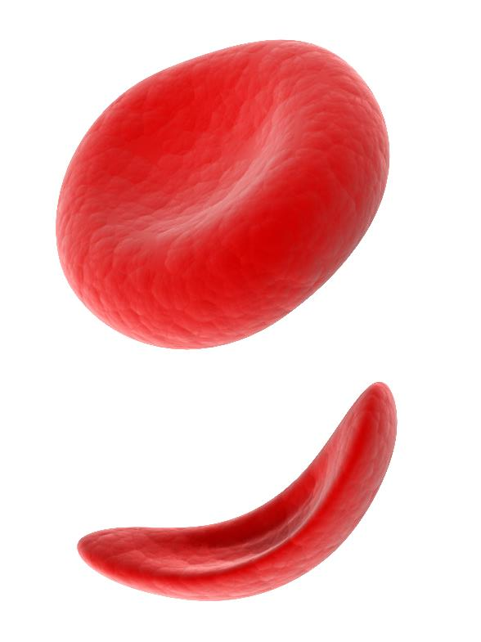
CRISPR gene therapy for Sickle Cell Anemia

Slide 14

CRISPR gene therapy for Sickle Cell Anemia
Harvest bone marrow stem cells
Before
chemotherapy
Cas9
Guide RNA

Slide 15
CRISPR gene therapy for Sickle Cell Anemia
fetal hemoglobin
Hemoglobin level
beta hemoglobin
Before Birth
After Birth

Slide 16
CRISPR gene therapy for Sickle Cell Anemia
Implant edited stem cells in patient
Harvest bone marrow stem cells
Before
chemotherapy
After
chemotherapy
CRISPR/Cas9 genome editing
Cas9
Guide RNA

Slide 17

CRISPR gene therapy Sickle Cell Anemia
www.npr.org

Slide 18
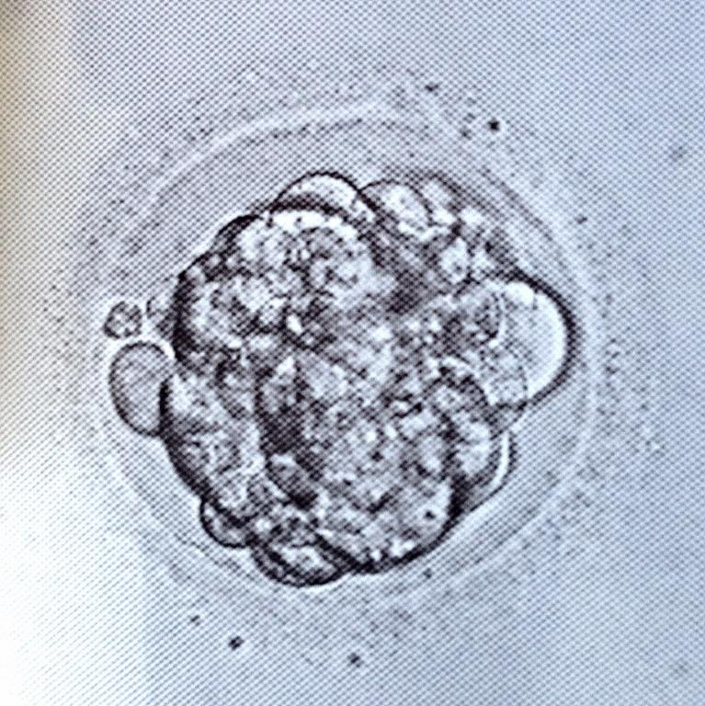
Gene therapy vs CRISPR babies

Slide 19
Overview
Where did this technology come from?
How does it work?
How is it used?
  Treatment of Sickle Cell Anemia
  Understanding DNA repair in space

Slide 20
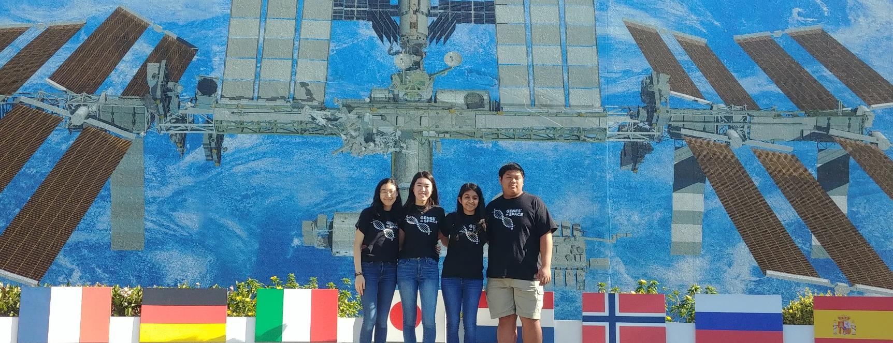
Genes in Space-6: CRISPR in space!

Slide 21
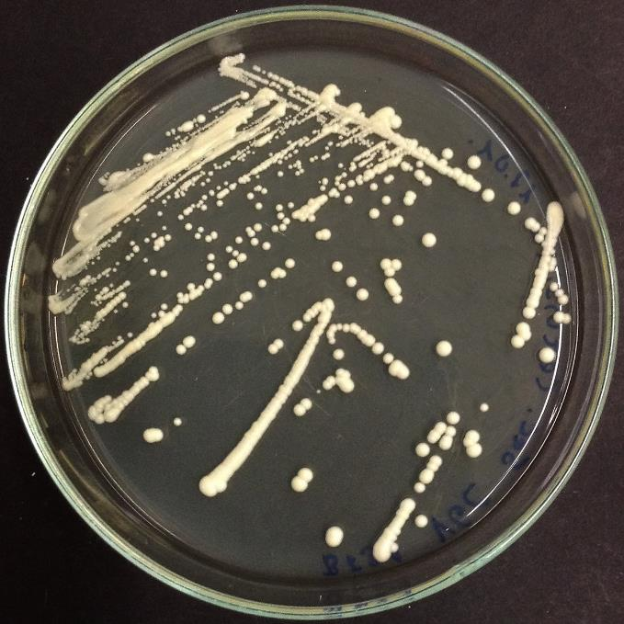
Genes in Space-6: CRISPR in space!
Model system = Saccharomyces cerevisiae (baker’s yeast)
Easy to grow and manipulate
DNA repair mechanisms well studied

Slide 22
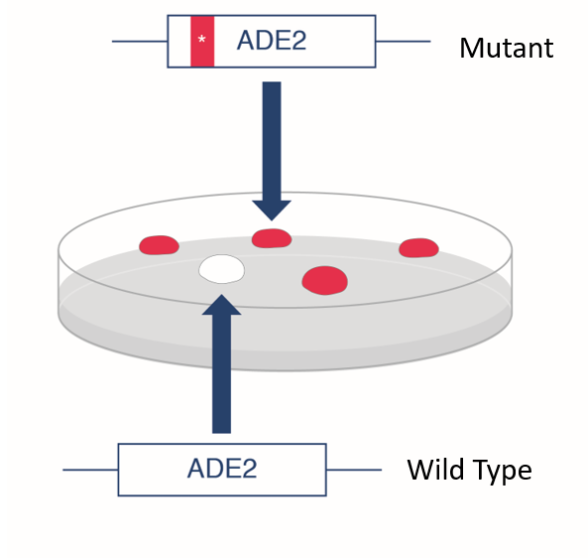
Genes in Space-6: CRISPR in space!

Slide 23
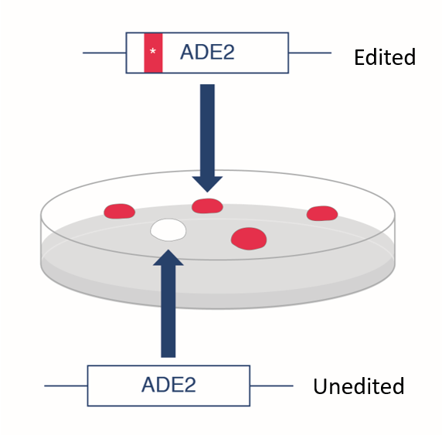
Genes in Space-6: CRISPR in space!
ADE2 guide RNA
Cas9
*
Mutant repair instructions
Yeast Cell

Slide 24
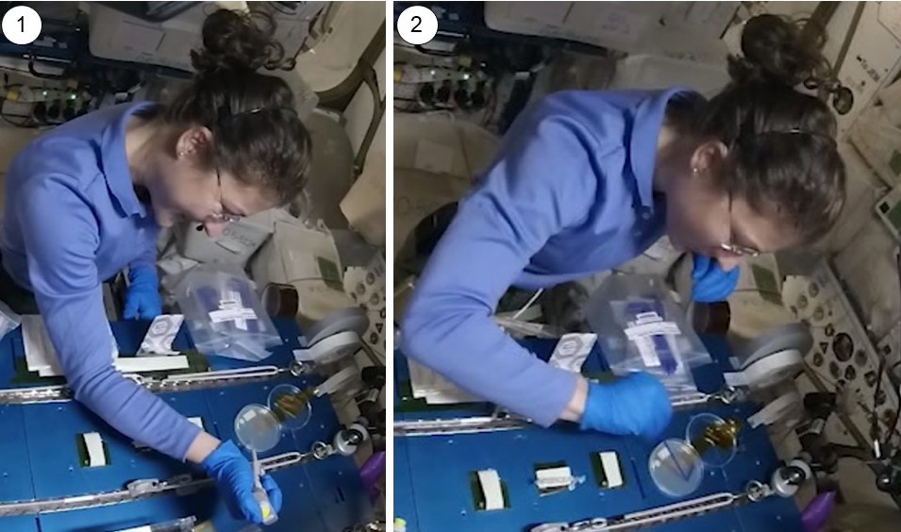
Genes in Space-6: CRISPR in space!

Slide 25
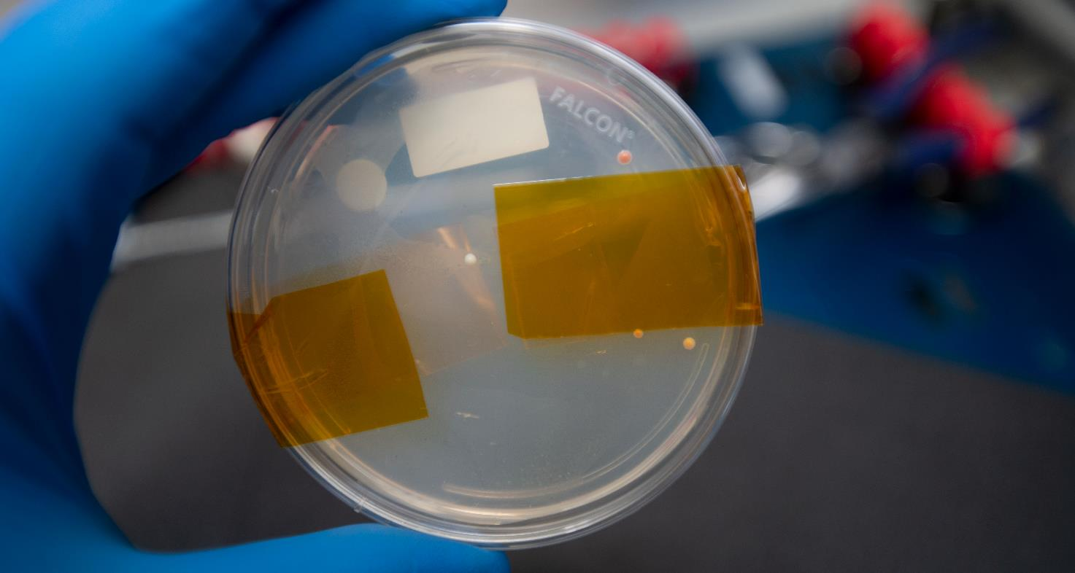
Success!

Slide 26
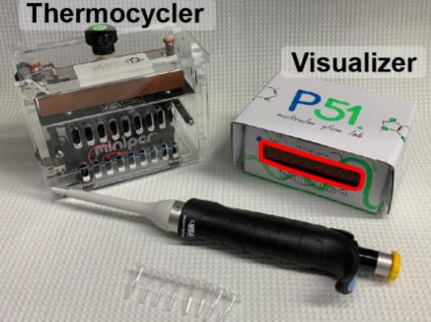

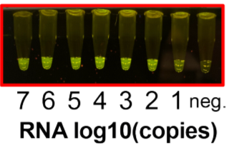
Future of CRISPR Genome Editing
Modify Cas nucleases to do things other than cut DNA
Ex. diagnosing COVID-19
Guide RNA
COVID-19 RNA
Rauch et al, 4-20-2020

Slide 27
Overview
Where did this technology come from?
How does it work?
How is it used?
  Treatment of Sickle Cell Anemia
  Understanding DNA repair in space
  COVID-19 diagnostics

Slide 28
Q and A
When will CRISPR be used to cure a genetic disorder?
What is the difference between a restriction enzyme and Cas9?
What is a PAM?
What resources are available for learning about CRISPR/Cas9 genome editing in the classroom?

Slide 29
Additional resources
CRISPR DNAdots from miniPCR bio
Unlocking Life’s Code - repository of CRISPR teaching resources
Victoria Grey’s story
Genes in Space
Genes in Space-6 mission
CRISPR diagnostic pre-print
Sign up for our newsletter to receive updates on miniPCR CRISPR resources

Slide 30
@miniPCR
fb.minipcr.com
@miniPCR
© 2020 by Amplyus LLC

