Slide 1
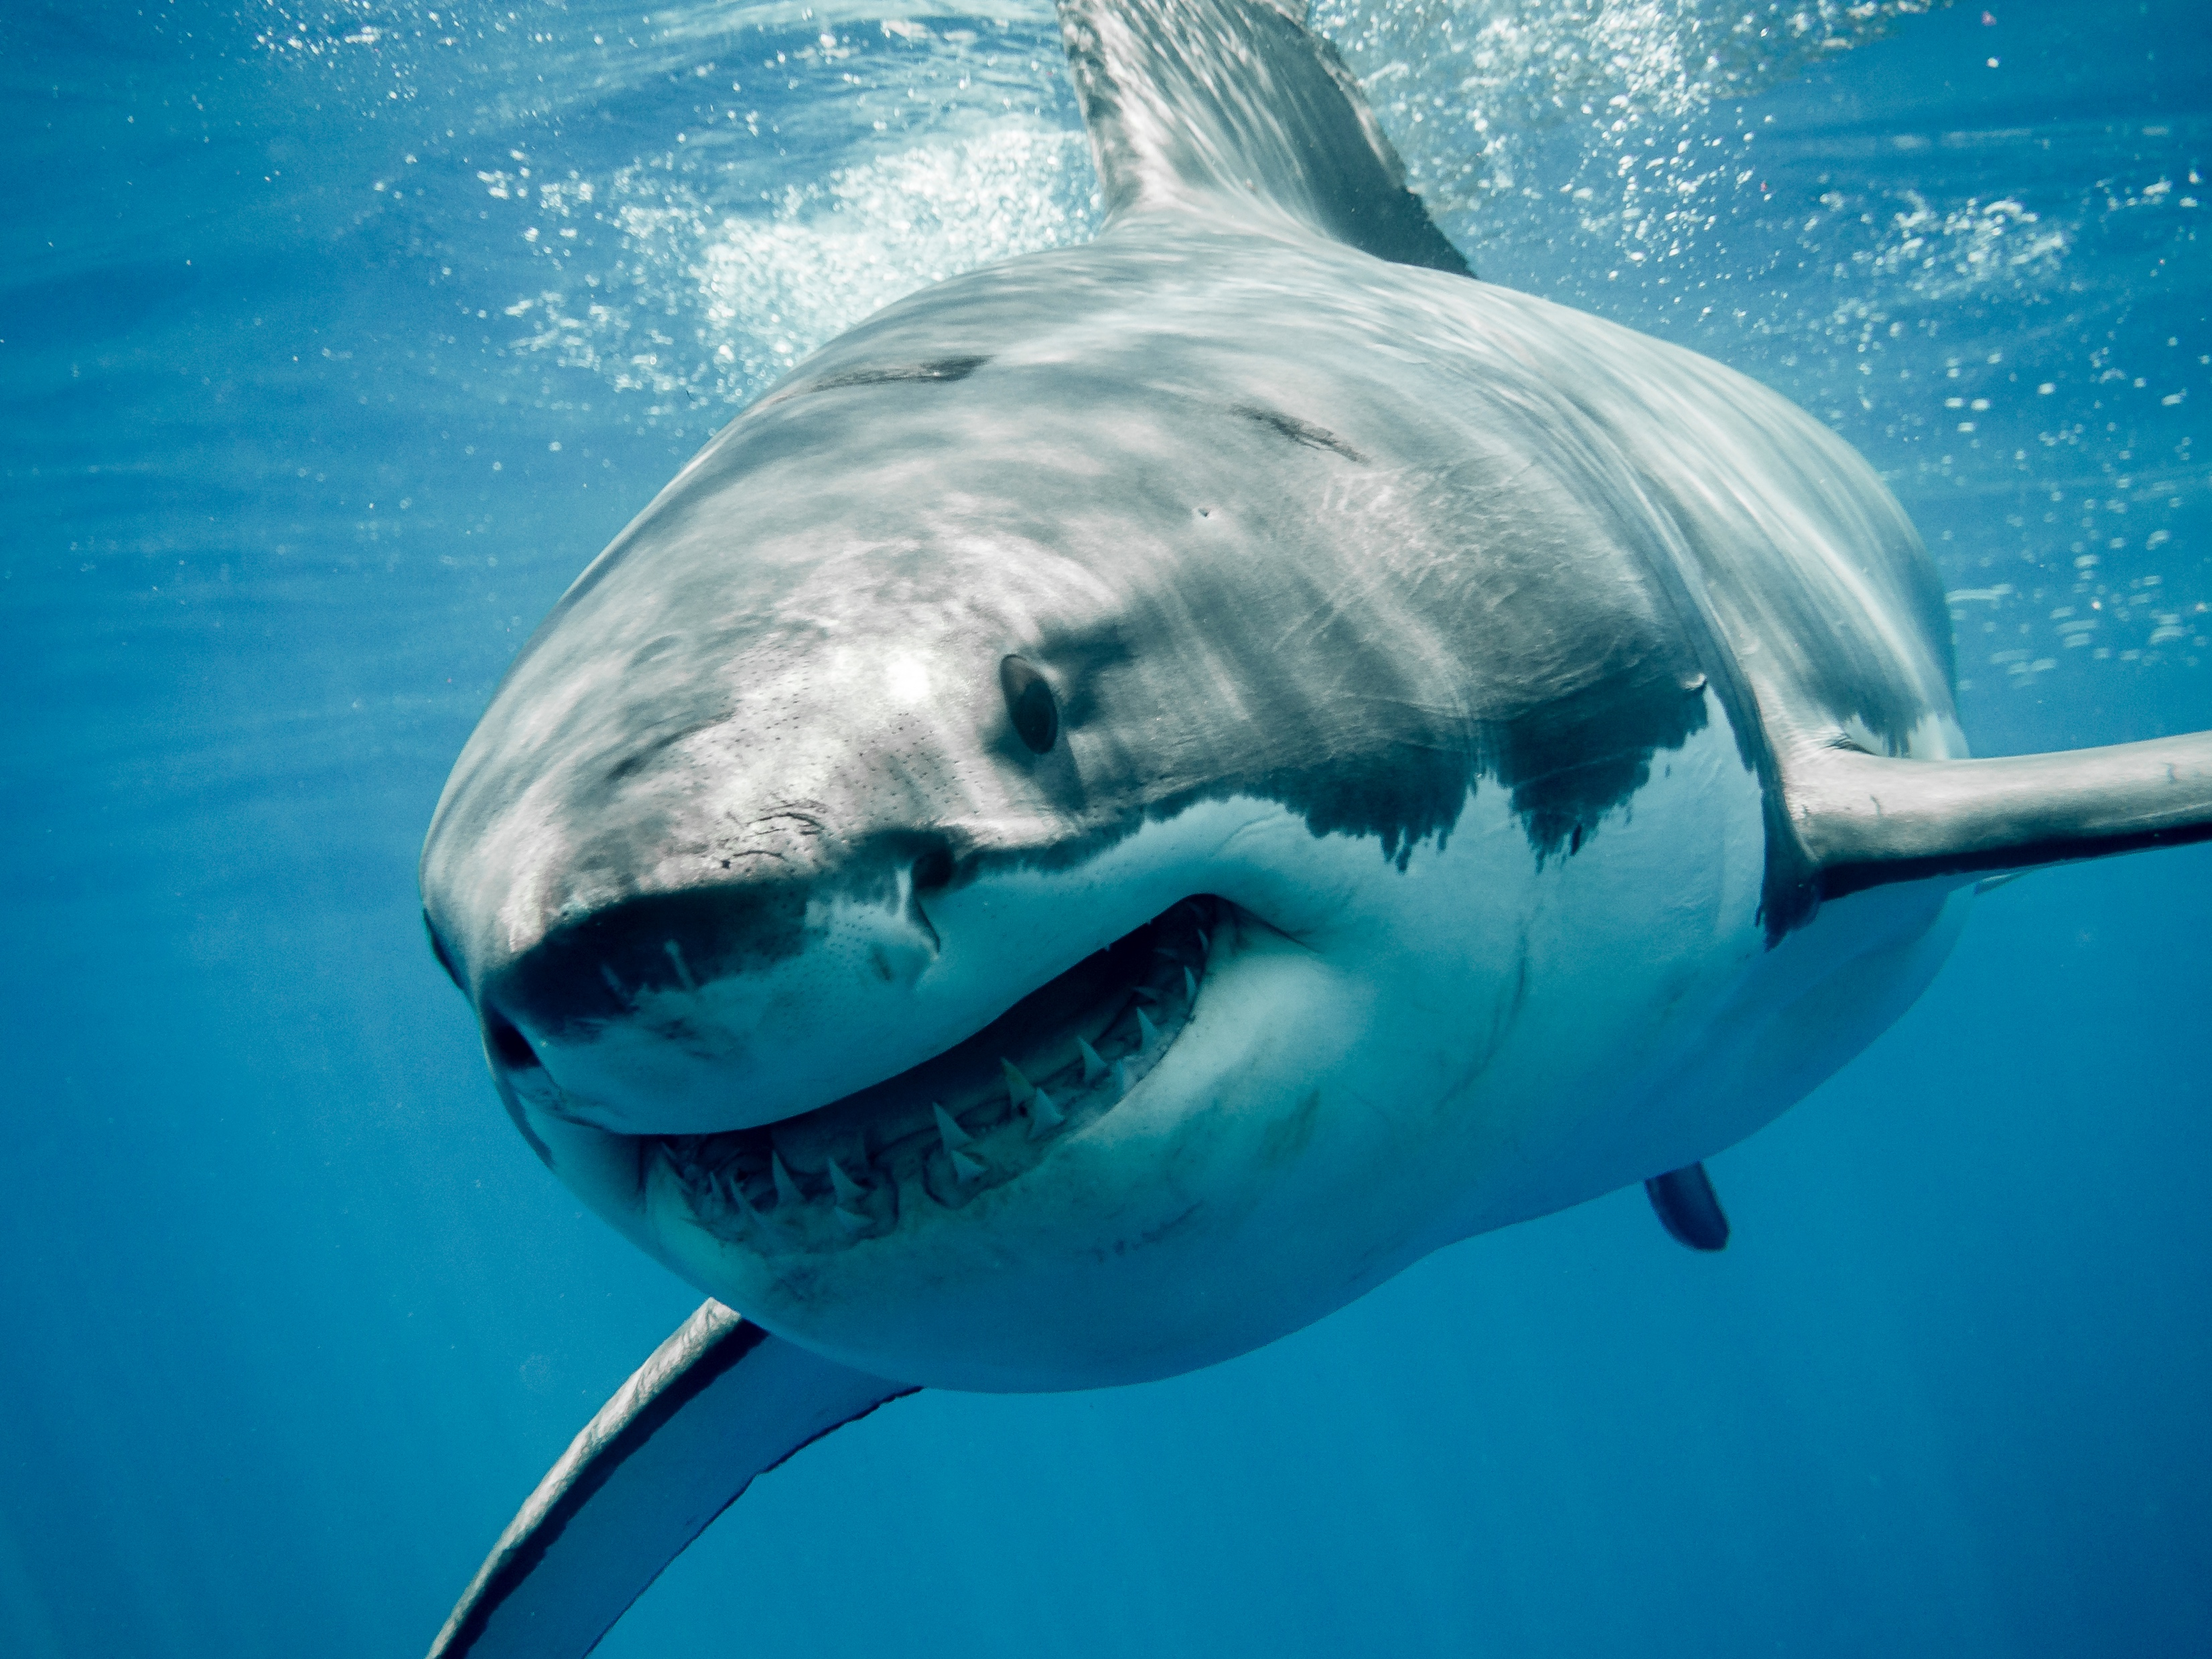
Shark Lab:
Great White Migration

Slide 2
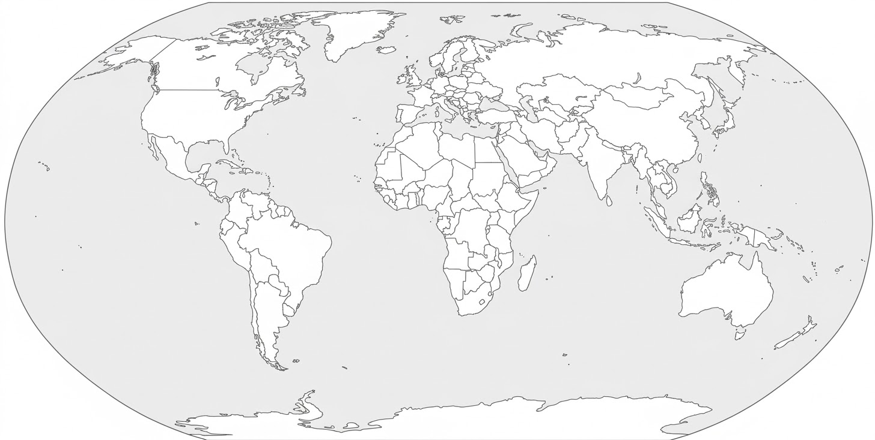

Overview
Scientists have noticed similar-looking white shark fins in four very different locations around the globe!
You will use DNA fingerprinting to determine if an individual shark is migrating across oceans!

Slide 3

Meet the white shark
The white shark (also known as the great white shark) is one of the top predators in the ocean.
White sharks play an essential role in marine ecosystems by preventing mid-level predators from becoming too abundant, which can cause ripple effects through the entire ecosystem.

Slide 4
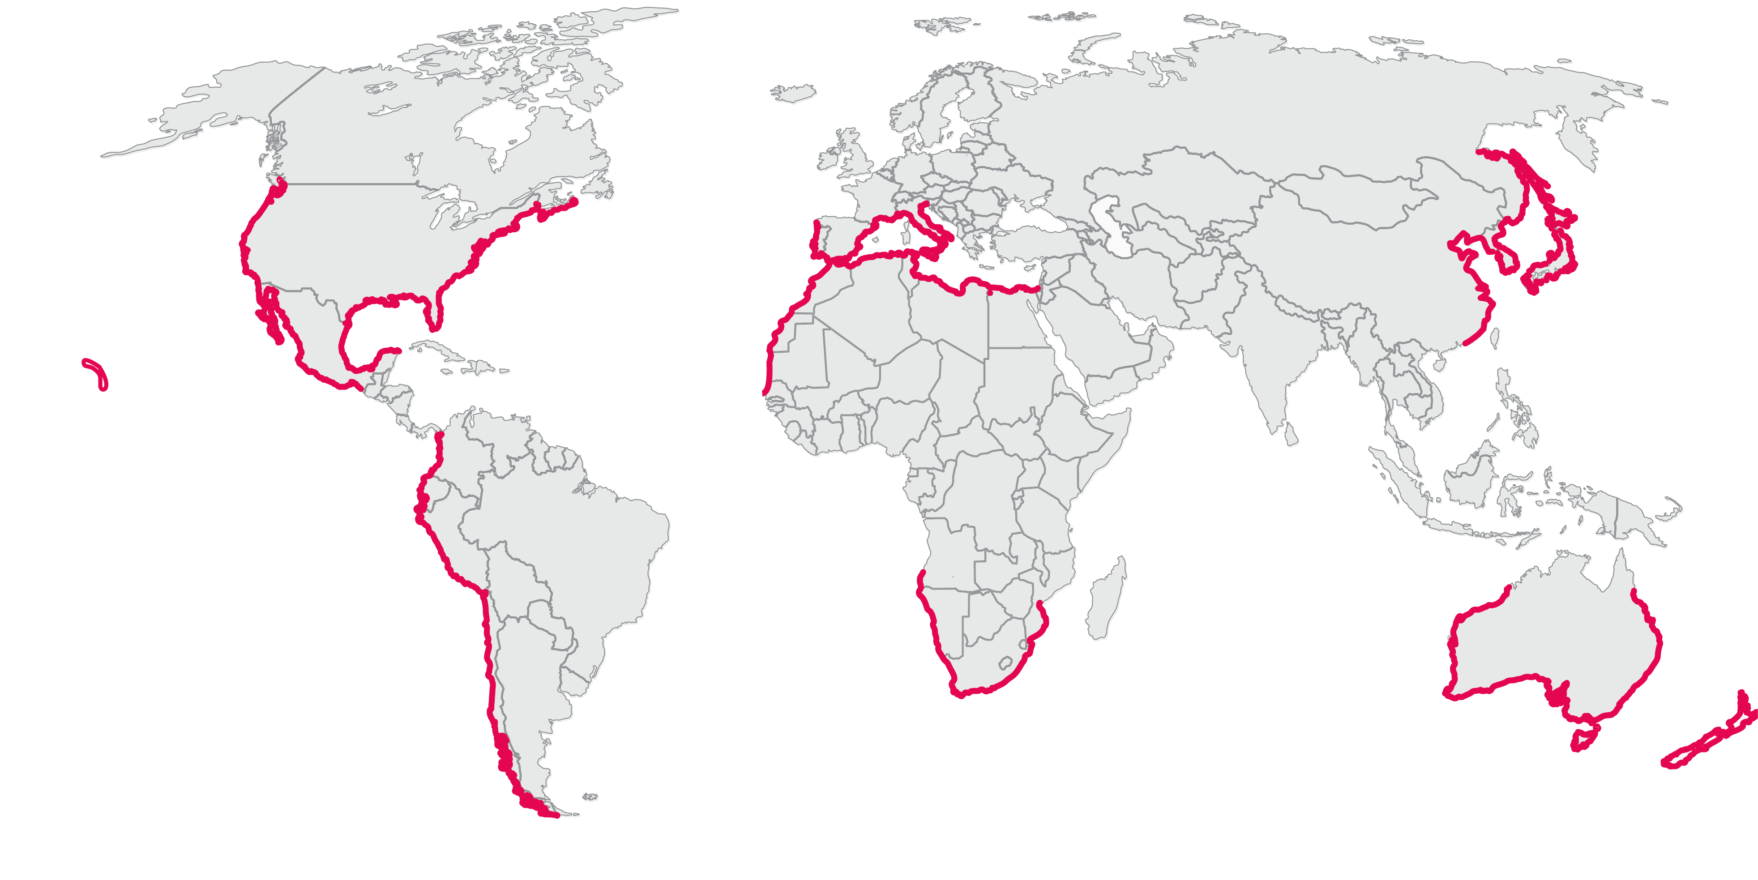
White shark habitat
White sharks live in all ocean waters, except the Arctic and Antarctic.
White sharks are known to inhabit many coastal waters where prey is abundant.
They also spend time in the open ocean.
Coastal waters inhabited by white sharks

Slide 5
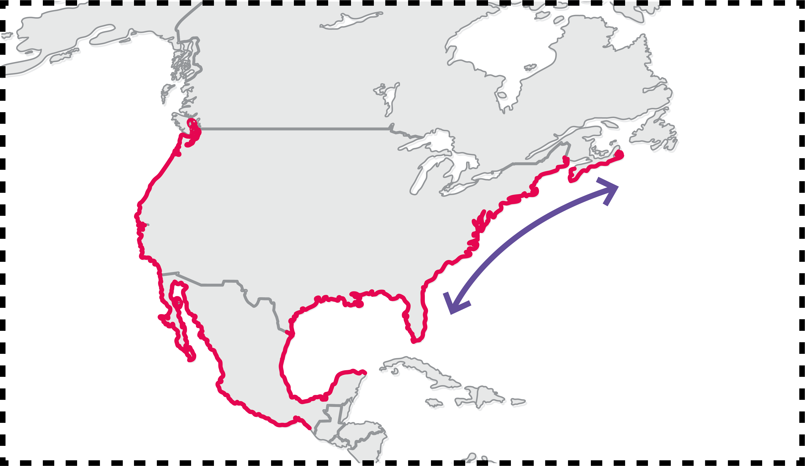
White shark migration
White sharks migrate seasonally along coastal waters.
Scientists think this seasonal migration helps sharks stay within their preferred temperature range of 50-80 ℉ and/or follow seasonal food sources.
summer
winter
Coastal waters inhabited by white sharks
Known coastal migratory route

Slide 6

Protecting white sharks
The conservation status of white sharks is Vulnerable on the IUCN Red List, and they are protected in many waters.
But there is still a lot we don’t know about where white sharks spend their time and how they migrate.
Scientists need to track the movements of individual sharks.

Slide 7
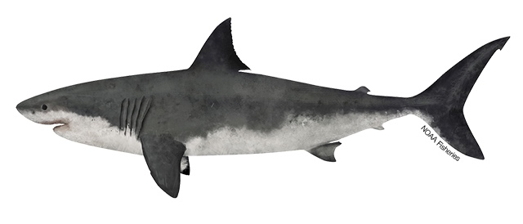
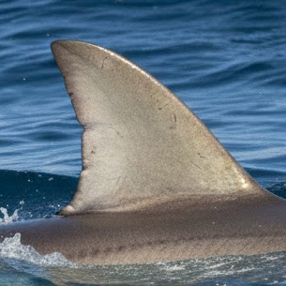
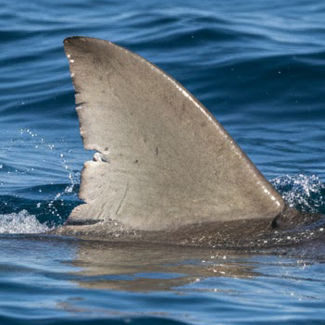
Identifying individual sharks
Dorsal fin
One way to track individual sharks is to use fin photos.
Each shark has unique markings such as notches, spots, or even scars on its dorsal fin.
Seeing the same fin in two locations means that shark swam between those locations.

Slide 8
Today’s lab
You work on a research team studying white shark migration.
The team observed shark fins with similar markings in four very different locations:
  Northwest Australia
  California
  Hawai’i
  Western Cape of South Africa
California
Hawai’i
Australia
South Africa

Slide 9
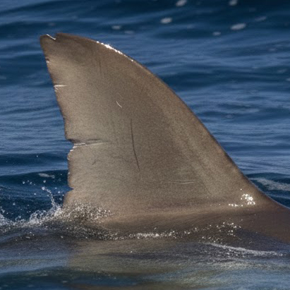
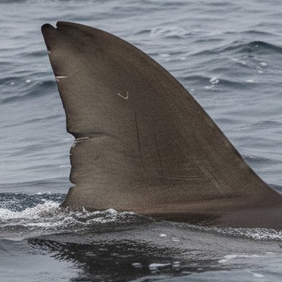
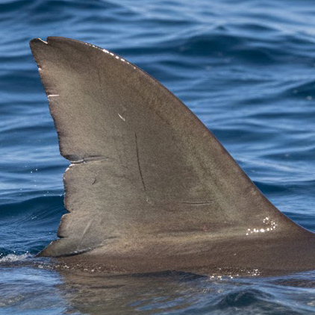
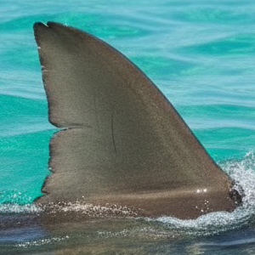
Nov 30th, 2004
California
Hawai’i
Australia
South Africa
Jun 12th, 2005
Nov 7th, 2003
Feb 28th, 2004

Slide 10

Your goal!
You will determine whether a single shark is migrating across the globe, and you will do so using DNA testing!
Your team collected water samples directly around the sharks when the fin photos were taken.
The sharks’ DNA can be isolated from these samples and used for identification.

Slide 11
DNA fingerprinting
Members of the same species share most of their DNA, but some regions of the genome vary in length between individuals.
DNA fingerprinting examines these variable regions of the genomes to generate a unique DNA profile that can identify an individual.

Slide 12

Sample preparation
Other members of your research team prepared the shark DNA samples for analysis by:
Collecting DNA from the water samples.
Using a method called PCR to copy regions of the shark genome that vary in length between individuals.
DNA collection
PCR
Water
sample
Shark DNA for fingerprints

Slide 13
DNA fingerprinting
Because each individual has a unique genome, these steps will create a distinct profile of DNA fragments of different lengths.
You will perform the final step and use gel electrophoresis to interpret the DNA fingerprints.

Slide 14
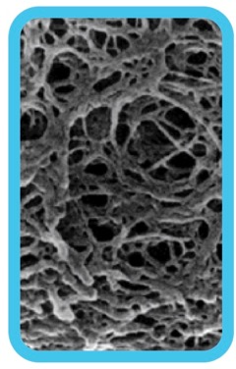
Gel electrophoresis separates DNA by size
- - - NEGATIVE - - -
Negative molecules like DNA move towards the positive charge
The agarose gel forms a web
+ + + POSITIVE + + +

Slide 15
Gel electrophoresis separates DNA by size
- - - NEGATIVE - - -
Larger molecules have more trouble moving through the web and travel slower
Smaller molecules move more easily through the web and travel faster
+ + + POSITIVE + + +

Slide 16

Gel electrophoresis
DNA pieces of different sizes
Gel electrophoresis separates DNA by size.
Samples are placed in pockets called wells.
Smaller pieces of DNA travel farther through the gel.
Wells

Slide 17
Gel electrophoresis
Gel electrophoresis separates DNA by size.
Samples are placed in pockets called wells.
Smaller pieces of DNA travel farther through the gel.
Longer
DNA pieces
Shorter
DNA pieces

Slide 18
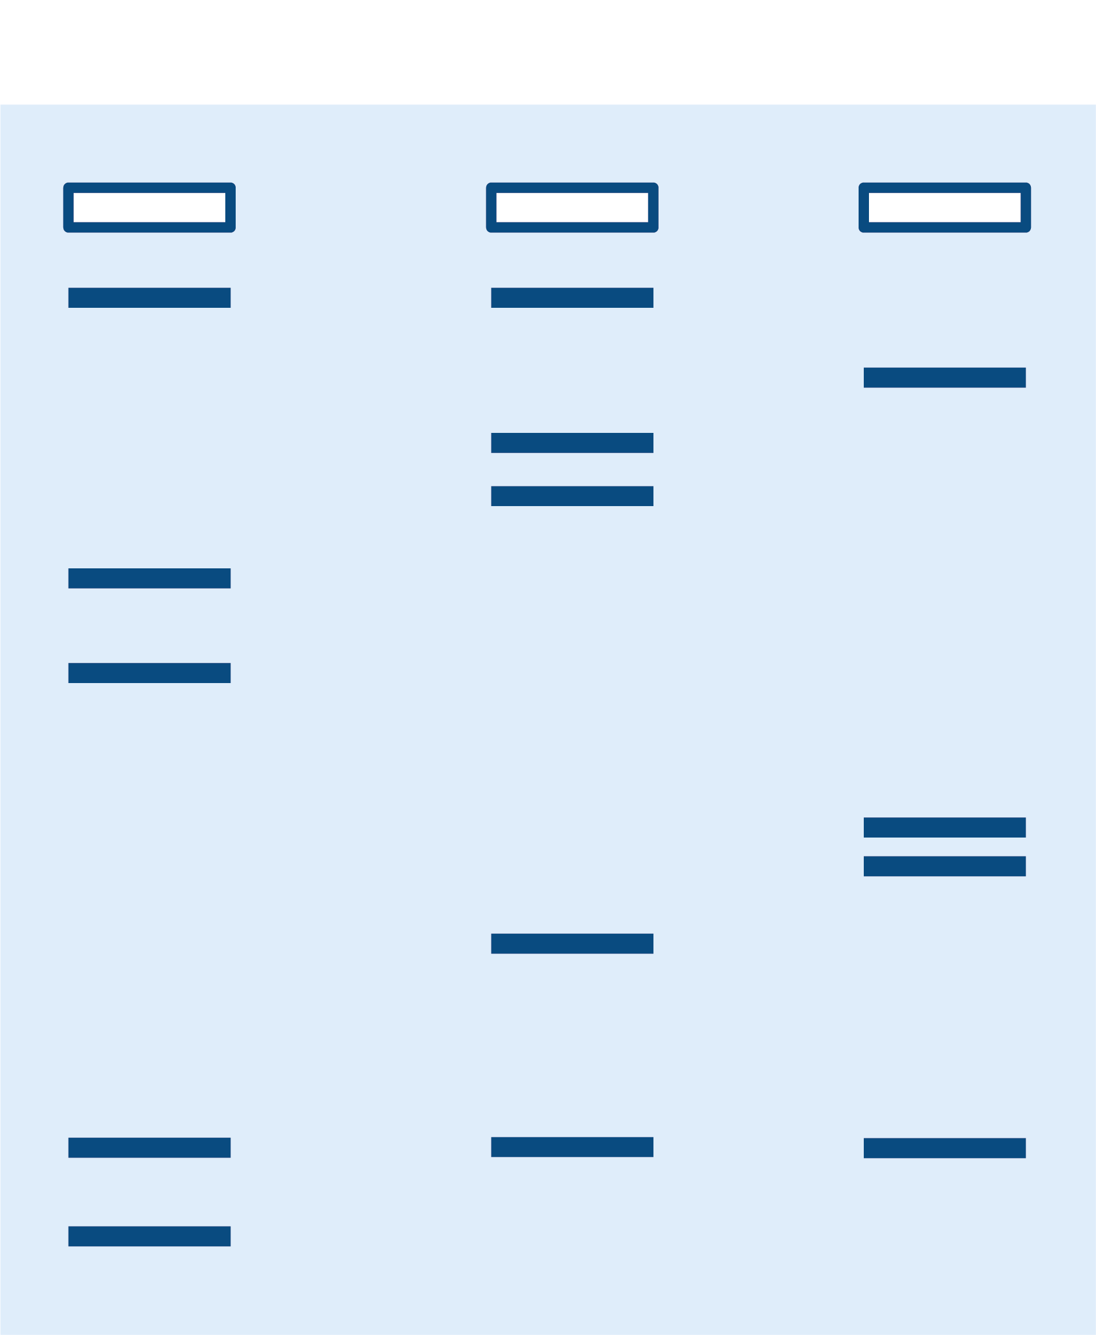
Reading a DNA fingerprint
Captain
Chase
Coral
Let’s compare DNA fingerprints from three white sharks: Captain, Chase, and Coral.
Notice that each shark has a unique pattern on the gel, representing their DNA fingerprint.
This type of analysis allows you to determine if two samples come from the same individual.

Slide 19
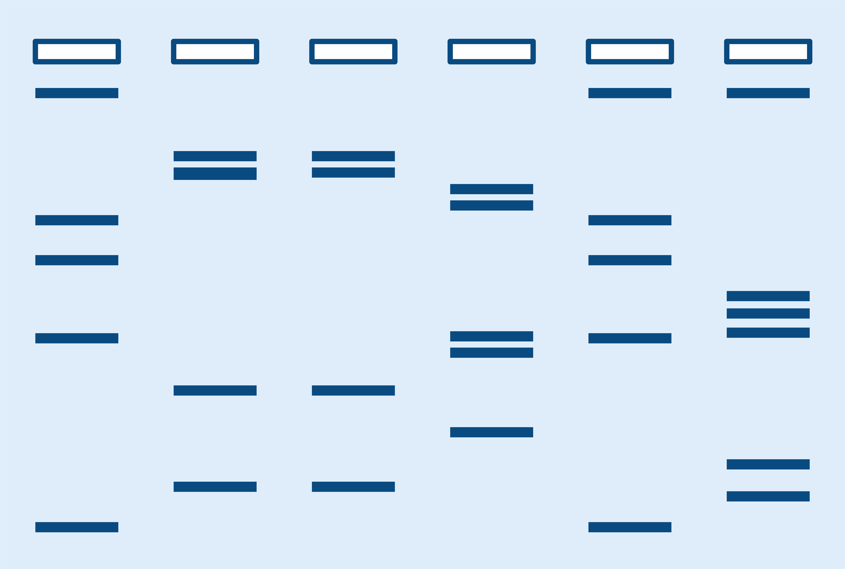
Reading a DNA fingerprint
A
B
C
D
E
F
Let’s look at a more complicated example.

Slide 20
Reading a DNA fingerprint
A
B
C
D
E
F
Samples A and E have the same bands in the same positions.
This means samples A and E are from the same individual.

Slide 21
Reading a DNA fingerprint
A
B
C
D
E
F
Samples B and C have the same bands in the same positions.
Samples B and C are also from the same individual.

Slide 22
Reading a DNA fingerprint
A
B
C
D
E
F
In summary:
Samples A and E are from the same individual.
Samples B and C are from the same individual.
This gel represents four different sharks.

Slide 23
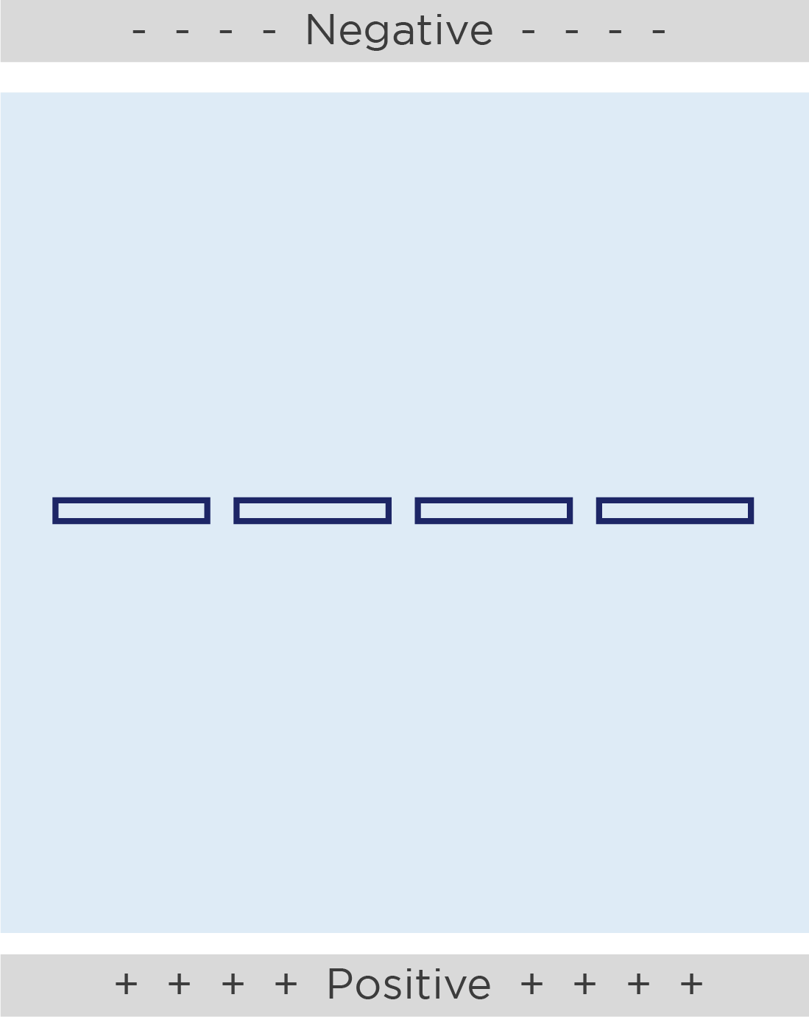

Gel loading tips
Gels have pockets called wells where we will add our samples.
The wells are a small target, so put your elbows on the table and hold the pipette with two hands.
Cross section of well

Slide 24
Gel loading tips
Pipette tip
Top of well
Place the micropipette tip just inside the opening of the well. Wiggle the tip back and forth to feel that the tip is in the well.
Do not stab your tip into the bottom of the well. The tip will either clog with gel or puncture the bottom of the well.
Too deep!

Slide 25
Load the gel
South Africa
California
Australia
Hawai’i
Well 1: 10 μl Australia sample (tube A)
Well 2: 10 μl California sample (tube C)
Well 3: 10 μl Hawaiʻi sample (tube H)
Well 4: 10 μl South Africa sample (tube S)

Slide 26
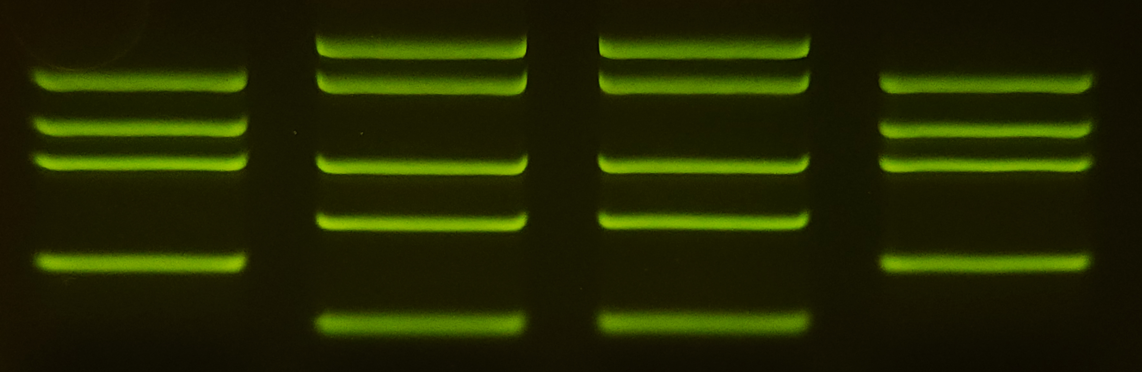
Expected results
Australia
California
Hawai’i
South Africa

Slide 27
Expected results
Australia
California
Hawai’i
South Africa
These samples have the same bands in the same positions.
This means they are from the same shark.

Slide 28
Expected results
Australia
California
Hawai’i
South Africa
Likewise, these samples have matching band patterns.
These samples are from the same shark.

Slide 29
Expected results
Australia
California
Hawai’i
South Africa
The data are consistent with white sharks migrating across oceans.
The data indicate that a shark migrated from California to Hawai’i and another shark migrated from South Africa to Australia.

Slide 30
Nov 30th, 2004
California
Hawai’i
Australia
South Africa
Jun 12th, 2005
Nov 7th, 2003
Feb 28th, 2004

Slide 31
What have we learned?
White sharks are top predators that help keep marine ecosystems healthy.
White sharks migrate across oceans!
Learning which waters white sharks use for migration can identify habitats to protect.
DNA analysis can be used to answer ecological questions.

Slide 32
Extension activity:
Tracking white shark migration with electronic tags

Slide 33
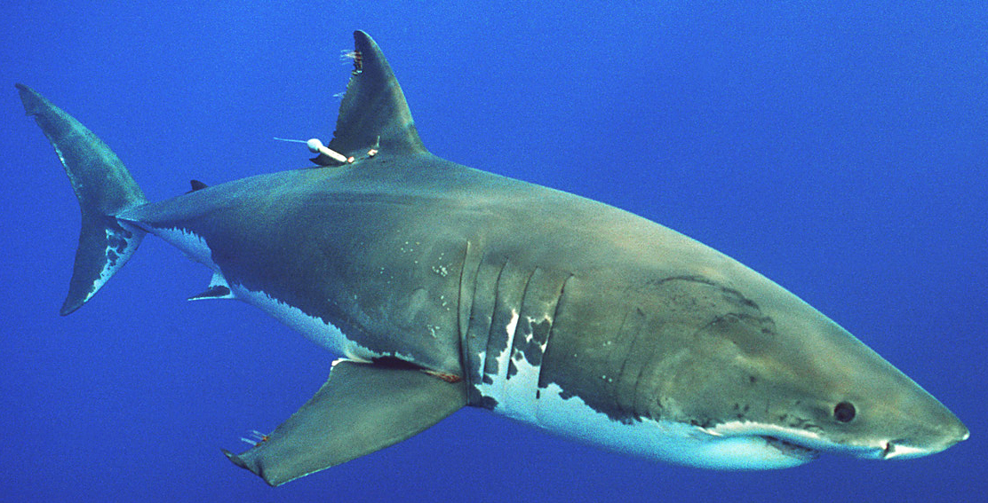
Electronic tags
Scientists can attach a small data-collection device to an animal.
Electronic tags can collect data related to shark behavior, such as location, speed, and depth.
They also collect data on shark habitats, such as water temperature, light, and oxygen levels.
Electronic tag

Slide 34
White shark migration in the Indian ocean
The white shark from today’s lab that migrated from South Africa to Australia is a real animal called Shark P12.
We will refer to her as Poppy.
South
Africa
Australia
Feb 28th, 2004
Nov 7th, 2003

Slide 35
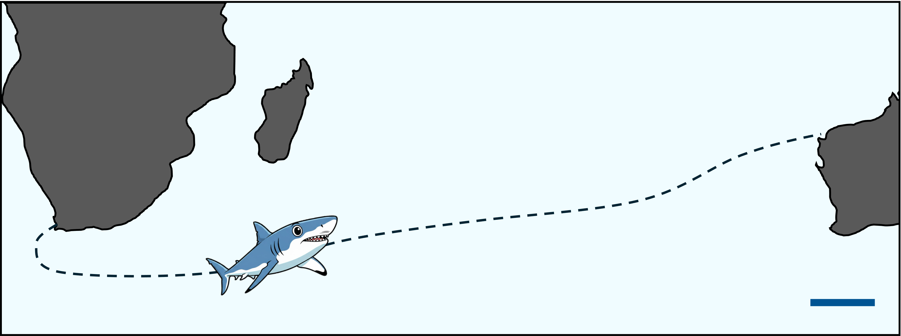
White shark migration in the Indian ocean
Over 99 days, Poppy’s tag recorded her crossing the Indian Ocean, ending off the coast of northwestern Australia on February 28, 2004
Poppy was tagged on November 7th, 2003, just off the coast of South Africa’s Western Cape
500 miles

Slide 36
White shark migration in the Indian ocean
Poppy’s journey broke many records for her species:
Fastest round-trip migration across an ocean: More than 12,000 miles in 9 months!
Speediest long-distance swim: Minimum speeds of 2.9 miles per hour!
Deepest dives: 3200 feet below the surface!
Coldest temperatures: 38.1°F!

Slide 37
White shark migration in the Indian ocean
Poppy’s tag had been programmed to stop collecting data in February 2004.
However, her dorsal fin was spotted off the coast of South Africa that August.
This means Poppy returned to South Africa between February and August.
South
Africa
Australia
Feb 28th, 2004
Aug. 2004

Slide 38
White shark migration in the Indian ocean
Poppy’s migration raised many questions.
For example, scientists don’t know if Poppy’s migration was unusual or typical for her population.
Do other white sharks living off the coast of South Africa regularly migrate across the Indian Ocean?

Slide 39
White shark migration in the Indian ocean
Scientists also don’t really know why Poppy made this round-trip journey across the entire Indian Ocean.
Based on what you have learned, propose one explanation for why Poppy migrated from South Africa to Australia and back.
Can you propose a study to gather evidence to test your hypothesis?

