Slide 1
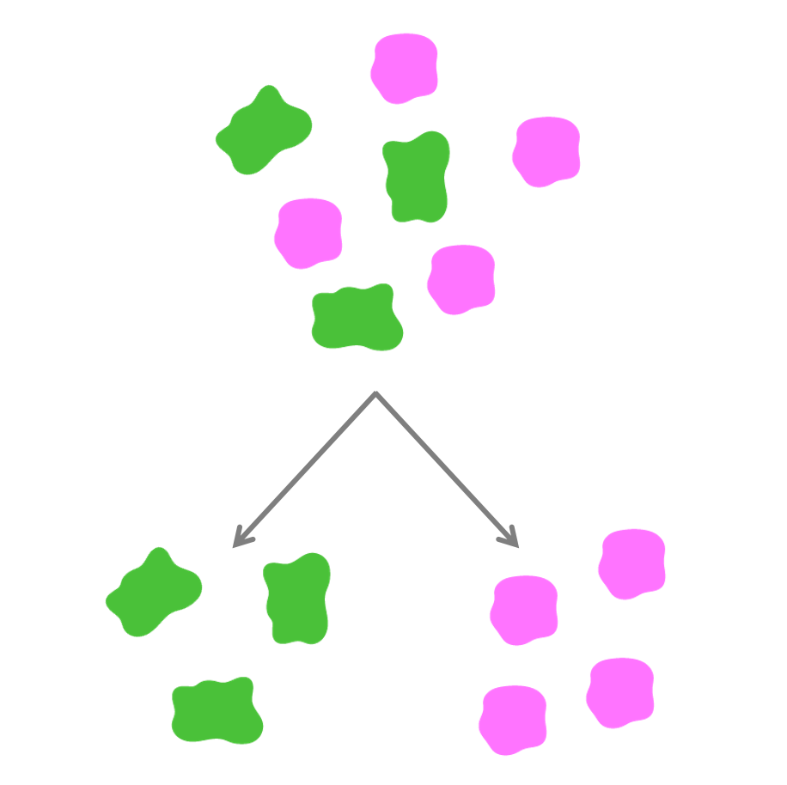
Biotech Skills Lab:
Protein Expression and Purification
1.0
9/24

Slide 2
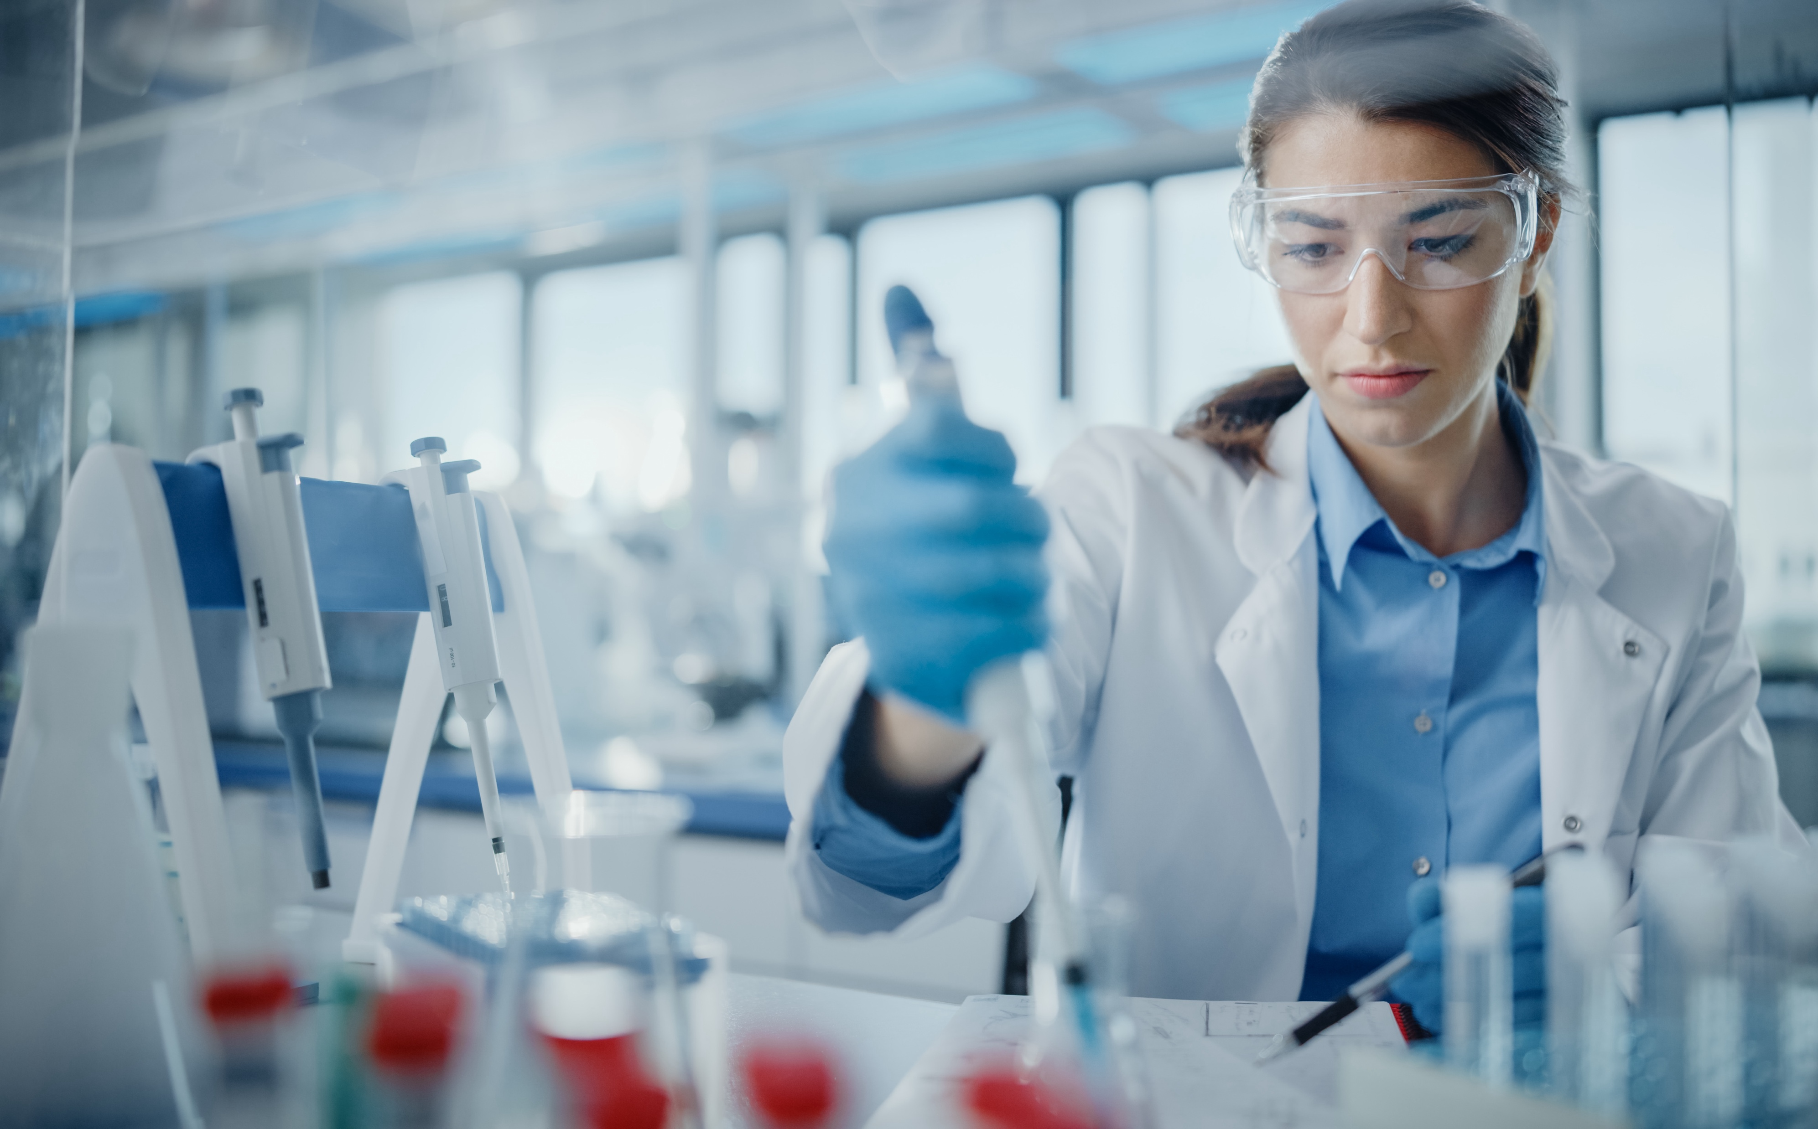
Overview of today’s lab
In this activity you will use two of the most important methods in biotechnology: protein expression and protein purification!

Slide 3
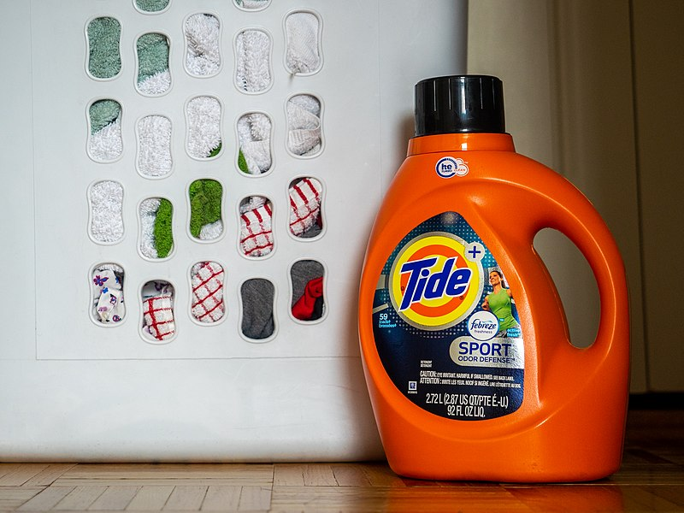
Protein expression
Scientists engineer and manufacture proteins for wide-ranging applications.
Examples include:
  Stain-removing enzymes used in laundry detergents
This file is licensed under the Creative Commons Attribution 2.0 Generic license.

Slide 4
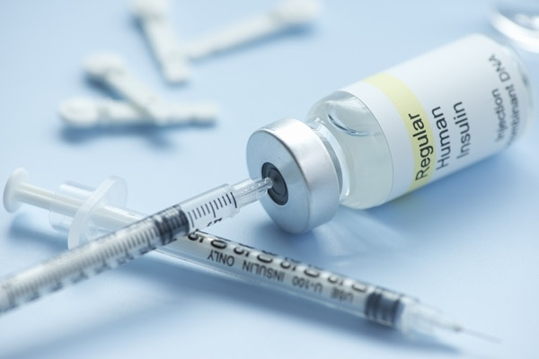
Protein expression
Scientists engineer and manufacture proteins for wide-ranging applications.
Examples include:
  Stain-removing enzymes used in laundry detergents
  Protein-based medicines like insulin
Photo credit: NIH National Institute of Diabetes and Digestive and Kidney Diseases

Slide 5

Protein expression
Cells
Scientists typically use living cells to produce proteins.
The cells are provided with DNA encodes the protein that the scientists want to produce, then the cells make a large quantity of the protein.
Gene of interest
Protein of interest

Slide 6
Protein expression
Mammalian
cells
Because all organisms share the same genetic code, scientists can provide virtually any cell with the genetic instructions to make almost any protein.
For example, human proteins can be produced using bacterial, yeast, and mammalian cells.
Bacteria
Yeast
Human gene
Human protein

Slide 7
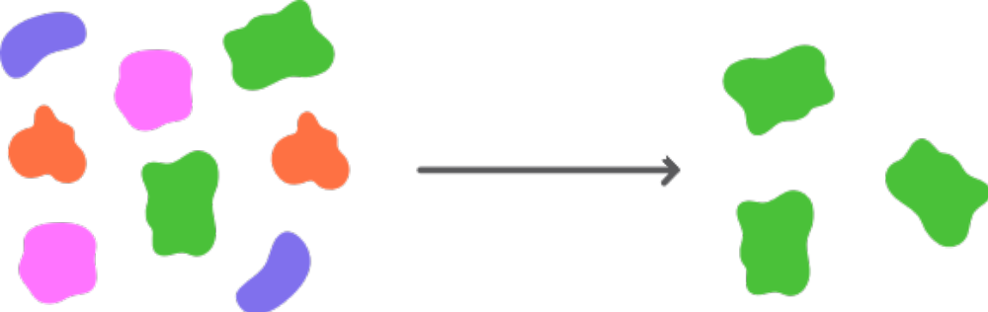
Protein purification
Mixture of molecules
Protein purification describes the process of isolating the protein of interest.
Protein purification methods rely on separating molecules by their unique characteristics.
Examples include separating molecules based on size, charge, or hydrophobicity.
Purified protein of interest

Slide 8
Affinity purification
Affinity purification relies on beads coated with a ligand that specifically binds to, or has an affinity for, the protein of interest.
Protein of interest
Ligand
Bead

Slide 9
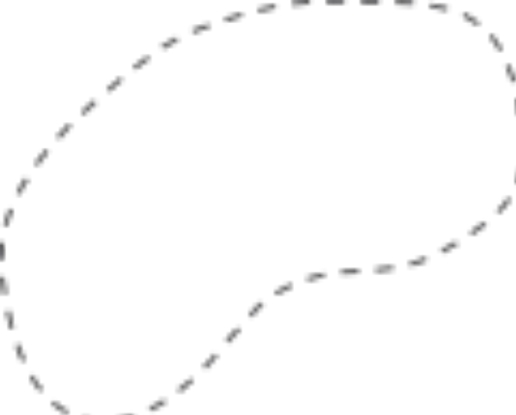
Affinity purification
Mixture of molecules
Unbound molecules
Affinity purification relies on beads coated with a ligand that specifically binds to, or has an affinity for, the protein of interest.
Only the protein of interest binds to the ligand and is captured by the beads.
Protein of interest
Ligand
Bead

Slide 10


Affinity purification of tagged proteins
The protein of interest you will purify includes a short tag made of a few amino acids.
Scientists engineered the tag to bind with high affinity to the ligand present on the beads you will use.
Protein of
interest
Tag
Ligand
Bead

Slide 11

Affinity purification of tagged proteins
Other molecules
The strong, specific interaction between the tag and the beads will allow you to isolate the protein of interest with relative ease.
The tagged protein of interest will bind to the beads and be captured.
All other molecules can be removed.
Protein of
interest
Tag
Ligand
Bead

Slide 12
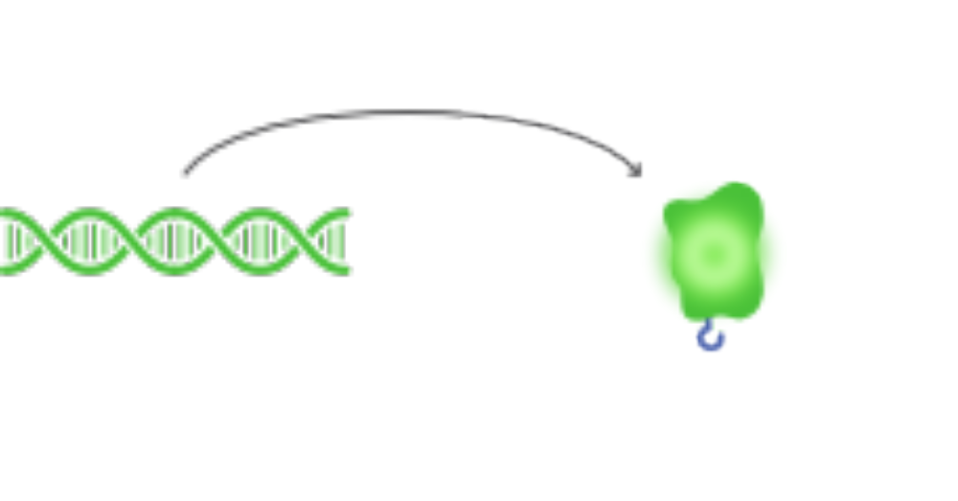
Creation of tagged fusion proteins
The tag is added by modifying the DNA that encodes the protein of interest.
This modified protein is called a fusion protein because it combines sections encoded by two different genes, the original protein and the tag.
DNA encoding the protein of interest
Protein
of interest
Tag
Fusion
protein
DNA encoding
the tag

Slide 13
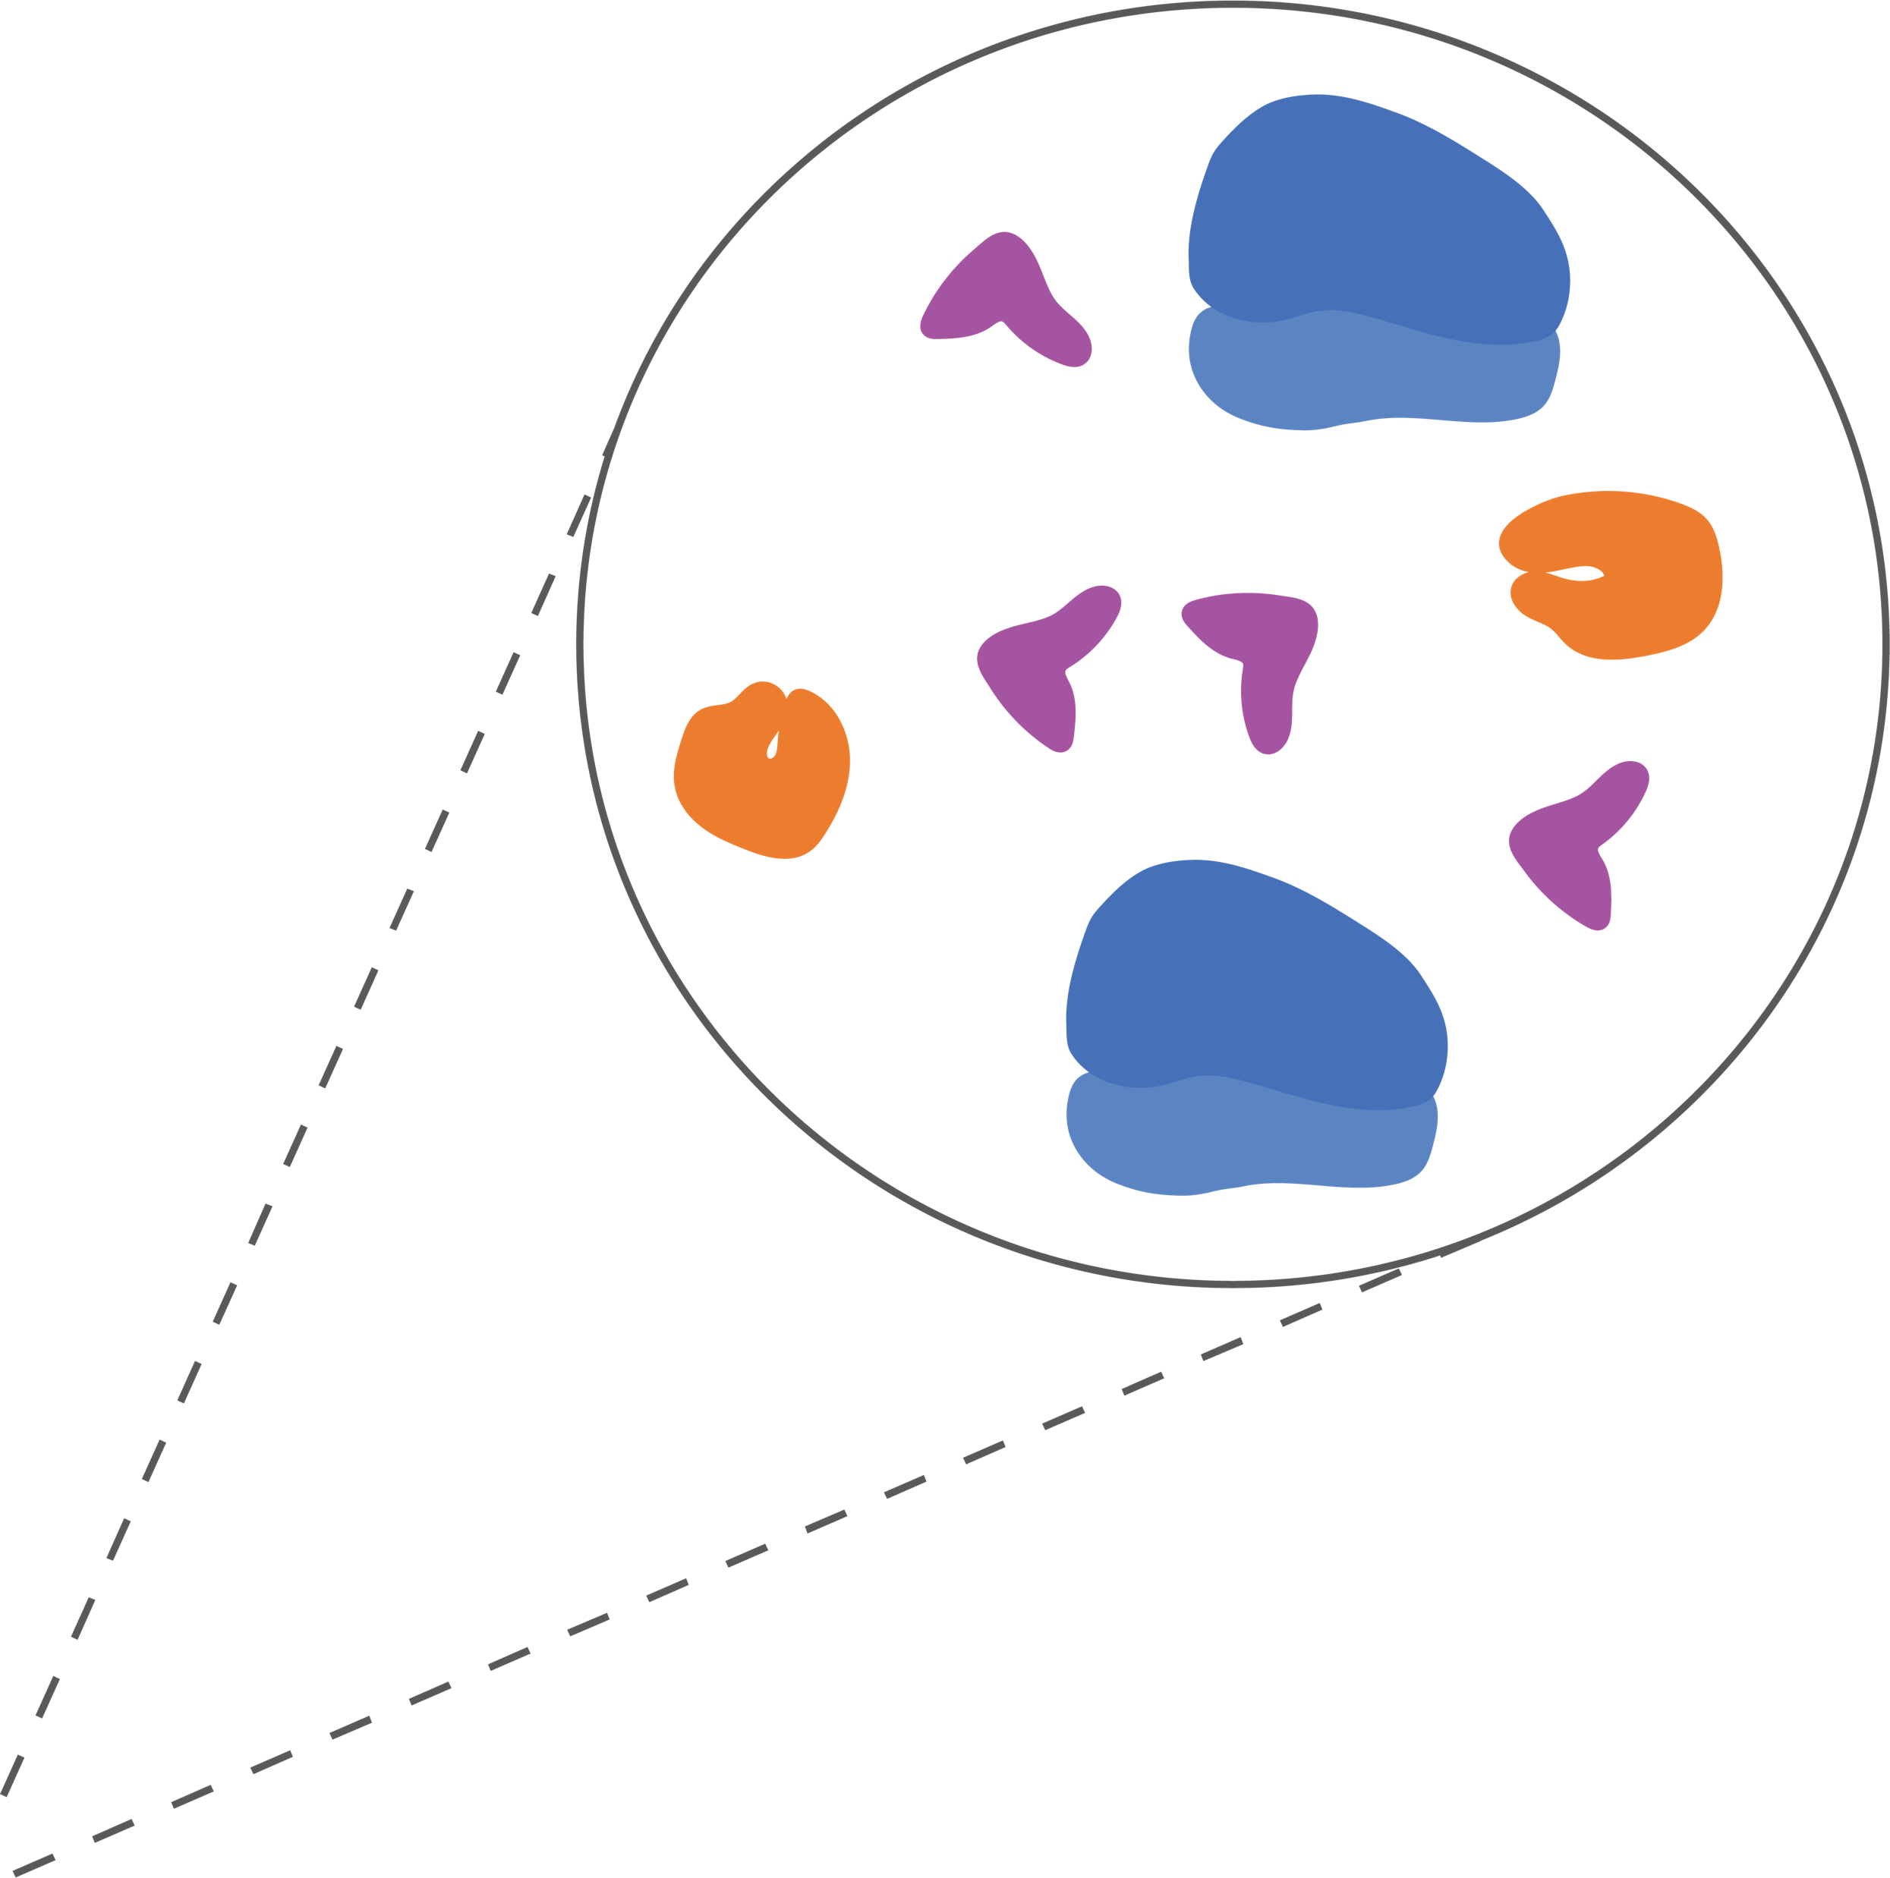
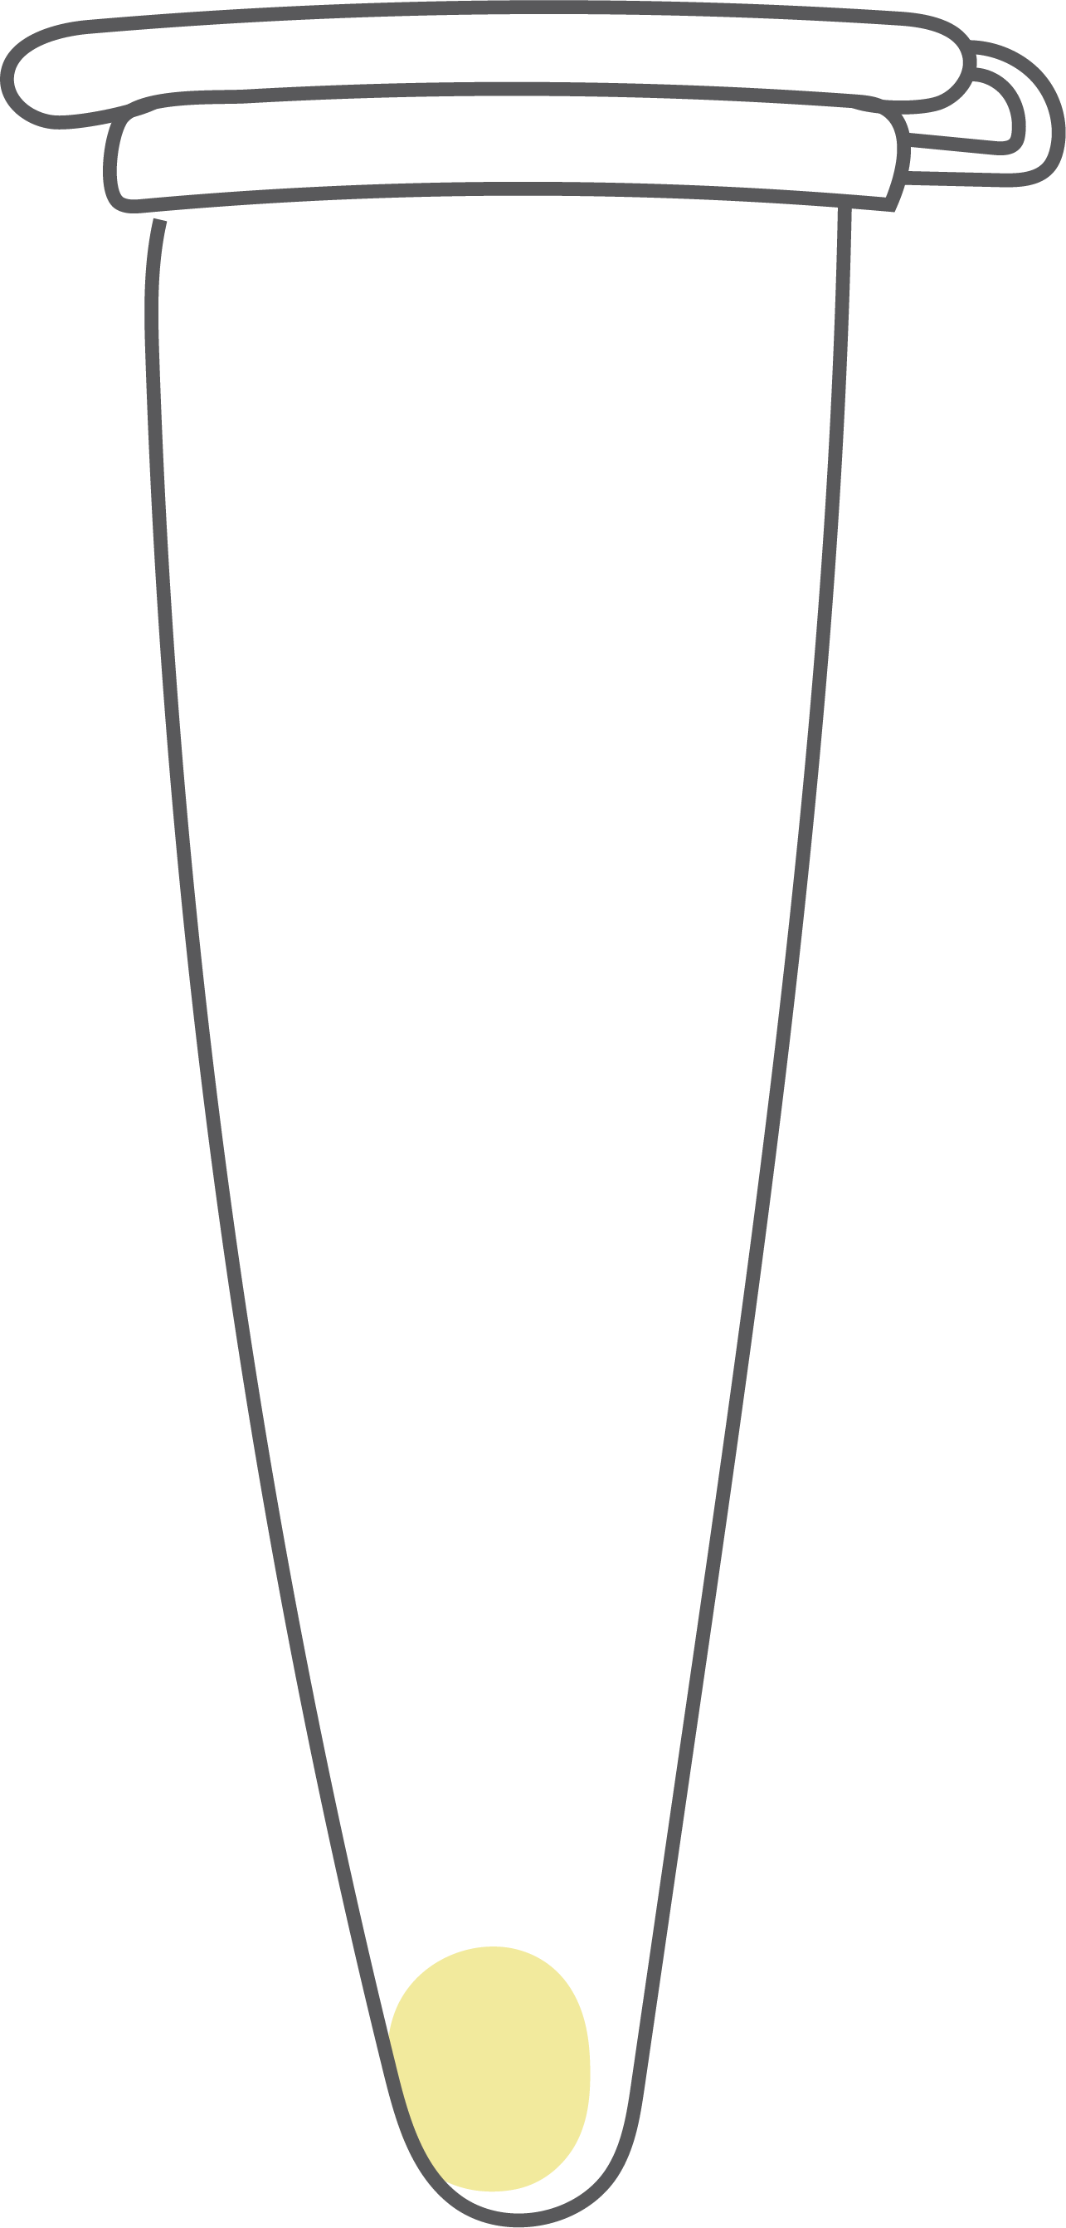
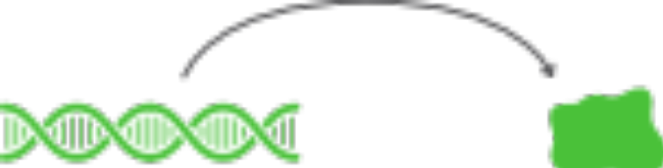
BioBits cell free expression system
You will use cell-free protein expression technology called BioBits to produce proteins in a test tube.
BioBits pellets contain the enzymes and molecular machinery needed for protein expression.
To trigger protein expression, you will add DNA to the BioBits pellets.
BioBits pellet
DNA
Protein

Slide 14


Experimental overview
You will use the BioBits pellets to express two proteins:
Tagged green fluorescent protein
A tagged green fluorescent protein (GFP) that will serve as your protein of interest
An untagged red fluorescent protein (RFP)
Untagged red fluorescent protein
You will use affinity purification to separate the tagged GFP from the untagged RFP and from everything else in the reaction.
Because you are using different colored fluorescent proteins, you will be able to track their expression and purification visually.

Slide 15

Your samples
Tube 1: GFP only (reference sample)
BioBits pellet
Green fluorescence
Protein
expression
Tagged green fluorescent protein
GFP DNA

Slide 16

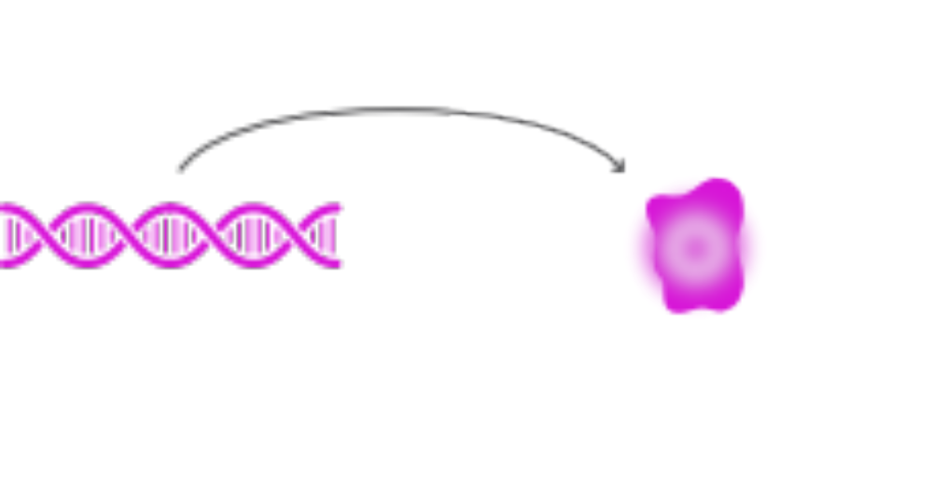
Your samples
Tube 2: RFP only (reference sample)
BioBits pellet
Red fluorescence
Protein
expression
Untagged red fluorescent protein
RFP DNA

Slide 17

Your samples
Tube 3 & 4: GFP + RFP
BioBits pellet
Yellow fluorescence
Tagged green fluorescent protein
The combination of green and red fluorescence appears yellow
GFP DNA
+
+
Untagged red fluorescent protein
RFP DNA

Slide 18
Purification goal
MIXTURE of green and red fluorescent proteins
You will purify the tagged GFP from the untagged RFP and the remaining cell-free components in tube 4.
Because you are using fluorescent proteins, you can track the purification process visually.

Slide 19
Purification goal
MIXTURE of green and red fluorescent proteins
At the beginning of the purification, the mixture of GFP and RFP in tube 4 will appear yellow.
At the end of the purification, you will have separated the GFP and RFP proteins from each other.
Tagged green fluorescent protein
Untagged red fluorescent protein

Slide 20

Affinity purification using magnetic beads
You will use affinity purification to isolate the tagged protein: GFP.
The beads you will use are coated with the ligand that binds to the tag.
The beads are also magnetic!
Protein of
interest
Tag
Ligand
Magnetic bead

Slide 21
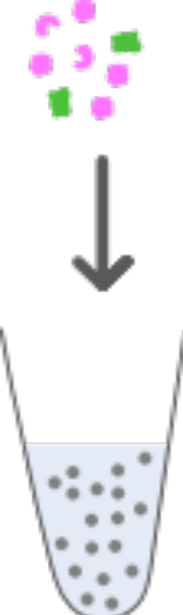

Affinity purification using magnetic beads
Cell-free reaction (mixture of proteins)
Apply
magnet
Unbound fraction
Magnetic beads in solution in a tube
Magnetic beads

Slide 22


Affinity purification using magnetic beads
Unbound
molecules
Tagged protein of interest bound to magnetic beads
Unbound fraction
Magnetic beads
Protein of interest held in place by the magnet. Unbound molecules can be removed!

Slide 23
Affinity purification using magnetic beads
Unbound
molecules
Pipette
Pipette tip
Tagged protein of interest bound to magnetic beads
Unbound fraction
Magnetic beads
Protein of interest held in place by the magnet. Unbound molecules can be removed!

Slide 24
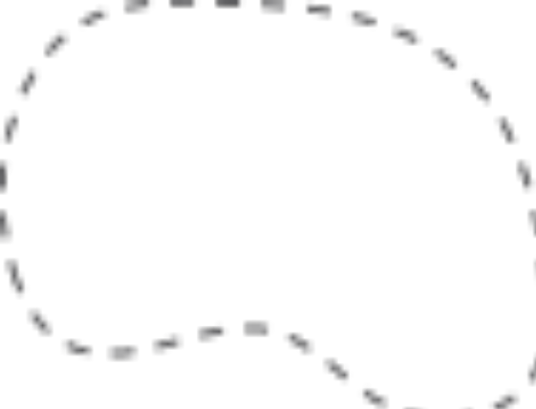


Purification workflow: Binding step
Unbound
molecules
You will add the protein expression mixture to the beads and allow the tag to bind to the ligand that coats the beads.
Only proteins with the tag will bind the beads.
STEP 1:
BIND
Tagged protein of interest bound to magnetic beads

Slide 25
Purification workflow: Wash step
You will remove unbound molecules by pipetting off the unbound fraction.
Then, you will add a wash buffer to rinse off residual unbound molecules and remove the unbound fraction again.

Slide 26
Purification workflow: Wash step
Remove unbound
molecules
You will remove unbound molecules by pipetting off the unbound fraction.
Then, you will add a wash buffer to rinse off residual unbound molecules and remove the unbound fraction again.
STEP 2:
WASH
Tagged protein of interest bound to magnetic beads

Slide 27
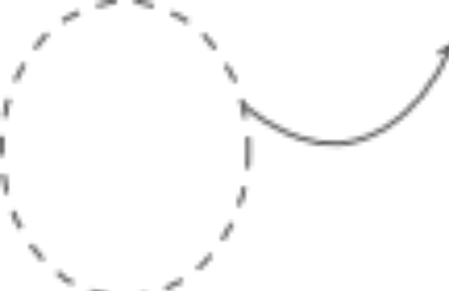

Purification workflow: Elution step
To release the tagged GFP fusion protein from the beads, you will add a competitive binding partner for the ligand.
The competitive binding partner will bind the ligand and displace the tagged protein into the solution.
Collect protein of interest
STEP 3:
ELUTE
Competitive binding partner bound to ligand on beads

Slide 28
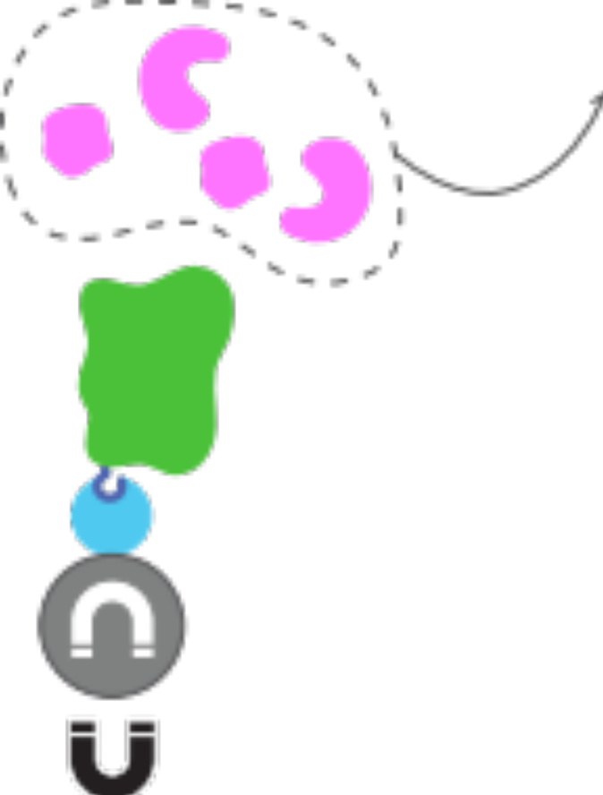
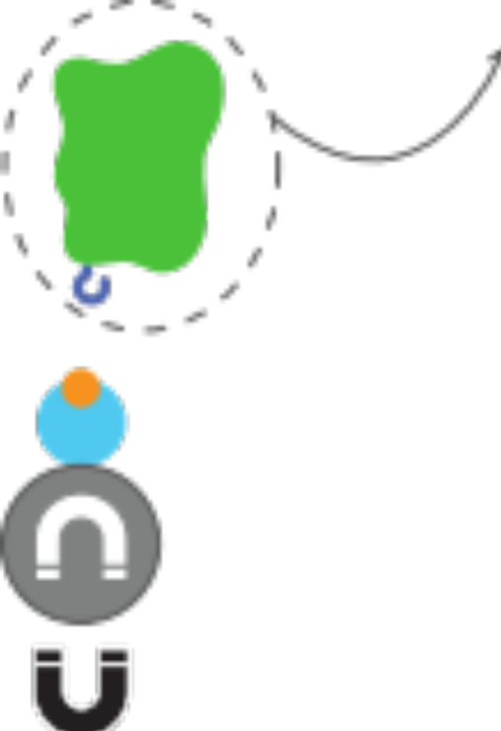
Purification workflow
Capture protein of interest
Remove unbound
molecules
Collect protein of interest
STEP 1:
BIND
STEP 2:
WASH
STEP 3:
ELUTE

Slide 29
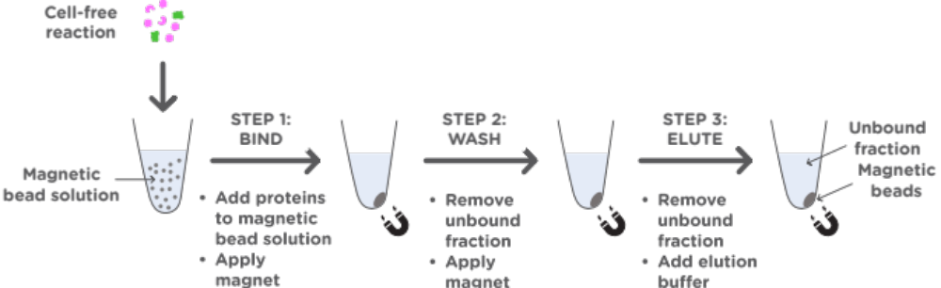
Check your understanding
After step 1, what color of fluorescence do you expect the unbound fraction to exhibit?
Remember that you will add a mixture of tagged GFP and untagged RFP from Tube 4 to the magnetic beads

Slide 30
Check your understanding
After step 1, what color of fluorescence do you expect the magnetic beads to exhibit?
Remember that you will add a mixture of tagged GFP and untagged RFP from Tube 4 to the magnetic beads

Slide 31
Check your understanding
After step 3, what color of fluorescence do you expect the unbound fraction to exhibit?
Add wash
buffer
Remember that you will add a mixture of tagged GFP and untagged RFP from Tube 4 to the magnetic beads

Slide 32
Check your understanding
Add wash
buffer
After step 3, what color of fluorescence do you expect the magnetic beads to exhibit?
Remember that you will add a mixture of tagged GFP and untagged RFP from Tube 4 to the magnetic beads

Slide 33
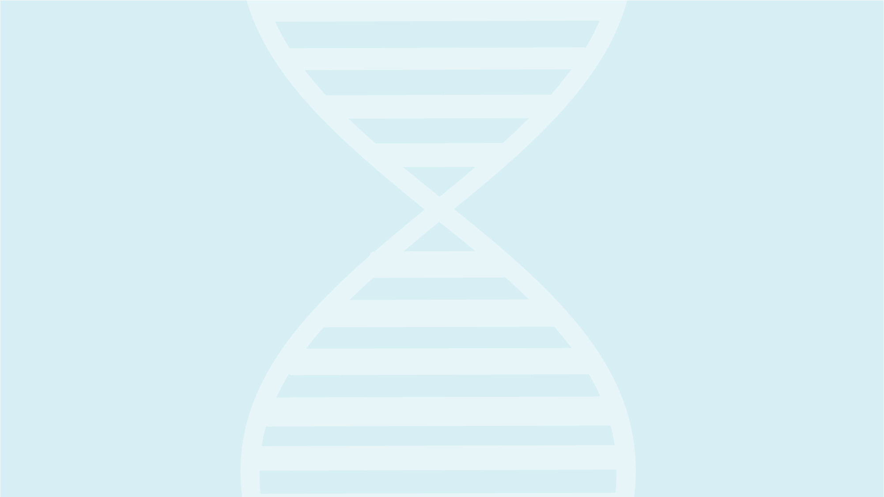

Slide 34
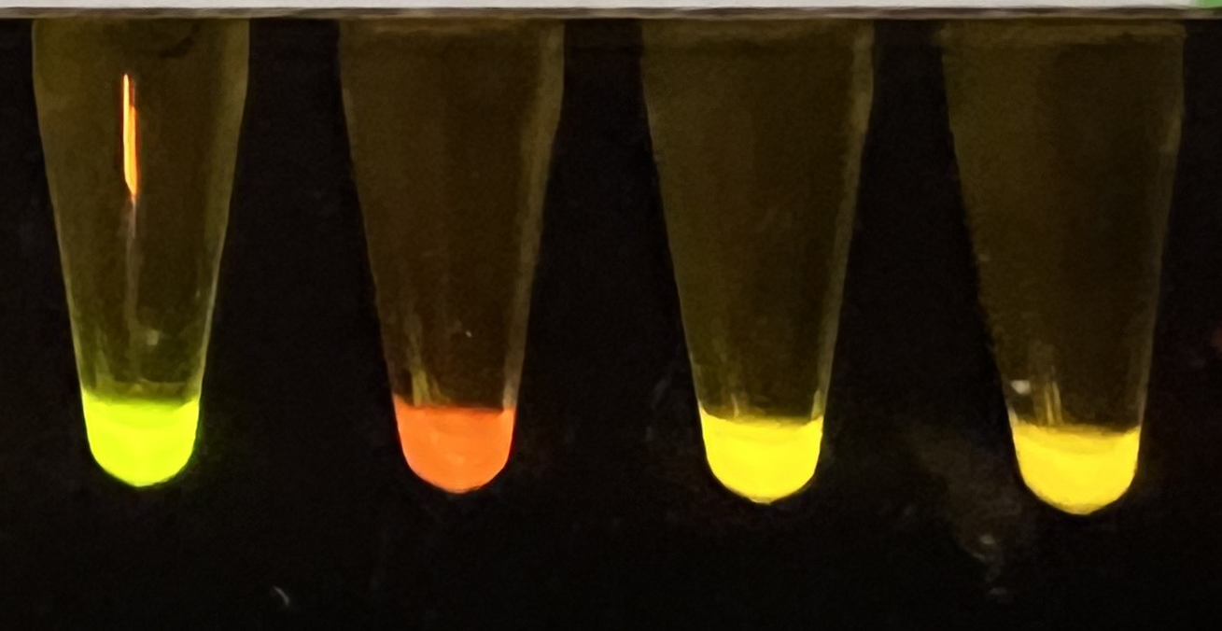
Expected results for part 1: protein expression
Tube 1
Tube 2
Tube 3
Tube 4
Table 1: Protein expression observations
 | Tube 1 | Tube 2 | Tube 3 | Tube 4
DNA added | GFP only | RFP only | GFP + RFP | GFP + RFP
Color of fluorescence | Green | Red | Yellow | Yellow

Slide 35
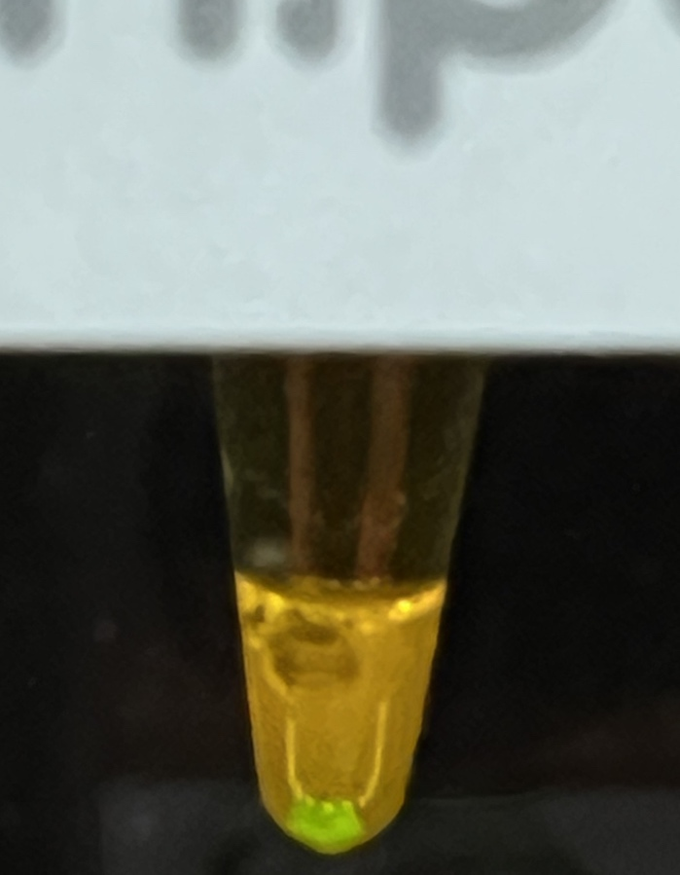
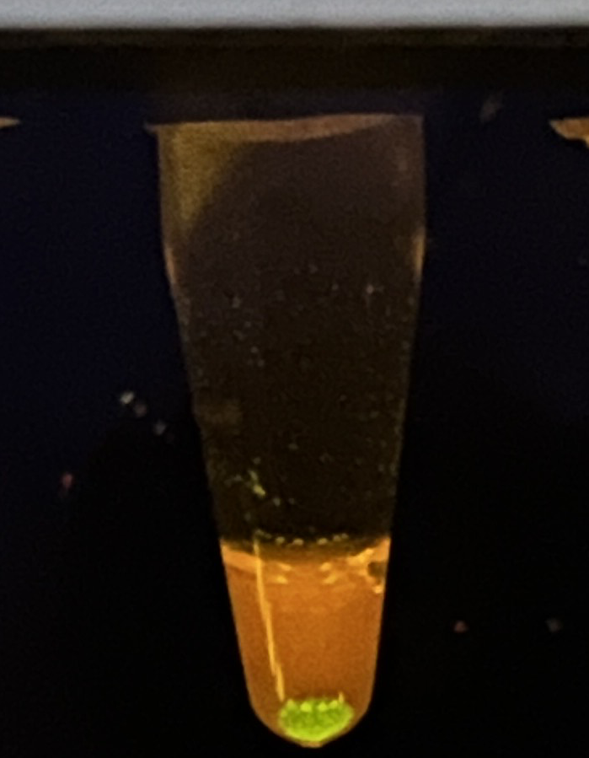
Expected results for part 2: protein purification
30 min binding
Overnight binding
Table 2: Initial separation during purification
 | Unbound fraction | Bound to beads
Color of fluorescence | Red (or orange) | Green

Slide 36
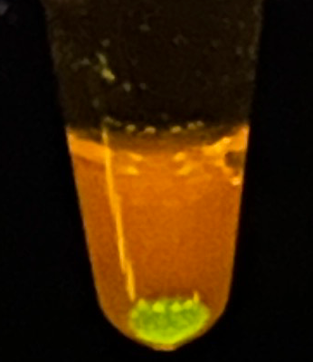

Expected results for part 2: protein purification
Unbound molecules including untagged RFP
STEP 1:
BIND
Tagged GFP bound to magnetic beads

Slide 37
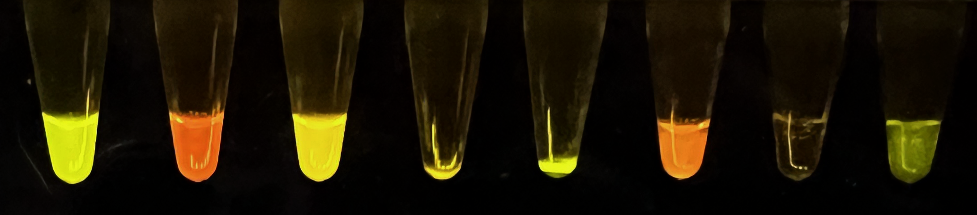
Expected results for part 2: protein purification
Reference samples
Tube 4 purification
1
2
3
4
(empty)
MB
U
W
E
Table 1: Final protein purification observations
 | Tube 3: GFP + RFP | Tube 4: GFP + RFP purification fractions
 | Unpurified reference | Beads Tube MB | Collection Tube U | Collection Tube W | Collection Tube E
Color of fluorescence | Yellow | Green | Red | Faint red | Green

Slide 38

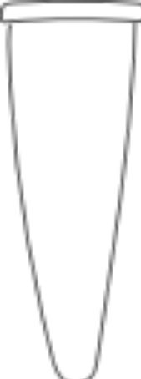




STEP 1:
BIND
Unbound molecules including untagged RFP
Tagged GFP bound to magnetic beads
Collection
tube U

Slide 39


STEP 1:
BIND
STEP 2:
WASH
Residual unbound molecules including untagged RFP
Tagged GFP bound to magnetic beads
Collection
tube U
Collection
tube W

Slide 40


STEP 1:
BIND
STEP 2:
WASH
STEP 3:
ELUTE
Tagged GFP released from magnetic beads
Collection
tube U
Collection
tube W
Collection
tube E

Slide 41
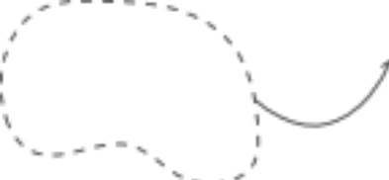

STEP 1:
BIND
STEP 1:
BIND

Slide 42

STEP 1:
BIND
STEP 2:
WASH
STEP 1:
BIND
STEP 2:
WASH

Slide 43


STEP 1:
BIND
STEP 2:
WASH
STEP 3:
ELUTE
STEP 1:
BIND
STEP 2:
WASH
STEP 3:
ELUTE

Slide 44
What have we learned and accomplished?
Scientists engineer and manufacture proteins for wide-ranging applications.
You have used the BioBits cell-free expression system to produce fluorescent proteins!
BioBits pellet
Protein
expression
Green fluorescent protein
GFP DNA

Slide 45
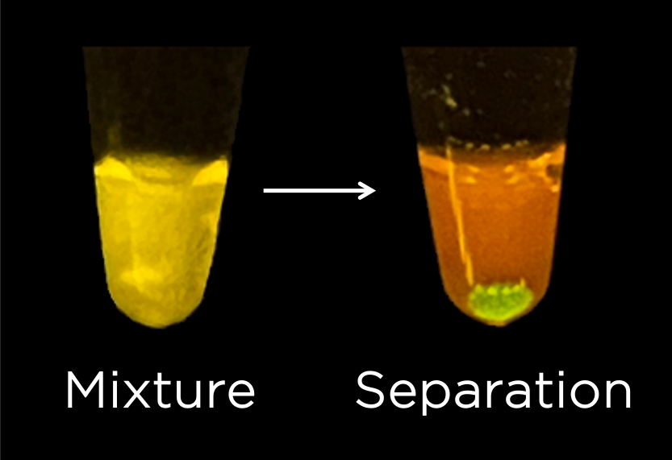
What have we learned and accomplished?
Once a protein of interest has been produced, it has to be isolated.
You have used magnetic bead based affinity purification to isolate tagged GFP!

