Slide 1

Mendel’s Peas
@miniPCR
fb.com/miniPCR
@miniPCR

Slide 2

Gregor Mendel
Many traits are inherited, meaning they are passed from parent to offspring.
In the 1800s, Gregor Mendel figured out basic patterns of inheritance by breeding pea plants and observing whether the offspring looked like either parent plant.

Slide 3
Gregor Mendel
Mendel concluded that pea plants receive something from each parent that defines the plant's appearance.
He did not know what this material was, but he symbolized it using capital and lowercase letters like A and a.

Slide 4

Overview of today’s lab
Your goal in today's lab is to connect Mendel’s A and a with our modern understanding of inheritance!

Slide 5
DNA and genes
Today, we know that all organisms inherit traits from their parents through DNA.
DNA contains instructions for the cell.

Slide 6
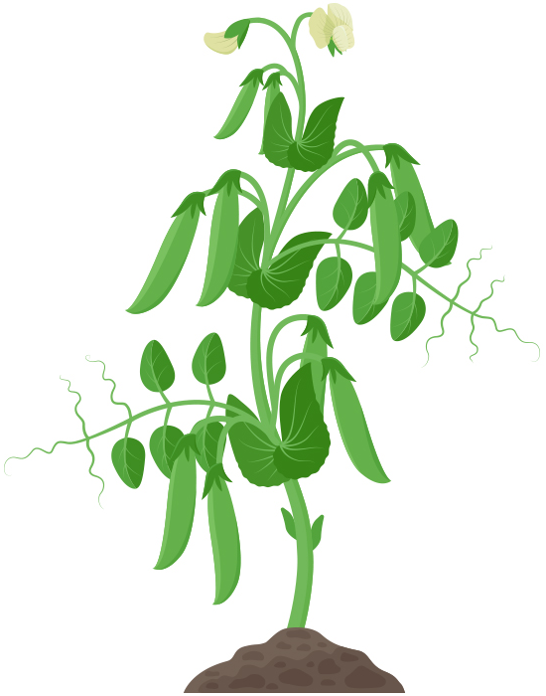

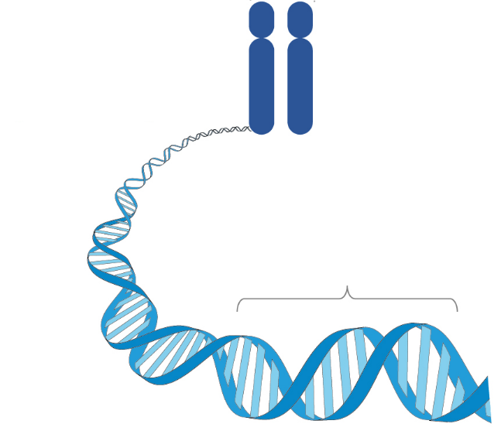
DNA and genes
Cell
DNA is found in structures called chromosomes.
The cells of many organisms, including humans and pea plants, have two copies of each chromosome, one inherited from each parent.
Chromosomes
Gene
DNA

Slide 7
DNA and genes
Cell
A gene is a section of DNA that contains a specific instruction for the cell.
The instructions in an organism's genes determine its inherited traits.
Pea plants have a gene that determines the shape of the pea. Peas can be round or wrinkled.
Chromosomes
Gene
DNA

Slide 8


Alleles
Each gene can come in different versions. We call different versions of the same gene alleles.
Alleles of the same gene carry different instructions.
Whether a pea is round or wrinkled depends on which alleles it inherited from its parents.
Round peas
Wrinkled peas

Slide 9
Mendelian inheritance: dominant vs. recessive
Today we know Mendel was tracking alleles in his experiments.
Mendel coined the terms dominant and recessive to describe how some traits skip a generation. Now we use the same language to describe the relationship between alleles of the some genes.
Round peas
(dominant trait)
AA or Aa
Wrinkled peas
(recessive trait)
aa

Slide 10
Mendelian inheritance: dominant vs. recessive
A single copy of a dominant allele of a gene will produce the corresponding dominant trait.
A recessive trait will only be present if both alleles of a gene are recessive.
Scientists often use Mendel’s abbreviations for alleles. A capital letter stands for the dominant allele and a lowercase letter for the recessive allele.
Round peas
(dominant trait)
AA or Aa
Wrinkled peas
(recessive trait)
aa

Slide 11


Punnett squares
Cross:
Aa
x
Aa
Mother’s
alleles
Father’s
alleles
Alleles are often shown in the context of a Punnett square, a diagram that shows the possible combinations of alleles in offspring that could be born to a pair of parents.
Like Mendel, Punnett squares use letters to represent alleles of a gene.
Alleles from ‘mother’ plant
A
a
A
AA
Aa
Alleles from
‘father’ plant
a
Aa
aa
1 AA : 2 Aa : 1 aa
3 round : 1 wrinkled

Slide 12
What gene was Mendel tracking?
We have known since Mendel’s experiments that having round peas is dominant…
But linking traits to actual DNA differences can be tricky.
In fact, scientists are still trying to figure out exactly which genes Mendel was studying!

Slide 13
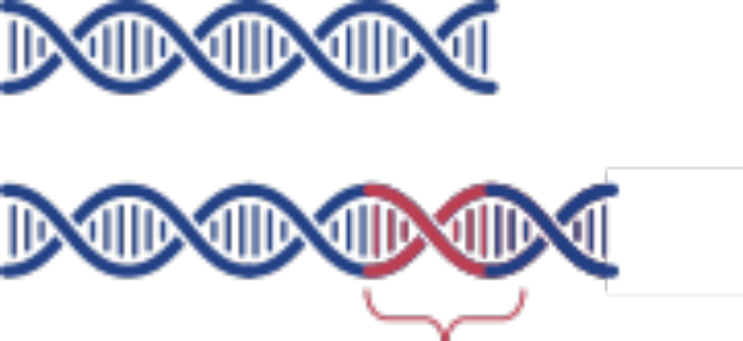
The SBE1 gene
You have discovered two alleles of a gene called SBE1 that controls pea shape.
The SBE1 alleles are the same, except one has extra DNA near the end of the gene.
We will refer to them as the short and long alleles.
Short
SBE1 allele
Long
SBE1 allele
Extra
DNA

Slide 14
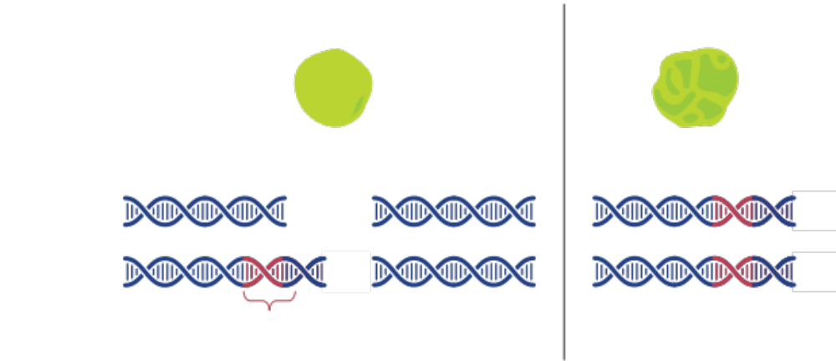
Your research has already shown the short allele is dominant
Round peas
Wrinkled peas
1 short allele,
1 long allele
2 short
SBE1 alleles
2 long
SBE1 alleles
Short SBE1 allele
Long SBE1 allele
Extra
DNA

Slide 15
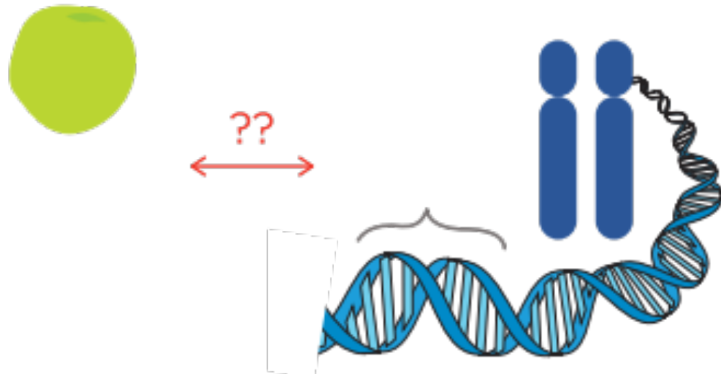
Was Mendel tracking the SBE1 gene?
You suspect that the short and long alleles of the SBE1 gene might be the A and a alleles that Mendel was tracking…
But without access to the actual peas Mendel was using in the 1800’s, there is no way to know for sure.
SBE1
gene
Mendel’s
Aa

Slide 16


Today’s lab
Historians have just discovered one of Mendel’s lost notebooks.
Included in Mendel’s notes are six dried peas!
You can now test your hypothesis that the short and long alleles of the SBE1 gene correspond to the A and a alleles the Mendel was tracking!
Pea 1: Aa
Pea 2: AA
Pea 3: aa

Slide 17
Today’s lab
You will:
Determine which SBE1 alleles are present in the peas from Mendel’s notebook.
Compare each pea’s SBE1 alleles with Mendel’s notes to see if the short and long SBE1 alleles match Mendel’s A and a.
Pea 1: Aa
Pea 2: AA
Pea 3: aa

Slide 18
DNA testing
DNA is removed from a pea
Pea
sample
DNA
Step 1:
DNA collection

Slide 19


DNA testing
SBE1 gene
PCR is used to copy just the SBE1 gene
Pea
sample
DNA
Portion of
SBE1 gene
Step 1:
DNA collection
Step 2:
PCR

Slide 20

DNA testing
SBE1 gene
Pea
sample
DNA
Portion of
SBE1 gene
Determine
SBE1 alleles
Step 1:
DNA collection
Step 2:
PCR
Step 3:
Gel electrophoresis
You complete this step

Slide 21
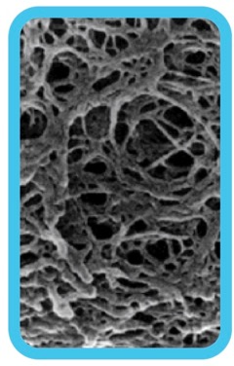
Gel electrophoresis separates DNA by size
- - - NEGATIVE - - -
Negative molecules like DNA move towards the positive charge
The agarose gel forms a web
+ + + POSITIVE + + +

Slide 22
Gel electrophoresis separates DNA by size
- - - NEGATIVE - - -
Larger molecules move have more trouble moving through the web and travel slower
Smaller molecules move more easily through the web and travel faster
+ + + POSITIVE + + +

Slide 23

Gel electrophoresis
Different sized
pieces of DNA
Gel electrophoresis separates DNA by size.
Samples are placed in pockets called wells.
Smaller pieces of DNA travel farther through the gel.
Wells
Longer
DNA pieces
Shorter
DNA pieces

Slide 24
Interpreting gel electrophoresis results
You will be using gel electrophoresis to determine which SBE1 alleles the peas from Mendel’s notebook have.
Remember, there is a short SBE1 allele and a long SBE1 allele.
Short
SBE1 allele
Long
SBE1 allele
Extra
DNA

Slide 25
Example gel
Pea A
Pea B
Pea C
Pea A only has one band. This tells us that all of the SBE1 DNA was the same size.
Because the DNA traveled farther, we know both chromosomes have the short SBE1 allele.
Long allele
Short allele
(traveled farther)

Slide 26
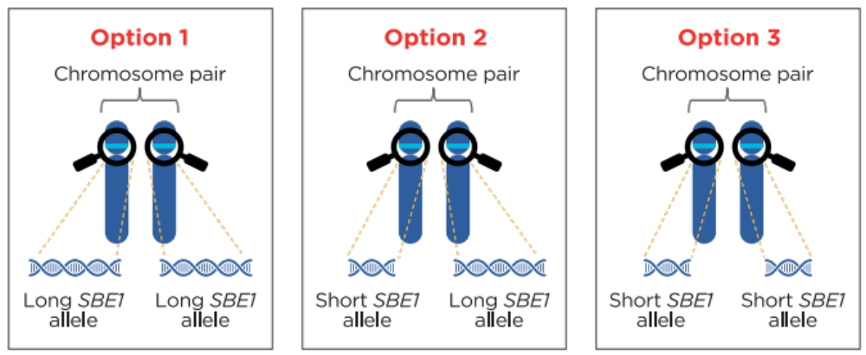
Example gel
Pea A
Pea B
Pea C
Long allele
Short allele
(traveled farther)
Short
SBE1 allele
Short
SBE1 allele

Slide 27
Example gel
Pea A
Pea B
Pea C
Pea B only has one band. This tells us that all of the SBE1 DNA was the same size.
Because the DNA traveled less far, we know both chromosomes have the long SBE1 allele.
Long allele
Short allele
(traveled farther)

Slide 28
Example gel
Pea A
Pea B
Pea C
Long allele
Short allele
(traveled farther)
Long
SBE1 allele
Long
SBE1 allele

Slide 29
Example gel
Pea A
Pea B
Pea C
Pea C has two bands. This tells us that the SBE1 DNA was two sizes.
Because Pea C has both bands, we know one chromosome has the short SBE1 allele and the other chromosome has the long SBE1 allele.
Long allele
Short allele
(traveled farther)

Slide 30
Example gel
Pea A
Pea B
Pea C
Long allele
Short allele
(traveled farther)
Short
SBE1 allele
Long
SBE1 allele

Slide 31
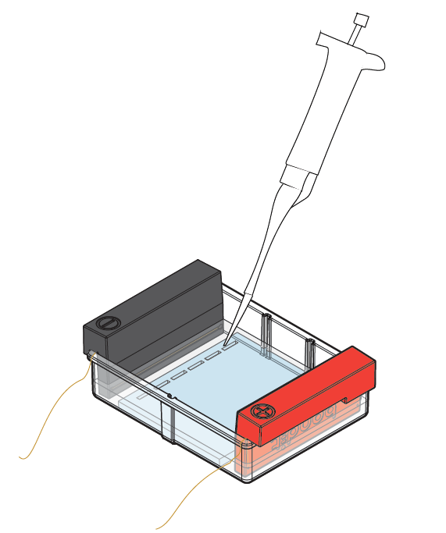
Loading your gel
Lane 1: 10 μl Pea 1 DNA
Lane 2: 10 μl Pea 2 DNA
Lane 3: 10 μl Pea 3 DNA
Lane 4: 10 μl Pea 4 DNA
Lane 5: 10 μl Pea 5 DNA
Lane 6: 10 μl Pea 6 DNA

Slide 32
Reminder of today’s goal
We know the some of the peas alleles from Mendel’s notes
Can we connect these alleles to the SBE1 gene?
Pea 1: Aa
Pea 2: AA
Pea 3: aa

Slide 33
Pre-lab study questions
1
2
3
4
5
6
Pea | Appearance | Mendel’s notes
1 | Round | Aa
2 | Round | AA
3 | Wrinkled | aa
Question 1:
On the gel above, draw what your gel would look like for Peas 1-3 if your experimental results support your hypothesis that the short and long SBE1 alleles were the A and a alleles Mendel was tracking.

Slide 34
Pre-lab study questions
Pea | Appearance | Mendel’s notes | Possible alleles
4 | Round | ??
5 | Round | ??
6 | Wrinkled | ??
Question 2:
You can’t read Mendel’s notes on the alleles for Peas 4-6, but you can make some predictions about which alleles they have based on what you know about the inheritance of pea shape. Abbreviate the alleles as A and a.

Slide 35
Pre-lab study questions
1
2
3
4
5
6
Pea | Appearance | Mendel’s notes | Possible alleles
4 | Round | ?? | AA or Aa
5 | Round | ?? | AA or Aa
6 | Wrinkled | ?? | aa
Question 3:
On the gel above, draw what your gel would look like for Peas 4-6 if your experimental results support your hypothesis that the short and long SBE1 alleles were the A and a alleles Mendel was tracking. Use a dashed line to draw alleles that you cannot predict with certainty based on the pea’s appearance.

Slide 36
Interpreting the results
Pea | Appearance | Mendel’s notes | SBE1 gel results
1 | Round | Aa | ??
2 | Round | AA | ??
3 | Wrinkled | aa | ??
4 | Round | (AA or Aa) | ??
5 | Round | (AA or Aa) | ??
6 | Wrinkled | (aa) | ??
You will compare the Mendel’s notes with your gel results to determine if the short and long allele of the SBE1 gene match with Mendel’s A and a

Slide 37
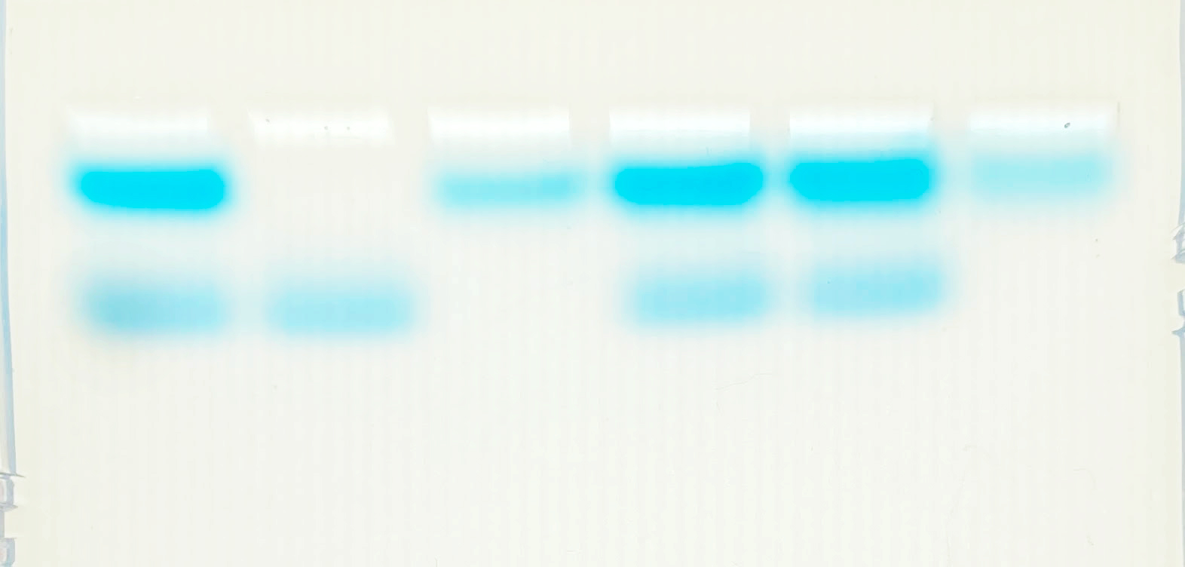
Expected results
1
2
3
4
5
6
Long allele
Short allele
(traveled farther)

Slide 38
Interpreting the results
Pea | Appearance | Mendel’s notes | SBE1 gel results
1 | Round | Aa | Long allele, short allele
2 | Round | AA | Short allele, short allele
3 | Wrinkled | aa | Long allele, long allele
4 | Round | (AA or Aa) | Long allele, short allele
5 | Round | (AA or Aa) | Long allele, short allele
6 | Wrinkled | (aa) | Long allele, long allele
Do the short and long SBE1 alleles correspond to Mendel’s A and a?

Slide 39
Interpreting the results
Pea | Appearance | Mendel’s notes | SBE1 gel results
1 | Round | Aa | Long allele, short allele
2 | Round | AA | Short allele, short allele
3 | Wrinkled | aa | Long allele, long allele
4 | Round | (AA or Aa) | Long allele, short allele
5 | Round | (AA or Aa) | Long allele, short allele
6 | Wrinkled | (aa) | Long allele, long allele
Assuming your hypothesis is correct, what would Mendel’s notes for Peas 4, 5, and 6 have read before the ink was smeared?

Slide 40
What have we learned?
What Mendel knew:
Round peas
AA or Aa
Wrinkled peas
aa
What we know now:
The “short” SBE1 allele is the “A” allele Mendel was tracking
The “long” SBE1 allele is the “a” allele Mendel was tracking
You have linked allele symbols used by Mendel and in Punnett squares with our modern understanding of DNA and inheritance!

