Slide 1
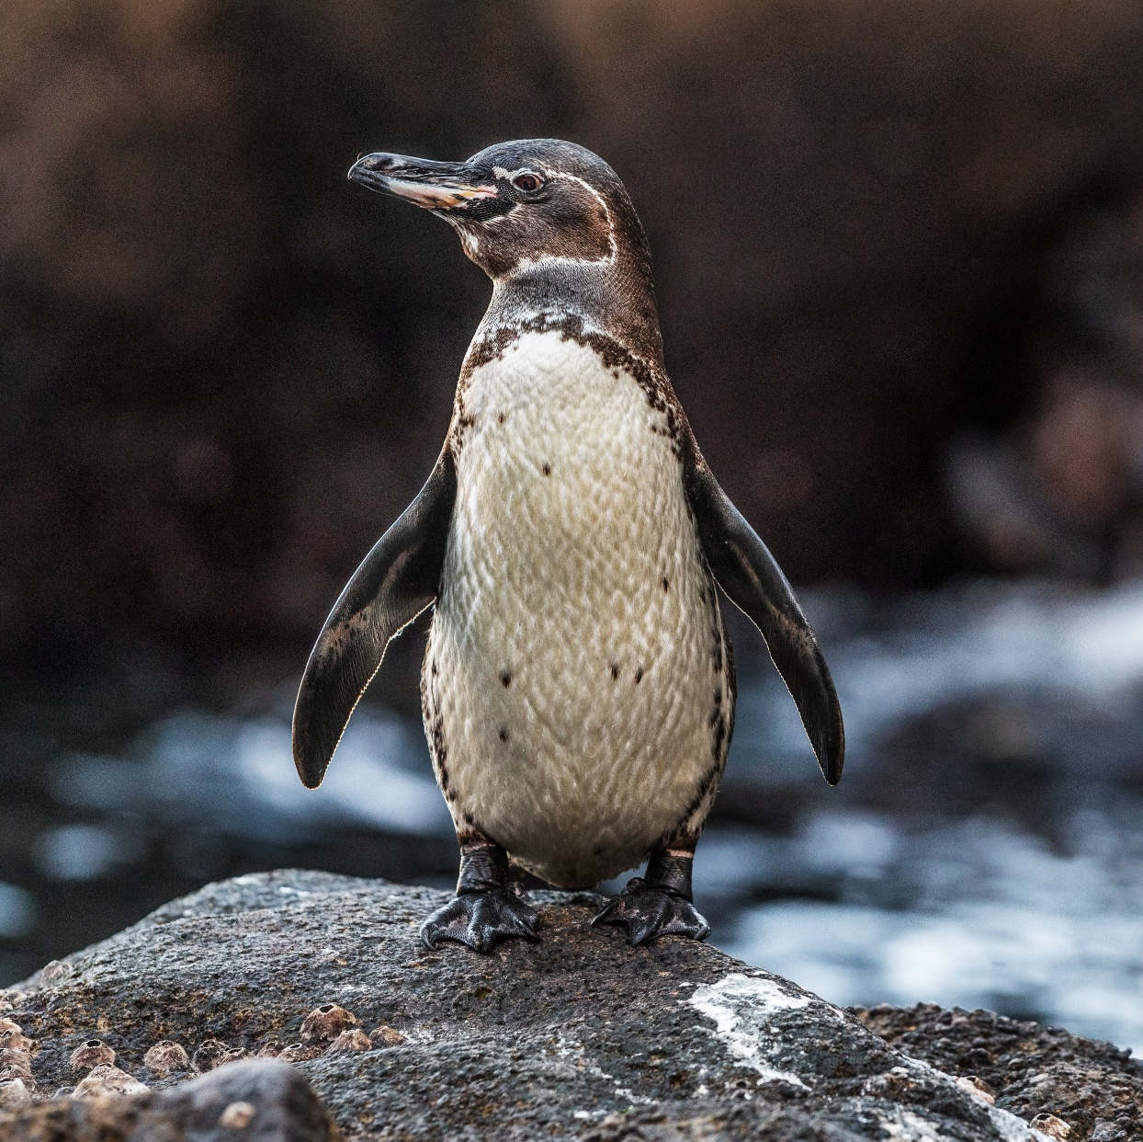
Galápagos Penguin Lab:
Biodiversity at Risk

Slide 2

Overview
Galápagos penguins have undergone population bottlenecks and are classified as Endangered.
You will use DNA testing to determine whether the Galápagos penguin population has low genetic diversity, which could put them at higher risk of extinction.

Slide 3
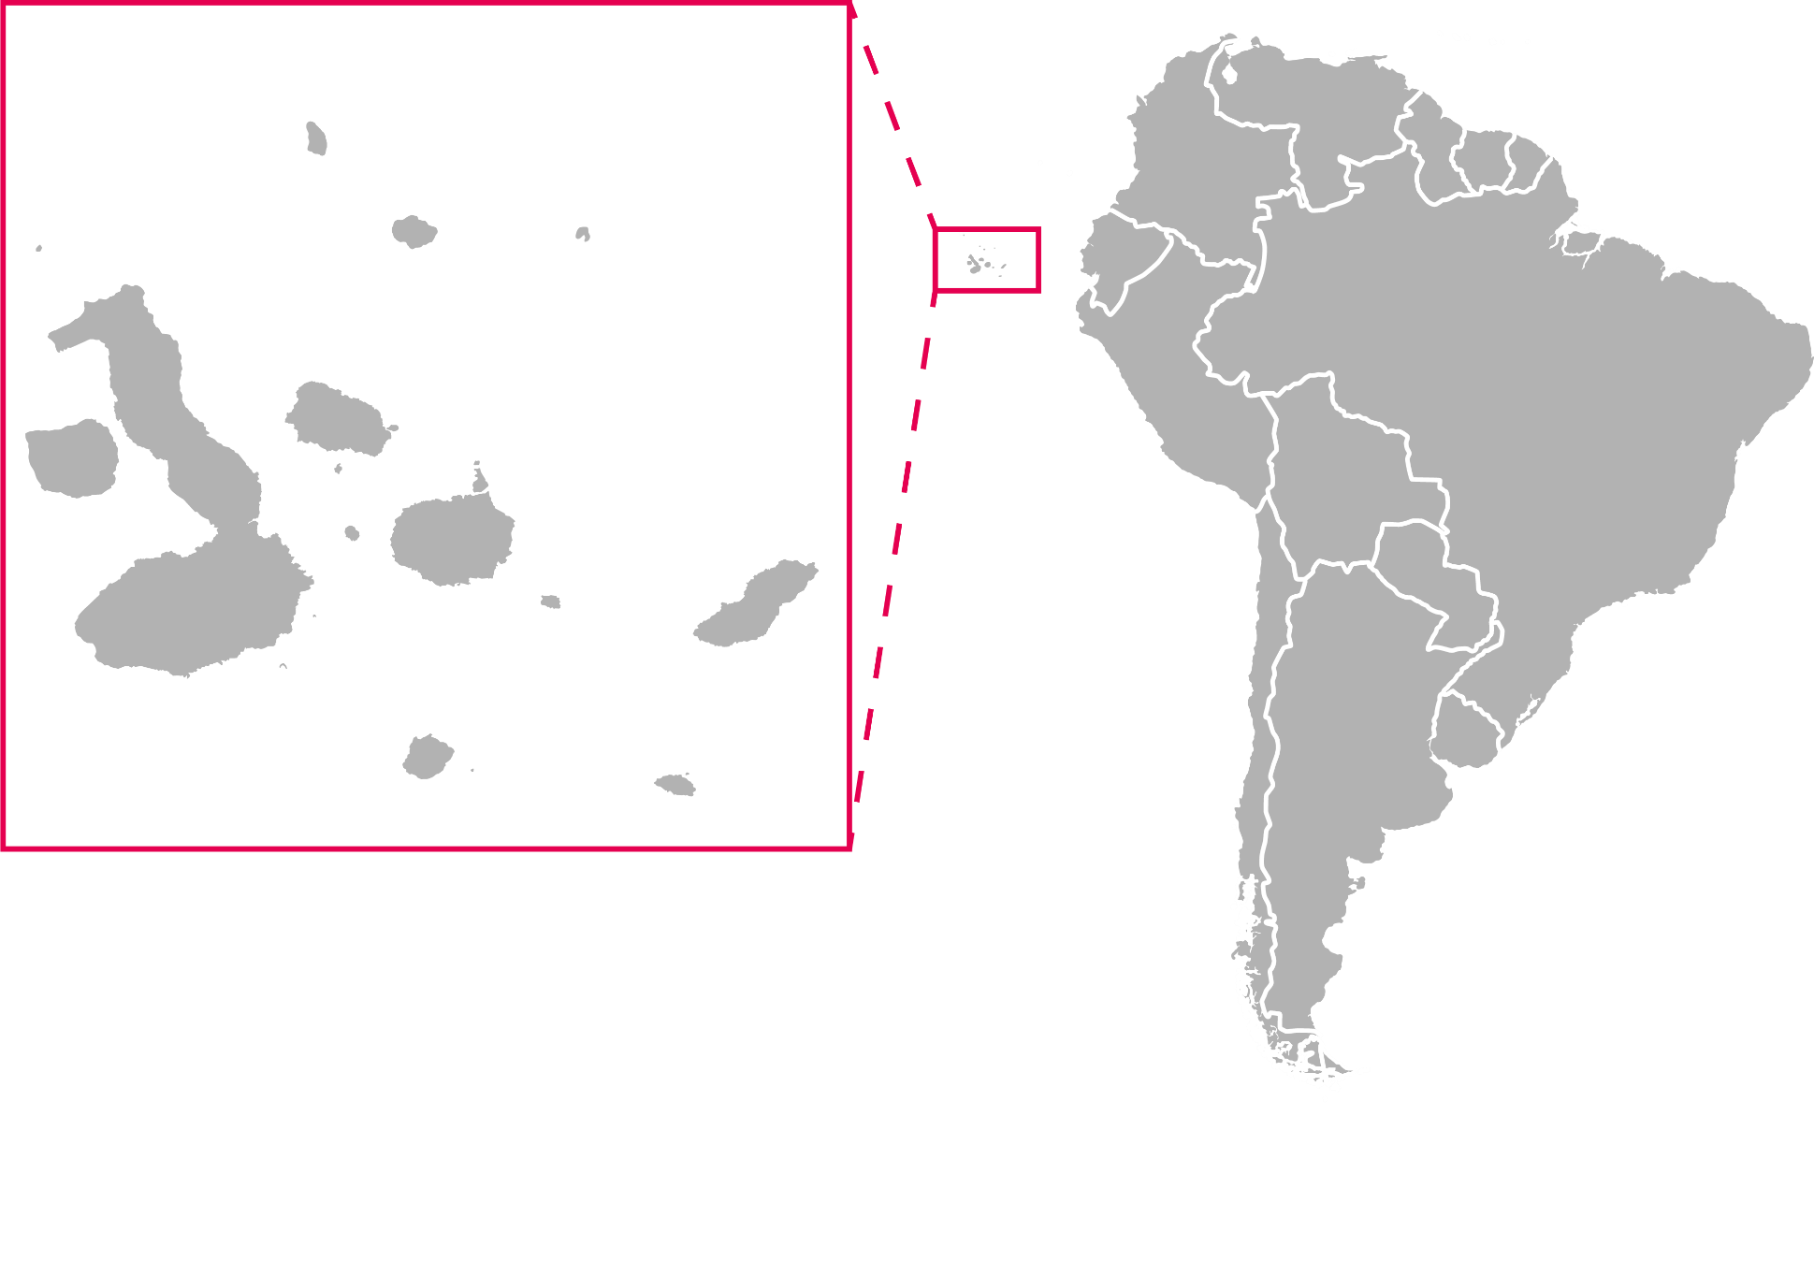
The Galápagos Islands
The Galápagos Islands are an archipelago ~600 miles off the coast of mainland Ecuador.
Many species in the Galápagos Islands are endemic, meaning they are found nowhere else on Earth.
This includes the Galápagos penguin.
South America
Galápagos Islands

Slide 4
Meet the Galápagos penguin
Galápagos penguins are small, standing around 1.5 feet tall.
They feed primarily on small fish and nest in cool caves and crevices.
They are currently listed as Endangered on the IUCN Red List.

Slide 5
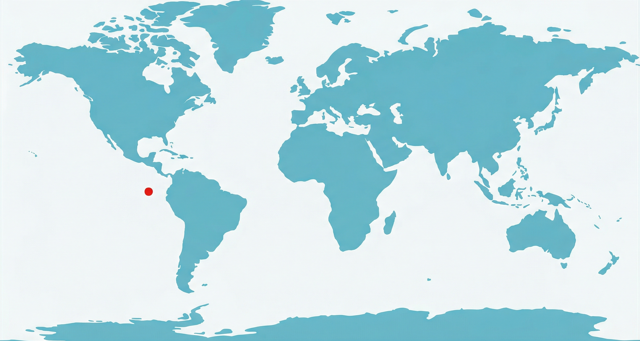
El Niño-Southern Oscillation and the Galápagos
The Galápagos food web depends on the upwelling of nutrient-rich cold water from the south.
This upwelling is affected by climate patterns known as El Niño-Southern Oscillation (ENSO).
Equator
Galápagos Islands

Slide 6
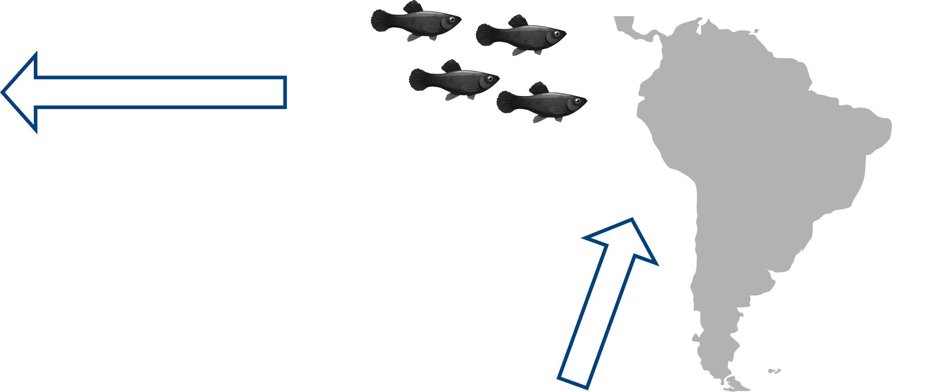
El Niño-Southern Oscillation and the Galápagos
Normal pattern
Under the normal pattern:
Winds carry warm surface waters from the Galápagos westward.
Cold, nutrient-rich water upwells from the south and reaches the Galápagos.
These nutrients support a large fish population.
(3)
(1)
(2)

Slide 7
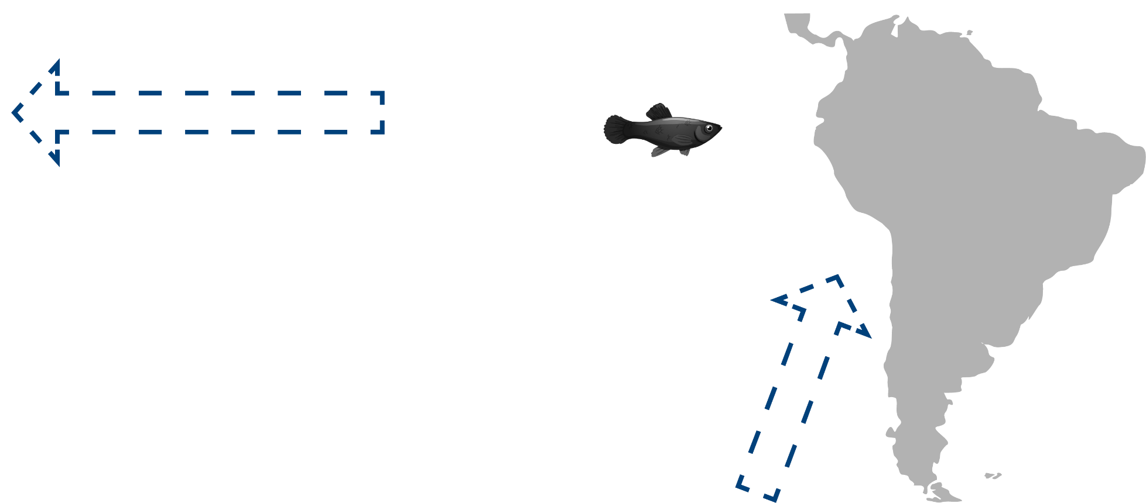
El Niño-Southern Oscillation and the Galápagos
El Niño pattern
During El Niño phases:
The east-to-west equatorial winds are weaker.
There is reduced upwelling of cold, nutrient-rich water reaching the Galápagos.
The reduction in nutrients impacts the food web and fish populations decline.
(3)
(1)
(2)

Slide 8
El Niño impacts on Galápagos penguins
When fish populations decline, the survival and reproduction of Galápagos penguins is negatively affected.
It is well established that Galápagos penguin populations decline during El Niño phases.

Slide 9
Population bottlenecks can reduce genetic diversity
Following El Niño phases, Galápagos penguins have undergone repeated bottlenecks, sudden and dramatic reductions in population size.
Let’s examine how a population bottleneck can alter a population’s genetic makeup.

Slide 10
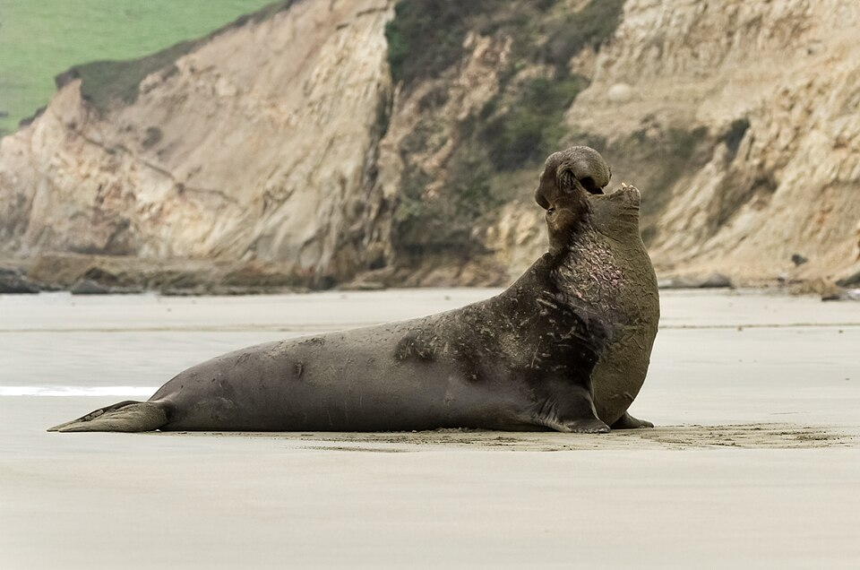
Population bottlenecks can reduce genetic diversity
We will use the northern elephant seal as an example.
In the 1800s, overhunting caused a sharp decline in the population, with as few as 20 individuals remaining.
Photo credit: Frank Schulenburg

Slide 11
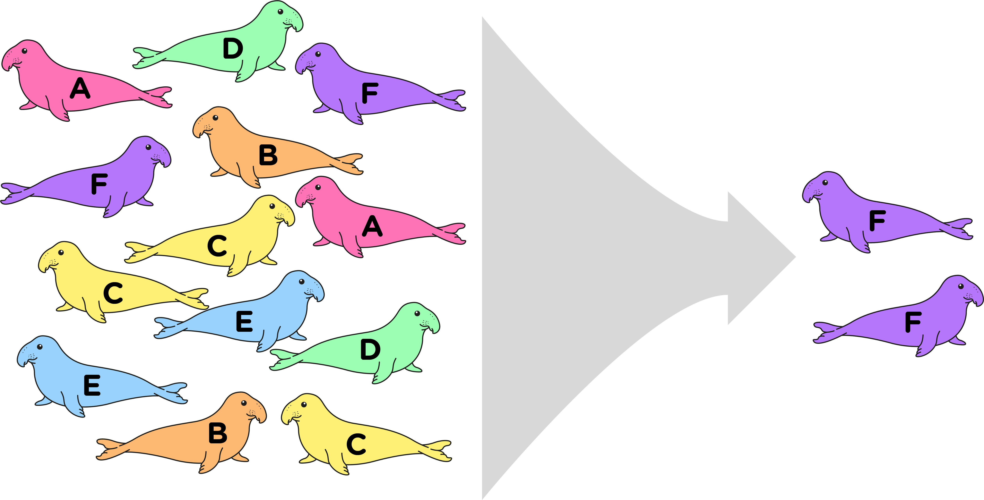
Population bottlenecks can reduce genetic diversity
Here, colors and letters represent genetic diversity.
Initially, the population had higher genetic diversity.
After the bottleneck, the remaining population had low genetic diversity.
Bottleneck
Higher genetic diversity
Low genetic diversity

Slide 12
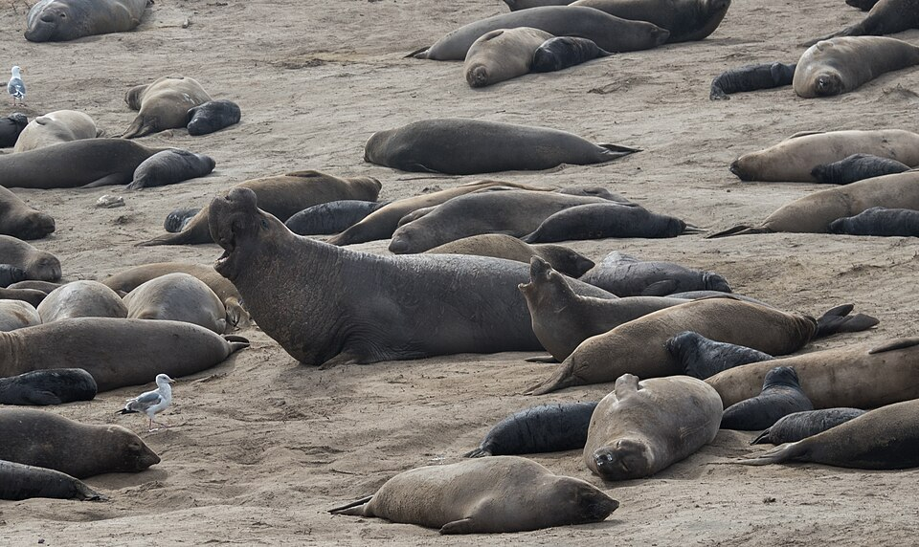
Genetic diversity increases population resilience
In general, a more genetically diverse population is a more adaptable population.
Genetic diversity increases variation in heritable traits.
In diverse populations it is more likely that some individuals will survive disturbances.
Photo credit: Rhododendrites

Slide 13

Today’s lab
You work on a research team that monitors Galápagos penguins.
Because Galápagos penguins have experienced repeated population bottlenecks, there is concern that they may have low genetic diversity, increasing their risk of extinction.

Slide 14
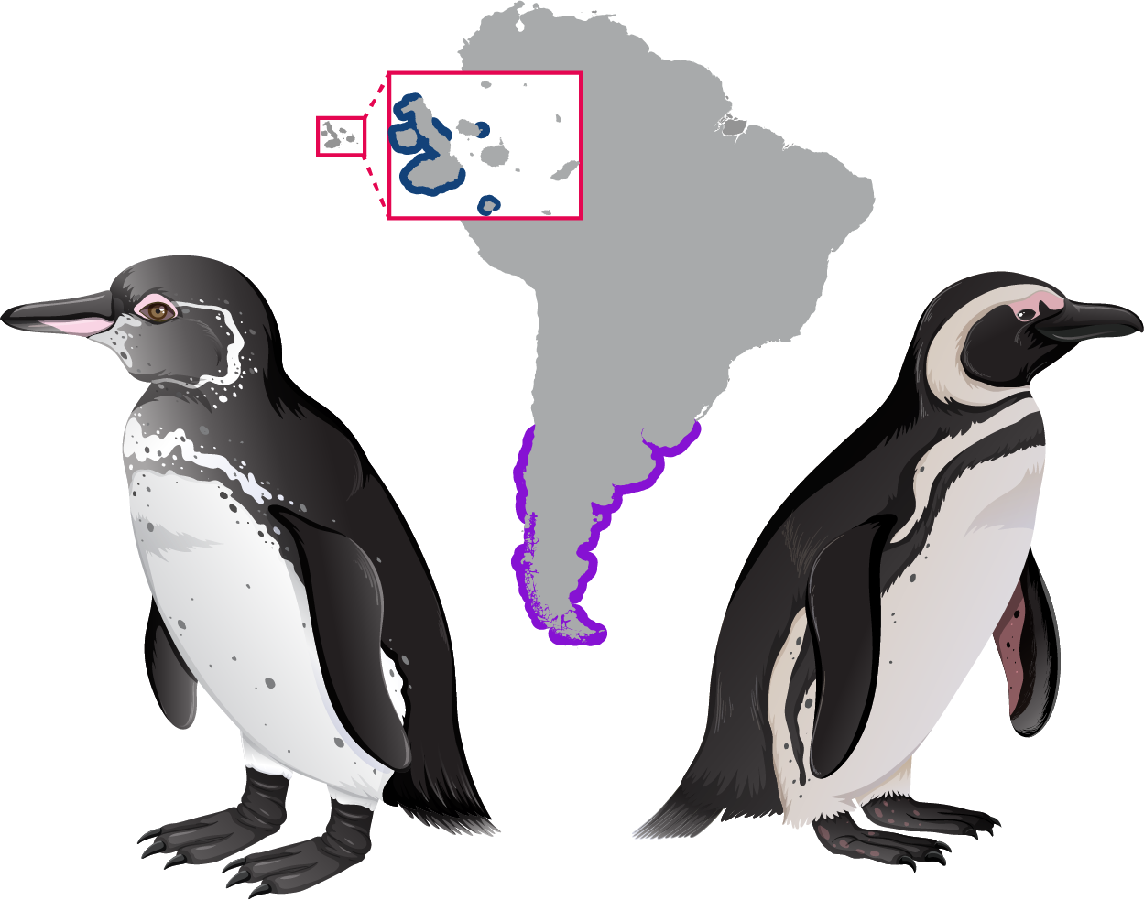
Today’s lab
Galápagos Islands
You will compare the genetic diversity of Galápagos penguins to the closely related Magellanic penguins.
Magellanic penguins have a broad range, are less affected by ENSO, and have not experienced a bottleneck.
There are more than one million breeding pairs of Magellanic penguins today.
Galápagos penguin
Magellanic penguin

Slide 15
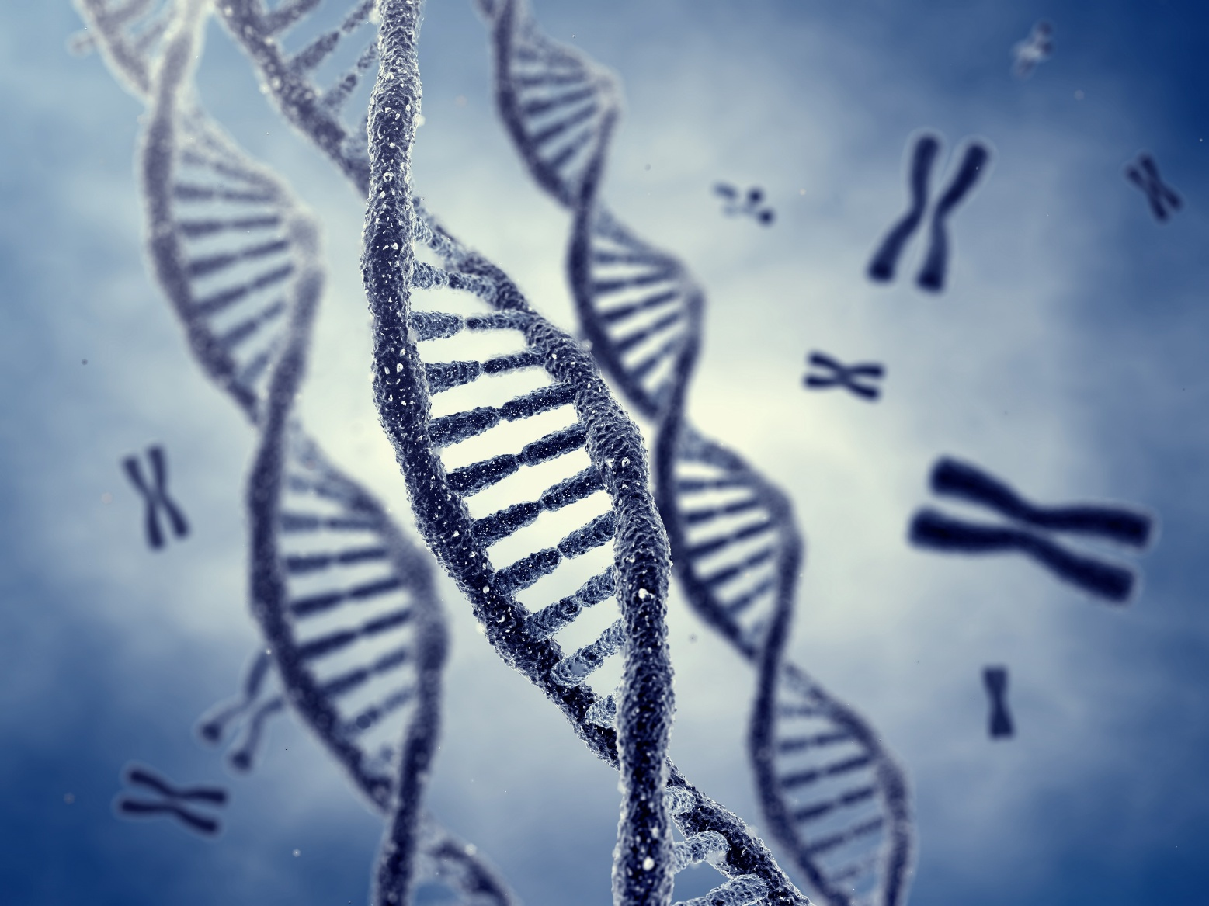
Measuring genetic diversity
To measure genetic diversity, scientists examine regions of DNA known to vary among individuals.
Alleles are different versions of the same place in the genome.
A population that has many different alleles has greater genetic diversity.

Slide 16
Your goal
You will determine the number of alleles in penguin populations at a location in the genome commonly used to assess genetic diversity in penguins.
Comparing the two penguin populations will allow you to assess whether the Galápagos penguin has low genetic diversity.

Slide 17
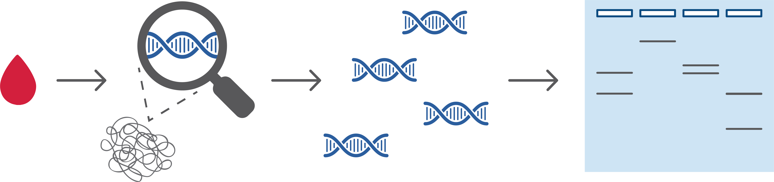
DNA testing
DNA is collected from penguin blood samples. Only a tiny amount of blood is needed.
Blood
sample
DNA
DNA
collection

Slide 18
DNA testing
PCR is used to make billions of copies of the location in the genome we are examining.
Blood
sample
DNA
Copies of DNA region of interest
DNA
collection
Polymerase chain reaction

Slide 19
DNA testing
You will complete the last step to determine the number of alleles in the samples!
Blood
sample
DNA
Copies of DNA region of interest
Visualize and interpret results!
DNA
collection
Polymerase chain reaction
Gel electrophoresis
Already done
You complete this step

Slide 20
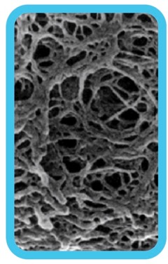
Gel electrophoresis separates DNA by size
- - - NEGATIVE - - -
Negative molecules like DNA move towards the positive charge
The agarose gel forms a web
+ + + POSITIVE + + +

Slide 21
Gel electrophoresis separates DNA by size
- - - NEGATIVE - - -
Larger molecules have more trouble moving through the web and travel slower
Smaller molecules move more easily through the web and travel faster
+ + + POSITIVE + + +

Slide 22

Gel electrophoresis
DNA pieces of different sizes
Gel electrophoresis separates DNA by size.
Samples are placed in pockets called wells.
Smaller pieces of DNA travel farther through the gel.
Wells

Slide 23
Gel electrophoresis
Gel electrophoresis separates DNA by size.
Samples are placed in pockets called wells.
Smaller pieces of DNA travel farther through the gel.
Longer
DNA pieces
Shorter
DNA pieces

Slide 24
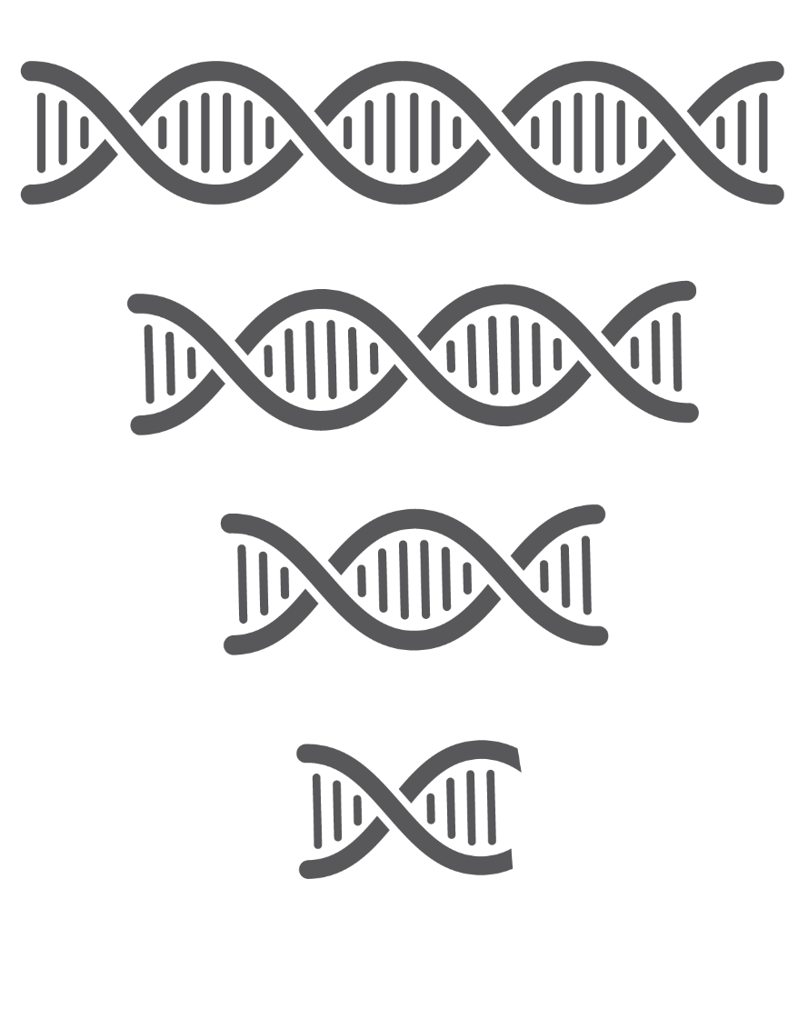
How to interpret the results
The penguin alleles we will analyze in this lab differ in size.
This means we can use gel electrophoresis to determine how many unique alleles are in different penguin populations.
Let’s walk through an example.

Slide 25
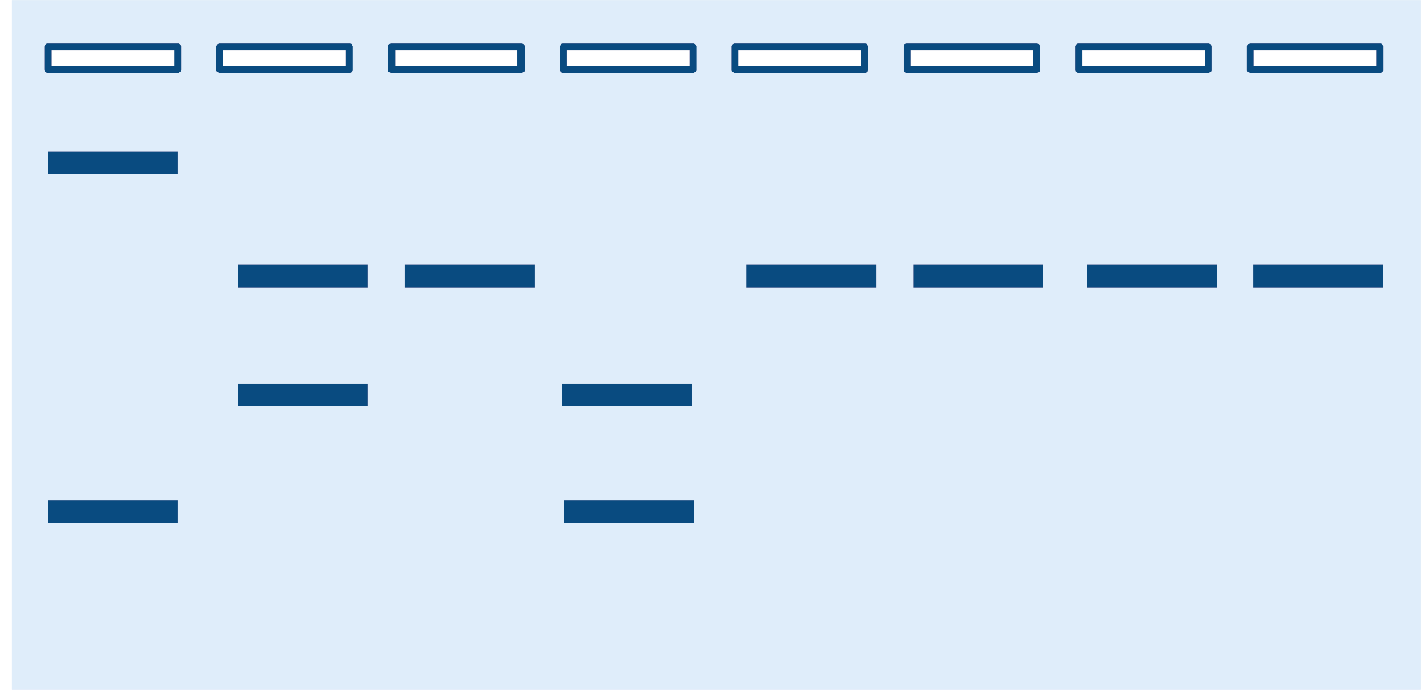
How to interpret the results
Population I
Population II
We will compare two penguin populations.
Four individual penguins were tested in each population.
Theses individual penguins are labeled as A through H.
Penguins:
A
B
C
D
E
F
G
H

Slide 26


How to interpret the results
Population I
Population II
After running the gel, penguin A has two bands.
Each band represents a different allele.
Penguin A inherited a different allele from each parent.
Penguins:
A
B
C
D
E
F
G
H

Slide 27
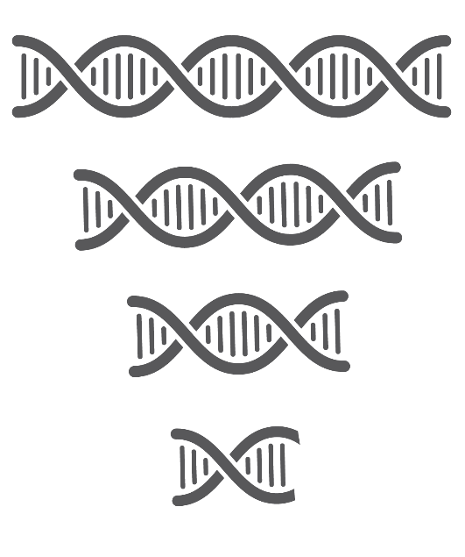
How to interpret the results
Population I
Population II
Penguin B also has two bands representing two alleles.
Penguin A and Penguin B do not have any of the same bands.
Therefore, Penguin A and B do not share any alleles.
Penguins:
A
B
C
D
E
F
G
H

Slide 28
How to interpret the results
Population I
Population II
For easy reference, we will label the alleles 1 through 4.
Allele 1 is the longest fragment at the top of the gel.
Allele 4 is the shortest fragment at the bottom.
Penguins:
A
B
C
D
E
F
G
H
Allele I
Allele 2
Allele 3
Allele 4

Slide 29
How to interpret the results
Population I
Population II
Penguin C only has one band, indicating it inherited the same allele from each parent.
Penguin C carries two copies of Allele 2.
Penguins:
A
B
C
D
E
F
G
H
Allele I
Allele 2
Allele 3
Allele 4

Slide 30
How to interpret the results
Population I
Population II
Penguin D has two bands.
The penguins from Population I show four unique alleles for the location being examined.
Penguins:
A
B
C
D
E
F
G
H
Allele I
Allele 2
Allele 3
Allele 4

Slide 31
How to interpret the results
Population I
Population II
All the penguins from Population II share a single allele (Allele 2).
This suggests Population II has low genetic diversity.
Penguins:
A
B
C
D
E
F
G
H
Allele I
Allele 2
Allele 3
Allele 4

Slide 32
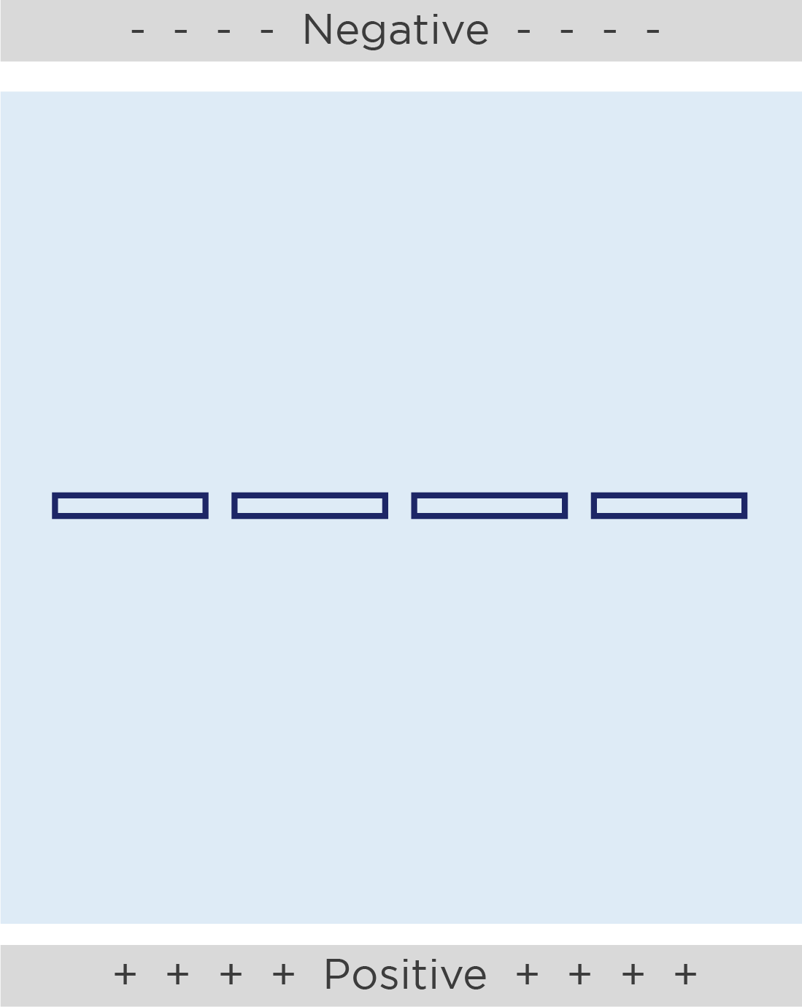

Gel loading tips
Gels have pockets called wells where we will add our samples.
The wells are a small target, so put your elbows on the table and hold the pipette with two hands.
Cross section of well

Slide 33
Gel loading tips
Pipette tip
Top of well
Place the micropipette tip just inside the opening of the well. Wiggle the tip back and forth to feel that the tip is in the well.
Do not stab your tip into the bottom of the well. The tip will either clog with gel or puncture the bottom of the well.
Too deep!

Slide 34
Load the gel
Galápagos penguins
Magellanic penguins
G1
G2
G3
G4
M1
M2
M3
M4
Well 1: 10 μl Tube G1
Well 2: 10 μl Tube G2
Well 3: 10 μl Tube G3
Well 4: 10 μl Tube G4
Well 5: 10 μl Tube M1
Well 6: 10 μl Tube M2
Well 7: 10 μl Tube M3
Well 8: 10 μl Tube M4

Slide 35
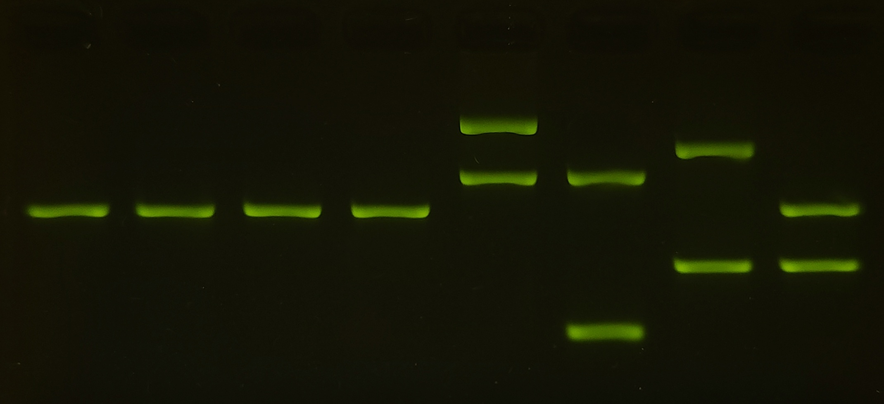
Expected results
Galápagos penguins
Magellanic penguins
G1
G2
G3
G4
M1
M2
M3
M4

Slide 36
Expected results
Galápagos penguins
Magellanic penguins
G1
G2
G3
G4
M1
M2
M3
M4
Here the bands have been arbitrarily numbered to make them easier to refer to.
1
2
3
3
4
4
4
4
4
5
5
6
 | Galápagos penguins | Magellanic penguins
# unique alleles
Relative diversity

Slide 37
Expected results
Galápagos penguins
Magellanic penguins
G1
G2
G3
G4
M1
M2
M3
M4
Here the bands have been arbitrarily numbered to make them easier to refer to.
1
2
3
3
4
4
4
4
4
5
5
6
 | Galápagos penguins | Magellanic penguins
# unique alleles | 1 | 6
Relative diversity | Low | Higher

Slide 38
What have we learned?
Galápagos penguins have undergone multiple population bottlenecks due to El Niño events.
Galápagos penguins have low genetic diversity compared to Magellanic penguins.
DNA analysis can help us understand the impacts of global climate patterns on local biodiversity.

Slide 39
Extension activity:
The Galápagos food web and the effects of El-Niño Southern Oscillation

Slide 40
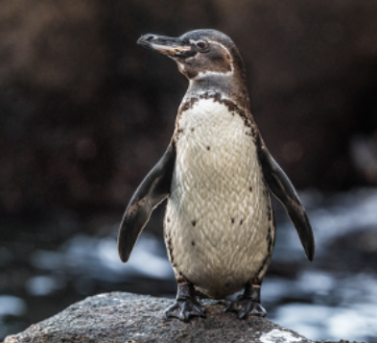
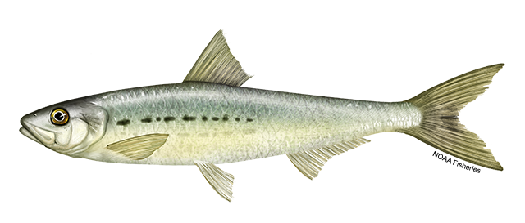
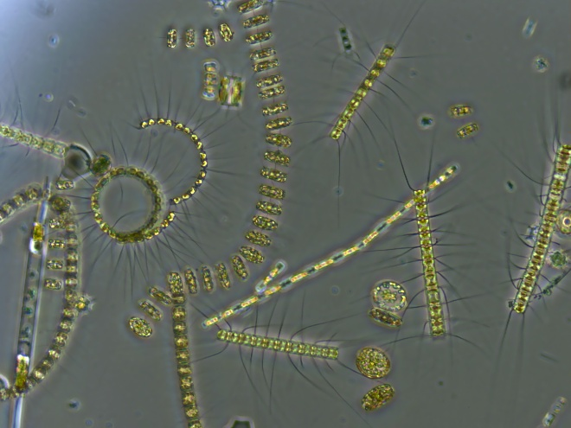
The marine food web in the Galápagos
Food chains show “what is eating what” in an ecological community.
They depict the linear relationships in energy transfer when one organism eats another.
Galápagos penguin
Pacific sardine
Phytoplankton

Slide 41
The marine food web in the Galápagos
Here is a simple food chain from the Galápagos marine ecosystem.
In this food chain, sardines eat phytoplankton and penguins eat sardines.
The arrows show the flow of energy from the bottom to the top of the food chain.
Galápagos penguin
Pacific sardine
Phytoplankton

Slide 42
The marine food web in the Galápagos
Trophic levels refer to an organism’s place in the food chain.
Producers are at the lowest trophic level and harvest energy from the sun.
In this food chain, phytoplankton are producers.
Galápagos penguin
Pacific sardine
Producer:
Phytoplankton

Slide 43
The marine food web in the Galápagos
Consumer:
Consumers occupy the other trophic levels and eat other organisms.
In this food chain, penguins and sardines are both consumers.
Galápagos penguin
Consumer:
Pacific sardine
Producer:
Phytoplankton

Slide 44
The marine food web in the Galápagos
Predator:
Consumers are sometimes also called predators.
The organisms eaten by predators are called prey.
In this food chain:
  Penguins are predators.
  Sardines are predators of phytoplankton and prey for penguins.
Galápagos penguin
Predator/prey:
Pacific sardine
Producer:
Phytoplankton

Slide 45
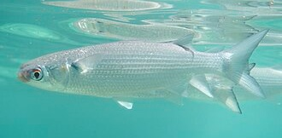
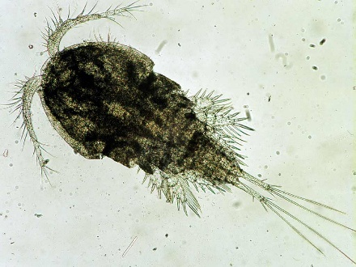

The marine food web in the Galápagos
Food webs contain many interconnected food chains.
They depict how energy flows based on the complex feeding relationships between organisms in an ecosystem.
Here is a slightly expanded food web.
Galápagos penguin
Thoburn’s mullet
Pacific sardine
Zooplankton
Phytoplankton

Slide 46
The marine food web in the Galápagos
Answer question 3 from the lab guide. Expand this web even further using these additional feeding relationships:
Orcas eat sharks and sea lions
Sea lions eat grouper and creolefish
Grouper eat lobster and creolefish
Creolefish eat zooplankton
Mullet also eat algae
Lobsters eat sea urchins
Sea urchins eat algae
Sharks eat sea lions and grouper

Slide 47
Effects of El Niño on the Galápagos food web
El Niño pattern
Recall that during El Niño:
Weaker winds reduce the
upwelling of cold, nutrient-rich water, which
reduces fish populations.
Producers, like algae and phytoplankton, also depend on this nutrient upwelling to grow.
(3)
(1)
(2)

Slide 48
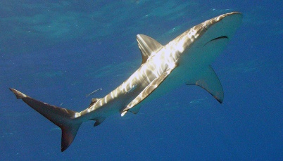
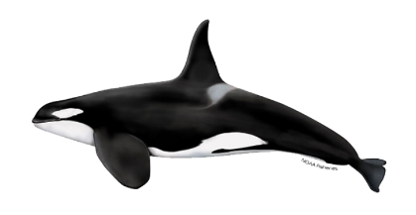
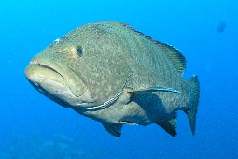
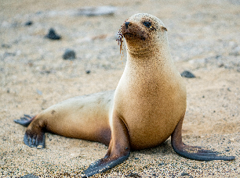
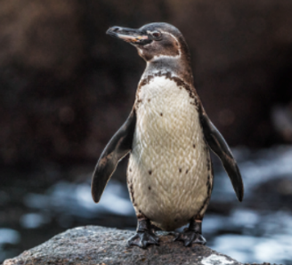
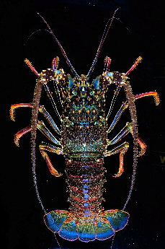
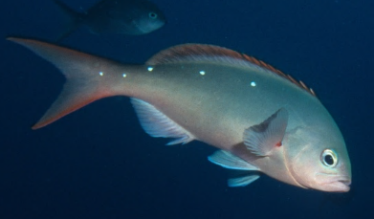
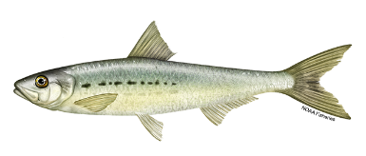

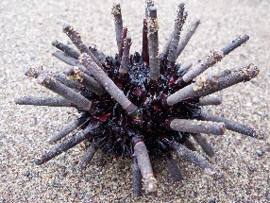
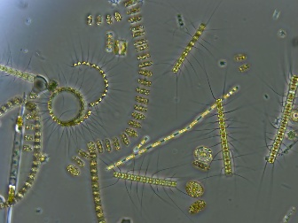
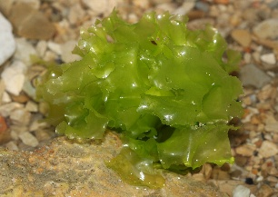
Effects of El Niño on the Galápagos food web
When producers decrease in the Galápagos during El Niño, there are cascading consequences to the entire marine food web.
Every consumer in the upper trophic levels depends on the abundance of producers at the bottom trophic level.

Slide 49
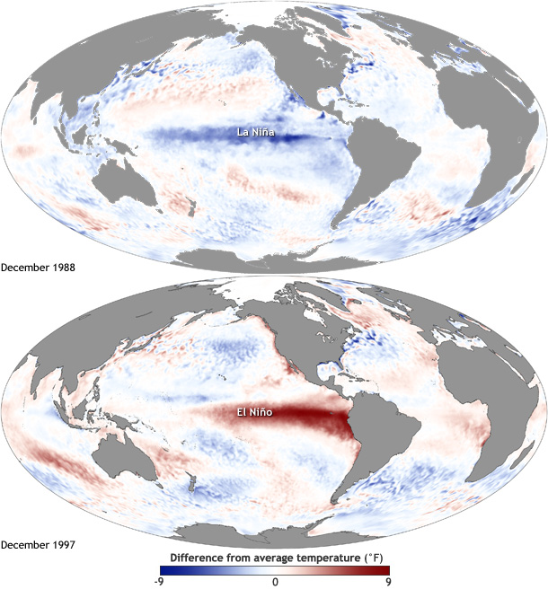
El Niño and La Niña are opposite ENSO patterns
El Niño can clearly have enormous impacts on the Galápagos marine food web.
But there is an opposite phenomenon called La Niña, which is the cool phase of the ENSO climate cycle.
Image credit: NOAA

Slide 50
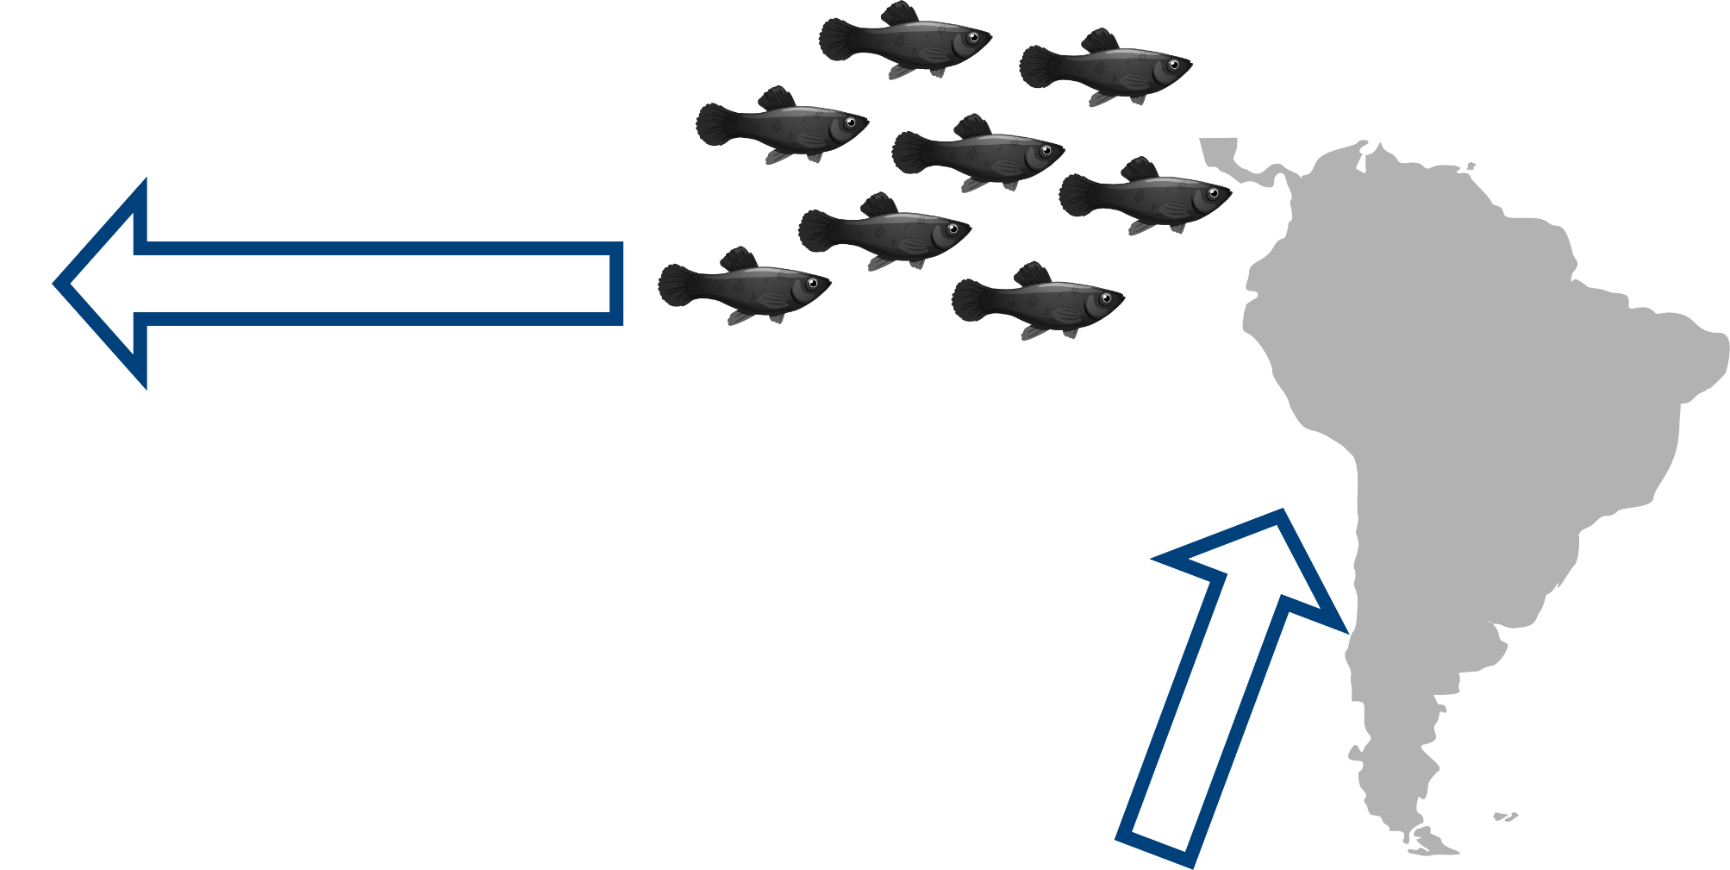
Effects of La Niña on the Galápagos food web
(3)
During La Niña phases:
The east-to-west equatorial winds are stronger.
Upwelling of cold, nutrient-rich water reaching the Galápagos increases.
This increase in nutrients supports an even bigger fish population.
(1)
(2)

Slide 51
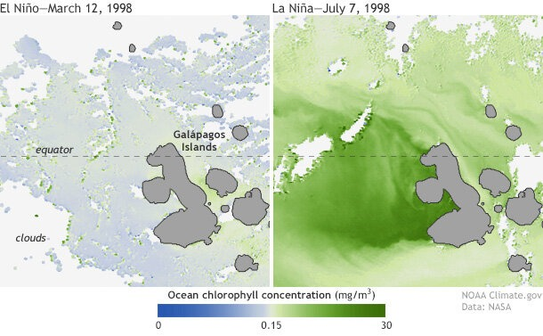
Effects of ENSO on the Galápagos food web
This increase in nutrients also increases producers.
La Niña therefore provides an opportunity for the marine food web to recover.
Oceans naturally oscillate between El Niño and La Niña every few years, producing good and bad years for the Galápagos food web.
Image credit: NOAA

Slide 52
Effects of ENSO on Galápagos penguins
Let’s go back to the Galápagos penguin and look at some real data during El Niño and La Niña phases.
Scientists working in the Galápagos collect information about yearly sea temperature.
They also conduct annual surveys to count the population.

Slide 53
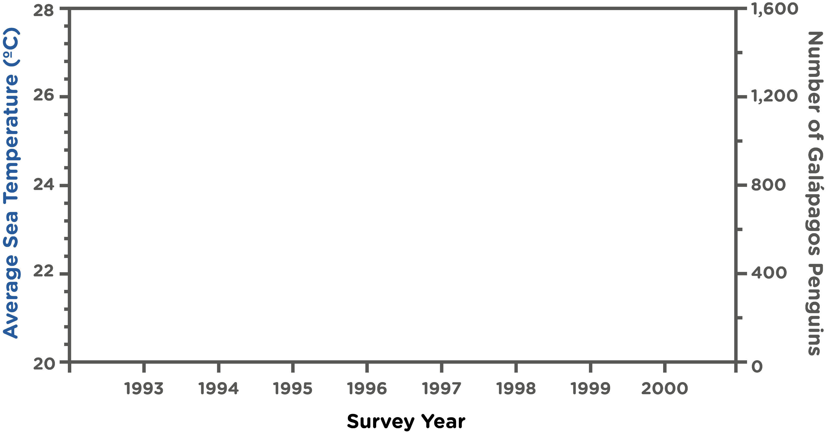
Data analysis of Galápagos sea temperatures and penguin populations between 1993-2000
We will analyze these data on a single graph

Slide 54
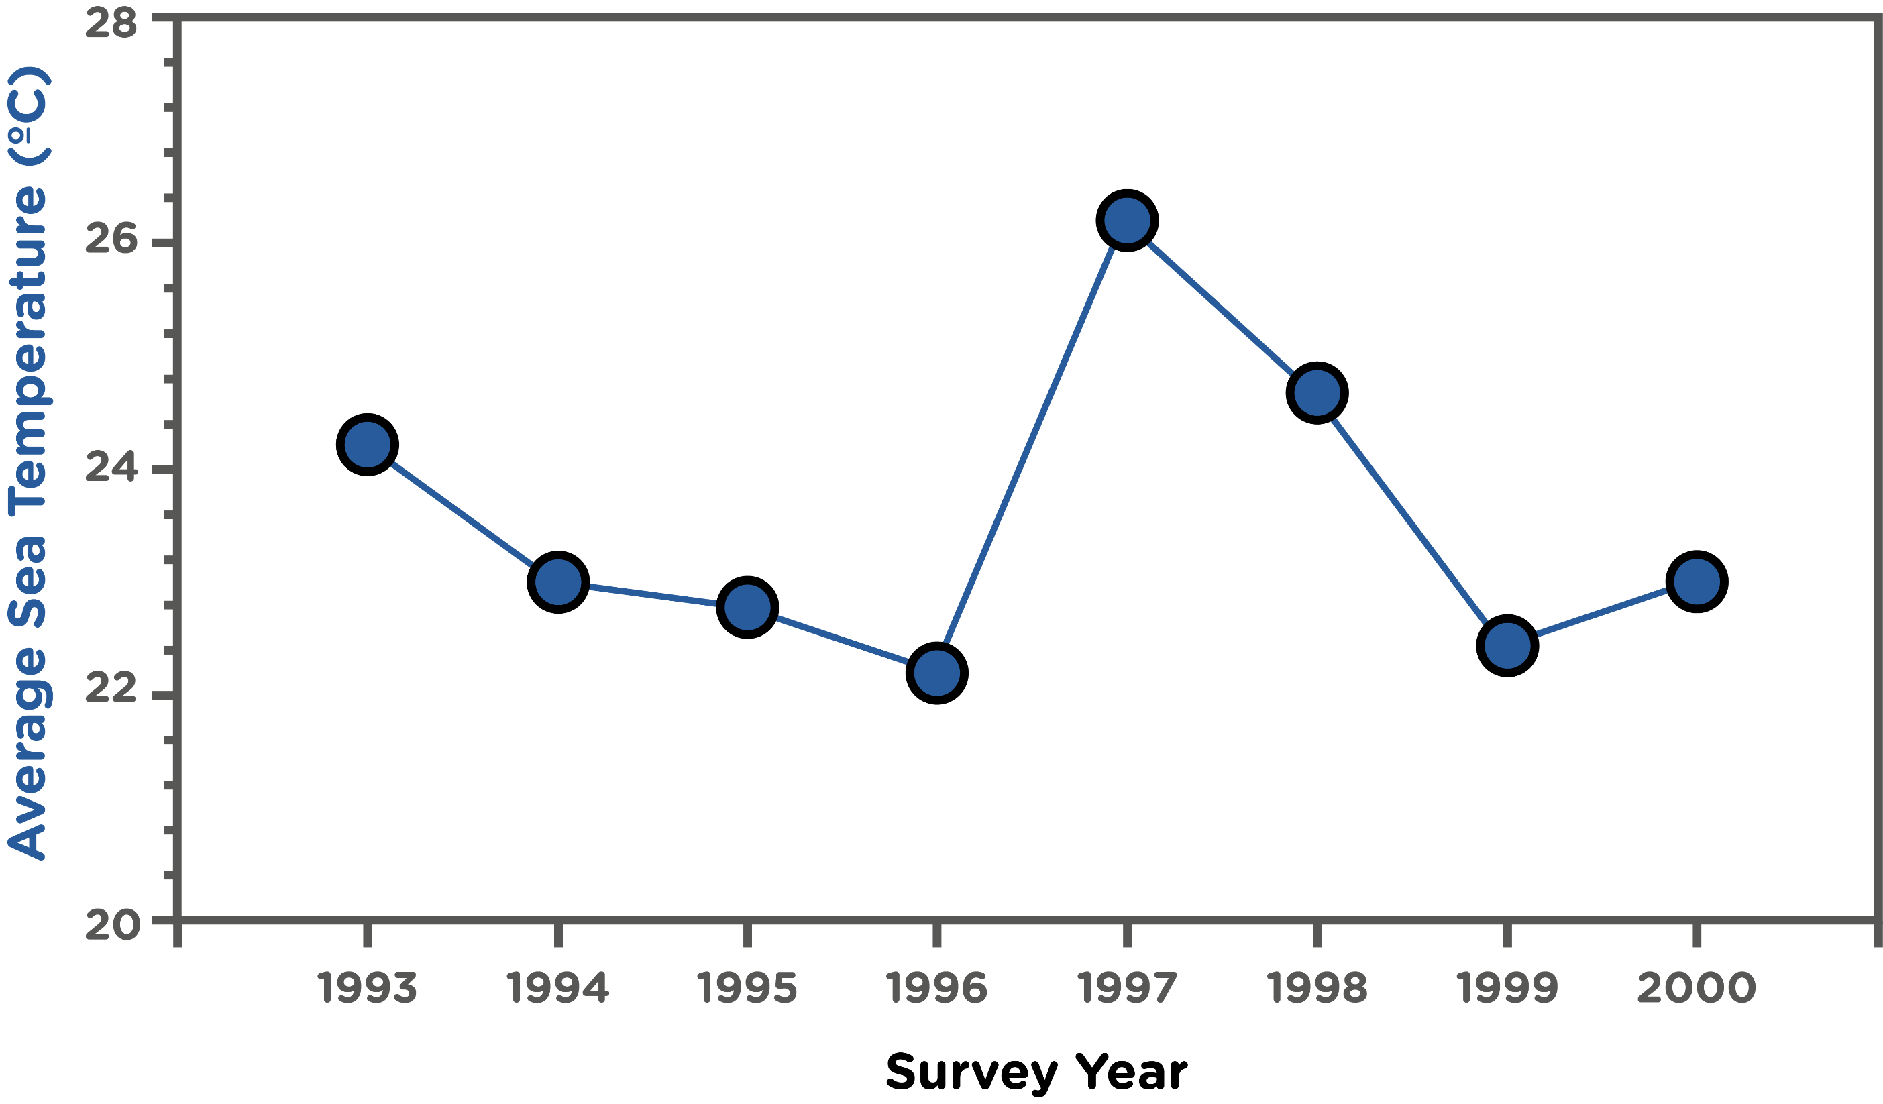
Data analysis of Galápagos sea temperatures and penguin populations between 1993-2000
Average yearly sea temperatures are graphed on the left y-axis as dots in blue

Slide 55
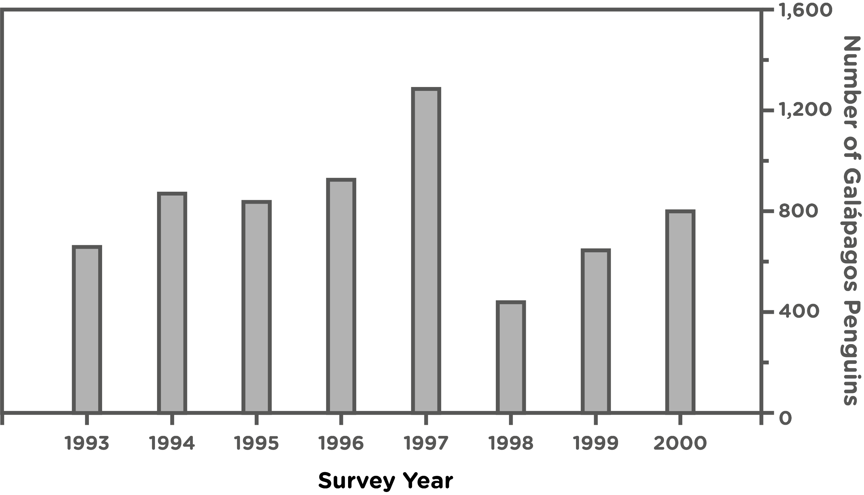
Data analysis of Galápagos sea temperatures and penguin populations between 1993-2000
Penguin population counts are graphed on the right y-axis in grey bars

Slide 56
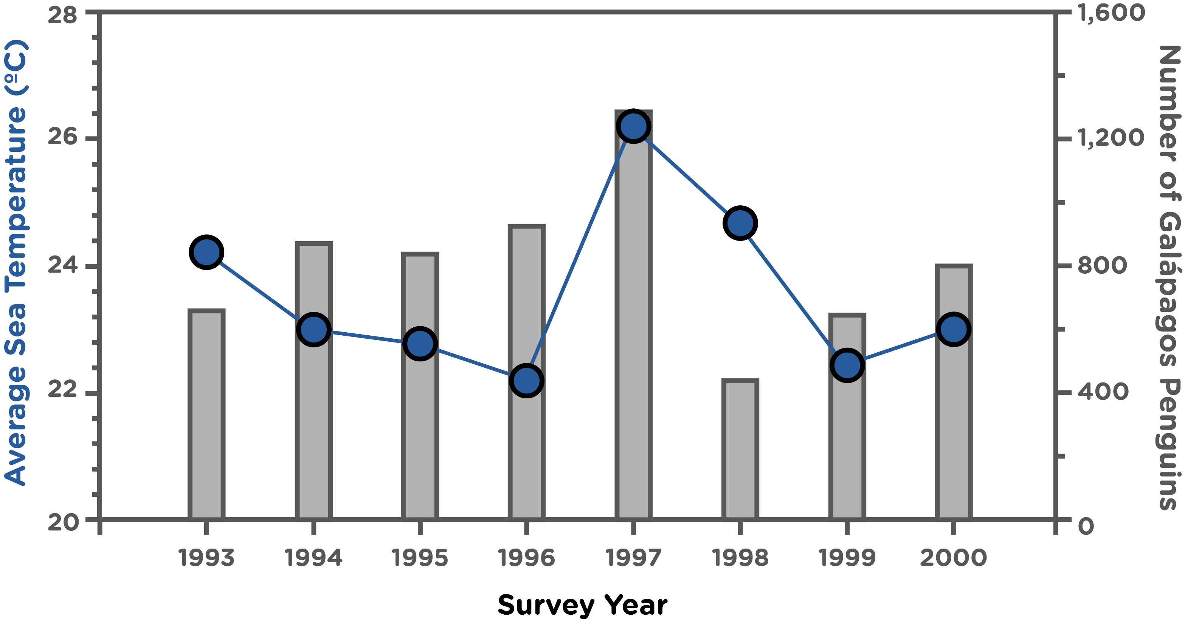
Data analysis of Galápagos sea temperatures and penguin populations between 1993-2000
By graphing these data together, we can compare patterns

Slide 57

Data analysis of Galápagos sea temperatures and penguin populations between 1993-2000
Use this graph to answer the questions in the Lab Guide!

Slide 58
What have we learned?
The Galápagos marine food web comprises many interconnected food chains and depends on producers at the lowest tropic level.
La Niña phases increase nutrients in the Galapagos waters, which supports the entire marine food web.
Penguin numbers decline after El Niño but increase after La Niña.

