Slide 1
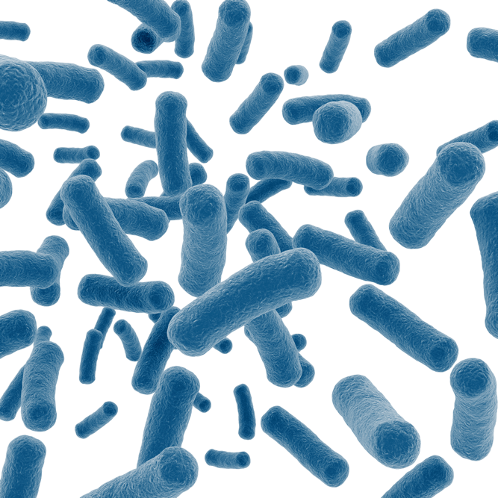
True BlueTM Transformation Lab:
Genetically Engineering Bacteria

Slide 2
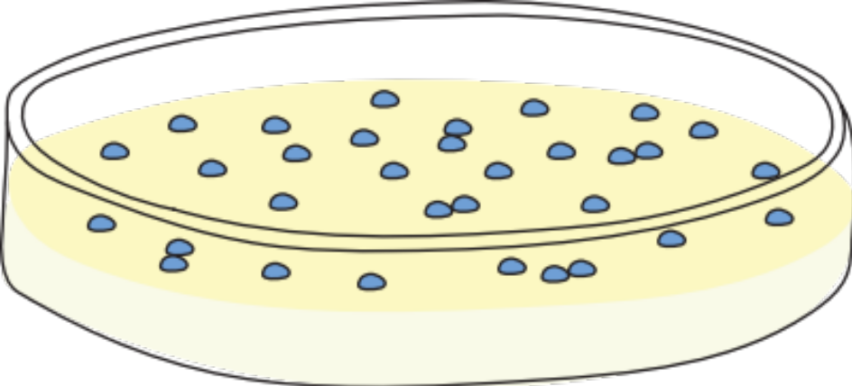
Overview of today’s lab
Today you will become a genetic engineer!
In this lab you will genetically engineer bacteria to appear blue.

Slide 3
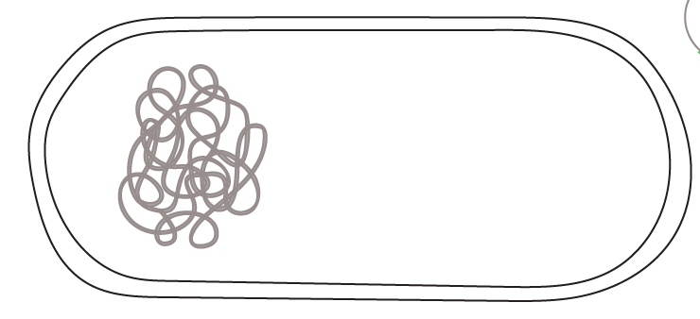



Genetic engineering
Bacterial cell
Insulin gene
Genetic engineering is the deliberate modification of an organism's DNA in the lab.
Scientists often genetically engineer bacteria. For example, bacteria are given human genes so they can produce medicines, like insulin.
In this lab you will genetically engineer bacteria to appear blue.
Insulin protein

Slide 4


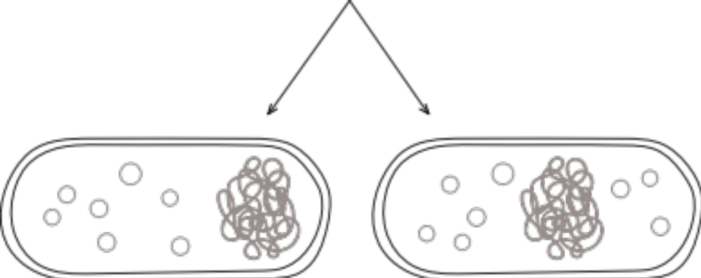
Bacterial DNA
Chromosome
Plasmids
Most bacteria have a single circular chromosome.
Bacteria often also have plasmids, smaller circular pieces of DNA.
Plasmids are passed on during cell division.
Cell
division

Slide 5
Transformation in nature
Bacteria can pick up new plasmid DNA from the environment, a process called transformation.
The proteins encoded by genes on plasmids can be expressed by the bacteria.
Plasmids found naturally in bacteria tend to have at least one gene that benefits the bacteria.
Transformation
Plasmids

Slide 6
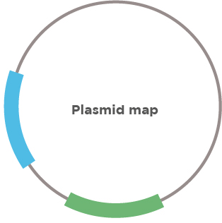
Transformation in the lab
Plasmid map
Scientists design engineered plasmids to introduce specific genes into bacteria.
Engineered plasmids contain at least one gene of interest, which is the gene that you want to introduce into the bacteria.
The gene of interest depends on the purpose of your experiment.
Gene 1
Gene 2

Slide 7


Transformation in the lab
To encourage bacteria to take up plasmid, you expose the cells to conditions that make DNA more likely to enter the cell.
We will expose the cells to calcium chloride.
Transformed bacterium
+ CaCl₂

Slide 8


Selection
Typical laboratory transformations lead to between 1 in 100,000 to 1 in 1,000,000 bacterial cells taking up the plasmid.
You need a way to isolate only the bacteria that were successfully transformed.

Slide 9

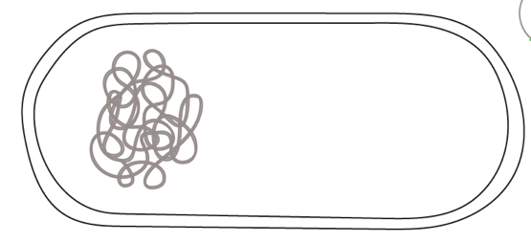

Antibiotic selection
Antibiotic
You can use antibiotics to select for bacteria that were successfully transformed.
The plasmid carries an antibiotic resistance gene.
Only bacteria with the plasmid survive.
Transformed bacterial cell

Slide 10






Antibiotic selection
Antibiotic
Scientists use antibiotics to select for bacteria that were successfully transformed.
The plasmid carries an antibiotic resistance gene.
Only bacteria with the plasmid survive.
Antibiotic
resistance
gene
Antibiotic
resistance protein

Slide 11
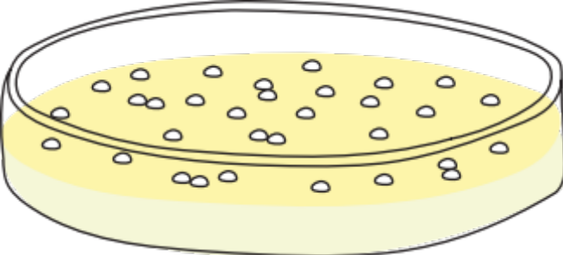
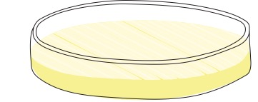
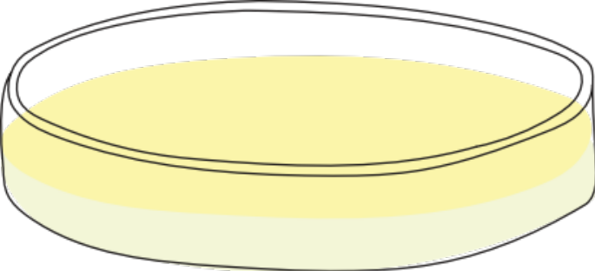
Growing bacteria on plates
After a transformation, bacteria are spread on nutrient agar and allowed to replicate.
There are three possible outcomes:
Colonies
Lawn
No growth

Slide 12
Growing bacteria on plates
Plate with colonies
After 12-24 hours, a single bacterial cell will have divided enough times to make a cluster visible to the naked eye.
If only a few bacteria survive, these clusters will form distinct spots that scientists call colonies.
All the cells in a colony are genetically identical because they came from a single bacteria cell that divided many times.
Colonies

Slide 13
Growing bacteria on plates
Plate with lawn
If too many bacteria survive, most of the agar will be covered in bacteria.
Scientists call this a lawn.
In bacterial transformation a lawn is an unwanted outcome because you cannot easily isolate genetically identical populations of bacteria.
Entire surface covered with bacteria

Slide 14
Growing bacteria on plates
Plate with no growth
It is also possible for there to be no bacterial growth.
In this case, you won't see any bacteria on the surface of the agar.
This tells you that all the bacteria died.

Slide 15


Transformation summary
You can genetically engineer bacteria by introducing plasmids.
Calcium chloride treatment makes bacteria more likely to take in plasmid DNA.
Antibiotic selection allows you to isolate bacteria that took up the plasmid.
+ CaCl₂
Transformed bacterial cell

Slide 16
Today’s lab
You will be working with one of the most common species of laboratory bacteria, Escherichia coli (E. coli).
Under normal conditions, E. coli appear white when grown on nutrient agar.
Your goal is to genetically engineer bacteria to appear blue!
You will introduce a plasmid to make the bacteria appear blue

Slide 17


Making bacteria blue with the lacZ gene
The lacZ gene encodes the β-galactosidase protein.
β-galactosidase can break down a chemical called X-Gal to produce a blue pigment.
You will add X-Gal to some of your nutrient agar plates.
lacZ gene
β-galactosidase
protein
X-Gal
(colorless)
Blue
pigment

Slide 18
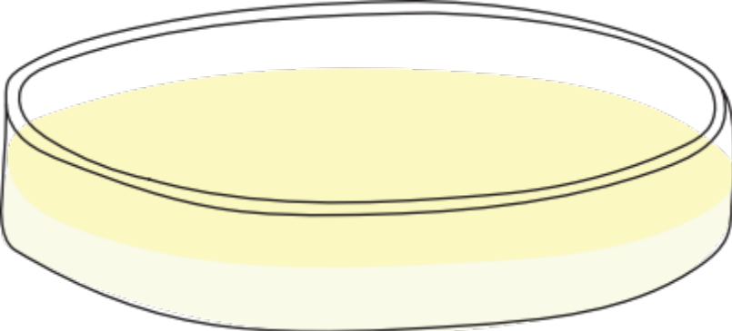
Making bacteria blue with the lacZ gene
lacZ gene
Blue colonies
β-galactosidase
protein
X-Gal
(colorless)
Blue
pigment
Nutrient agar with X-Gal

Slide 19
The pTru plasmid
The gene of interest that you are introducing to the bacteria is the lacZ gene.
Remember, your goal is to genetically engineer the bacteria to be blue. The β-galactosidase enzyme encoded by the lacZ gene allows bacteria to break down X-Gal to create a blue pigment.
pTru plasmid
lacZ gene

Slide 20
The pTru plasmid
To select the bacteria that have taken up the plasmid, the plasmid also contains an antibiotic resistance gene that confers resistance to the antibiotic carbenicillin.
In the presence carbenicillin, only bacteria that have taken up the pTru plasmid will be able to grow.
pTru plasmid
lacZ gene
Antibiotic resistance gene

Slide 21
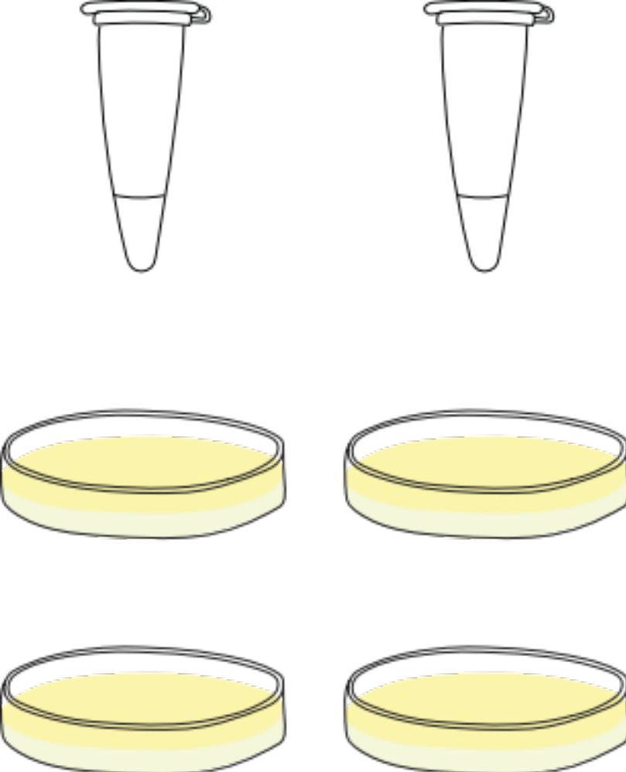
Your experimental samples
H₂O
(control)
pTru Plasmid DNA
- pTru
+ pTru
You will have two transformation reactions.
To one tube of bacteria, you will add only water. This will serve as a control.
To the other tube of bacteria, you will add the pTru Plasmid DNA.
Bacteria in CaCl₂

Slide 22
Your experimental samples
H₂O only
(control)
pTru Plasmid DNA
- pTru
+ pTru
The bacteria from each transformation reaction will be spread on two different plates.
One plate will contain plain nutrient agar as a control.
The other plate will contain nutrient agar with the antibiotic carbenicillin for selection and X-Gal ("CarbX plates”).
Bacteria in CaCl₂
Plain nutrient agar
Nutrient agar + CarbX

Slide 23
Pre-lab study questions
Predict what you will see on each plate:
Plate | Type of bacterial growth (no growth, colonies, lawn) | Color of bacteria (white or blue)
Control cells (no pTru Plasmid "-") plated on plain nutrient agar
Cells transformed with pTru Plasmid ("+") plated on plain nutrient agar
Control cells (no pTru Plasmid "-") plated on nutrient agar + CarbX
Cells transformed with pTru Plasmid ("+") plated on nutrient agar + CarbX

Slide 24
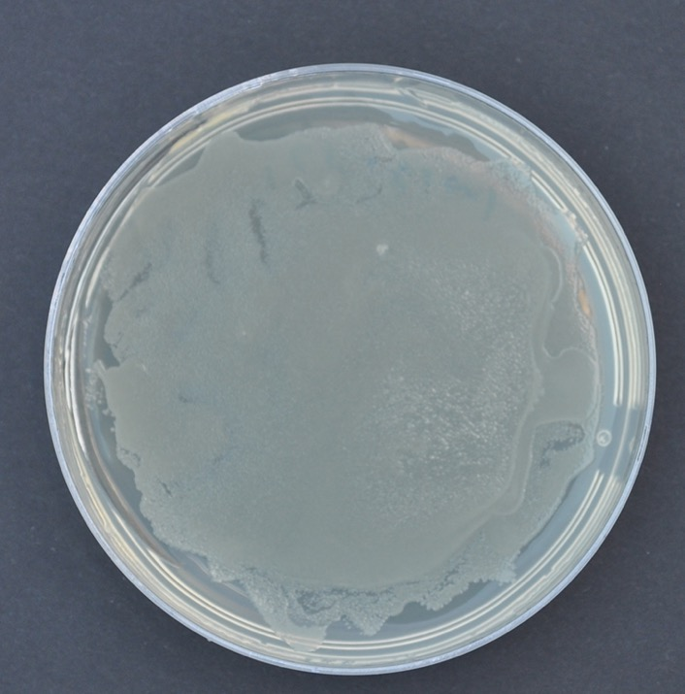
Expected results
- pTru Plasmid on plain nutrient agar
Control cells on plain nutrient agar plates should form a lawn.
In the absence of carbenicillin antibiotic, most of the bacteria should survive.
This condition allows you to assess the viability of your bacteria.

Slide 25
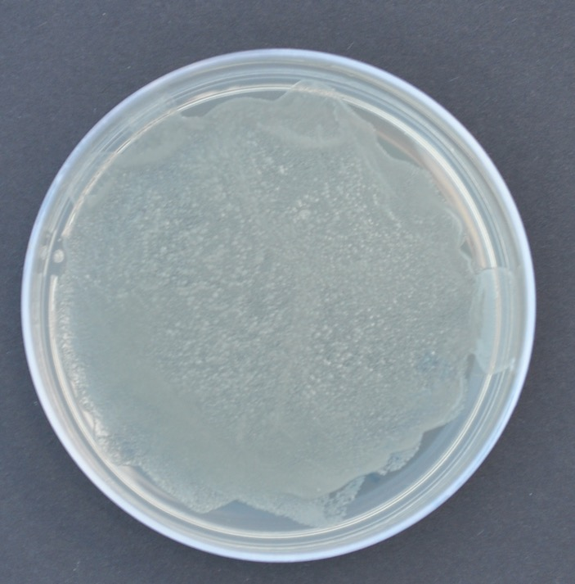
Expected results
+ pTru Plasmid on plain nutrient agar
Cells transformed with pTru on plain plain nutrient agar plates should form a lawn.
In the absence of carbenicillin antibiotic, most of the bacteria should survive.
This condition shows the importance of antibiotic selection.

Slide 26
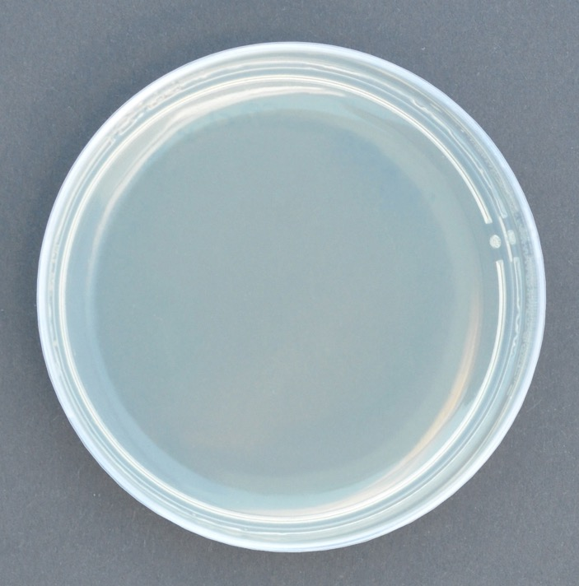
Expected results
- pTru Plasmid on nutrient agar + CarbX
Control cells on CarbX plates should show no growth.
Because the pTru Plasmid was not added to these cells, they will not gain antibiotic resistance.
In the presence of carbenicillin antibiotic, all of the cells should die.

Slide 27
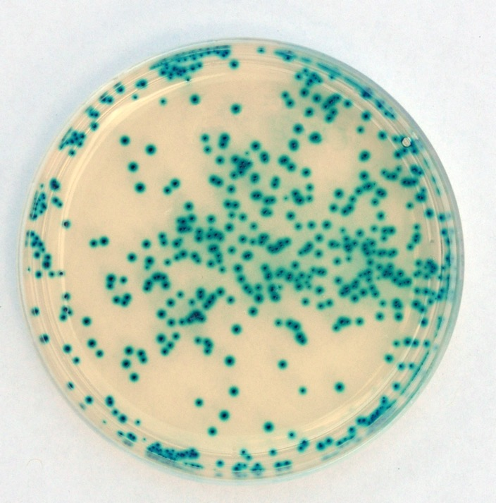
Expected results
+ pTru Plasmid on nutrient agar + CarbX
Cells transformed with pTru on CarbX plates should form blue colonies.
pTru provides resistance to carbenicillin. Only transformed cells can grow in the presence of carbenicillin antibiotic.
Transformation is infrequent so few cells take up the plasmid. These cells divide and form colonies.

Slide 28
Expected results
+ pTru Plasmid on nutrient agar + CarbX
Cells transformed with pTru on CarbX plates should form blue colonies.
pTru also carries the lacZ gene, so the ß-galactosidase protein will be expressed.
ß-galactosidase breaks down the X-Gal in the plates and makes a blue pigment.

Slide 29
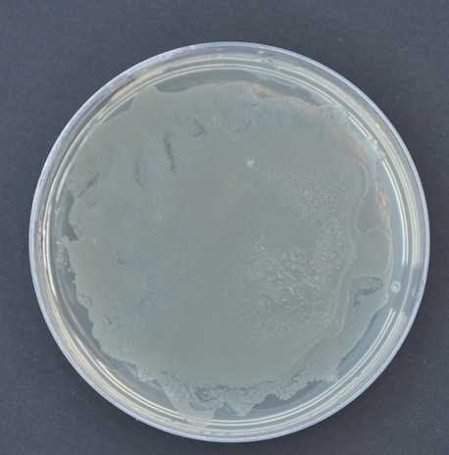
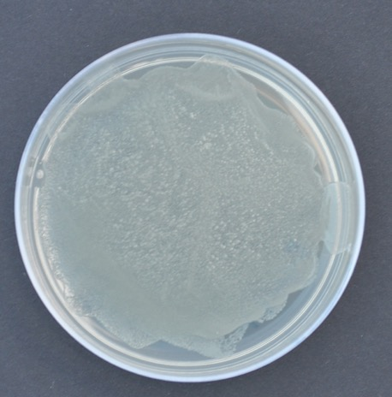
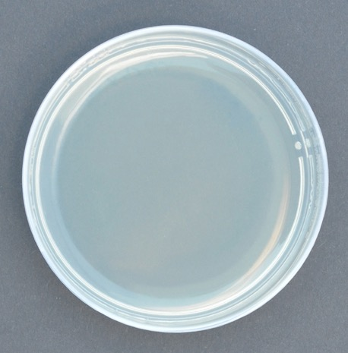

Expected results
- pTru Plasmid
+ pTru Plasmid
Plain LB
LB + CarbX

Slide 30

Summary
Genetic
Engineer!
You genetically engineered bacteria by transforming them with plasmid DNA.
You started with bacteria that appeared white and were susceptible to the antibiotic carbenicillin.
You changed the bacteria to appear blue and be resistant to carbenicillin.

