Slide 1


V1.0: March 2019
© Copyright by Amplyus LLC, all rights reserved
P51 Enzyme Lab
β-Gal Glow™

Slide 2
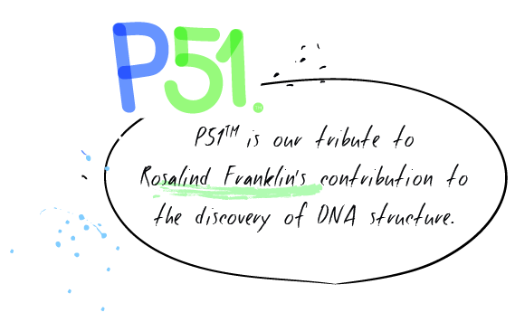
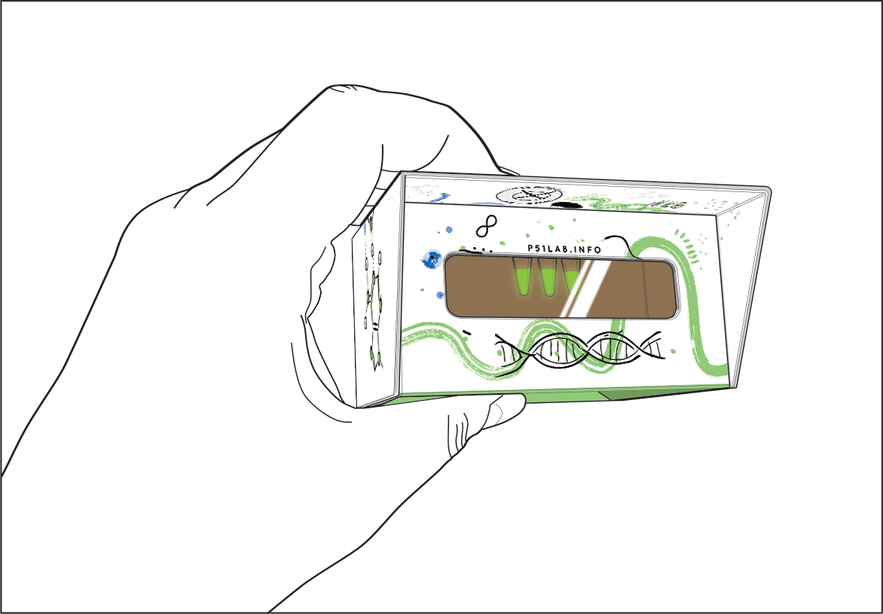
Observing Fluorescence
P51 allows you to observe fluorescence easily in the palm of your hand.

Slide 3
Enzyme Glow Lab
Goals for today:
Review enzyme catalyzed reactions.
Predict how changing properties will affect enzyme catalyzed reactions.
Investigate enzyme properties by observing reactions that produce a fluorescent product.

Slide 4
Enzymes catalyze reactions
To catalyze means to speed up or accelerate.
Enzymes do not make reactions happen; they lower the amount of energy needed for the reaction to occur.

Slide 5
Enzymes and substrates
Substrates bind to the enzyme at the active site.
The active site binds to substrates in a specific conformation that make a reaction much more likely to occur.
The substrate molecule (or molecules) react to form the product.
The substrate is changed by the reaction. The enzyme is not.
An enzyme can catalyze the same reaction repeatedly.

Slide 6
Enzymes and substrates
The enzyme (blue) binds to the substrate (orange) at the active site.
The substrate is changed by the reaction, creating a product (or products, green and purple).
The enzyme is not changed and is able to bind to another substrate.

Slide 7
Conditions that affect enzymes
Individual enzymes have evolved to function optimally in the unique environment in which they are normally found.
Changing those conditions can have profound effects on enzyme function.
Common factors that can influence enzyme activity are:
  Temperature
  pH
  Enzyme and substrate concentration
  Inhibitors

Slide 8
Temperature
Increasing the temperature in a reaction increases the overall energy and, up to a point, generally makes enzyme catalyzed reactions proceed more rapidly.
Increasing temperature past a point can destabilize the enzyme, reducing reaction speed.
Heating an enzyme too much for too long will denature the enzyme, permanently changing its structure and eliminating its ability to catalyze reaction.
Enzymes have generally evolved to perform best at the temperature in which they are normally found.

Slide 9
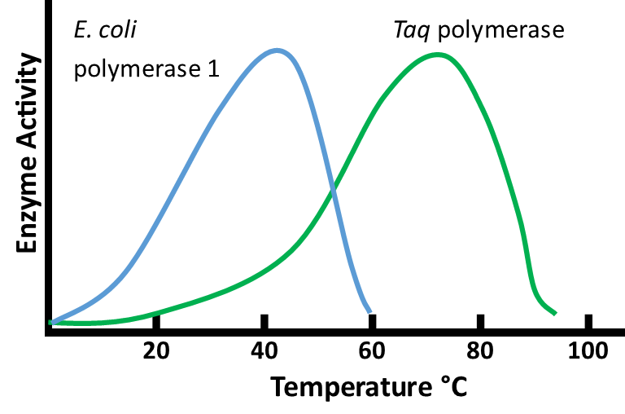
Temperature
E. coli bacteria are normally found in the guts of animals where the temperature is around 37°C.
T. aquaticus (Taq) bacteria are normally found in hot springs where temperatures are can be hotter than 70°C.

Slide 10
pH
Most enzymes have evolved to work best at the pH in which they evolved.
Increasing pH (increasing OH⁻ concentration) or decreasing pH (increasing H⁺ ion concentration) can interfere with reactions.
Changing pH can affect enzymes in two ways:
  An excess of OH⁻ or H⁺ ions in solution can directly interfere with the chemical reaction, affecting reaction rate.
  A protein’s structure is maintained through hydrogen and other bonds. Changing pH by greater amounts can affect the structure of the enzyme by interfering with the bonds and destabilizing the enzyme.
  Increasing or decreasing pH by too large amount will denature the enzyme, permanently affecting its structure and eliminating its ability to catalyze reactions.

Slide 11
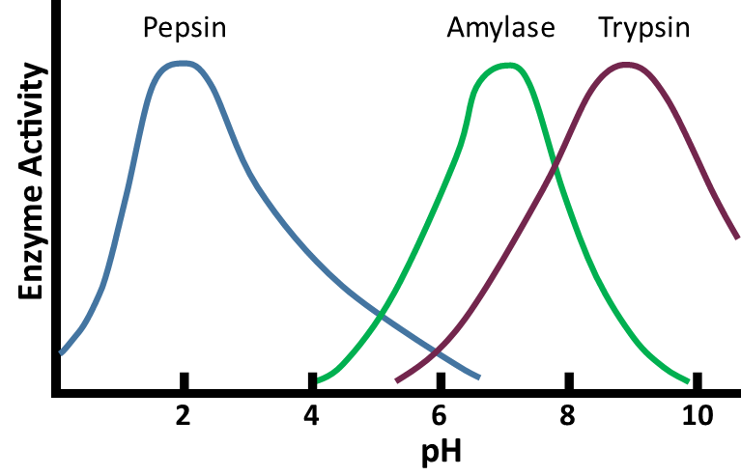
pH
Pepsin is an enzyme that catalyzes the breakdown of proteins. It typically functions in the acidic environment of the stomach.
Amylase is an enzyme that catalyzes the breakdown of starches. It is produced in saliva and the pancreas and typically functions at a neutral pH.
Trypsin is another enzyme that catalyzes the breakdown of proteins. It functions in the small intestine and works best at a pH of 8 or even above.

Slide 12
Concentration
The rate of an enzyme catalyzed reaction can be affected by both the concentration of enzyme in substrate and the concentration of enzyme in solution.
Enzymes and substrates interact when they come in contact in solution, typically through random Brownian motion. The more enzyme and substrate in solution, the more likely they are to come in contact.

Slide 13
Concentration
A single enzyme can catalyze the same reaction over and over.
But each enzyme can only process individual reactions one at a time.
A single enzyme catalyzes the breakdown of 5 substrate molecules sequentially.

Slide 14
Concentration
Increasing enzyme concentration will cause more substrate molecules to react at a time.
This will increase reaction rate until there is so much enzyme that the reaction occurs virtually instantaneously.
Changing the amount of enzyme will not affect the amount of product formed in the reaction.
Multiple enzymes catalyze the breakdown of 5 substrate molecules simultaneously.

Slide 15
Concentration
Increasing substrate concentration will also increase reaction rate.
The more substrate in solution, the more frequently enzyme and substrate will interact.
This will also increase the total amount of product produced in the reaction.

Slide 16
Concentration
Increasing substrate concentration will also increase reaction rate.
The more substrate in solution, the more frequently enzyme and substrate will interact.
This will also increase the total amount of product produced in the reaction.

Slide 17
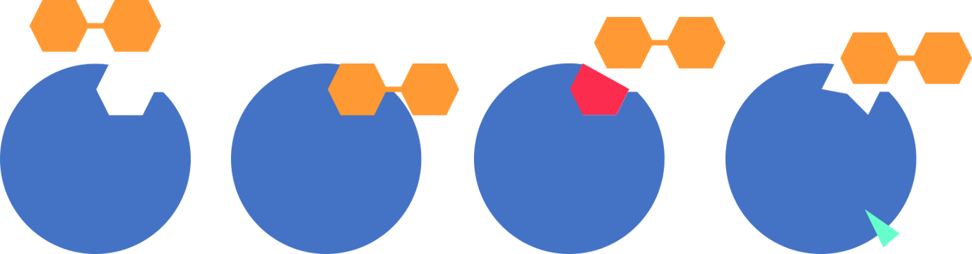
Inhibitors
Other molecules in solution can interfere with enzyme catalyzed reactions. These molecules are called inhibitors.
There are two basic types of inhibitors:
  Competitive
  Non-competitive
Substrate binding
Competitive
inhibitor
Non-competitive inhibitor

Slide 18
Competitive inhibitors
A competitive inhibitor is a molecule that binds to the active site of the enzyme.
By binding to the active site, it blocks the substrate from reacting, slowing the reaction.
If substrate concentration is high, a competitive inhibitor will have less effect, because the high number of substrate molecules will out-compete the inhibitor for access to the active site. If substrate concentration is low, the inhibitor will have a greater effect.

Slide 19
Non-competitive inhibition
A non-competitive inhibitor typically binds to a region of the enzyme that is separate from the active site.
The binding of the inhibitor will change the conformation of the active site or otherwise impede the enzyme’s ability to catalyze the reaction.
Because the inhibitor can bind whether or not substrate is present, competitive inhibition is not affected by substrate concentration.

Slide 20
Creating a fluorescent standard
We will be using the molecule fluorescein to create a fluorescent standard for comparison.
Fluorescein is a fluorescent molecule commonly used in biological and other molecules.
Fluorescein is also the fluorescent product that is created in our reaction.
To measure the amount of product in our reaction we will compare it to tubes with known amounts of fluorescein.

Slide 21
Creating a fluorescent standard
Label 5 tubes 1 through 5.
Add 20 µl Dilution buffer to tubes 1-4.
Add 20 µl of 30µM Fluorescein to tube 5.
Add 20 µl of 30µM Fluorescein to tube 4. Pipette up and down to mix.
Take 20 µl from tube 4 and add it to tube 3. Pipette up and down to mix.
Take 20 µl from tube 3 and add it to tube 2. Pipette up and down to mix.
Take 20 µl from tube 2 and add it to tube 1. Pipette up and down to mix.
Take 20 µl from tube 1 and discard.
All tubes should now have 20 µl.

Slide 22
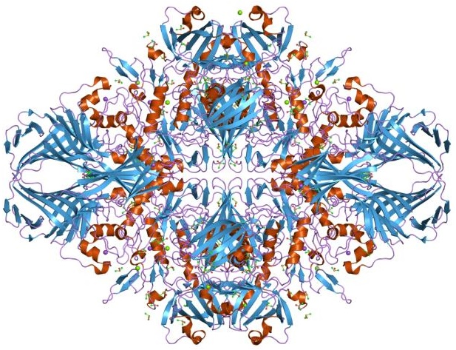
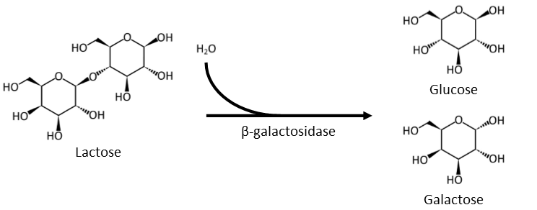
Enzyme Glow Lab
β-galactosidase
Catalyzes the breakdown of glycosidic bonds between a terminal galactose molecule and neighboring molecules.

Slide 23
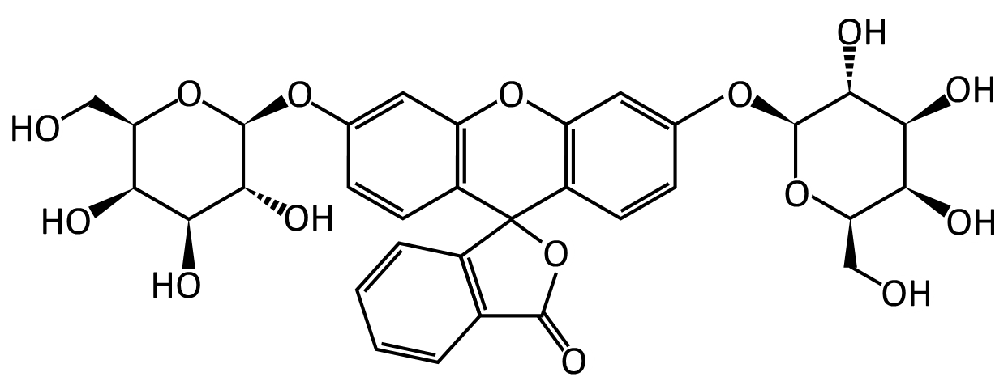
Galactose substrate
2 Galactose
Galactose Substrate
Fluorescein

Slide 24
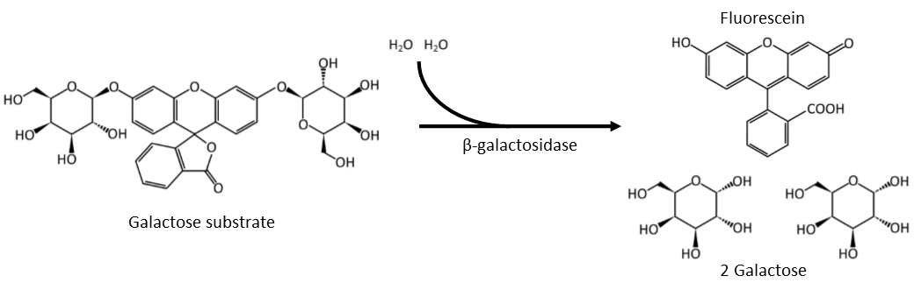
The reaction we are observing
The active site in β-galactosidase recognizes galactose, regardless of what galactose is bound to.
We will use fluorescein bound to two galactose monomers in this reaction.
Fluorescein will not fluoresce when bound to other molecules, but will fluoresce when those molecules are removed.

Slide 25
The reaction we are observing
When the galactose monomers are removed from the central fluorescein, it will begin to fluoresce under blue light.

Slide 26
Observing the reaction
Instructions:
  Turn on P51
  Add 10 µl 2X substrate to a tube.
  Add 10 µl Dilution Buffer to create a 1X solution and place in P51.
  Pipette 5 µl of 1X enzyme into the substrate.
    Pipette up and down to mix.
    Immediately start timer.
  Every 10 seconds compare brightness of substrate to fluorescein dilution series.

Slide 27
Reaction conditions to investigate
  Temperature
  pH
  Concentration
  Inhibitors
Enzyme conditions

Slide 28
Materials available to you
Temperature sensitivity |  | pH sensitivity
2X Substrate solution 1X Enzyme solution Dilution buffer Ice bath miniPCR machine OR Warm water bath (40-55°C) and Hot water bath (Above 75°C) | 150 µl 80 µl 150 µl | 2X Substrate solution 1X Enzyme solution Dilution buffer 100 mM NaOH pH paper (optional) Note: pH values lower than six cannot be investigated using this lab, as fluorescein does not fluoresce at low pH | 150 µl 80 µl 150 µl 50 µl
Concentration dependence |  | Competitive inhibition
2X Substrate solution 1X Enzyme solution 5X Enzyme solution Dilution buffer | 150 µl 80 µl 40 µl 150 µl | 2X Substrate solution 1X Enzyme solution Dilution buffer 500 mM Sucrose solution 500 mM Lactose solution | 150 µl 80 µl 150 µl 50 µl 50 µl

Slide 29
Enjoy discovering the properties of enzymes!

