Slide 1

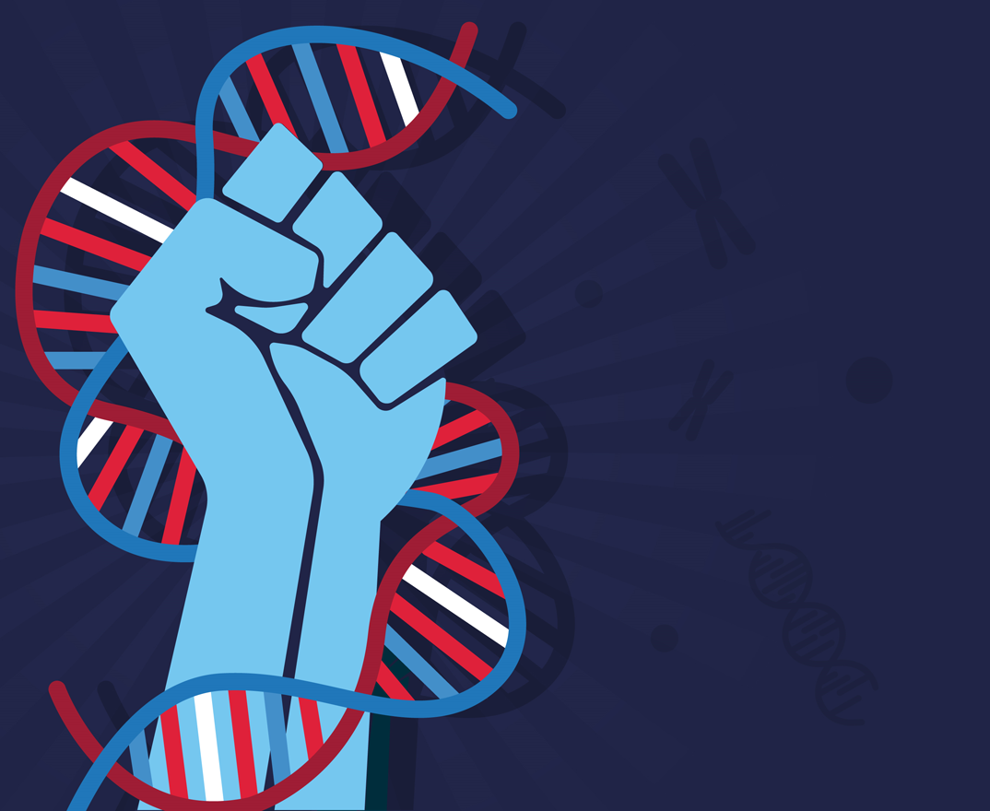
V1.0: Aug 2019
© Copyright by Amplyus LLC, all rights reserved
P51TM qPCR LAB
Principles of Quantitative PCR

Slide 2
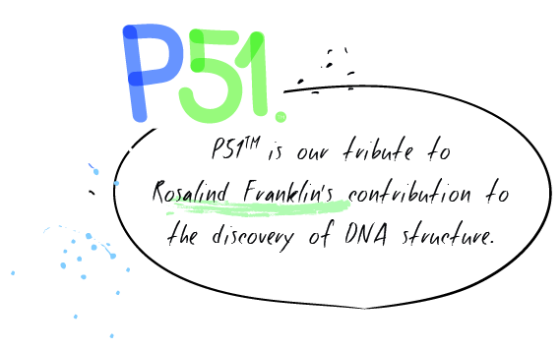
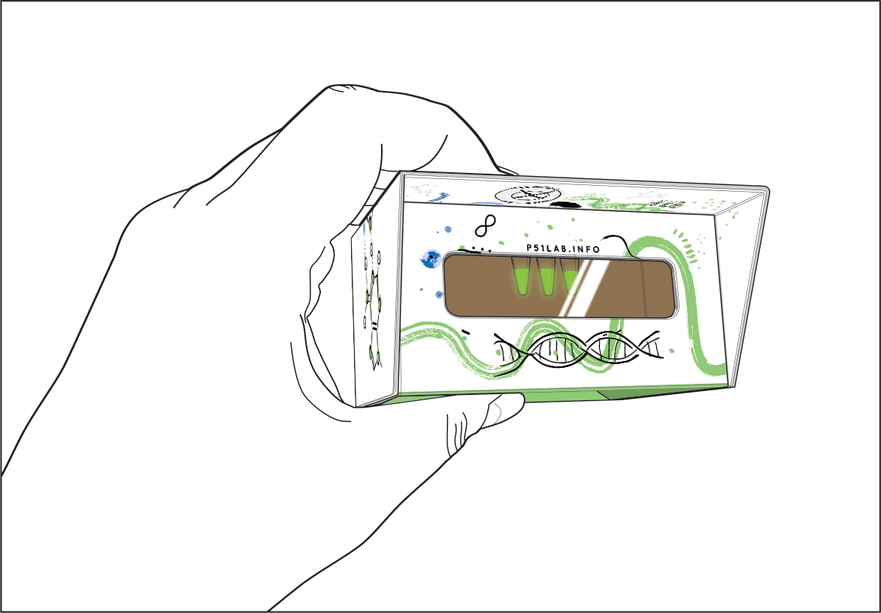
Observing Fluorescence
P51 allows you to observe fluorescence easily in the palm of your hand.

Slide 3
qPCR Glow Lab
Goals for today:
Directly visualize PCR product through fluorescence
Predict how DNA template concentration will affect PCR amplification
Estimate starting concentration of a sample by observing fluorescence during PCR
Compare and contrast end-point and real-time assays

Slide 4
Polymerase Chain Reaction (PCR)
Genetic testing
Pathogen detection
Drug development
Crop modification
Forensic analysis
Sequencing
Etc.
Complex DNA sample
Region of
interest
Amplified DNA (Billions of copies)
Applications
  A process that identifies and copies (amplifies)
  a specific piece of DNA in a biological sample

Slide 5
Polymerase Chain Reaction (PCR)
1
  94°C
Denaturation
  50-60°C
2
Primer 1
Annealing
Primer 2
  72°C
3
Taq DNA polymerase
Extension
dNTPs

Slide 6
Thermal cycling
denatured DNA
DNA + primers
DNA + copy
Single molecule
94° C
~1B copies
72° C
50-60° C
Denaturation
Annealing
Extension
Repeat x ~25-30 cycles

Slide 7
What goes in a conventional PCR
  Template DNA to be amplified
  Pair of DNA primers
  DNA polymerase
  dNTPs
  Buffer to maintain pH
  and provide Mg²⁺
Taq
FWD primer
Master Mix
REV primer
G
G
T
C
T
G
A
C
T
A
G
T
G
C
A
A
C
G
A
G
T
A
A
G
T
C
C
C

Slide 8
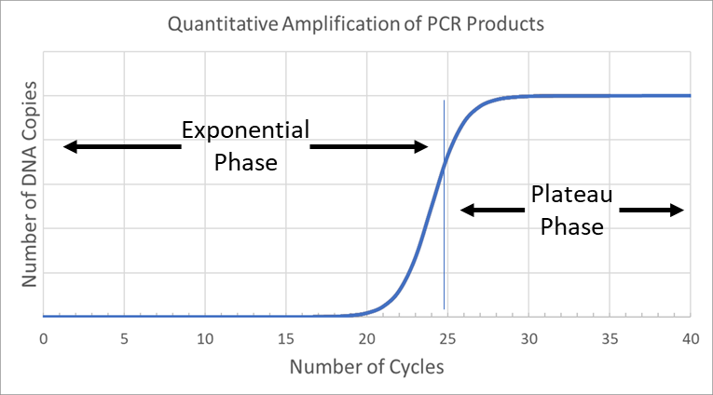
PCR products increase exponentially
The amount of PCR products in the reaction doubles every cycle.
Early in the reaction there will be very few copies of the target sequence and the amount of PCR product will grow slowly…
…until there are not enough reagents to sustain the reaction.
…the amount of PCR product will grow faster and faster…

Slide 9
Traditional PCR is an endpoint assay
Traditionally, PCR simply aims to obtain a large amount of the target sequence.
Researchers try to get the PCR close to, or into, the plateau phase before stopping the reaction.
Typically, the exponential phase of the reaction is not observed or monitored in any way.
Endpoint PCR typically observes PCR product only once the plateau phase is reached

Slide 10
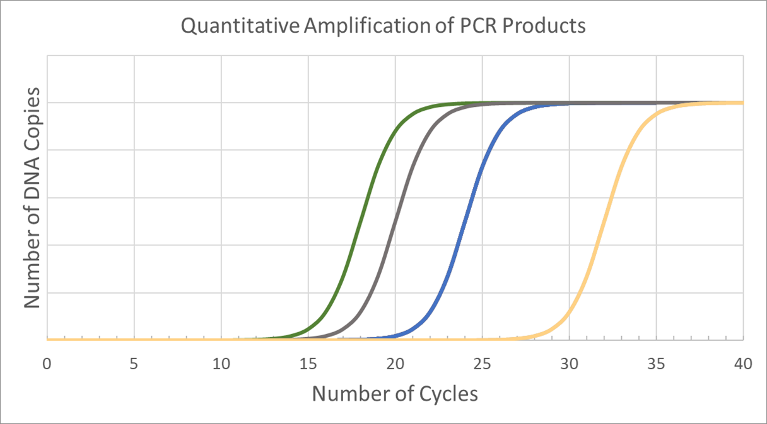
Different starting points have the same endpoint
In conventional PCR, regardless of starting point, all reactions will end at the same, or similar, concentration.

Slide 11
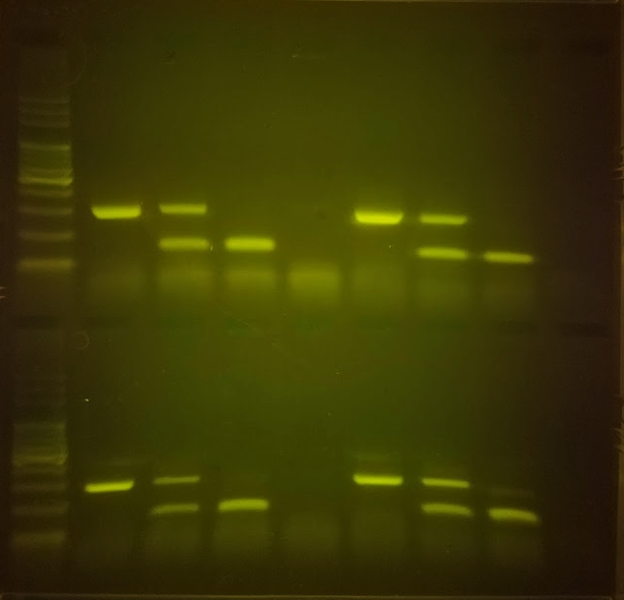
Different starting points have the same endpoint
This is good if you are running an agarose gel, for example.
You just want bright bands in every lane.

Slide 12
qPCR doesn’t look at the endpoint
qPCR changes the approach by gathering information during the reaction, when different reactions are still in the exponential phase.
qPCR allows us to monitor PCR product during exponential phase, as it’s doubling with every PCR cycle

Slide 13
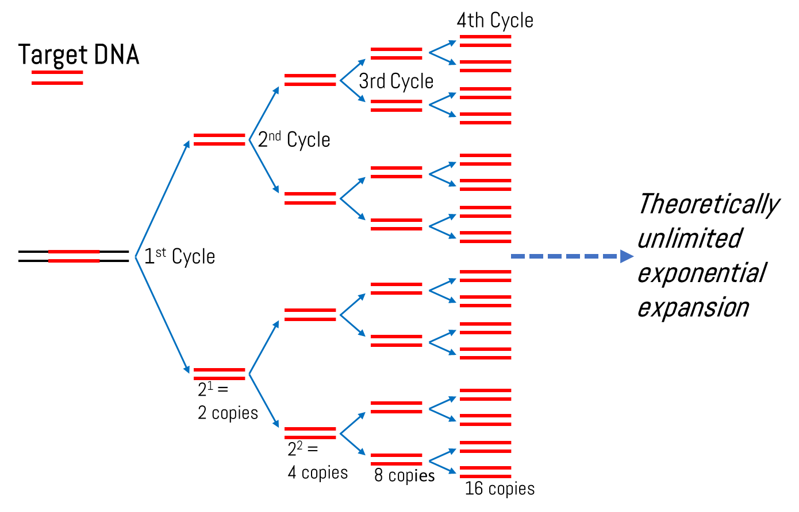
qPCR uses a fluorescent dye
qPCR uses a fluorescent dye that only fluoresces when bound to double stranded DNA (dsDNA).
Every PCR cycle, more and more dsDNA is made, and fluorescence will get brighter and brighter.
Fluorescent dye

Slide 14
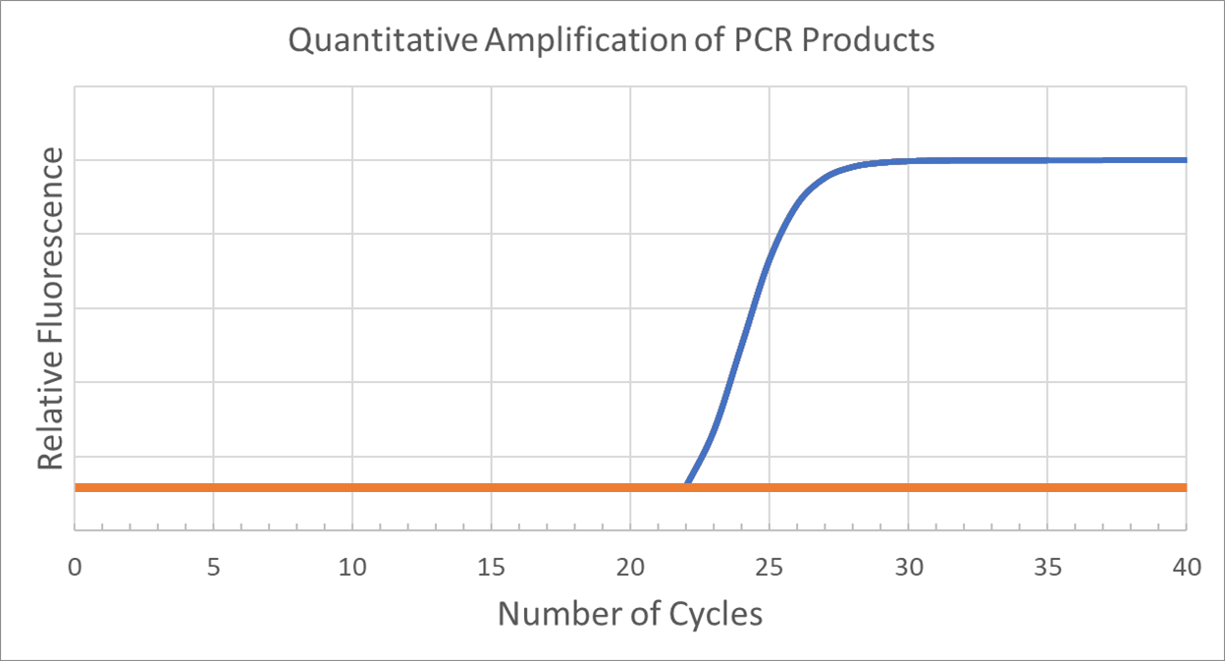
qPCR uses a fluorescent dye
The amount of fluorescence in the reaction serves as a readout of how many copies of DNA have been made.
Early in the reaction there is so little DNA that the fluorescence cannot be detected.
Eventually there is enough DNA that the fluorescence level passes a threshold where it can be observed.
The cycle at which fluorescence is first observable above background is called Ct, for cycle threshold.
Fluorescence is used as a measure of DNA copies.
Threshold
Ct

Slide 15
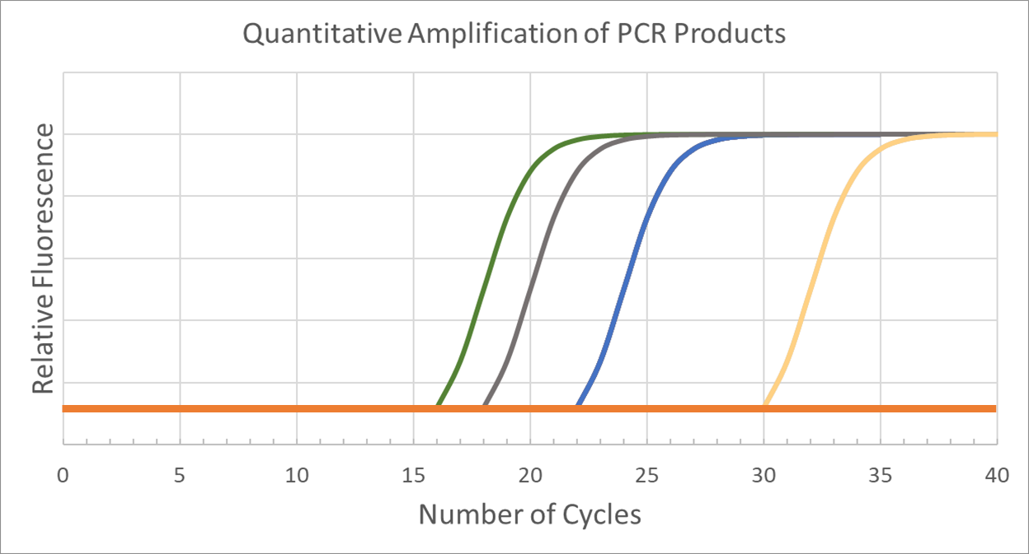
Starting DNA concentration affects Ct
A reaction’s Ct is directly linked to the starting concentration of target sequence.
In a PCR, the amount of target sequence doubles every cycle. This means that if a reaction reaches Ct one cycle earlier than another reaction, it is expected to have started with twice as much target sequence.
If there is a two-cycle difference, you expect a four-fold difference in starting DNA concentration. A three-cycle difference, eight-fold and so on.

Slide 16
Starting DNA concentration affects Ct
These two reactions reached Ct two cycles apart.
The reaction represented by the green line is expected to have started with four times as much of the target DNA sequence.

Slide 17
Starting DNA concentration affects Ct
The reaction represented by the blue line reaches Ct four cycles after the reaction represented by the gray line.
Which reaction was more concentrated to start?
Gray
By how much?
The gray reaction started with about sixteen times (2⁴) as much target sequence as the blue reaction.

Slide 18
qPCR allows researchers to estimate DNA concentration
By comparing PCR reactions in real-time, qPCR allows you to calculate the relative amount of starting sample between two reactions.
Imagine if you wanted to test not just if a virus was present in a sample, but also how much virus was there.
qPCR can do that.

Slide 19
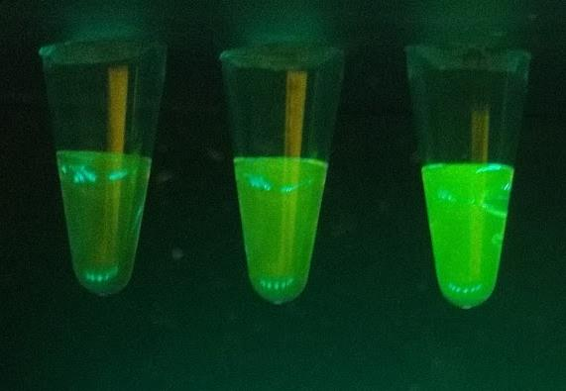
qPCR is usually expensive
qPCR is typically performed in machines that can cost tens of thousands of dollars.
These machines not only perform the PCR, but also continuously measure fluorescence using finely calibrated light beams and highly precise fluorescence detectors.
Today you will be using low cost, but effective alternatives to view qPCR first hand, with your own eyes.
1
2
3

Slide 20
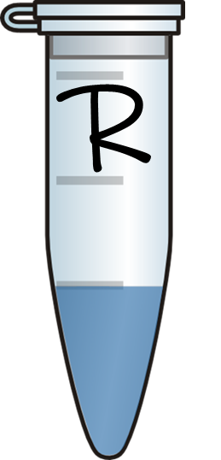
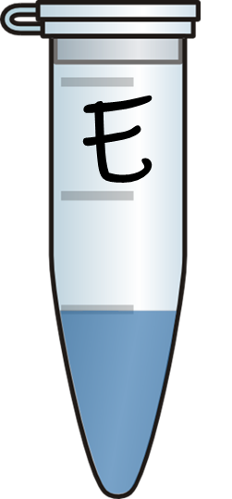
Predict your approximate Ct
You are given a sample of DNA with a known concentration: 40 pg/µl
This is your Reference, or R, sample.
Your job is to dilute this sample and predict how many more cycles it will take to begin fluorescing.
Label your diluted sample E, for Experimental
My dilution factor will be: ___________________
The number of additional cycles I expect it will take for this tube to fluoresce compared to Reference sample: ___________________
Why I think this:

Slide 21
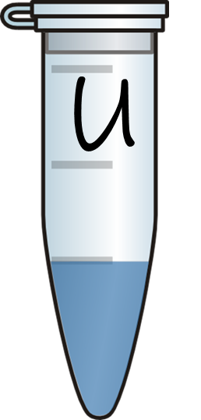
Which group’s is more diluted?
Once you have made your dilution, you will trade some of your sample with another group.
Do not tell the other group how diluted your sample is.
Label this tube U, for Unknown.

Slide 22
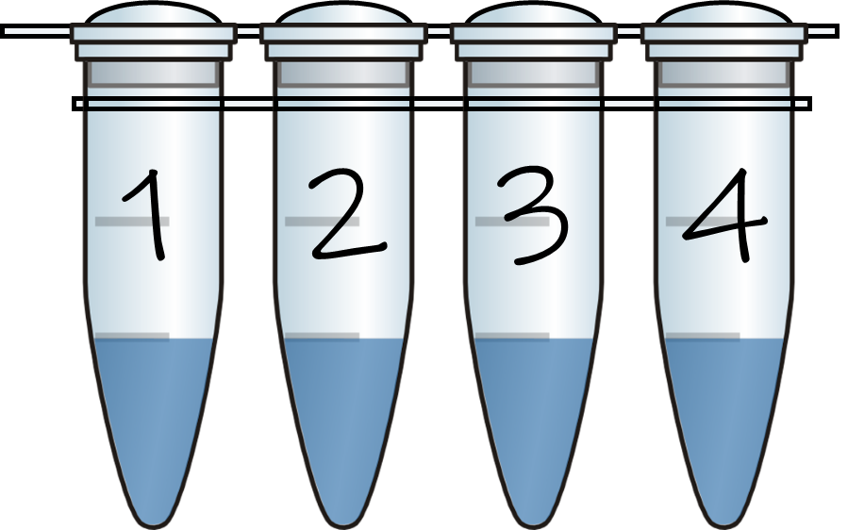
Setting up your reaction
You will set up four reactions
1: N, negative control
2: R sample
3: E sample
4: U sample
 | Tube 1 | Tube 2 | Tube 3 | Tube 4
2X qGRN Master Mix (qMM) | 15 µl | 15 µl | 15 µl | 15 µl
qPCR Primers (Primers) | 7.5 µl | 7.5 µl | 7.5 µl | 7.5 µl
Template DNA | 7.5 µl H₂O | 7.5 µl “R” | 7.5 µl “E” | 7.5 µl “U”

Slide 23
What goes in the qPCR
  qPCR reagents are basically the same as regular PCR with the addition of a fluorescent dye or probe.
  Template DNA to be amplified
  Pair of DNA primers
  DNA polymerase
  dNTPs
  Buffer to maintain pH
  and provide Mg²⁺
  qPCR Fluorescent Dye
Taq
FWD primer
REV primer
qGRN Master Mix
G
G
T
C
T
G
A
C
T
A
G
T
G
C
A
A
C
G
A
G
T
A
A
G
T
C
C
C

Slide 24
Observing fluorescence – room temperature
Observe the fluorescence of your samples by viewing in P51™ before putting them in the thermocycler.
The brightest tube you see should be considered a “3” – the brightest value on our scale.
Record your observations in Table 1.
1
2
3

Slide 25
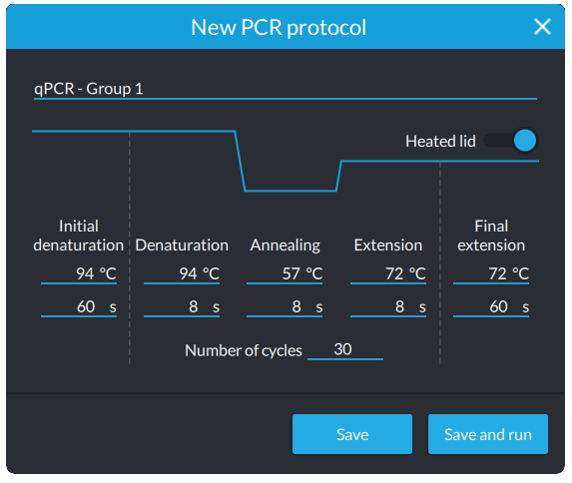
Programming the machine
  Use the following PCR program:
  Initial denaturation 94°C, 60 sec
  Denaturation 94°C, 8 sec
  Annealing 57°C, 8 sec
  Extension 72°C, 8 sec
  Number of cycles 30
  Final extension 72°C, 30 sec
  Heated lid ON

Slide 26
Observing fluorescence – Denaturing (94°C)
Place your tubes in the thermocycler and start the reaction.
When the tubes have been at 94°C for at least 30 seconds, pause the reaction.
Remove the tubes and view fluorescence in P51™.
The dimmest tube should be considered a “0” on your brightness scale.
Record your observations in Table 1.
1
2
3

Slide 27
Observing fluorescence – Extension (72°C)
Return your tubes to the thermocycler.
Resume the reaction (press “Run”), and allow it to proceed to cycle 10.
During the 72°C extension stage, again pause the reaction and view your tubes in P51™.
Record your data in Table 2.
Continue checking fluorescence at regular intervals, according to your experimental design.
1
2
3

Slide 28
Drawing conclusions
What cycle did the reference sample (R) begin fluorescing?
Did your experimental sample begin fluorescing at the cycle you expected it to?
Which was more concentrated, your experimental or unknown sample?
By about how much?

Slide 29
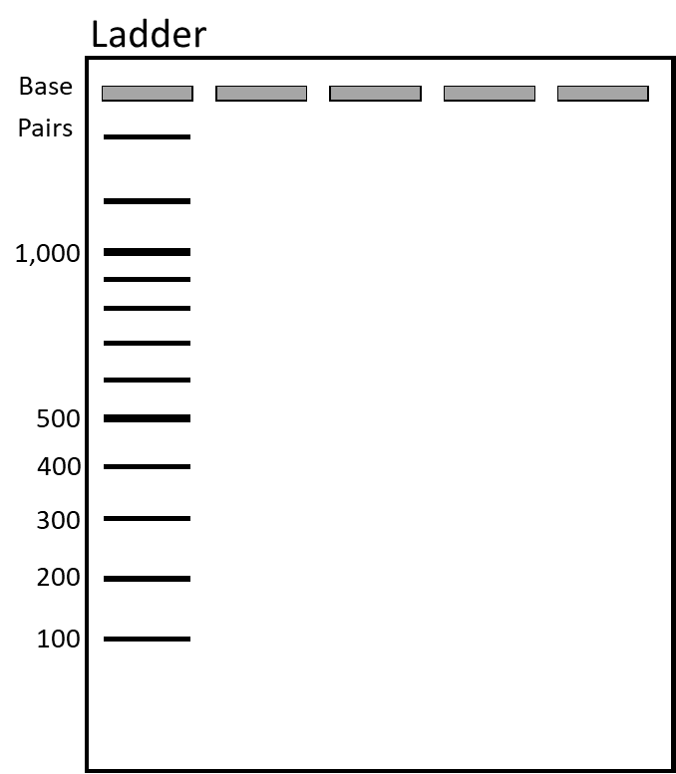
Comparing real-time and endpoint assays
Run your samples on an agarose gel after they have completed all 30 PCR cycles.
What information can you gain from the gel that you could not get from observing fluorescence?
What information could you only get from viewing fluorescence?

Slide 30
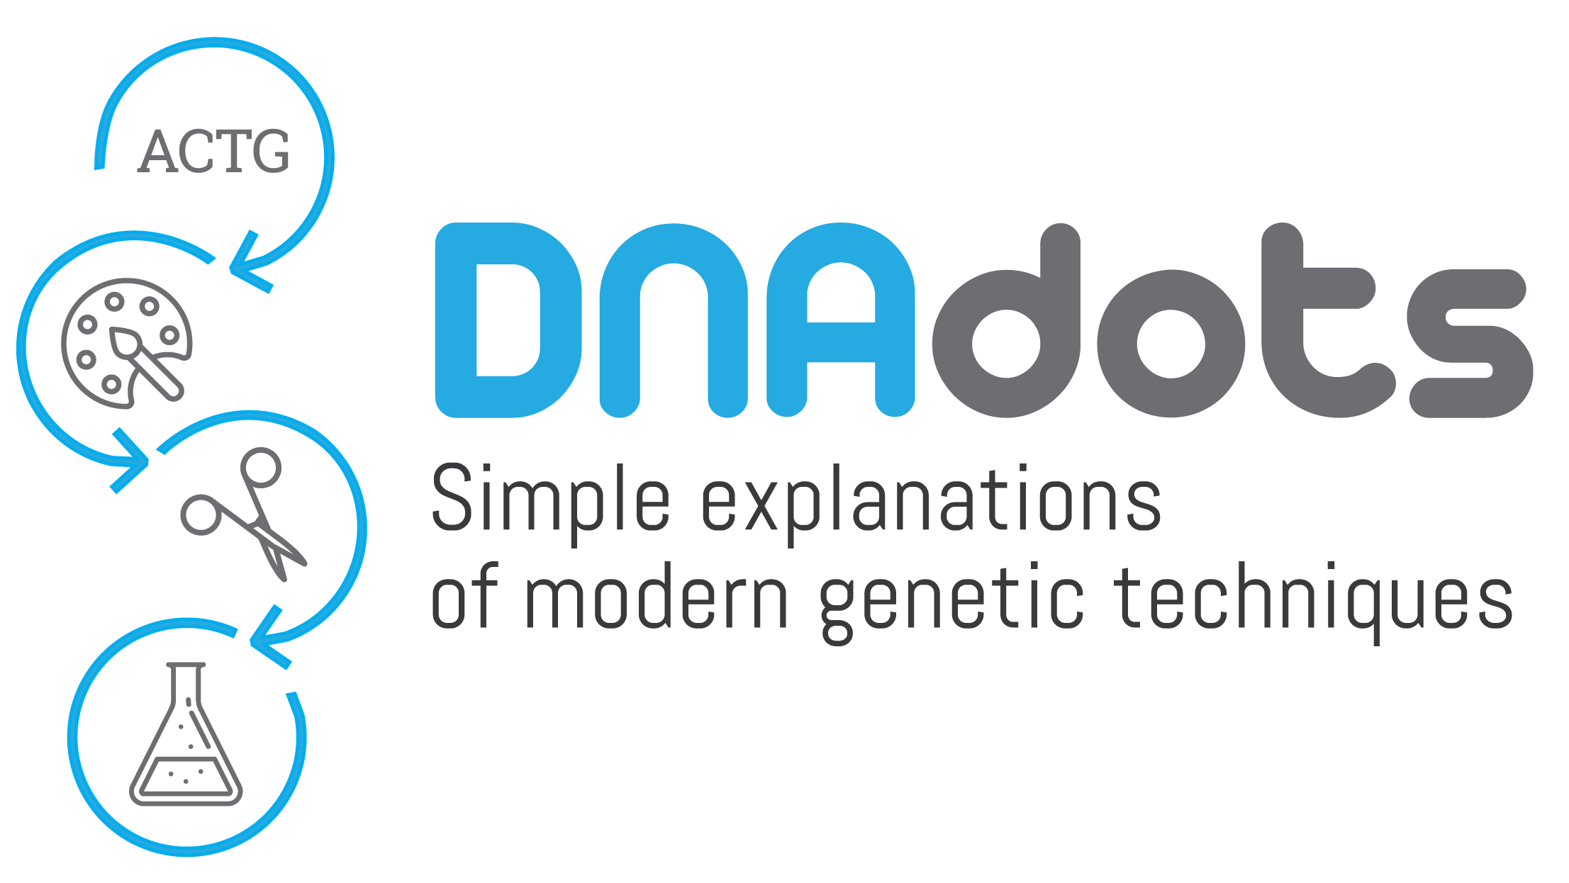
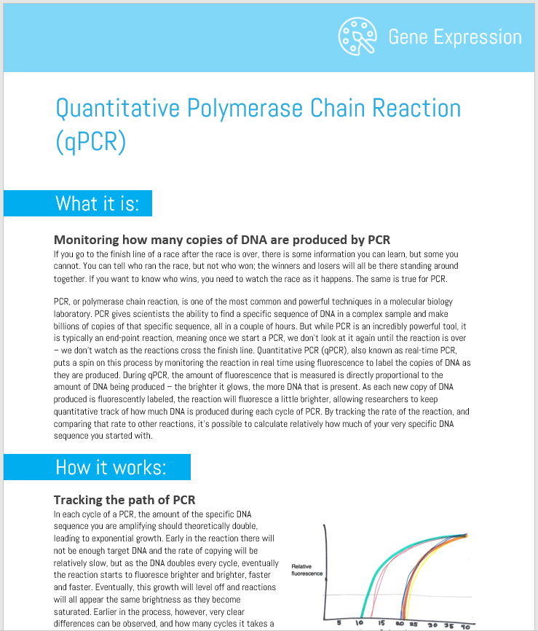
Learn more
https://dnadots.minipcr.com/dnadots/real-time-polymerase-chain-reaction

Slide 31

Thank you!
We hope you enjoyed the lab!

