Slide 1


V1.0: April 2018
© Copyright by Amplyus LLC, all rights reserved
miniPCRTM
Sickle Cell Genetics Lab
Diagnosing Baby Marie

Slide 2
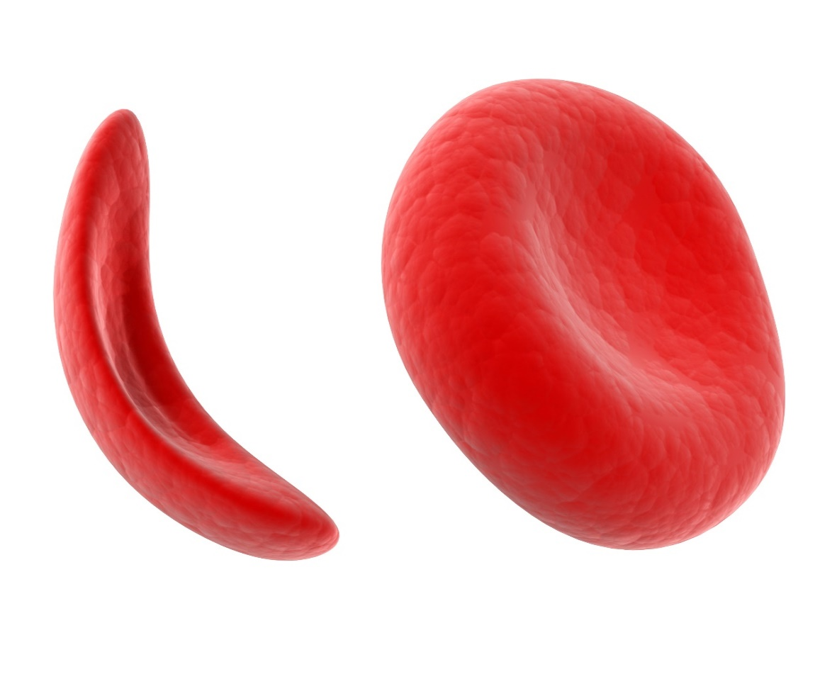
Welcome!
Our goals for today
Review the genetics and biology of sickle cell anemia.
Analyze DNA sequences to diagnose sickle cell anemia in a family.

Slide 3
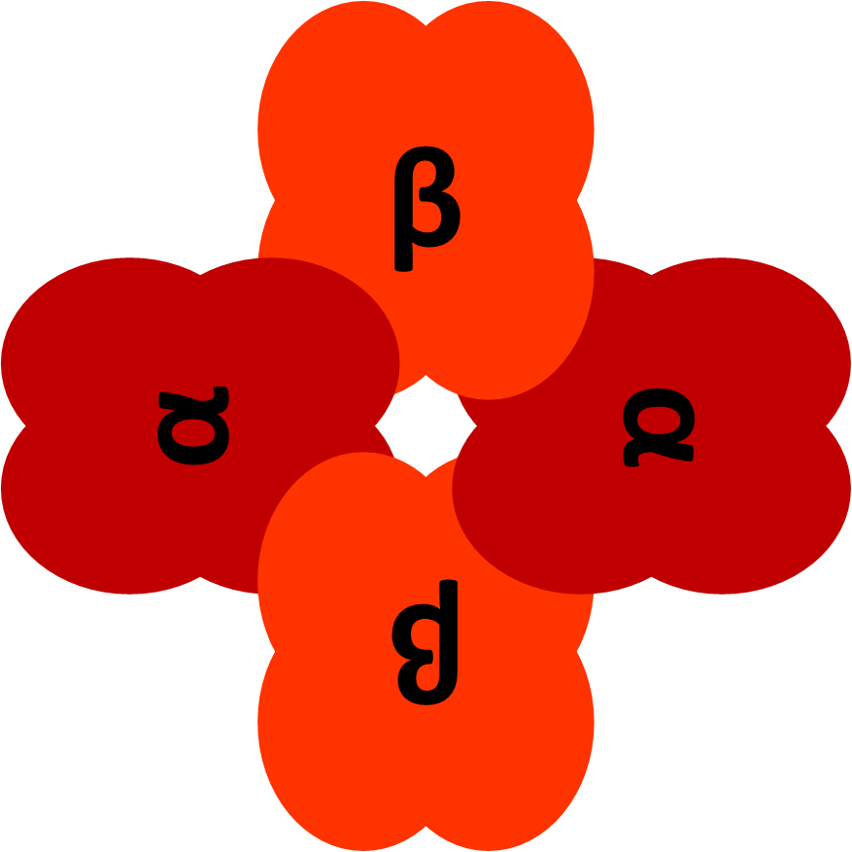
Hemoglobin – what makes your blood red.
Hemoglobin is the protein in red blood cells that carries oxygen through your body. It is what gives your blood its red color.
Hemoglobin is a tetramer – a protein made of four smaller protein subunits.
Two alpha-globin and two beta-globin subunits come together to make one hemoglobin protein.
Sickle cell anemia is a disease that affects the structure of the protein hemoglobin.

Slide 4
Hydrophobic and hydrophilic
Hydrophobic means to be repelled by water. Oil is an example of a hydrophobic substance.
Hydrophilic means that a substance will mix easily with water.
The inside of your cells are mostly water, so proteins, like hemoglobin, that are dissolved in the cytoplasm need to have a hydrophilic exterior.

Slide 5
The sickle cell mutation
Sickle cell disease is caused by a mutation that affects the 6th amino acid in the beta-globin polypeptide chain.
Most beta-globin subunits have glutamic acid, a hydrophilic amino acid, which will mix well with the cytoplasm, in the 6th position.
The mutation that leads to sickle cell causes there to be valine, a hydrophobic amino acid, in the 6th position.

Slide 6
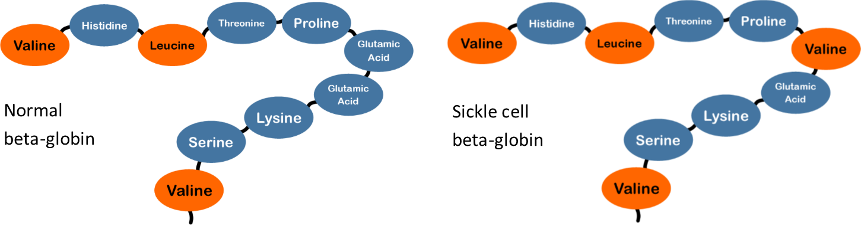
The sickle cell mutation
The first ten amino acids in the beta globin subunit.
Hydrophobic amino acids are represented by the color orange.
Hydrophilic amino acids are represented by the color blue.

Slide 7
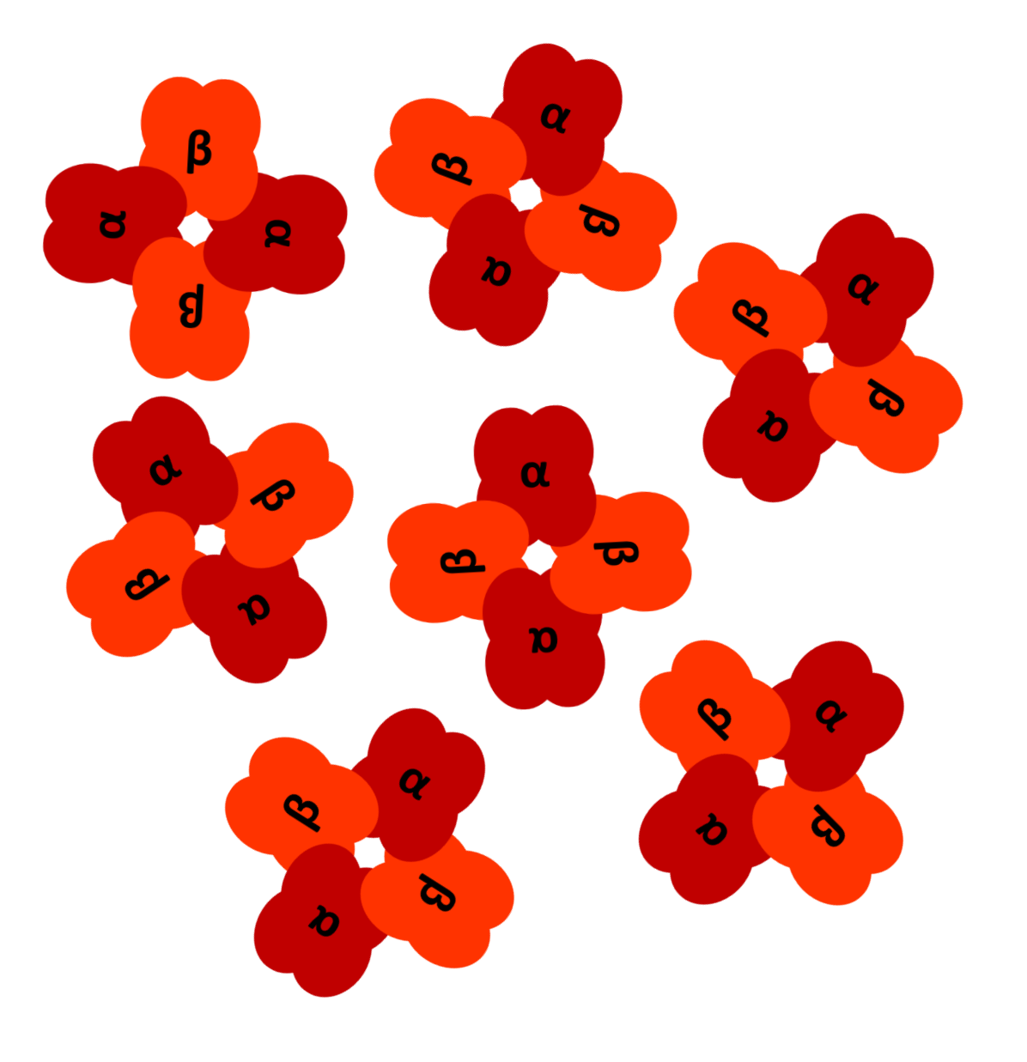
Normal hemoglobin
In a person who is homozygous for normal beta-globin, all of the amino acids on the exterior of the hemoglobin protein are hydrophilic.
The protein dissolves easily in the cytoplasm.
All hemoglobin proteins can move freely.

Slide 8
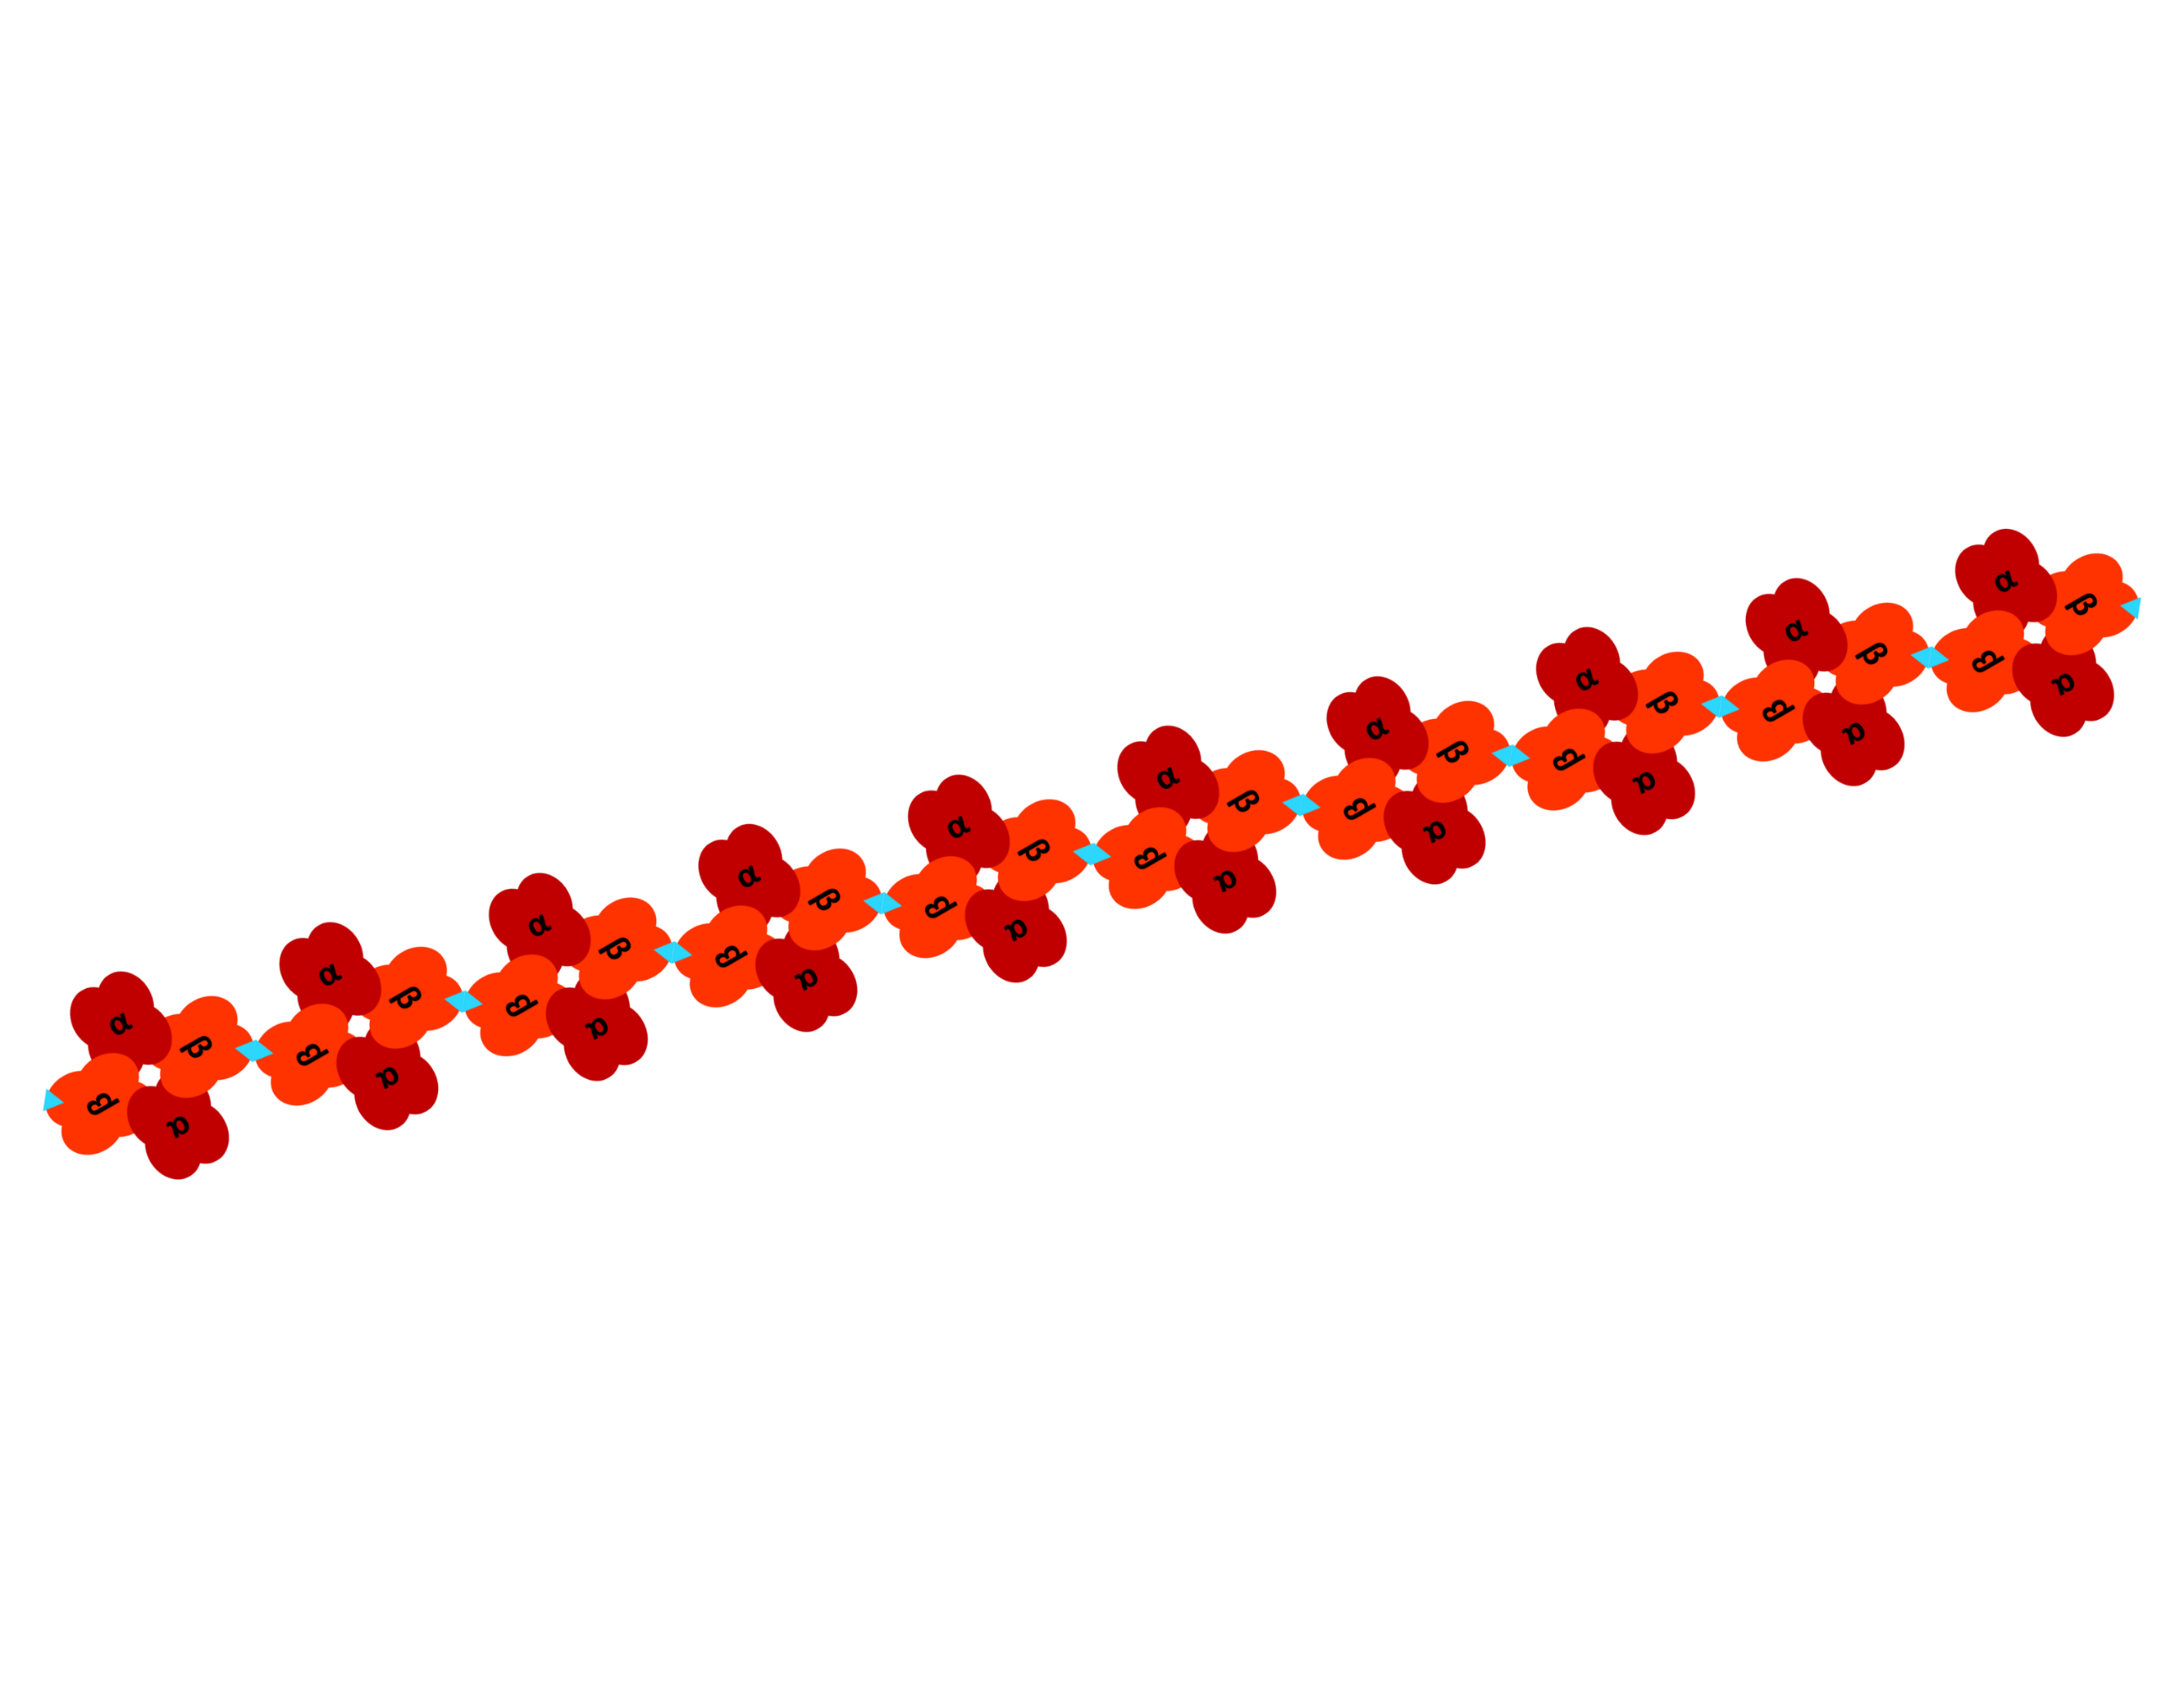
Sickle Cell Disease
In a person who is homozygous for sickle cell beta-globin, the hydrophobic valine is found on the exterior of the protein on each of the two beta-globin subunits.
The valines (represented here by blue triangles), clump together, as they are repelled by the water.
This results in very long chains of hemoglobin protein.

Slide 9
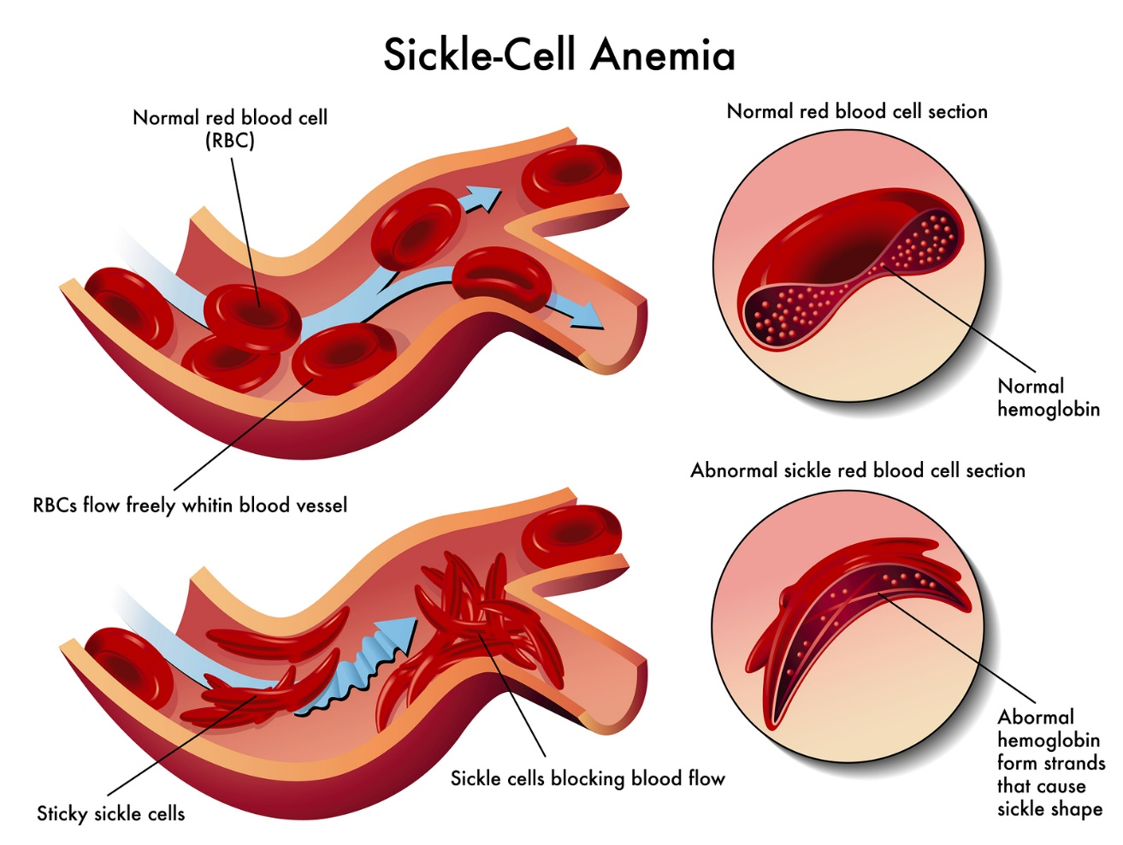
Sickle cell disease
These long chains of hemoglobin cause the cell to “sickle” in shape and lead to many serious health concerns.
Illustration courtesy Diana Grib under Creative Commons license

Slide 10
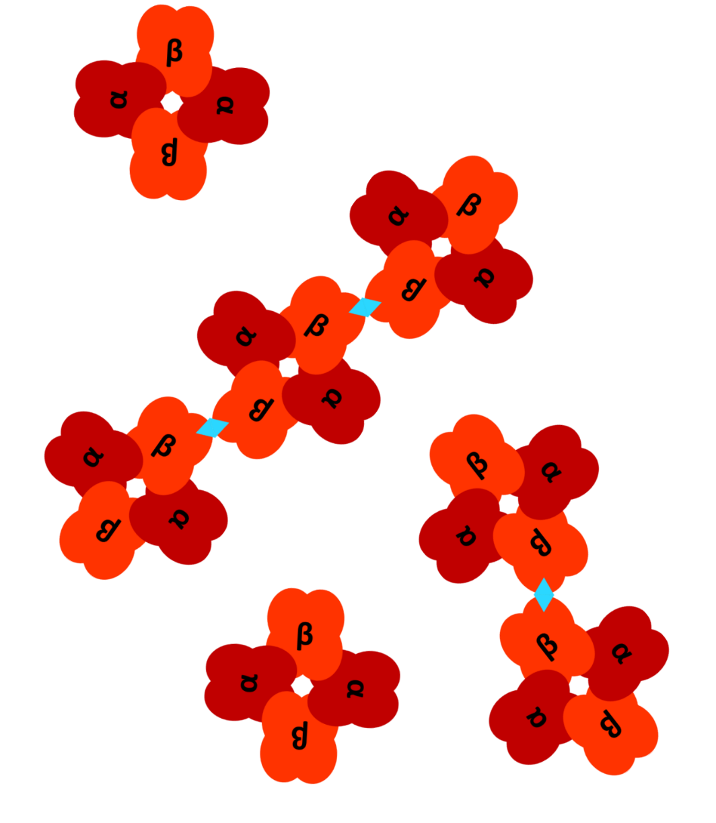
Sickle cell trait
In a person who is heterozygous for sickle cell beta-globin, both normal beta-globin and sickle cell beta-globin will be used to make the hemoglobin protein.
Some hemoglobin molecules will clump together, but it is unlikely that long chains will form.
These people are unlikely to ever experience symptoms.

Slide 11
A recessive trait
Sickle cell disease is considered a recessive trait.
You must have two copies of the sickle cell allele to have sickle cell disease.
Having only one copy of the sickle cell allele means that you will not be sick, but that you are a carrier. We say that people with only one copy of the sickle cell allele have the “sickle cell trait”.
Two parents who are carriers can have children with or without the disease.
A = normal beta globin
S = Sickle cell Beta globin
 | A | S
A | AA | AS
S | AS | SS

Slide 12
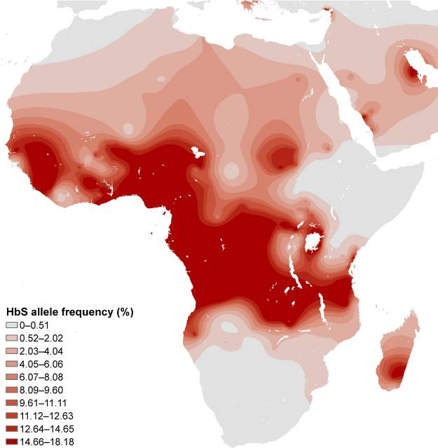
Sickle cell risk factors
Sickle cell disease is a genetic disorder, meaning it must be inherited.
Therefore, the single largest risk factor is family history and by extension, ancestry.
Sickle cell is by far most common in people who are from, or who’s ancestors are from, central West Africa.
From: Sickle Cell Disease in Africa, Grosse et al. 2011

Slide 13
Sickle cell disease symptoms
Sickled cells are regularly removed from the blood by the liver and spleen. As a result, sickle cell disease patients tend to be anemic (have low red blood cell count).
Sickled cells that block blood vessels can cause extremely painful episodes called a “sickle cell crisis”.
The spleen is often severely damaged in sickle cell patients. This can lead to low immune function.
Low immune function in sickle cell patients can lead to regular infections.
Without medical intervention, many sickle cell disease patients die before the age of five, often from pneumonia or other infections.

Slide 14
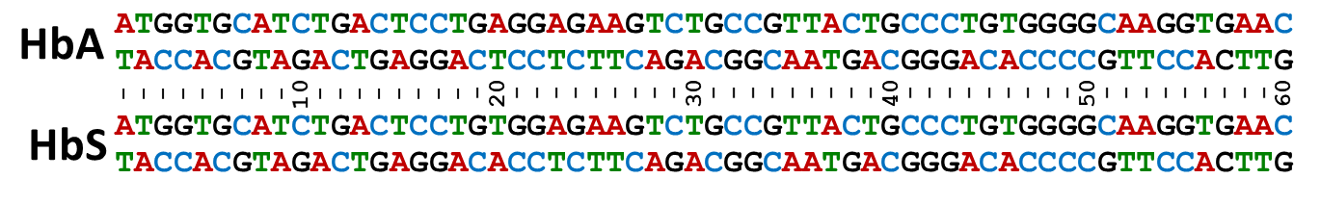
A genetic test for sickle cell
The mutation that causes sickle cell is a change from and adenine (A) to a thymine (T) in position 20 of the beta-globin coding sequence.
We can test for this mutation using a restriction enzyme.

Slide 15
Restriction enzyme DdeI
Restriction enzymes recognize a very specific sequence of DNA. When sequence is recognized, the enzyme cuts the DNA in two.
The restriction enzyme DdeI cuts DNA whenever it encounters the sequence CTGAG.
The sequence CTGAG is only present in the HbA, or normal, beta-globin sequence, so only that sequence will be cut by the restriction enzyme.

Slide 16
Today’s lab
Robinson family: The Robinson family has been referred to genetic testing and counseling after their infant daughter, Marie, was identified in routine infant screening as possibly having sickle cell disease.
Your job: Use genetic techniques to test whether each member of the Robinson family has sickle cell disease, the sickle cell trait, or is unaffected by sickle cell.

Slide 17
Medical histories
Jacqueline: Jacqueline is a 32-year-old female who was born in Port-au-Prince, Haiti. She immigrated to the United States with her family when she was 5 years old. She reports no abnormal medical history other than occasional migraine headaches. She has three surviving sisters, all of whom are in normal health. Jacqueline’s older brother died from pneumonia as a 1-year-old while the family was still living in Haiti. Jacqueline is of primarily African descent. Jacqueline does not believe that she has ever been tested for sickle cell.
Cory: Cory is a 32-year-old male who was born and raised in the United States. Cory reports nothing abnormal in his medical history. Cory is one of three children. He has two older sisters, both surviving, who also have nothing abnormal in their medical histories. Cory is of primarily African descent. Cory has never been tested for sickle cell.
Risk Factors?

Slide 18
Medical histories continued
Samuel: Samuel is a 4-year-old healthy boy. Jacqueline reports that her pregnancy with Samuel was normal and that he has had no major illnesses. Samuel did not show any abnormalities in his routine infant screenings.
Marie: Marie is 2 months old. Jacqueline reports that her pregnancy with Marie was normal. A pre-natal screening program found low levels of normal hemoglobin in Marie’s blood and she was referred to follow up testing. A second blood test was inconclusive.
Risk Factors?

Slide 19
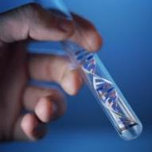


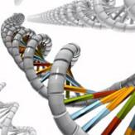
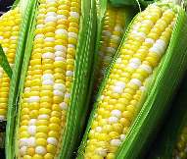
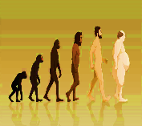

PCR is at the heart of DNA analysis
Molecular
diagnostics
Text
Consumer
genomics
Personalized medicine
Text
Text
PCR
Text
Text
Human evolution
Food and
agriculture
Text
Forensics

Slide 20
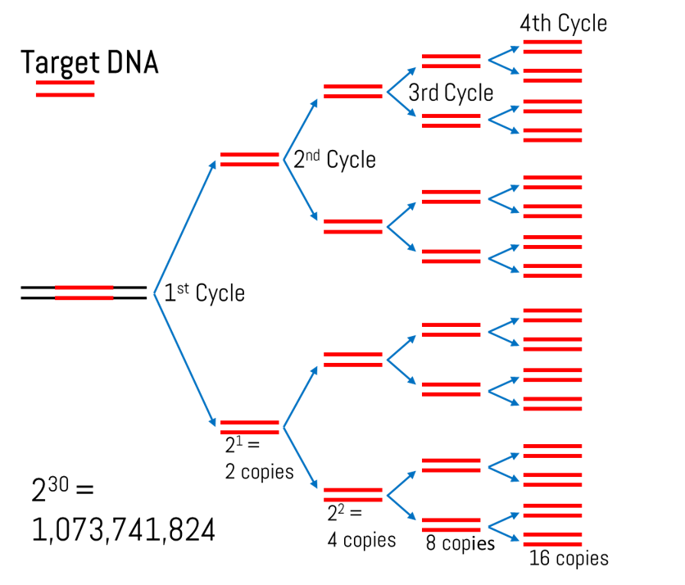
PCR cycles amplify DNA exponentially
After 30 cycles, we expect to have over 1 billion copies of our target DNA.

Slide 21
Using PCR on the beta-globin gene
With PCR we can make billions of copies of a very specific sequence of DNA very quickly.
Making copies of the beta-globin gene will allow us to use restriction digest to tell if the DNA has the sickle cell mutation.
But after a restriction digest, how do tell if the DNA has been cut by the restriction enzyme?

Slide 22
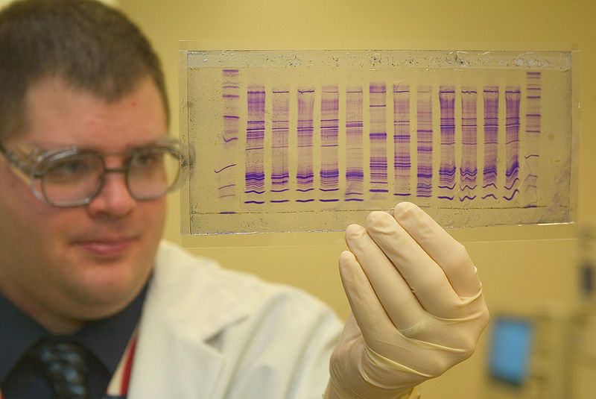
Gel electrophoresis is a method of separating molecules
Gel electrophoresis separates molecules based on 2 basic factors, size and charge-to-mass ratio.
For DNA, because all DNA has the same charge to mass ratio, only size matters.
A scientist views his results on a polyacrylamide gel
Photo: James Tourtellotte, CBP Today

Slide 23
Gel electrophoresis - agarose gels
Today we will be using agarose gels.
Agarose gels are typically used for separating DNA. Agarose is a polysaccharide extracted from seaweed and is safe to handle.
The gel is a matrix, similar to web-like obstacle course that molecules are pulled through.
Smaller molecules have an easier time making it through the obstacles and so move faster.
Larger molecules have more trouble making it through the obstacles and so move slower.

Slide 24
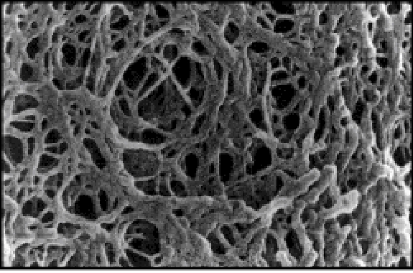
Electron micrograph of the agarose gel matrix
https://openwetware.org/wiki/File:Be109agarosegelEM.jpg

Slide 25
Larger molecules migrate more slowly through the matrix.
+

Slide 26


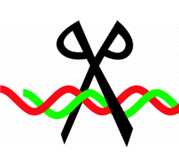
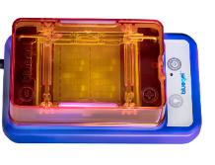


Today we will look at results
Electrophoresis is the final step in the experimental chain.
DNA extraction
PCR
Restriction Digest
Gel electrophoresis

Slide 27
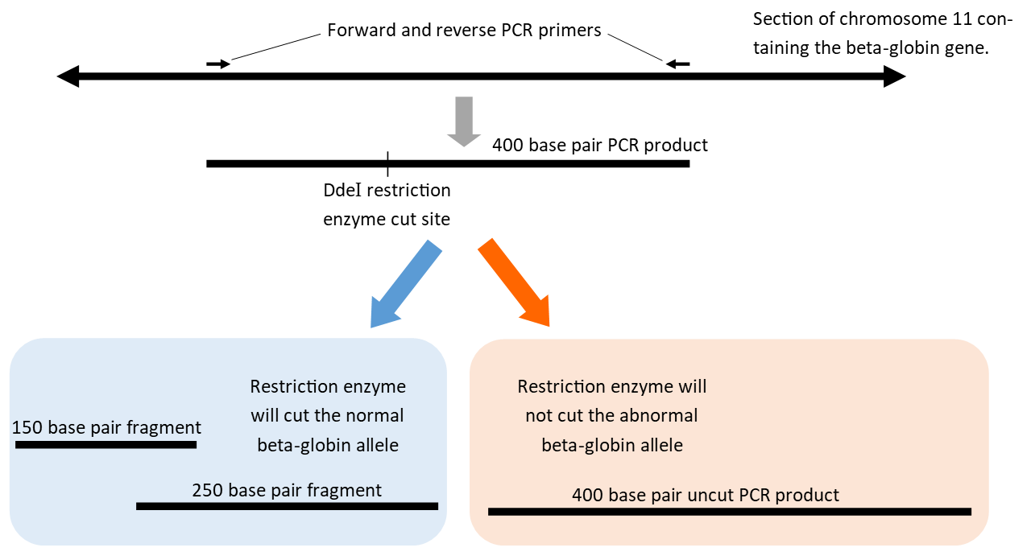
Experimental design

Slide 28
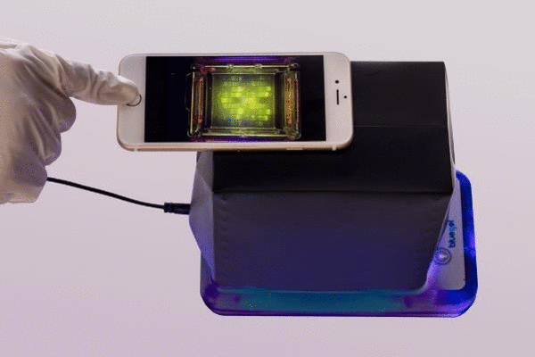
blueGel separates DNA by size and allows for real-time illumination.

Slide 29
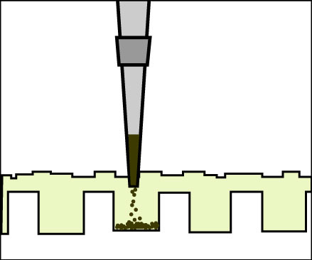
Visualize the DNA fragments amplified by PCR
Lane 1: 8µL DNA ladder
Lane 2: 10µL Jacqueline DNA
Lane 3: 10µL Cory DNA
Lane 4: 10µL Samuel DNA
Lane 5: 10µL Marie DNA

Slide 30
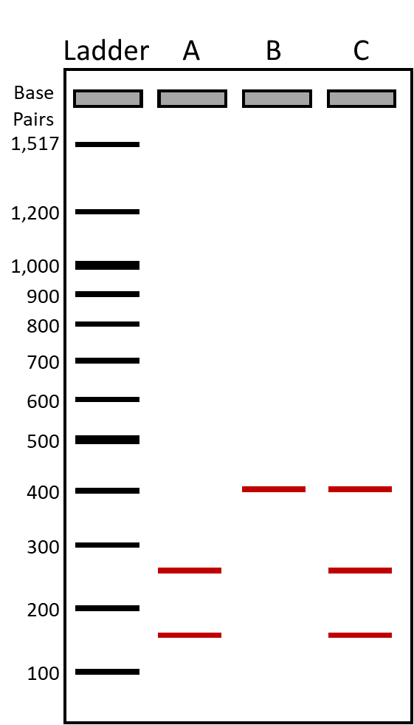
How to interpret the gel run with the PCR products
A
B
Individual “A” has had all of the PCR product cut by the restriction enzyme.
Now, instead of one 400 base pair product, there are two bands at 150 and 250 base pairs.
Individual A is homozygous for normal hemoglobin.

Slide 31
How to interpret the gel run with the PCR products
A
B
Individual “B” has had no PCR product cut by the restriction enzyme.
There is only a single 400 base pair band. This is the same size as the intact PCR product.
Individual B is homozygous for sickle cell hemoglobin and has sickle cell disease.

Slide 32
How to interpret the gel run with the PCR products
A
B
Individual “C” has only some PCR product cut by the restriction enzyme.
There is a 400 base pair band of uncut PCR product. There are also bands at 150 and 250 base pairs, indicating that some of the DNA was cut by the restriction enzyme.
Individual C is a heterozygote. This person has both the sickle cell and normal allele for beta-globin. They are said to have the sickle cell trait.

Slide 33

What is you diagnosis?
Can you diagnose:
  Jacqueline?
  Cory?
  Samuel?
  Marie?

Slide 34
Thank you
We hope you enjoyed this lab!

Slide 35
Extensions

Slide 36
Heterozygote advantage
If sickle cell disease is so dangerous, why has it not been removed from the population by natural selection?
People who are heterozygous for the sickle cell allele (people with sickle cell trait) show an increased resistance to malaria.
If you are an HbA homozygote, you are at risk of dying from malaria, a major killer in tropical regions around the world.
If you are and HbS homozygote, you have sickle cell disease and (until very recently in human history) are likely to die of it in childhood.
HbA/HbS heterozygotes show resistance to malaria and typically show no symptoms of sickle cell.
When heterozygotes reproduce they are likely to produce both types of homozygotes.

Slide 37
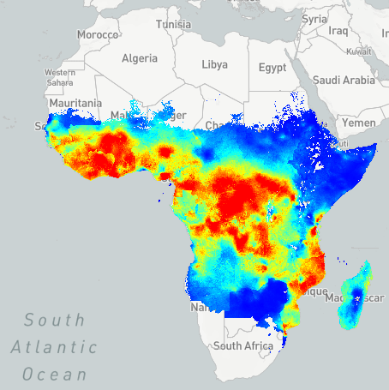
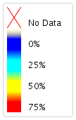
Sickle cell and malaria
Prevalence of sickle cell allele in Africa
Prevalence of malaria in Africa
From: Sickle Cell Disease in Africa, Grosse et al. 2011
From: https://map.ox.ac.uk/explorer/#/explorer

Slide 38
Balanced Polymorphism
Another name for heterozygote advantage is a balanced polymorphism.
When the HbS allele is rare in the population, most alleles will be found in heterozygotes, and therefore will not suffer from sickle cell disease.
As people die from malaria, HbS carriers will have protection and natural selection will cause the frequency of the HbS allele to rise in the population.
As the HbS allele becomes more common, more and more people will be born as homozygotes and will suffer from sickle cell disease.
As people die of sickle cell disease, natural selection will keep the frequency of the HbS from rising any further.
Natural selection against both homozygotes will lead to both the HbS and HbA alleles becoming “balanced” in the population.

