Slide 1
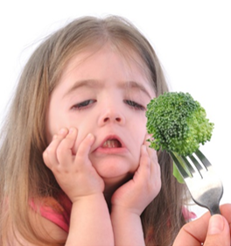
PTC Taster Lab
Genotype to Phenotype

Slide 2
Today’s lab
Examine the link between genotype and phenotype using yourself as an experimental subject!
Today you will:
  Assess your ability to detect the bitter testing chemical PTC
  Genotype yourself for the gene that encodes the bitter taste receptor that binds PTC

Slide 3
Presentation outline
Background
Lab protocol
Extension activities

Slide 4


PTC (Phenylthiocarbamide)
Chemical not normally found in foods
When tasted, elicits one of two responses
Doesn’t taste like anything to me
Yuck, that is bitter!

Slide 5
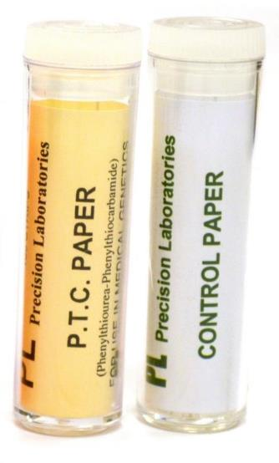
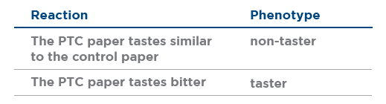
Determining your phenotype
Place the control paper strip on your tongue. This will give you a baseline of what plain paper tastes like.
Place the PTC paper strip on your tongue and rate your reaction using the guidelines below:
Notes:
Uck. It’s not good.

Slide 6
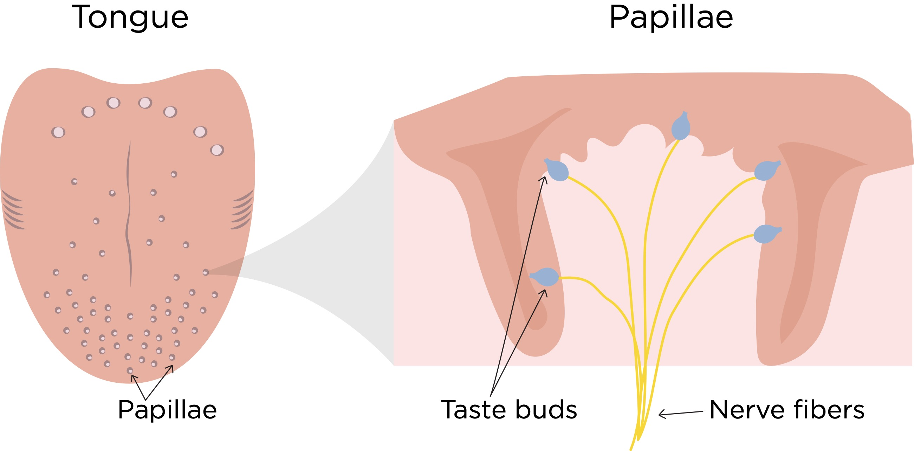
Taste
The tongue is covered in bumps called papillae, many of which contain taste buds
A taste bud is a cluster of specialized taste cells
Notes:
Hundreds of papillae
3-5 Buds per papillae – More on back of tongue and side
30-100cells per bud – gustatory cells

Slide 7
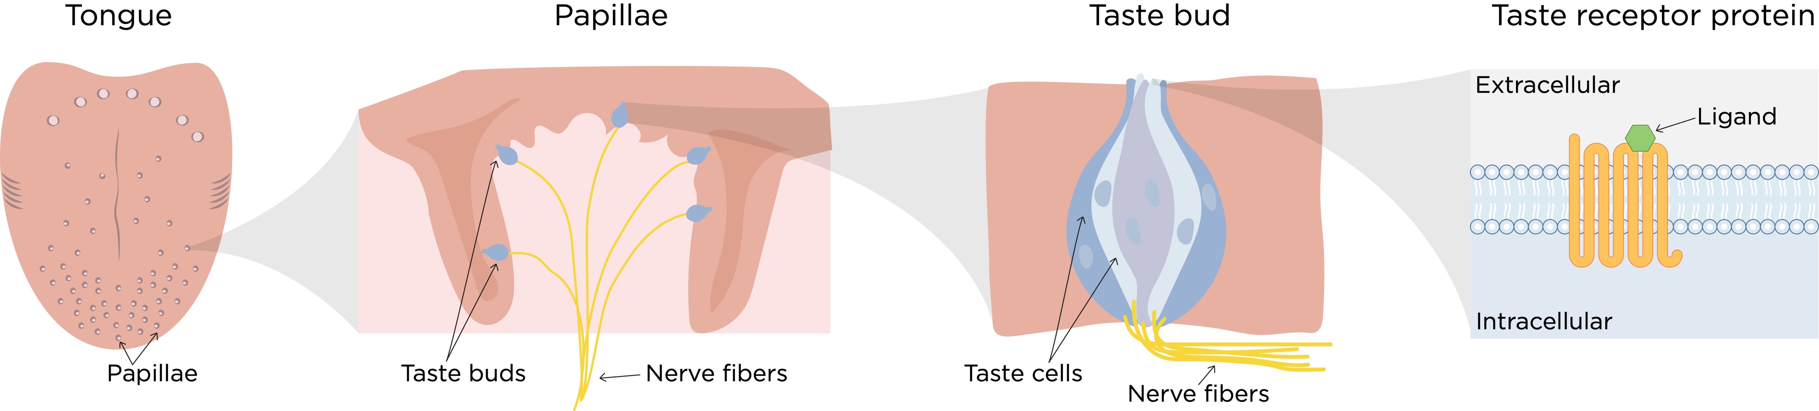
Taste
The tips taste cells contain receptors that detect various chemicals that enter the mouth
Information collected by taste receptors leads to a signal being sent to the brain where the perception of taste occurs
Notes:
Hundreds of papillae
3-5 Buds per papillae – More on back of tongue and side
30-100cells per bud – gustatory cells

Slide 8
TAS2R38 taste receptor
Binds the chemical PTC as well as other other bitter tasting compounds
Whether or not a person can taste PTC depends on their genotype for the TAS2R38 gene
Model made using Swiss-Model
Waterhouse, A., Bertoni, M., Bienert, S., Studer, G., Tauriello, G., Gumienny, R., Heer, F.T., de Beer, T.A.P., Rempfer, C., Bordoli, L., Lepore, R., Schwede, T. SWISS-MODEL: homology modelling of protein structures and complexes. Nucleic Acids Res. 46, W296-W303 (2018).

Slide 9
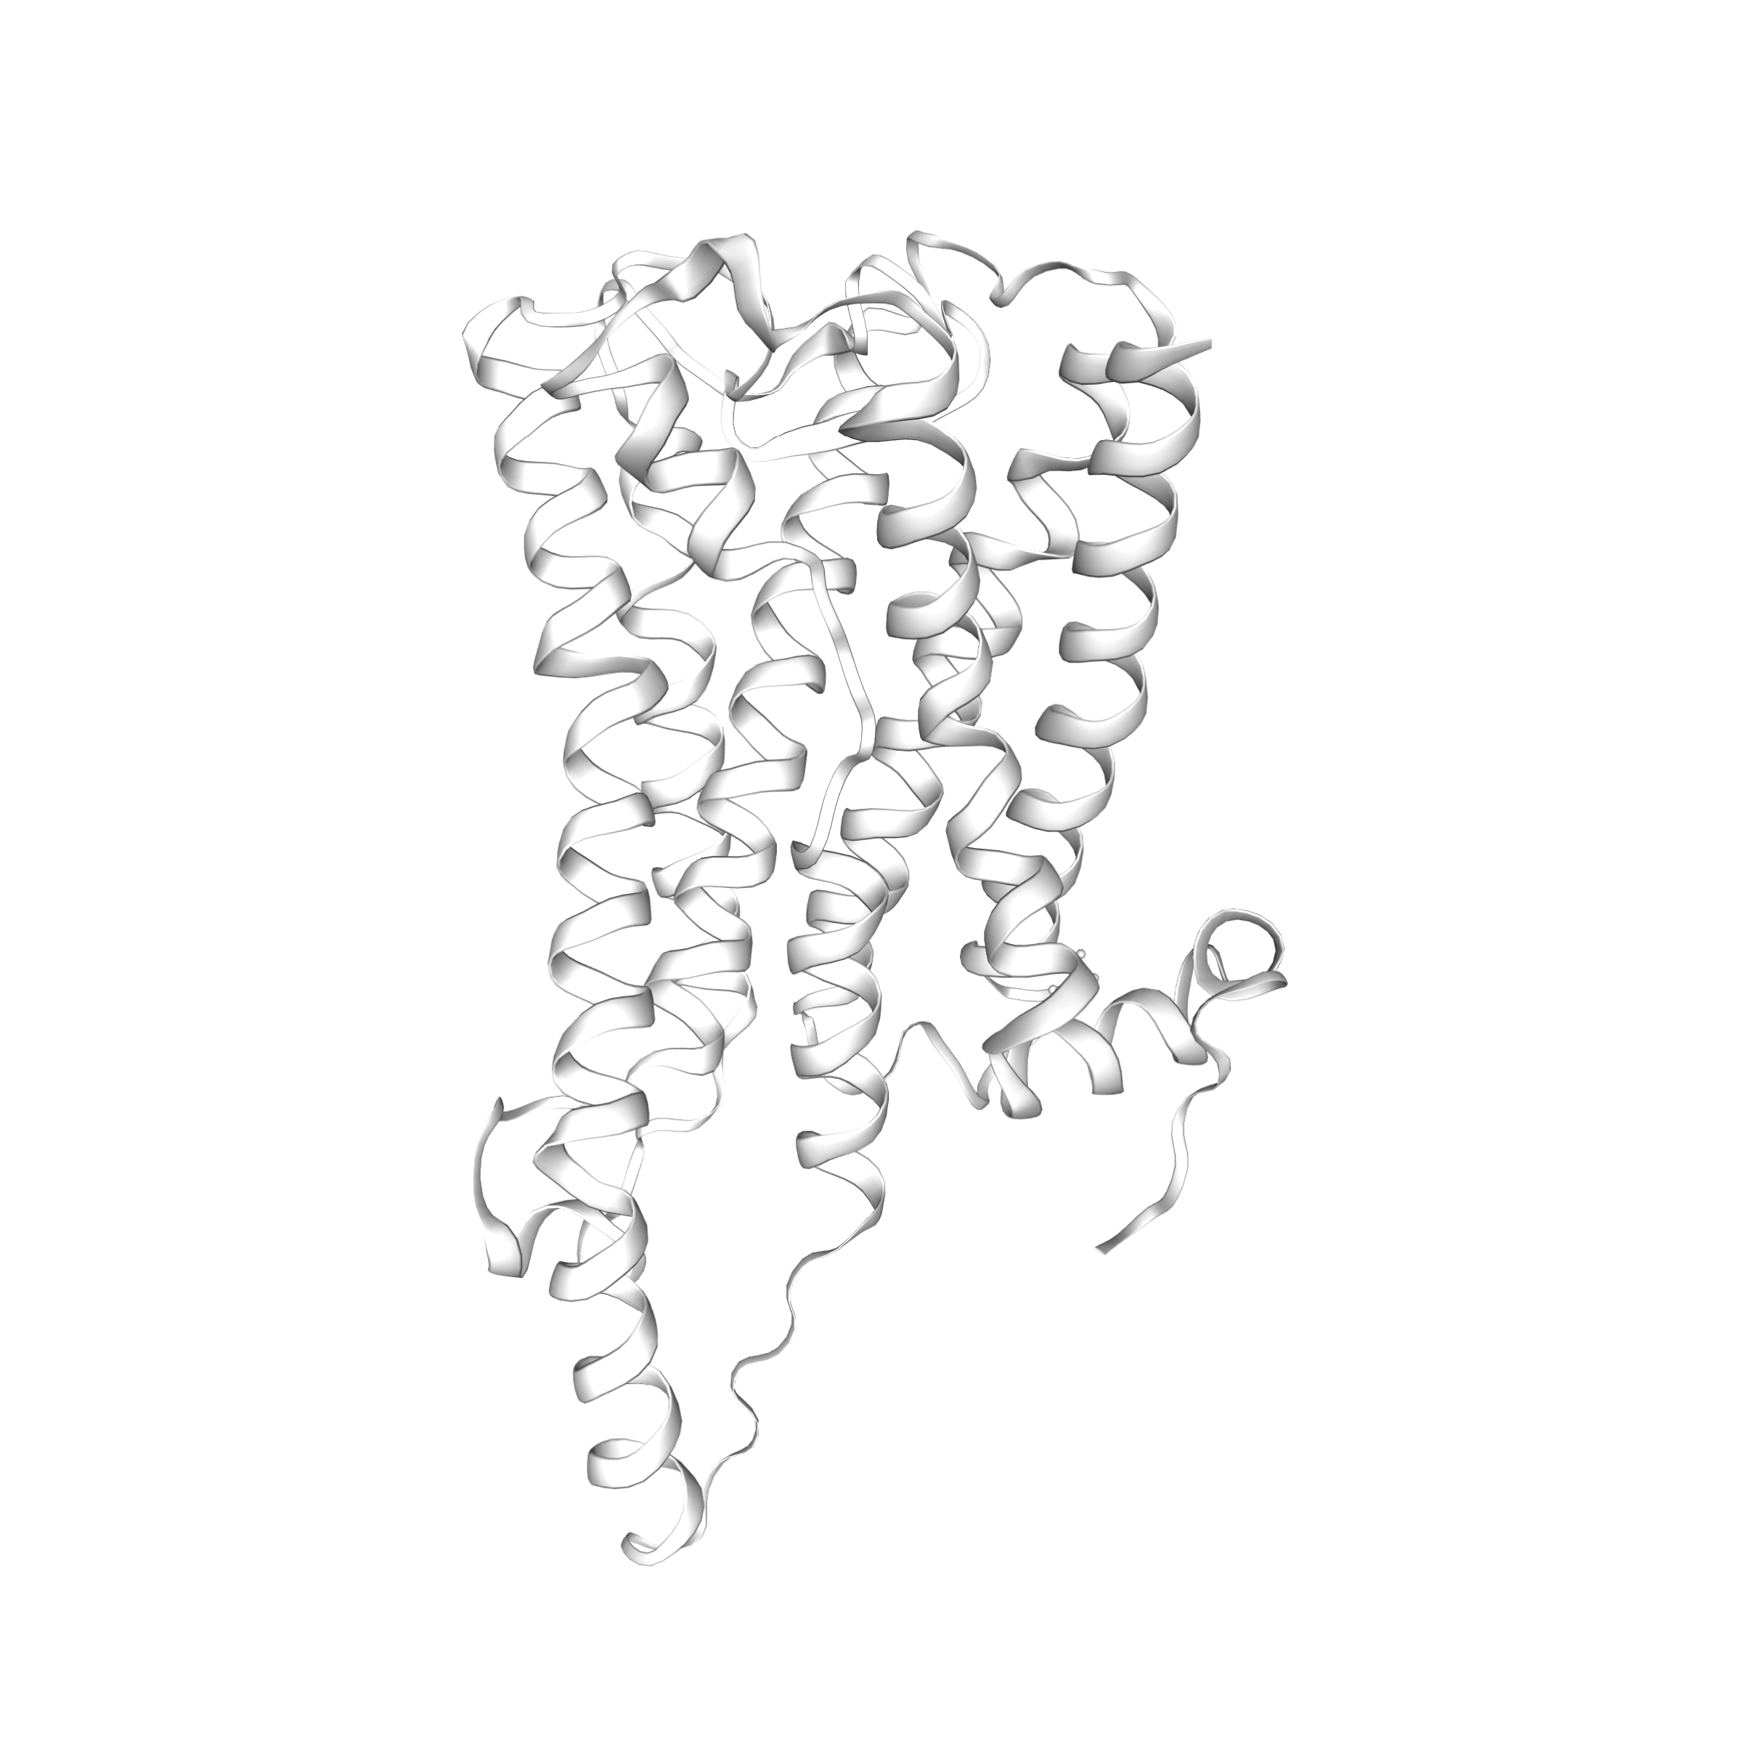
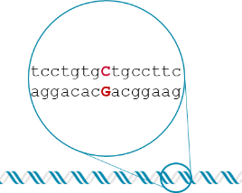
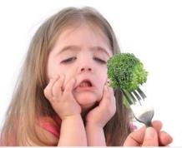
We understand this phenotype down to the gene
TRANSLATION
AAAAAA
TRANSCRIPTION
SIGNAL
TRANSDUCTION
‘taster’ mRNA
‘non-taster’ mRNA
‘taster’ protein
‘non-taster’ protein
genotype
phenotype

Slide 10
TAS2R38 genetic variability: 2 alleles, 3 SNPs
aggcagCcactgagc
tccgtcGgtgactcg
tcctgtgCtgccttc
aggacacGacggaag
gcagccGtcctgatc
cgtcggCaggactag
TAS2R38 allele 1
SNPs: Single Nucleotide Polymorphisms
aggcagGcactgagc
tccgtcCgtgactcg
tcctgtgTtgccttc
aggacacAacggaag
gcagccAtcctgatc
cgtcggTaggactag
TAS2R38 allele 2

Slide 11
The SNPs are in the coding region
TAS2R38 allele 1
aggcagCcactgagc
tccgtcGgtgactcg
tcctgtgCtgccttc
aggacacGacggaag
gcagccGtcctgatc
cgtcggCaggactag
Transcription
aggcagCcacugagc
uccugugCugccuuc
gcagccGuccugauc
Translation
R-Q-P-L-S
S-C-A-A-F
A-A-V-L-I

Slide 12
The SNPs are in the coding region
TAS2R38 allele 1
: PAV = functional TAS2R38
aggcagCcactgagc
tccgtcGgtgactcg
tcctgtgCtgccttc
aggacacGacggaag
gcagccGtcctgatc
cgtcggCaggactag
aggcagCcacugagc
uccugugCugccuuc
gcagccGuccugauc
R-Q-P-L-S
S-C-A-A-F
A-A-V-L-I
TAS2R38 allele 2
: AVI = non-functional TAS2R38
aggcagGcactgagc
tccgtcCgtgactcg
tcctgtgTtgccttc
aggacacAacggaag
gcagccAtcctgatc
cgtcggTaggactag
aggcagGcacugagc
uccugugUugccuuc
gcagccAuccugauc
R-Q-A-L-S
S-C-V-A-F
A-A-I-L-I

Slide 13
TAS2R38 genetic variability: 2 alleles, 3 SNPs
SNP at
position 886
SNP at position 145
SNP at
position 785
*
*
*
1,148 bp TAS2R38 gene
TAS2R38 gene position (bp) | TASTER ALLELE (T) |  | NON-TASTER ALLELE (t)
TSAR38 gene (bp) | Codon | Amino acid | Codon | Amino acid
145 | CCA | Pro | GCA | Ala
785 | GCT | Ala | GTT | Val
886 | GTC | Val | ATC | Ile

Slide 14
The taster allele is dominant
Whether or not a person can taste PTC depends on their genotype for the TAS2R38 gene
But scientists do not fully understand how the sequence differences in the 2 alleles affect TAS2R38 protein function
TAS2R38 genotype | PTC tasting phenotype
TT | Taster
Tt | Taster
tt | Non-taster

Slide 15
Presentation outline
Background
Lab protocol
Extension activities

Slide 16
Lab overview
You will perform four steps to determine your TAS2R38 genotype
DNA
extraction
Polymerase
chain reaction
Restriction
digestion
Gel
electrophoresis

Slide 17
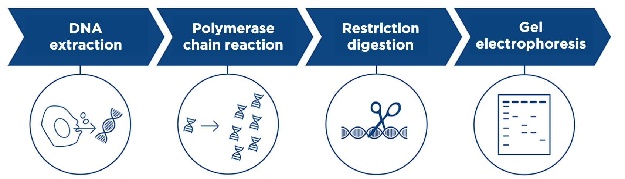
Lab overview
  Extract DNA from your cheek cells
  Use PCR to make many copies of an ~250 bp region of the TAS2R38 gene
  Digest your PCR product with a restriction enzyme that cuts the TAS2R38 taster allele, but not the non-taster allele
  Visualize your results using gel electrophoresis

Slide 18
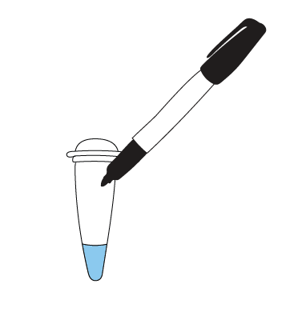
DNA extraction
You should receive a tube with 50 μl extraction buffer in it. Label the tube with your initials.

Slide 19
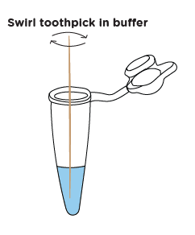
DNA extraction
Collect cheek cells
  Gently scrape the inside of your cheek 3-4 times with a flat-end toothpick
Transfer cheek cells to tube with buffer
  Dip the end of the toothpick with your cheek cells in the extraction buffer
  Swirl the toothpick to dislodge the cells
  Dispose of the toothpick

Slide 20
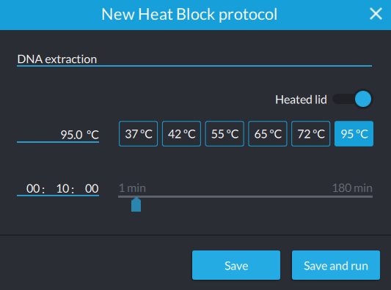
DNA extraction
Cap your tube
Incubate your sample for 10 minutes at 95°C
Remove your tube from heat and immediately use DNA extract for PCR

Slide 21
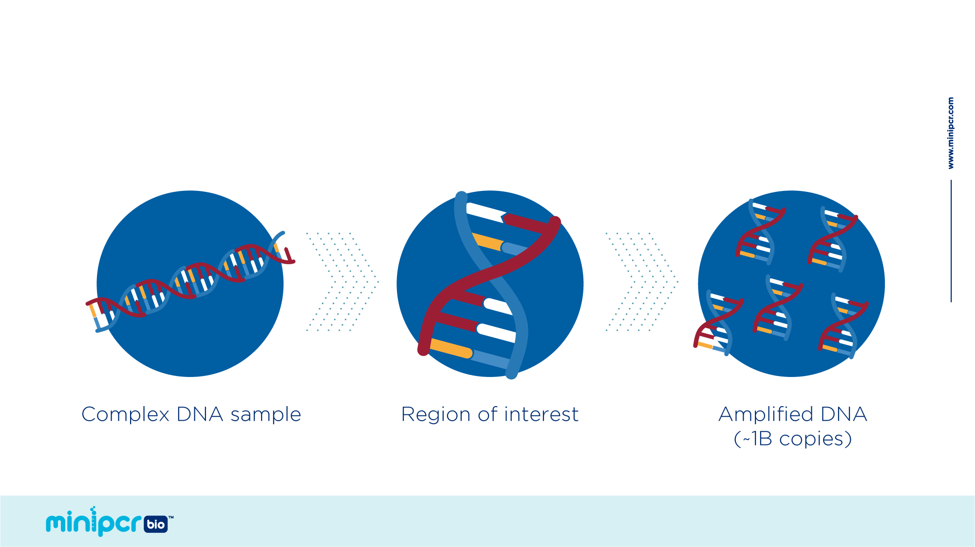
The Polymerase Chain Reaction
Find and replicate a specific DNA target
© 2019 by Amplyus LLC

Slide 22




PCR background:
3 steps to copy DNA
1) 94 °C
Denaturation
2) 57 °C
Annealing
Primer 2
Primer 1
3) 72 °C
Extension
Taq polymerase
dNTPs

Slide 23
Primers used today
The PTC Primer Mix that you will use contains primers that will lead to amplification of an ~250 bp region of the TAS2R38 gene
This ~250 bp region include a SNP that varies between the 2 alleles of the TAS2R38 gene
Once you have copied this ~250 bp region of the TAS2R38 gene you will use additional techniques to differentiate between the 2 alleles
SNP @ 145
SNP @ 785
SNP @ 886
*
*
*
1148 bp TAS2R38 gene
~250 bp PCR product

Slide 24
Prepare PCR samples
Add PCR reagents to your labeled PCR tube
 | Volume
EZ PCR Master Mix | 12.5 µl
PTC Primer Mix | 12.5 µl
Student DNA sample | 3 µl
Total Volume | 28 µl

Slide 25
PCR protocol
Program your thermocycler according to the protocol below:
  Initial Denaturation 94°C,120 sec
  Denaturation 94°C , 10 sec
  Annealing 58°C , 15 sec
  Extension 72°C , 40 sec
  Number of Cycles 30
  Final Extension 72°C , 5 sec

Slide 26
Restriction digestion
DNA
extraction
Polymerase
chain reaction
Restriction
digestion
Gel
electrophoresis
Your tubes now contain billions of copies of an ~250 bp region of the TAS2R38 gene
Now you will perform a restriction digestion to differentiate between the taste and non-taster alleles

Slide 27

Restriction enzymes
Recognize specific DNA sequences and cut the DNA
5’…GAATTC…3’
3’…CTTAAG…5’
5’…GCNGC…3’
3’…CGNCG…5’
EcoRI
Fnu4HI
tgtggc
acaccgt
agcctctg
cggagac

Slide 28
RFLP
5’…GCNGC…3’
3’…CGNCG…5’
Fnu4HI
Restriction fragment length polymorphism
Taster allele - SNP785
tgtgC
acacGa
tgcctt
cggaa
Non-taster allele – SNP785
tgtgTtgcctt
acacAacggaa

Slide 30
Restriction digestion
Label a new PCR tube (200 μl tube) with your initials and ‘RE’ for restriction digestion
Transfer 14 μl of your PCR reaction to your tube
Add 2 μl restriction enzyme to your tube and mix well
Incubate at 37°C for at least 15 minutes

Slide 31
Gel electrophoresis
DNA
extraction
Polymerase
chain reaction
Restriction
digestion
Gel
electrophoresis
Now you will use gel electrophoresis to visualize your samples
This will allow you to determine your TAS2R38 genotype

Slide 32
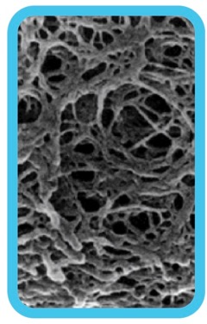
Gel electrophoresis separates DNA by size
- - - NEGATIVE - - -
DNA is negatively charged and moves towards the positive charge
The agarose gel forms a web
+ + + POSITIVE + + +

Slide 33
Gel electrophoresis separates DNA by size
- - - NEGATIVE - - -
Larger molecules move have more trouble moving through the web and travel slower
Smaller molecules move more easily through the web and travel faster
+ + + POSITIVE + + +

Slide 34

Gel electrophoresis
Different sized
pieces of DNA
Gel electrophoresis separates DNA by size.
Smaller pieces of DNA travel farther through the gel.
Longer
DNA pieces
Shorter
DNA pieces

Slide 35
Gel electrophoresis
A DNA ladder contains pieces of DNA of known lengths.
Comparing to the ladder allows you to estimate the size of the DNA in your samples.
Ladder
Base
Pairs
1200 -
~ 700 bp
700 -
500 -
300 -
~ 400 bp
200 -
100 -

Slide 36
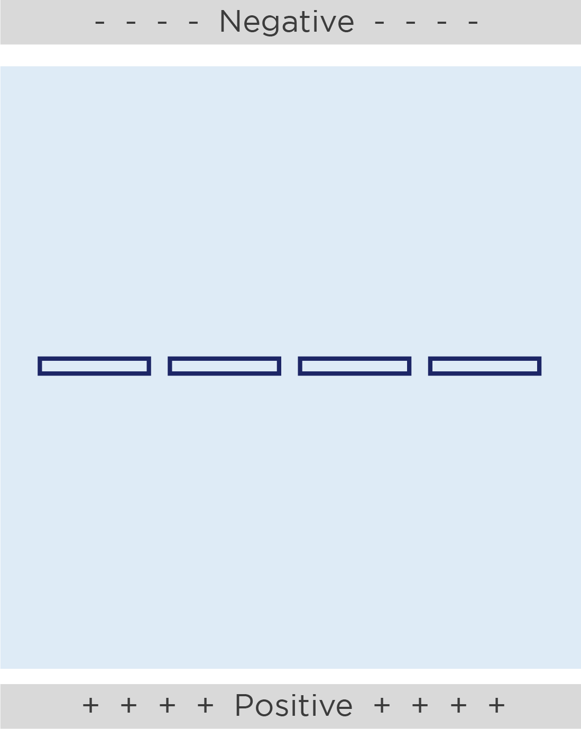

Gel loading tips
Gels have pockets called wells where we will add our samples.
The wells are a small target, so put your elbows on the table and hold the pipette with two hands.
Cross section of well

Slide 37


Gel loading tips
Pipette tip
Top of well
Place the micropipette tip just inside the opening of the well. Wiggle the tip back and forth to feel that the tip is in the well.
Do not stab your tip into the bottom of the well. The tip will either clog with gel or puncture the bottom of the well.
Too deep!

Slide 38
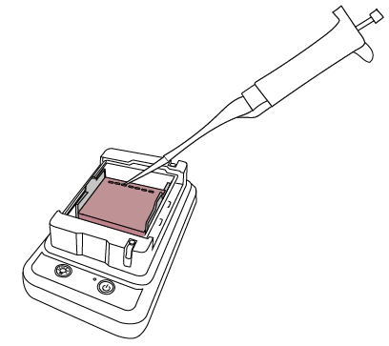
Load your gel
Lane 1: 10 μl Fast DNA Ladder 2
Lane 2: 15 μl Student 1’s restriction digest
Lane 3: 15 μl Student 2’s restriction digest
Lane 4: 15 μl Student 3’s restriction digest
Lane 5: 15 μl Student 4’s restriction digest
Be sure to write down whose sample you loaded in each well!

Slide 39
Expected results
TAS2R38 genotype | Band size(s)
TT | 150 bp + 100 bp
Tt | 250 bp 150 bp + 100 bp
tt | 250 bp

Slide 40
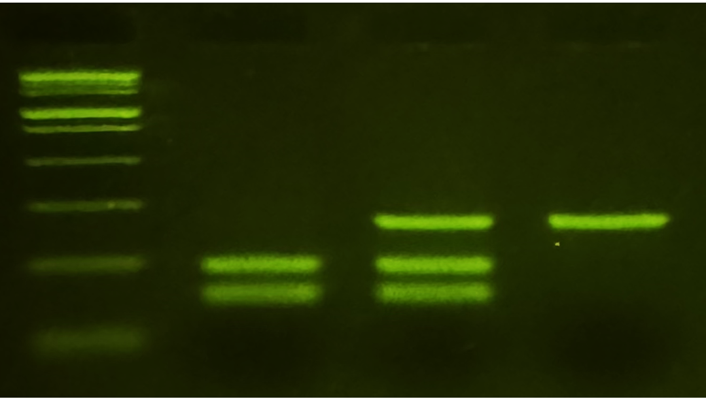
Expected results
TT
Tt
tt
TAS2R38 genotype | Band size(s)
TT | 150 bp + 100 bp
Tt | 250 bp 150 bp + 100 bp
tt | 250 bp
10,000 -
1,000 -
500 -
250 bp
300 -
150 bp
150 -
100 bp
50 -

Slide 41
Presentation outline
Background
Lab protocol
Extension activities
Quantifying PTC taste intensity
Using the Hardy-Weinberg equation
G protein-coupled receptors

Slide 42
Extension: Quantifying PTC taste intensity

Slide 43
Extension: Quantifying PTC taste intensity
Some experimental evidence suggests that heterozygous individuals may have an intermediate sensitivity to PTC (Bufe et al., 2005)
Score your perception of PTC bitterness to further investigate the relationship between TAS2R38 genotype and PTC taste intensity!
TAS2R38 genotype | PTC tasting phenotype
TT | Taster
Tt | Taster
tt | Non-taster

Slide 44
Quantifying PTC taste intensity
Scientists use a labeled magnitude scale to quantify the intensity of tastes
Subjects rate the intensity of a taste on a quasi-logarithmic scale of verbal descriptions
The physical location of the subject’s rating is then matched with a numerical value
These data are subjective

Slide 45
Quantifying PTC taste intensity
100
90
Place the control paper strip on your tongue to get a baseline of what plain paper tastes like.
Place the PTC paper strip on your tongue and rate the intensity of the taste by physically marking an “X” on the labeled magnitude scale.
Assign yourself a numeric score. The scale where you marked your perceived taste intensity should be exactly 10 cm. Use a ruler to measure how many millimeters the X you drew is from the bottom of the scale.
80
70
60
50
40
30
20
10
0

Slide 46
Quantifying PTC taste intensity
Calculate the average labeled magnitude scale score and standard error of the mean for each TAS2R38 genotype
TAS2R38 genotype | Average labeled magnitude score | Standard error of the mean
TT
Tt
tt

Slide 47
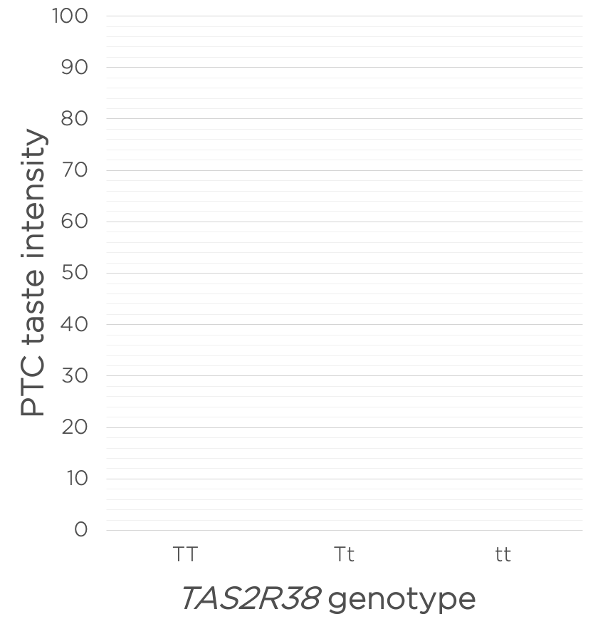
Quantifying PTC taste intensity
Graph your class data. Include error bars that indicate ± 1 SEM.
Does your class data support the hypothesis that people who are heterozygous for the TAS2R38 gene have an intermediate sensitivity to PTC? Explain your reasoning.

Slide 48
Extension: Using the Hardy-Weinberg equation

Slide 49
Extension: Using the Hardy-Weinberg equation
In a population that is not evolving, the prevalence of different alleles within a population are expected to remain the same over time. A population in this state is referred to as being in Hardy-Weinberg equilibrium.
The Hardy-Weinberg equation describes the genotype frequencies you would expect to see in a population that is in Hardy-Weinberg equilibrium.

Slide 50
Using the Hardy-Weinberg equation
In its simplest form, the Hardy-Weinberg equation describes a gene with two alleles. The convention is to use the symbols p and q to represent the frequencies of each allele in the population.
p² = the genotype frequency for individuals homozygous for the p allele
2pq = the genotype frequency for heterozygous individuals
q² = the genotype frequency for individuals homozygous for the q allele
p² + 2pq + q² = 1

Slide 51
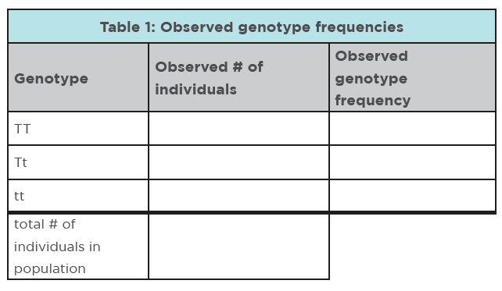
Using the Hardy-Weinberg equation
Based on your class genotype data, calculate the observed genotype frequencies.
Count the number of TT, Tt, and tt individuals in your class, then divide by the total number of individuals to get the observed genotype frequencies.

Slide 52
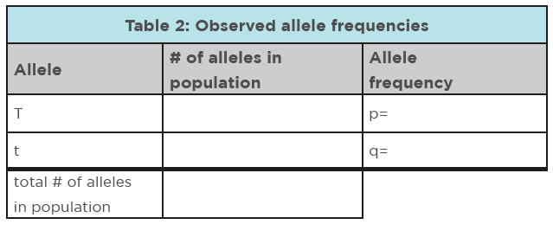
Using the Hardy-Weinberg equation
Based on your class data, calculate the observed allele frequencies.
Count the total number of T and t alleles in your class, then divide by the total number of alleles to get p and q.

Slide 53
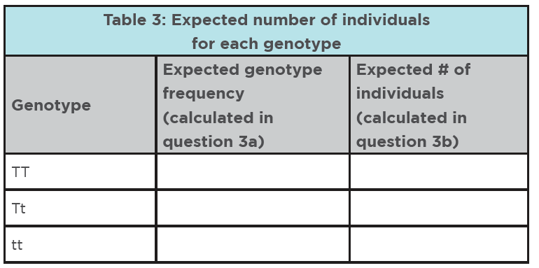
Using the Hardy-Weinberg equation
First, use the allele frequencies for your class that you calculated in Table 2 to determine the expected genotypic frequencies for a population in Hardy-Weinberg equilibrium.
Second, use the expected genotype frequencies that you calculated in the previous step to determine the expected number of individuals for each genotype in your class.

Slide 54
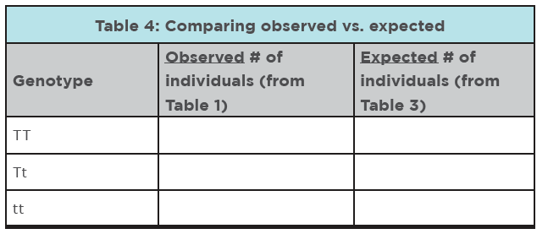
Using the Hardy-Weinberg equation
How similar are the observed and expected values?
With only this information, how confident do you feel in saying whether or not your class population is in Hardy-Weinberg equilibrium?

Slide 55
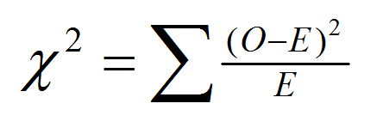
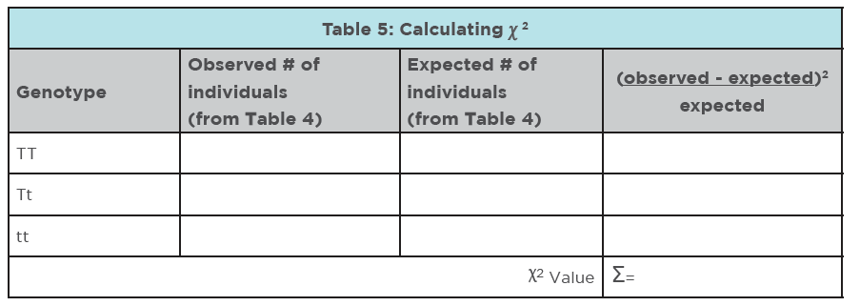
Using the Hardy-Weinberg equation

Slide 56
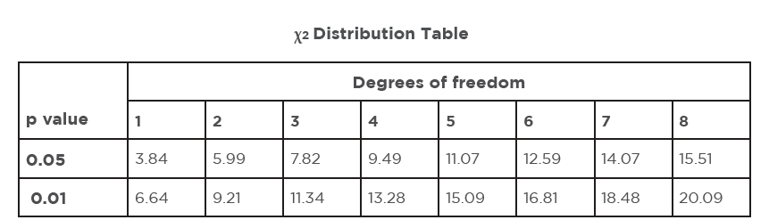
Using the Hardy-Weinberg equation
Use the 𝛘² value you calculated in Table 5 to determine whether the variation in the observed results could be due to chance.
Based on your 𝛘² value, do you reject or fail to reject the null hypothesis? Explain your reasoning.

Slide 57
Extension: G protein-coupled receptors

Slide 58
Extension: G protein-coupled receptors
Scientists do not fully understand how the sequence differences in the 2 alleles affect TAS2R38 protein function.
Use what is known about GPCR signaling to make predictions about the TAS2R38 protein.
extracellular
MEMBRANE
intracellular

Slide 59
G protein-coupled receptors
If the different versions of the TAS2R38 protein bind to ligands differently, roughly where would you expect the proteins to differ?
If the different TAS2R38 proteins interact with the G protein differently, roughly where on the protein would you expect the proteins to differ?
extracellular
MEMBRANE
intracellular

Slide 60
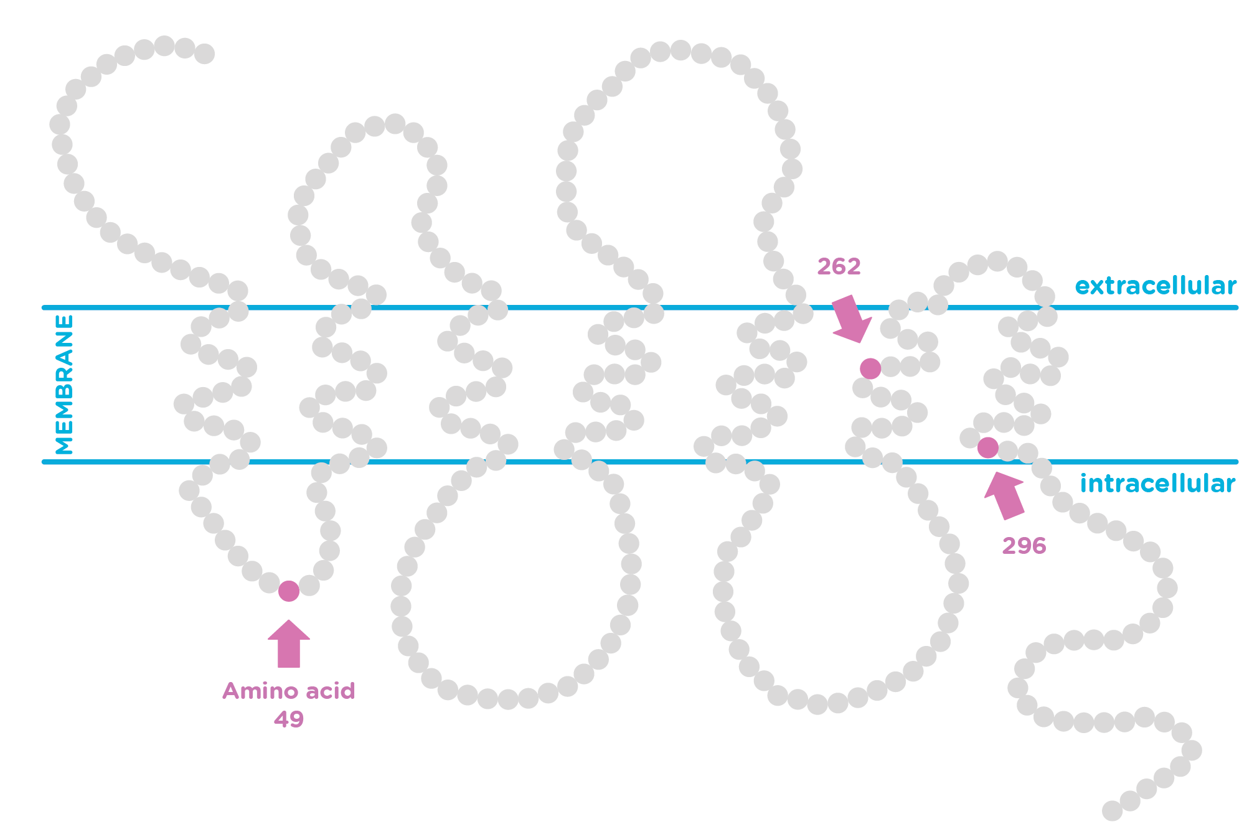
G protein-coupled receptors
Scientists do not fully understand how the sequence differences in the 2 alleles affect TAS2R38 protein function.
But they do know where the three amino acids that differ between the alleles are located in the protein.

Slide 61
G protein-coupled receptors
Just by looking at this diagram, would you predict that ligand binding or signal transduction is more likely to underline the ability to taste PTC?
How confident are you in your prediction?

Slide 62
G protein-coupled receptors
Assume amino acid 49 was the only difference between the taster and non-taster forms of the TAS2R38.
In this case, would you predict that changes to ligand binding or signal transduction is more likely to underlie the ability to taste PTC?
How confident are you in your prediction?

Slide 63
G protein-coupled receptors
Assume amino acid 262 was the only difference between the taster and non-taster forms of the TAS2R38.
In this case, would you predict that changes to ligand binding or signal transduction is more likely to underlie the ability to taste PTC?
How confident are you in your prediction?

Slide 64
G protein-coupled receptors
Assume amino acid 296 was the only difference between the taster and non-taster forms of the TAS2R38.
In this case, would you predict that changes to ligand binding or signal transduction is more likely to underlie the ability to taste PTC?
How confident are you in your prediction?

