Slide 1
COVID-19 RNA Vaccines
What are RNA vaccines and how do they work?
@miniPCR
Facebook.com/miniPCR
@miniPCR
© 2021 by Amplyus LLC

Slide 2
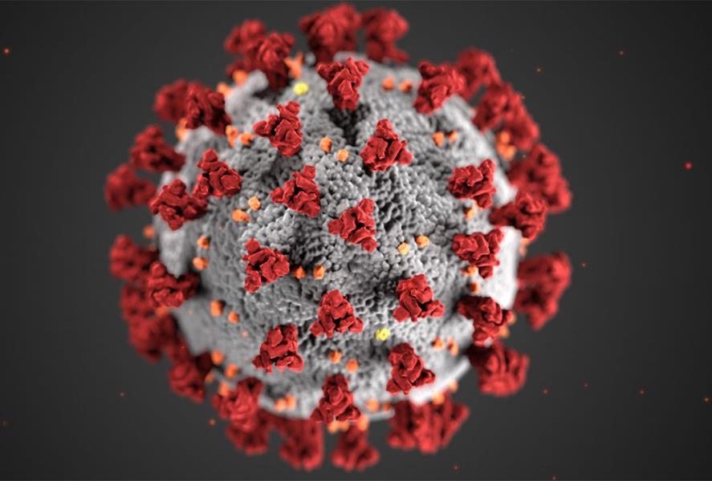
Overview
What is SARS-CoV-2?
What is an RNA vaccine?
How does our immune system respond?
How are they made?
Q&A

Slide 3
What is a virus?
DNA or RNA genome
Enclosed in some sort of shell
Different viruses can infect different hosts – bacteria, animals, plants, humans
Image: CDC
Notes:
So first up: what is a virus? Well a virus has two main parts. First, it has a nucleic acid genome. This can be DNA, like our own genomes, or it can be RNA.
Remember that in our own cells, information is stored as DNA. It is then copied into RNA molecules, which go out into the cell and give the cell instructions for how to make a protein. But in many viruses, the first step of DNA isn’t needed, and all of their instructions are stored as RNA.
The second part of a virus is some kind of shell that holds this nucleic acid genome. In many viruses, this is a protein shell called a capsid. In some viruses, like the novel coronavirus, there can be an additional shell made of lipids called an envelope.
And that’s really all there is to a virus: a genome, and some kind of shell that contains it. But you need both parts for it to be an infectious particle: the RNA on its own is just information, and can’t do much of anything.
Viruses have evolved to infect a whole range of hosts, including bacteria, animals, plants, and humans.
And viruses are not considered living things. This is because, despite having a genome like us, they cannot replicate on their own. One virus will just stay as one virus, unless it can infect a host cell and use the host cell’s own machinery to make more virus.

Slide 4
SARS-CoV-2 and COVID-19
Rabi et al. 2019
Notes:
https://www.mdpi.com/2076-0817/9/3/231/htm
So as we talked about before, SARS-CoV-2 is a virus, so it has all of the important parts of a virus. It has its genetic material, which is stores as RNA. Its RNA is wrapped in nucleocapsid proteins. It is then surrounded by a lipid envelope. And embedded in that lipid envelope are spike proteins. You probably have seen them as big red spikes in a lot of images online. And those spikes are why SARS-CoV-2 is classified as a coronavirus. These types of viruses, covered in spikes, look a bit like a crown, or a corona, when you look at them under a microscope.
And the lipid envelope is very important for us trying to keep ourselves and those around us healthy, because good old soap can disrupt it. So washing your hands truly is one of the best things that you can do, because the virus needs both parts, the RNA and its external package, to be infectious. So disrupting that lipid membrane with soap can help inactivate it as well as just washing it off your hands.
Those spike proteins are also how the virus enters our cells. They bind to something called the ACE-2 receptor on the surface of our lung cells, and then enter inside.

Slide 5





Viral replication cycle
Host cell
Ribosome
Antibodies
Receptors
Enzymes

Slide 6
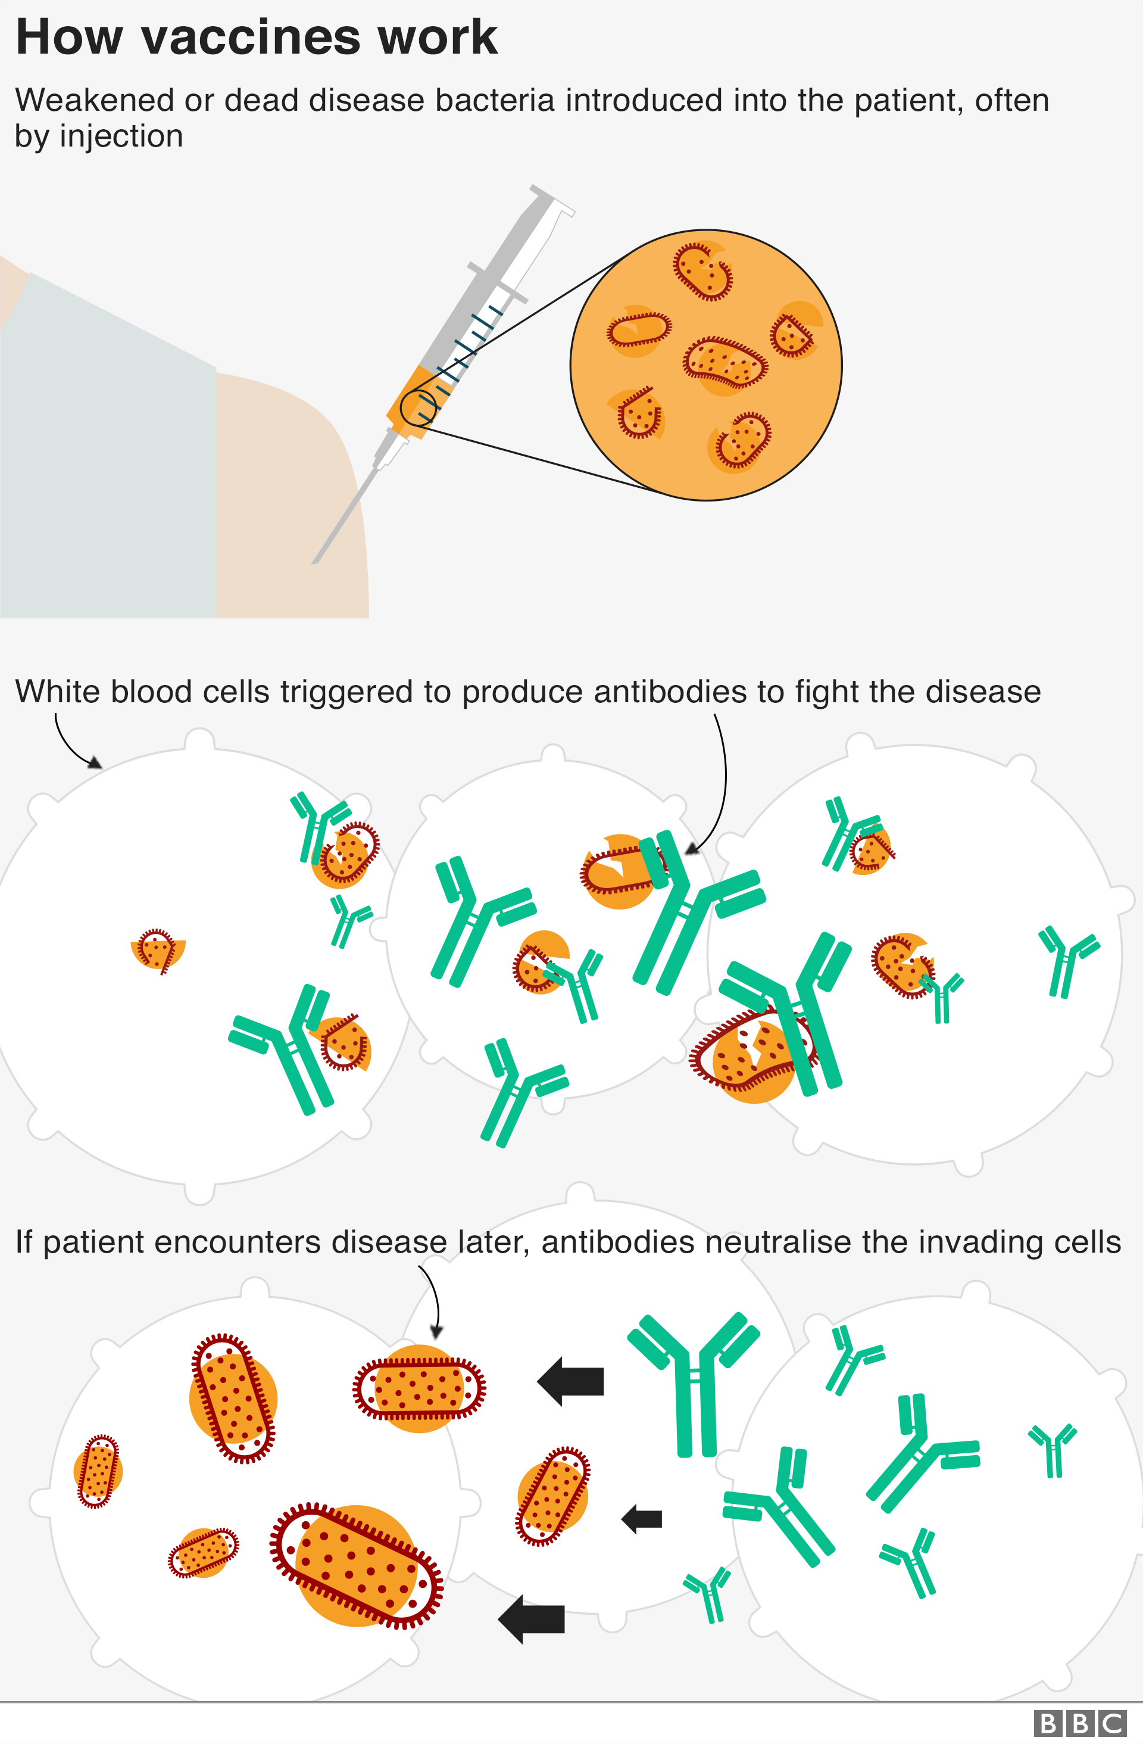
What is a vaccine?
Some portion of a weakened or dead virus/bacteria presented to your immune system
Teaches your immune system what the infection looks like
Allows it to create antibodies that help it fight the disease on future infection
Notes:
https://www.bbc.com/news/world-48186856

Slide 7
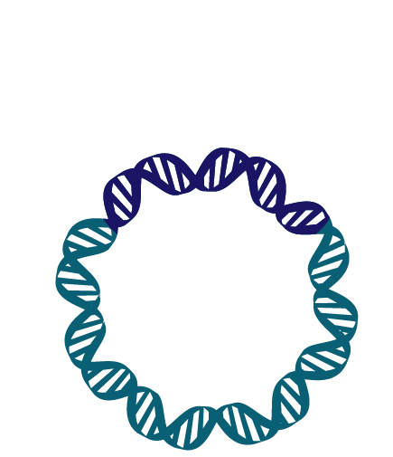
How are we developing vaccines against COVID-19?
Using some traditional strategies, but also trying new things to get us to a vaccine sooner
Different groups are trying all kinds of vaccine strategies against it, but we need something effective and safe that we can make lots of rapidly
One of these strategies is RNA vaccines
Notes:
COVID-19 is a virus
A vaccine can help us slow its spread
Different groups are trying all kinds of vaccine strategies against it, but we need something effective and safe that we can make lots of rapidly

Slide 8

RNA Vaccines Have Two Parts
RNA Coding for Spike Protein
Lipid Nanoparticles

Slide 9



How do RNA Vaccines Work against SARS-CoV-2?
Host cell
Ribosome
nucleus

Slide 10
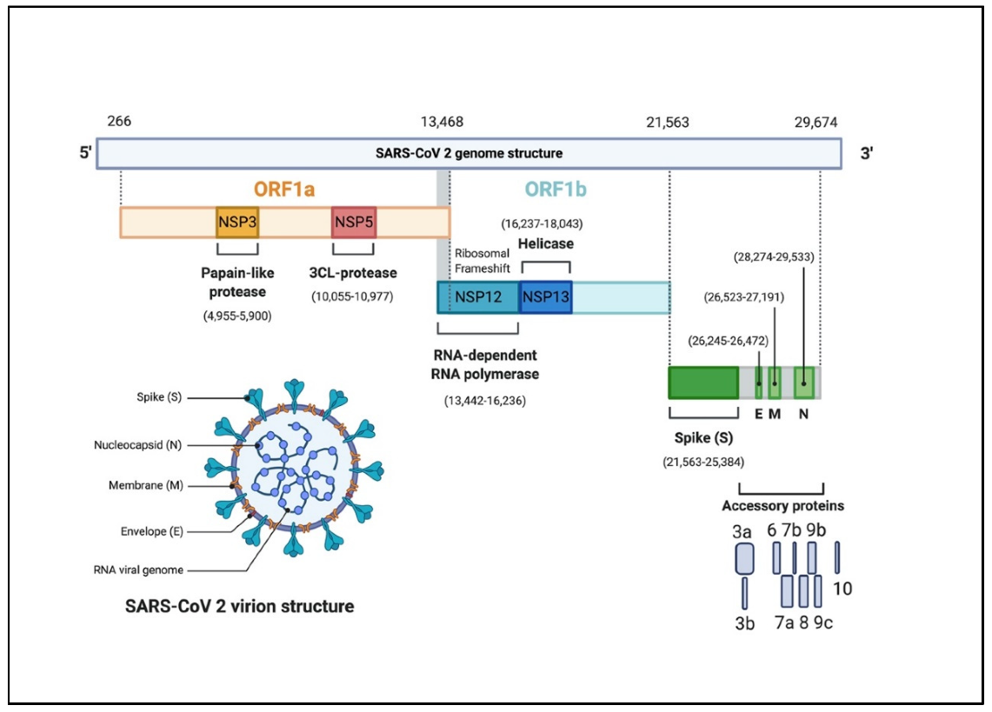

Spike Protein
Notes:
https://www.mdpi.com/2076-0817/9/5/331/htm
https://www.nature.com/articles/s41577-020-00480-0

Slide 11
How does the immune system respond?
Immune system remembers the spike protein using antibodies and memory cells
Immune system recognizes foreign RNA and the lipid nanoparticles to stimulate immune response–no need for additional adjuvants, which are sometimes added to other vaccines to increase the immune response
Notes:
https://www.nature.com/articles/nrd.2017.243

Slide 12
Why an mRNA vaccine?
RNA Vaccines Have Advantages:
  Easy to manufacture
  Potentially inexpensive
  Does not require the infectious virus for vaccine production
  But, RNA not super temp stable – need lipid or carrier molecule to get into cells
mRNA
Protein
Notes:
https://www.youtube.com/watch?v=3JV0yK6V7_Y&list=PLzdzfHVYq2XqhA-Zg2y_PguWUPb30gKCR
Moderna/Pfizer
Great deep dive on three covid vaccines: https://www.youtube.com/watch?v=hGrp5zsqi60
mRNA codes for protein, which it expresses in the context of the cell it has entered, the myocyte—it is not integrating, so don’t have to worry about it modifying your DNA
https://www.nejm.org/doi/full/10.1056/NEJMcibr2009737
Ebola trials: https://www.ncbi.nlm.nih.gov/pmc/articles/PMC5853918/
https://www.statnews.com/2020/01/07/inside-story-scientists-produced-world-first-ebola-vaccine/
The vaccine mimics natural viral infections in a way that the immune system recognizes. It’s delivered to the muscle and immune cells, which process the nucleotide sequence just as they would do during an infection using viral DNA/mRNA inside the body’s own cells (but safely). - https://www.modernatx.com/sites/default/files/RNA_Vaccines_White_Paper_Moderna_050317_v8_4.pdf

Slide 13
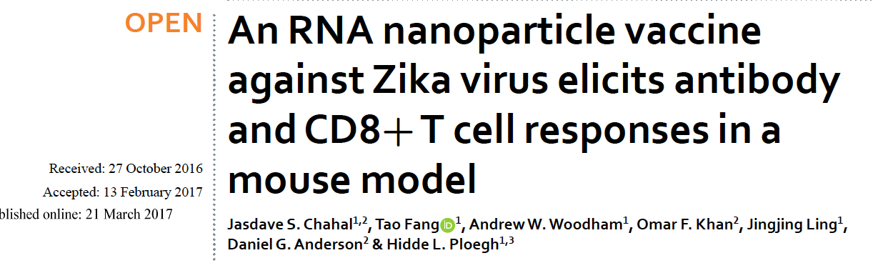
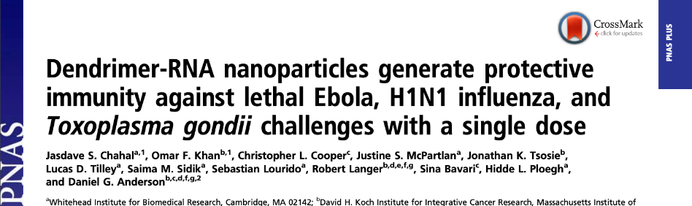
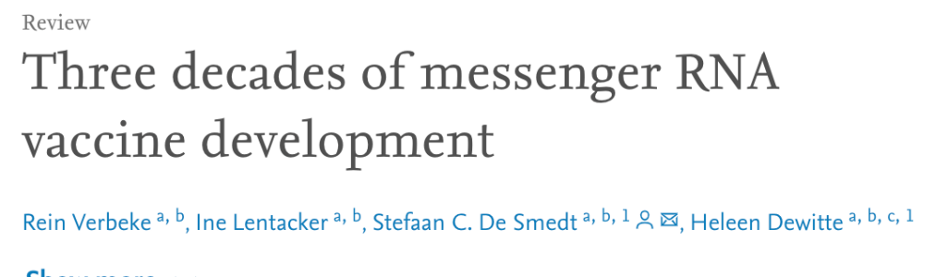
How long have we been studying RNA vaccines?
Decades!
Notes:
https://www.nature.com/articles/nrd.2017.243

Slide 14
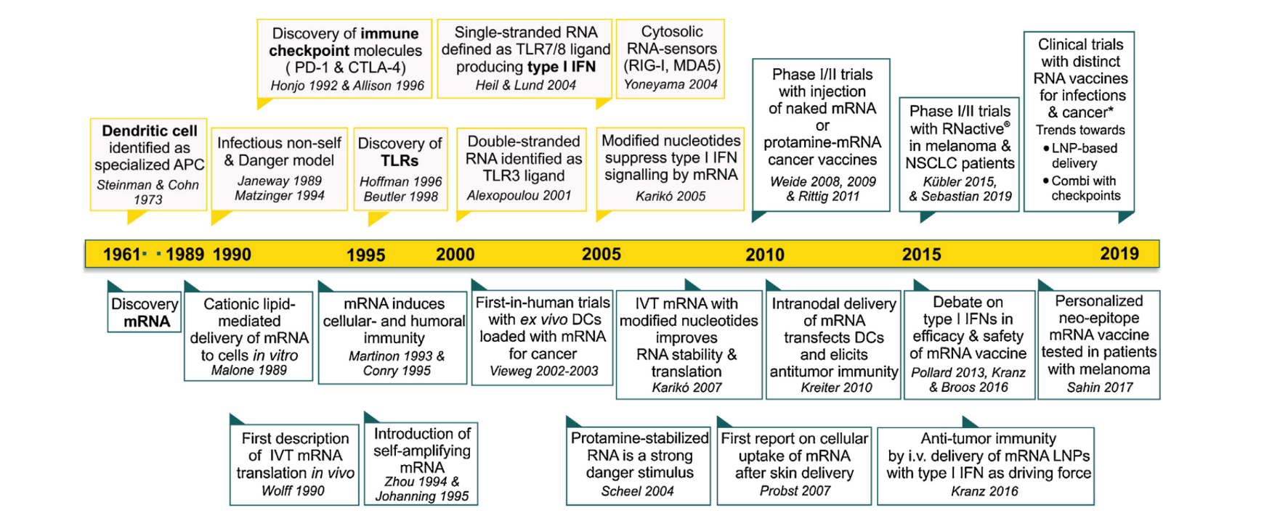
How long have we been studying RNA vaccines?
Notes:
https://doi.org/10.1016/j.nantod.2019.100766
https://www.nature.com/articles/d41586-019-03068-4

Slide 15
Two RNA vaccines have been approved for use
Moderna
Pfizer/BioNTech
Made by different companies, but the RNA in each codes for the spike protein
Slightly different lipid nanoparticles mean slightly different storage temperatures

Slide 16
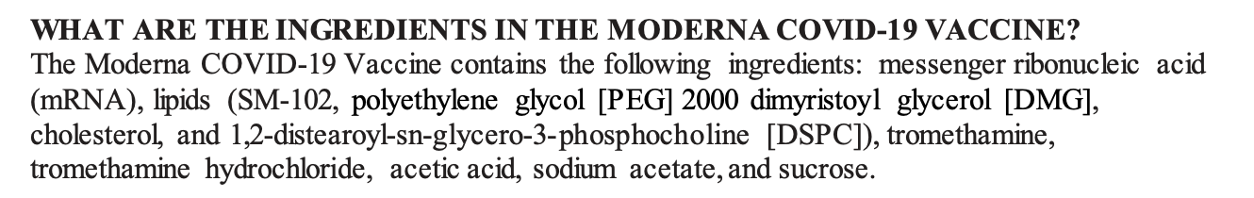
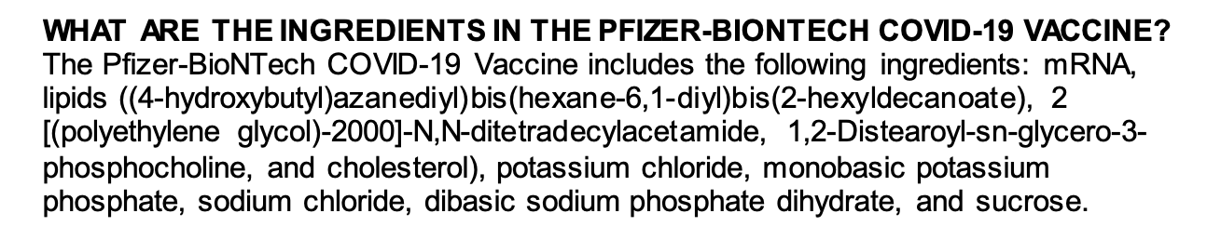
What are the ingredients?

Slide 17
The Anatomy of a Eukaryotic mRNA Molecule
CAP
5’ UTR
Protein Coding Region
3’ UTR
Poly A Tail
Notes:
E

Slide 18
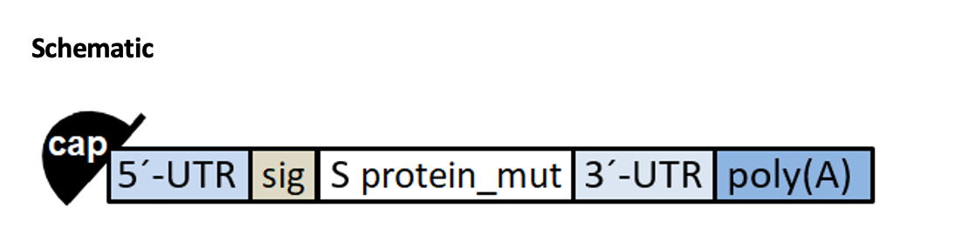
Exactly what does the RNA in the vaccine code for?
Notes:
Example Pfizer
Source: WHO
*

Slide 19
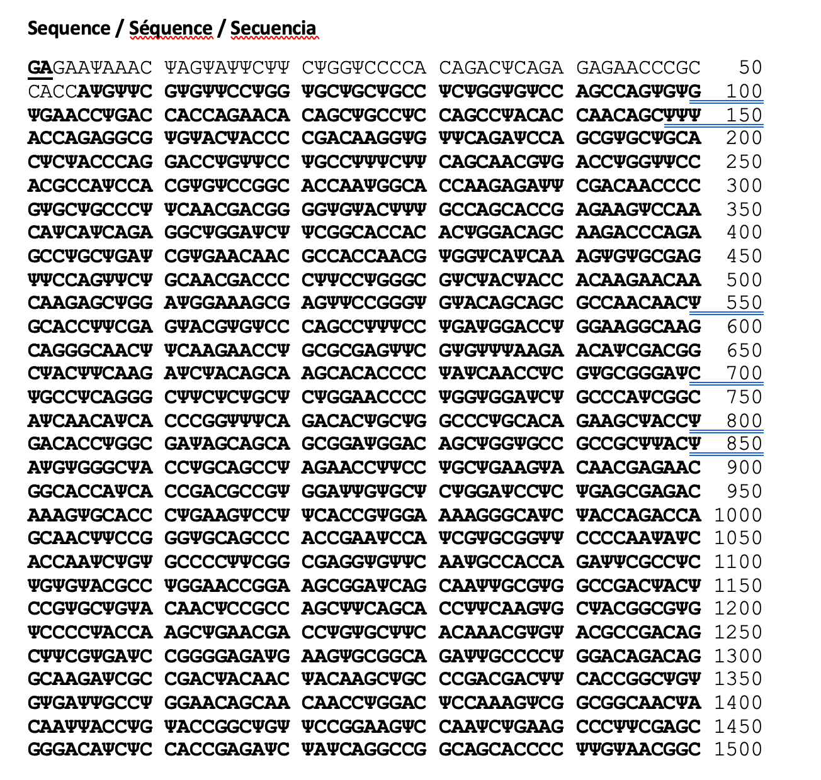
Exactly what does the RNA code for?
Notes:
Source: WHO

Slide 20
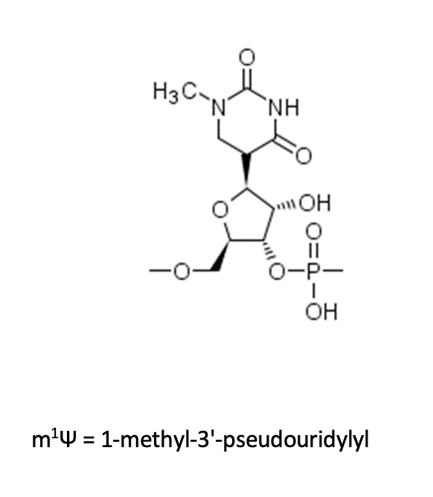
What’s that weird looking base pair?
Helps prevent your body from breaking down the RNA before it has a chance to do anything!
Read just like a uracil or U would be.
While it looks funny, pseudouridines are naturally found in our own RNA!
Notes:
https://academic.oup.com/nar/article/38/7/2387/3100516

Slide 21
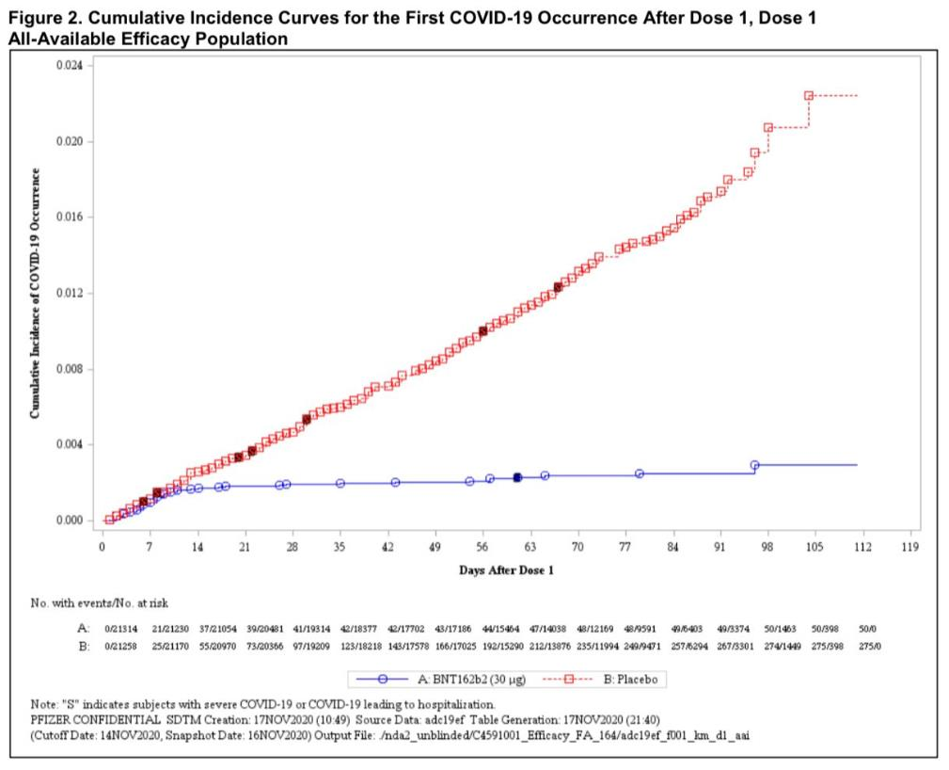
Do they work?
Notes:
Pfizer

Slide 22
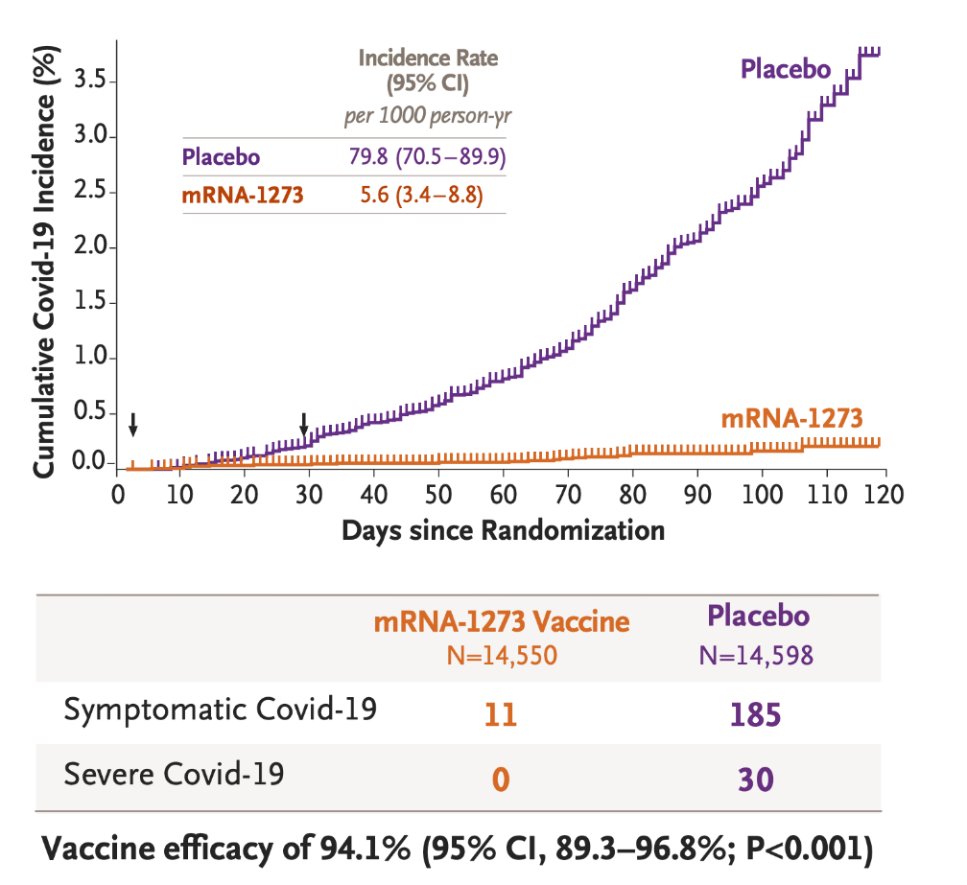
Do they work?
Notes:
Moderna
https://www.nejm.org/doi/full/10.1056/NEJMoa2035389

Slide 23
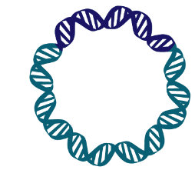
How are RNA Vaccines Made?
E. coli
In Vitro Transcription
  Potential Low Cost
  Fast Production
  No need to use eggs or cell culture to grow virus
DNA
Enzymes & Nucleotides
mRNA
Notes:
Really good description: https://www.ncbi.nlm.nih.gov/pmc/articles/PMC5906799/
Okay 2012 overview: https://www.ncbi.nlm.nih.gov/pmc/articles/PMC3597572/

Slide 24

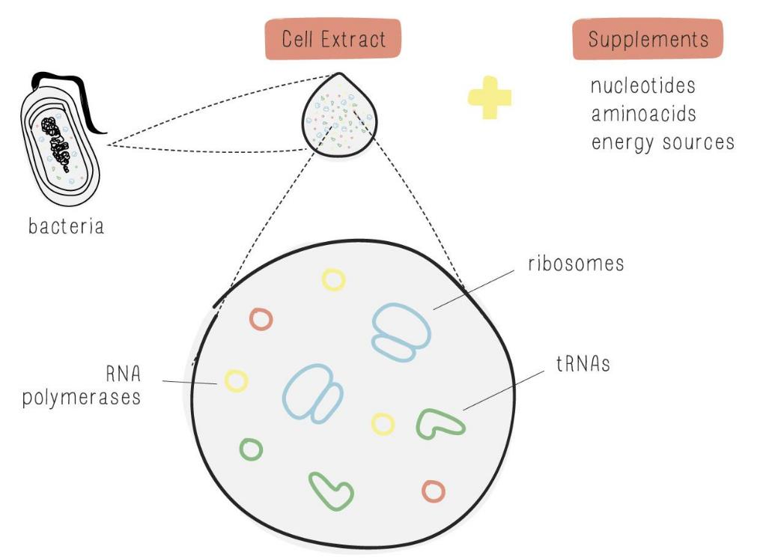
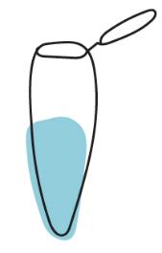
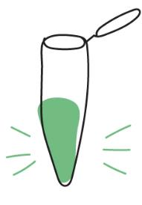
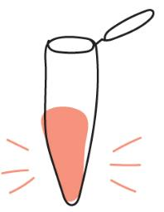
Model a similar system in the classroom
Freeze-dried, cell-free reactions for educational uses

Slide 25
Wrap Up
RNA vaccines have been in development for decades
Two RNA vaccines are currently shown to be around 95% effective in preventing COVID-19 and are approved for use in the United States
This type of vaccine platform could be used for a multitude of other diseases moving forward

Slide 26
Q&A
Do RNA vaccines change our DNA?
No! RNA in the vaccine does not enter the nucleus or interact with our own DNA in any way. It is also quickly degraded.
Notes:
https://www.cdc.gov/coronavirus/2019-ncov/vaccines/different-vaccines/mrna.html
https://news.mit.edu/2020/rna-vaccines-explained-covid-19-1211

Slide 27
How do RNA Vaccines Work against SARS-CoV-2?
Host cell
Ribosome
nucleus

Slide 28
Q&A
Will they be effective against new viral variants? How easy will they be to change and update?
Most likely. Variants would need to accumulate lots of mutations for the vaccines to become ineffective and virologists don’t believe we’ve reached that point.
Lab results have so far shown that the Pfizer/BioNTech vaccine neutralizes the N501Y mutation
Notes:
https://www.cdc.gov/coronavirus/2019-ncov/vaccines/different-vaccines/mrna.html
https://news.mit.edu/2020/rna-vaccines-explained-covid-19-1211

Slide 29

Q&A
Can you get COVID from these vaccines?
No.
Notes:
https://www.cdc.gov/coronavirus/2019-ncov/vaccines/different-vaccines/mrna.html
https://news.mit.edu/2020/rna-vaccines-explained-covid-19-1211

Slide 30
Q&A
Do these vaccines stop transmission?
We need more data to know for sure.

Slide 31
Q&A
Why do these RNA vaccines require two shots?
The second shot is like a “booster shot” for your immune system.
Notes:
https://www.cdc.gov/coronavirus/2019-ncov/vaccines/different-vaccines/mrna.html
https://news.mit.edu/2020/rna-vaccines-explained-covid-19-1211
https://blogs.bmj.com/bmj/2021/01/06/john-p-moore-how-do-you-take-your-vaccine-one-lump-or-two/

Slide 32
Q&A
Why do these vaccines need to be kept so cold?
Because RNA is fragile. RNAse can easily chop it up at warmer temperatures, and even water can start to break the backbone down if not kept cold.
Notes:
https://www.cdc.gov/coronavirus/2019-ncov/vaccines/different-vaccines/mrna.html
https://news.mit.edu/2020/rna-vaccines-explained-covid-19-1211

Slide 33
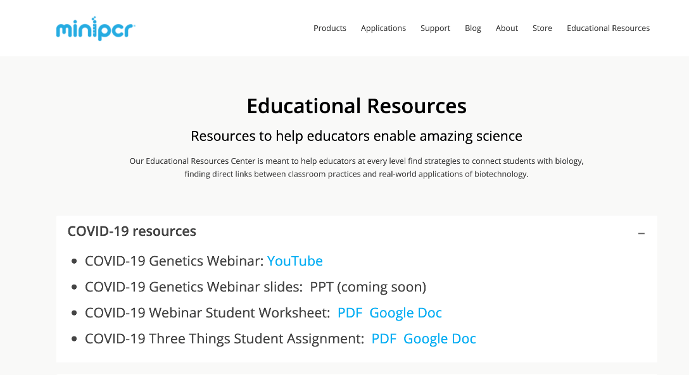
Resources for Teachers
Awesome RNA Vaccine Breakdown
NYT Vaccine Tracker and Vaccine Explainers
Webinar Question Worksheet
PPT slides and worksheets for this webinar and past webinars
https://www.minipcr.com/educational-resources/
Notes:
Other resources, upcoming webinars,
Really great NIH/Fauci/Collins: https://twitter.com/NIH/status/1309163826085011458

Slide 34
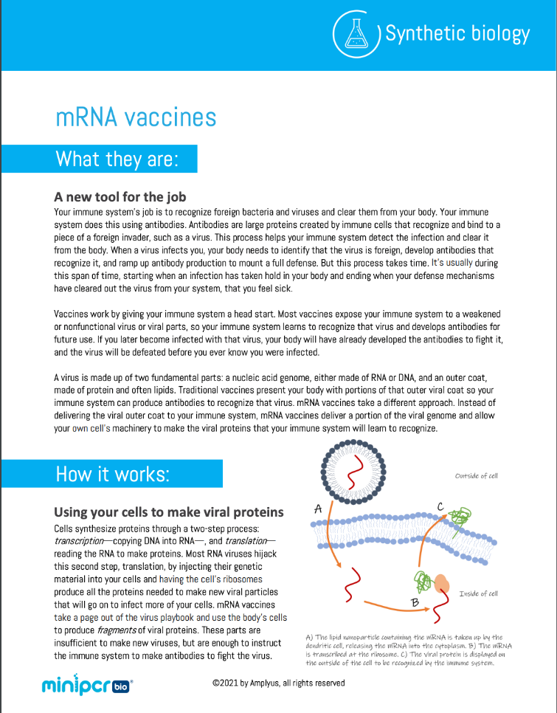
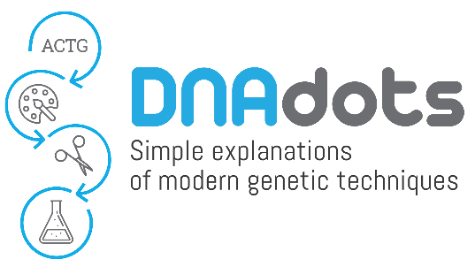
Learn more
https://dnadots.minipcr.com/dnadots/mrna-vaccines

Slide 35
Webinar schedule
Jan 11 mRNA vaccines
Feb 8 Introduction to fluorescence
Mar 8 Dog genetics lab
April 12 GMO Detection Lab
May 10 Detecting antibiotic resistance in the environment

Slide 36
@miniPCR
Facebook.com/miniPCR
@miniPCR
© 2021 by Amplyus LLC

